Slide 1

User-friendly Procedural Decision Support System
Synho Do, PhD
Laboratory of Medical Imaging and Computation
Massachusetts General Hospital

Slide 2
Current PrOE System
Manually Entered Answers for Questionnaire
Electronic Health Record
Recommendation
Manual Review
Logic Diagram
2-15 clicks
A decision compliant with the automatically generated recommendation is exempt from prior authorization for the procedure
Manual Process
Automated Process

Slide 3
The Need for a New System
Having to click multiple time to go through an evaluation adds burden
Current prepopulated fields are not accurate
Natural Language Processing and Artificial Intelligence can be leveraged to make the system easier to use and faster to complete

Slide 4







Laboratory of Medical Imaging and Computation
Director:
Synho Do, PhD
Research Fellows:
Jinserk Baik, PhD
Myeongchan Kim, MD
Sehyo Yune, MD, MPH, MBA
Research Assistants:
Allison Welton
Lucy Liu, MPH
Poornima Ramaraj

Slide 5
New System in Development
Enterprise Data Warehouse
Electronic Health Record
Extracted Features (keywords)
Data Loader
Feature Extractor
Prediction
Models
Recommendation
Confirmed Answers for Questionnaire
Predicted Answers for Questionnaire
Logic Diagram
Confirmation
75% reduced number of clicks
75% accuracy to predict indication for cervical fusion
Manual Process
Automated Process

Slide 6
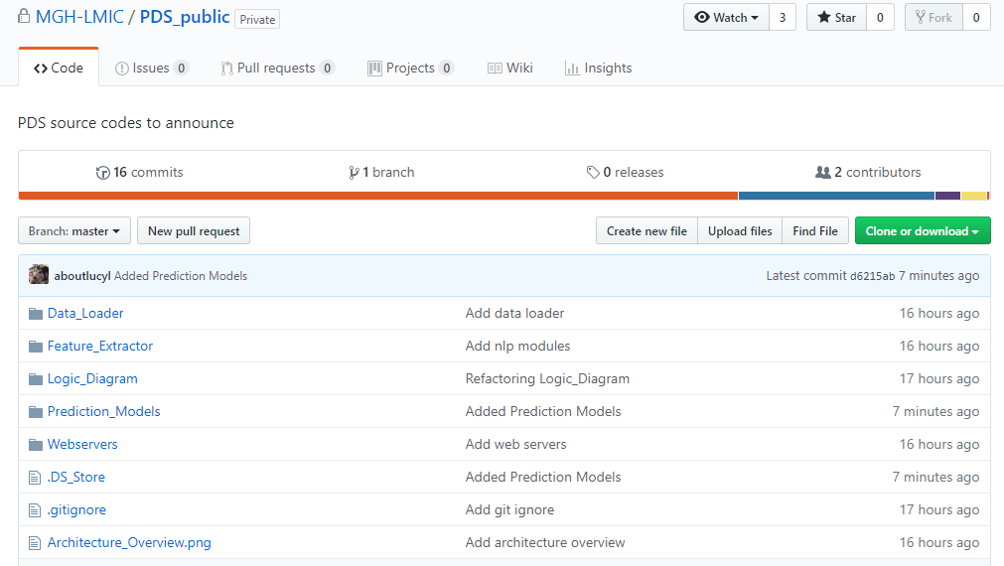
Check out our work on GitHub!
https://github.com/MGH-LMIC/PDS_public

