Slide 1

Module leader
Dr. Gábor Rekettye
MKTB352_26S
Mohammadali Ghaderi

Slide 2

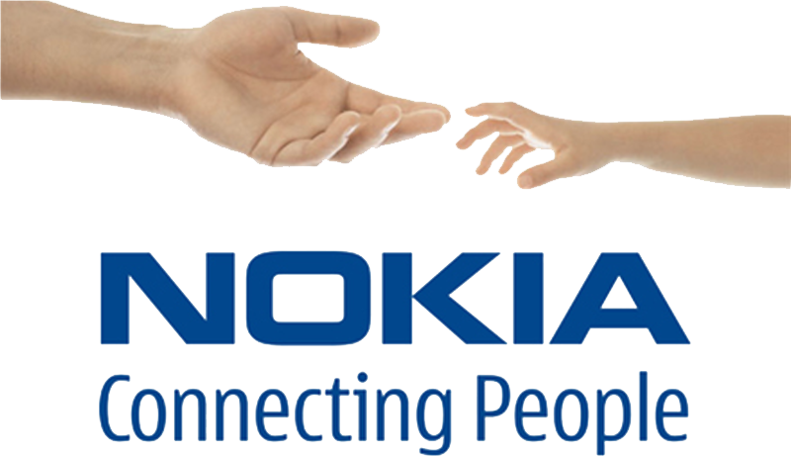
NOKIA

Slide 3

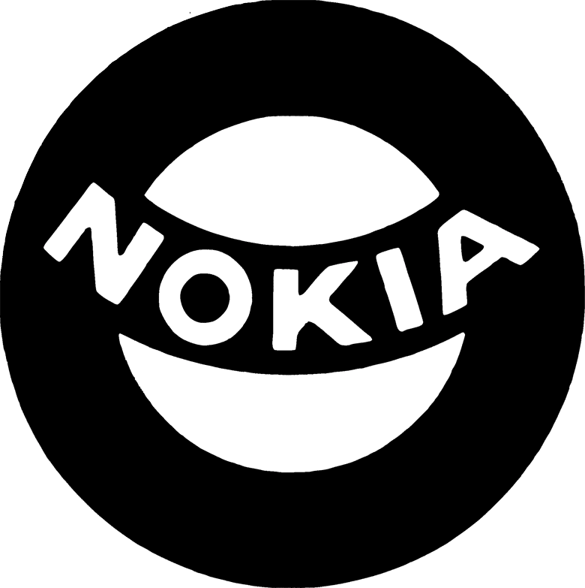
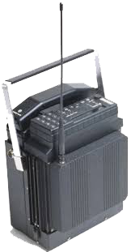

1974
History
of
Innovation
Develops
the
First Car Phone
1987
1967
Nokia Corporation
Nokia Corporation
(1910–1991)
In 1910 starts to Provide Electricity to Finnish homes
In 1912 Beginning of Finnish cable works
1963 Developed VHF radio and the beginnings of telecommunication
1971 First digital exchange switch
1981 creates First international Mobile Network
In 1985 Launched first portable phones
In 1987 Launch First hand held phone
In July 1, 1991 First official GSM call happened (Finland)[1]
In 3 Dec 1992 First SMS message sent via Nokia phone with fully supported user-sending of SMS text messages[8]

Slide 4

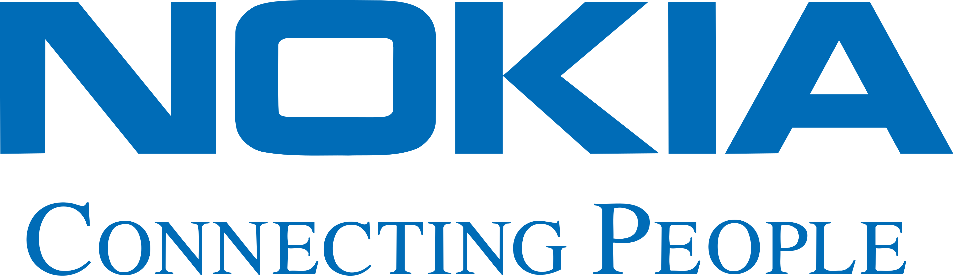
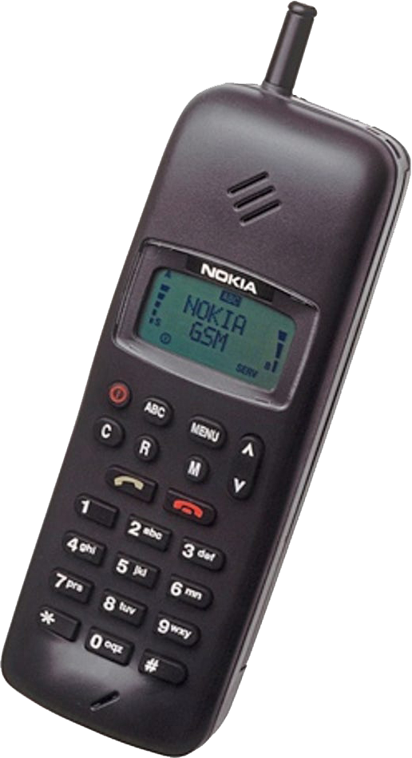

Origins & Slogan Evidence
Nokia launched the Nokia 1011, described by Nokia as its first GSM phone, introduced in late 1992. [1]
Nokia’s corporate materials show the phrase “Nokia… connecting people.” in its 1995 Annual Report. [7]
“Connecting People”
introduced in 1992

Slide 5
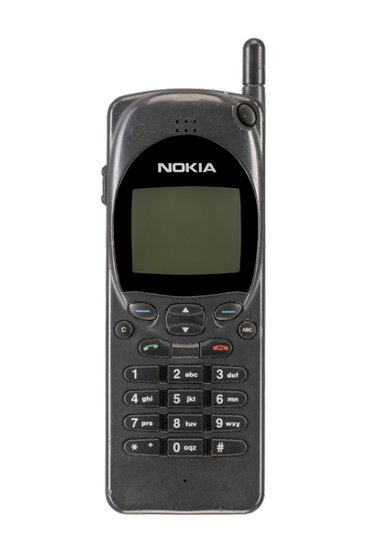

Early Brand Recognition Through Product-Embedded Cues
Nokia 2110 released in 1994. [2]
The Nokia 2110 is documented as the first phone to feature the iconic Nokia ringtone (“Nokia ringtone”). [2]
This provides evidence of distinctive, repeatable recognition cues tied to Nokia consumer handsets (auditory brand identifier embedded in the product). [2]

Slide 6
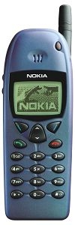

Cultural Embeddedness via Shared Consumer Experiences
First mobile gaming
The game Snake appeared on the Nokia 6110 in 1997. [3]
This is documented in major business/technology press as a defining Nokia-era mobile experience. [3]
Snake’s Nokia 6110 deployment is a verified example of a Nokia-linked cultural product feature in the period. [3]

Slide 7
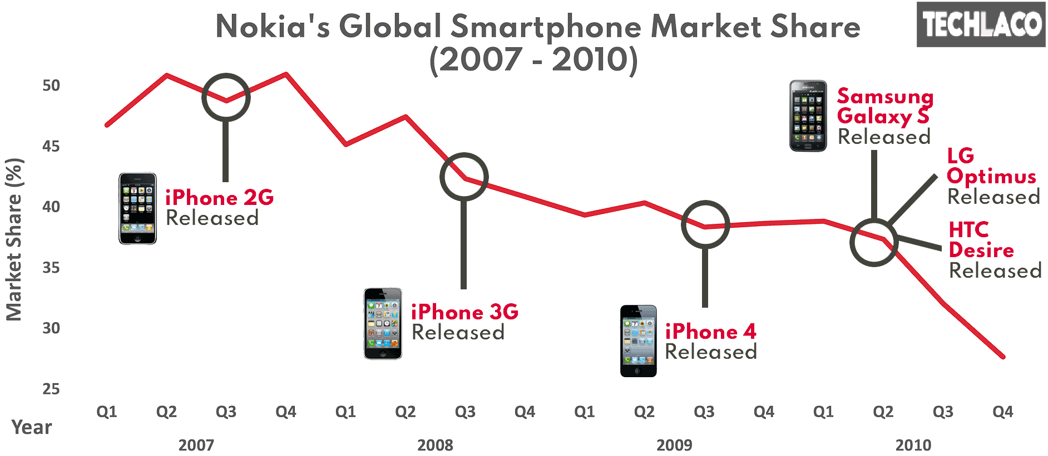
Peak Dominance & Brand Scale
In its Q4 and full-year 2008 interim report, Nokia reports estimated full-year 2008 mobile device market share: 39%, and Q4 2008: 37%. [4]
These figures are explicitly presented by Nokia as estimated market share in its investor/stock exchange reporting. [4]
The reported scale indicates Nokia’s consumer devices had very wide global distribution at that time (as measured by Nokia’s market-share estimate). [4]

Slide 8

Divestment & Period Endpoint (2013–2014)
3 Sept 2013
Microsoft announced an agreement to acquire Nokia’s Devices & Services business (consumer handset business) and to license Nokia patents. [5]
25 Apr 2014
Nokia announced completion of the sale of substantially all of its Devices & Services business to Microsoft. [6]
These announcements provide the verified endpoint for the Nokia-owned consumer handset era in your timeframe. [5], [6]
Lumia 900

Slide 9
Key Takeaway: What Made the Brand Unique
Early GSM milestone: Nokia positions Nokia 1011 (late 1992) as its first GSM phone. [1]
Consistent brand line in official materials: “Nokia… connecting people.” appears in the 1995 Annual Report (usage verified by 1995; intro date 1992 = SOURCE NEEDED). [7]
Product-integrated recognition cue: Nokia 2110 (1994) documented as first to feature the iconic Nokia ringtone. [2]
Cultural feature association: Snake documented on Nokia 6110 (1997). [3]
Scale at peak: Nokia-reported estimated market share figures for 2008 (FY 39%, Q4 37%). [4]

Slide 10


Reference list
[1] Nokia (2021) Thirty years on from the call that transformed how we communicate (notes Nokia 1011 as Nokia’s first GSM phone; late 1992). https://www.nokia.com/blog/thirty-years-on-from-the-call-that-transformed-how-we-communicate/
[2] University of Salford (n.d.) GSM Mobiles – 2G (states Nokia 2110 released 1994; first to feature iconic Nokia ringtone). https://www.cntr.salford.ac.uk/comms/gsm_mobiles.php
[3] Dredge, S. (2015) ‘Snake returns for modern smartphones…’, The Guardian (states Snake appeared on Nokia 6110 in 1997). https://www.theguardian.com/technology/2015/may/06/snake-rewind-taneli-armanto-ios-android-windows-phone
[4] Nokia (2009) Interim Report: Q4 and full year 2008 (includes Nokia’s estimated mobile device market share figures for 2008). https://www.nokia.com/system/files/files/q4-2008-earnings-release-pdf.pdf
[5] Microsoft (2013) Microsoft to acquire Nokia’s Devices & Services business… (transaction announcement). https://news.microsoft.com/source/2013/09/03/microsoft-to-acquire-nokias-devices-services-business-license-nokias-patents-and-mapping-services/
[6] Nokia (2014) Nokia completes sale of substantially all of its Devices & Services business to Microsoft (completion announcement; 25 Apr 2014). https://www.nokia.com/newsroom/nokia-completes-sale-of-substantially-all-of-its-devices--services-business-to-microsoft/
[7] Nokia (1995) Annual Report 1995 (contains “Nokia… connecting people.” confirming slogan usage by 1995; not sufficient alone to prove “introduced in 1992”). https://web.lib.aalto.fi/fi/old/yrityspalvelin/pdf/1995/enokia.pdf
[8] Wikipedia Nael, Merili (June 30, 2015). "Suri tekstisõnumite looja Matti Makkonen" [Creator of text messages Matti Makkonen died]. Err.ee (in Estonian). Eesti Rahvusringhääling. Archived from the original on March 4, 2016. Retrieved July 27, 2015.

