Slide 1

Brand elements
CA2
Memorability
1️⃣ Memorability
2️⃣ Meaningfulness
3️⃣ Likability
4️⃣ Transferability
5️⃣ Adaptability
6️⃣ Protectability
Meaningfulness
Protectability
Likability
Adaptability
Transferability

Slide 2



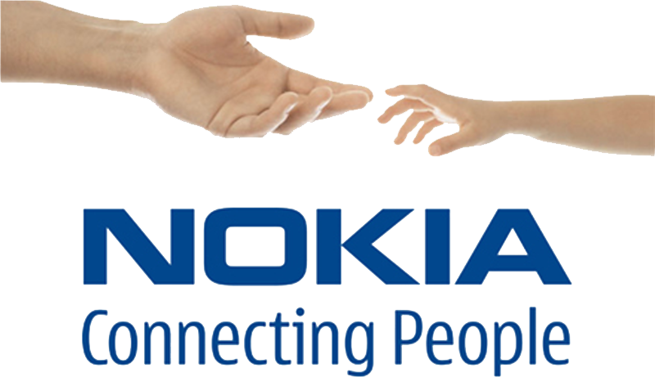


Nokia Brand Elements
Brand elements are identifiable components used to build brand awareness and recognition.
Keller identifies elements such as brand names, slogans, symbols, and other identity cues. [1]
This analysis focuses on three Nokia elements:
Brand Name
Slogan
Audio identity

Slide 3

Brand Name: Nokia
Nokia brand name originates from Finland.
Used consistently during the GSM mobile phone era.
Brand name functions as the primary identifier of the product.
Supports global recognition of Nokia devices.
According to Keller, the brand name is a key element for brand recognition and recall. [1]

Slide 4



Slogan & Audio Identity
Connecting People
Used in Nokia communication during the 1990s.[2]
Communicated the brand’s focus on human communication.
Nokia Tune
Introduced in Nokia mobile phones such as the Nokia 2110 in 1994.[3]
Became a recognizable sound associated with Nokia phones.

Slide 5


Evaluation of Nokia Brand Elements
Using Keller’s brand element criteria:
Memorability:
simple name and recognizable ringtone
Meaningfulness: Connecting People
slogan communicates human connection
Likability:
positive and simple brand message
Transferability:
worked across global markets
Adaptability:
brand elements remained relevant over time

Slide 6

Reference
[1] Keller, K.L. Strategic Brand Management. [2] Nokia Annual Report 1995 – "Nokia… connecting people" https://web.lib.aalto.fi/fi/old/yrityspalvelin/pdf/1995/enokia.pdf [3] University of Salford – GSM Mobiles (Nokia 2110) https://www.cntr.salford.ac.uk/comms/gsm_mobiles.php

