Slide 1


CA3
Positioning of the brand (value proposition)

Slide 2


Brand Positioning – Nokia
Brand positioning is:
“The act of designing the company’s offer and image so that it occupies a distinct place in the customer’s mind.” [1]
Positioning answers:
Brand
How the brand is similar (POP)
• How the brand is different (POD)
Customer
Who is the target customer
Competitor
Who are the competitors

Slide 3

STP Strategy – Nokia
Segmentation • Global mobile phone users • First-time and mass-market consumers
Targeting • Broad global market • Focus on accessible communication
Positioning • Simple, reliable mobile communication • Human connection (“Connecting People”)
1
2
3
Research on the mobile phone market shows that consumers do not all evaluate phones in the same way. Some segments focus more on functionality and practicality, while others emphasize price, design, or technological superiority.[3]

Slide 4
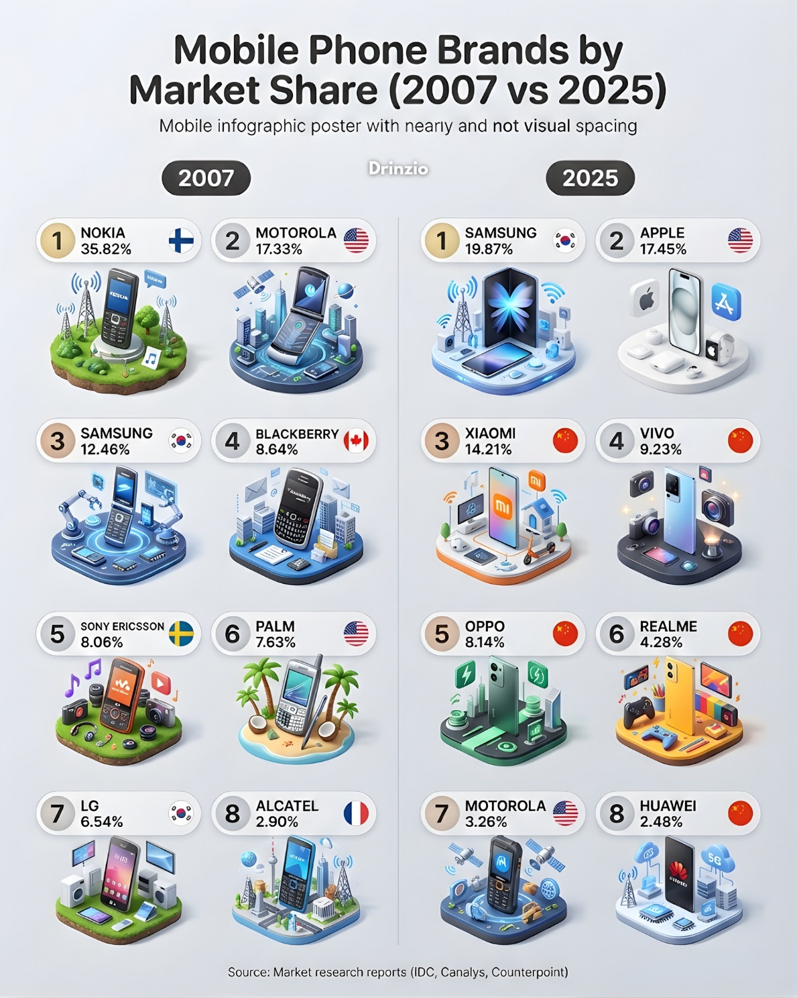




Competitive Landscape
Main competitors:
Competition occurs at the benefit level, not only product level. [1]

Slide 5

Points of Parity (POP)
Nokia shared these with competitors:
Voice calling
SMS messaging
Mobile hardware functionality
Basic communication features

Slide 6

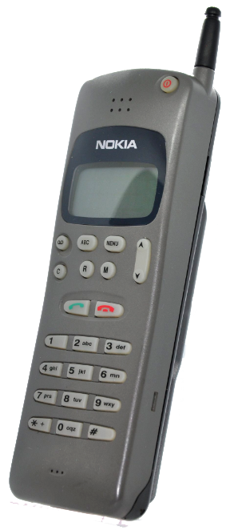
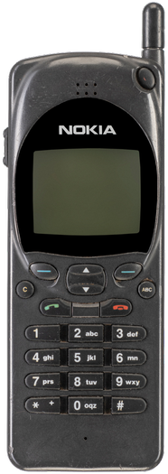
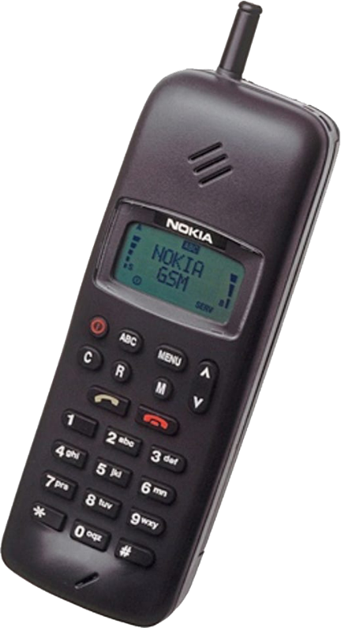
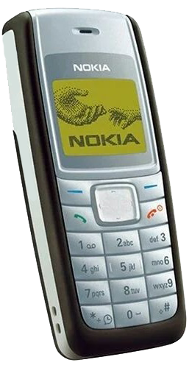
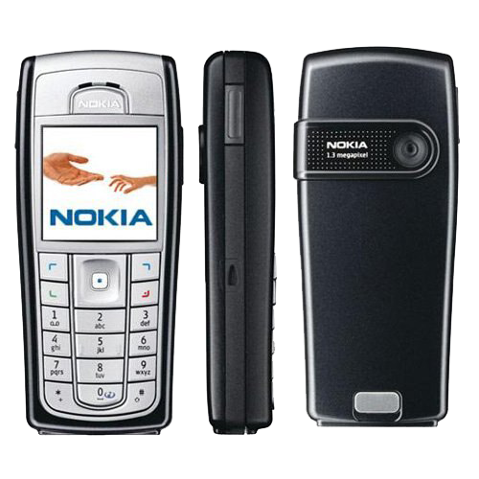
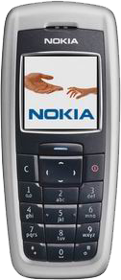

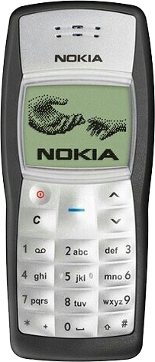
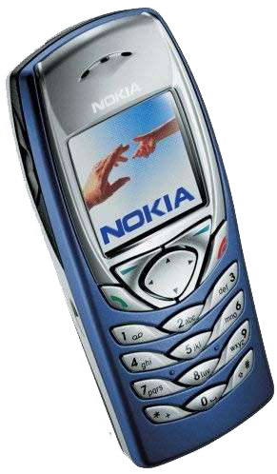
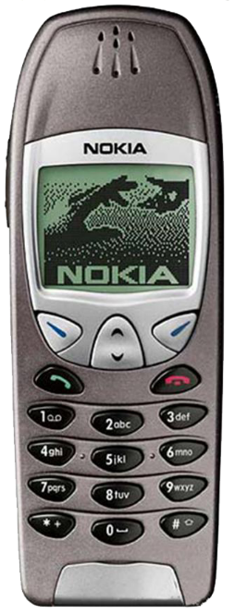
Points of Parity (POP)
Points of parity are the basic features and category requirements that a brand must offer in order to compete. [1]
Examples from Nokia portfolio:
• 6xxx series – Nokia 6100, 6210, 6230
For Nokia, key POPs in the mobile phone market included:
• Basic mobile communication: calling and SMS
• Standard handset formats: bar, flip, slider
• Business and consumer phone options
• Later category features such as camera, messaging, and internet access
• 1xxx series – Nokia 1011, 1100, 1110
• 2xxx series – Nokia 2010, 2110, 2600
These models show that Nokia met the essential requirements of the mobile phone category.

Slide 7

Points of Difference (POD)
Points of difference are unique and valued benefits. [1]
Nokia differentiation:
Strong brand consistency
(“Connecting People”)
User-friendly interface and design
Reliable and durable devices
Global accessibility across markets
These created a distinctive brand position.
Nokia = Simple + Reliable + Human

Slide 8

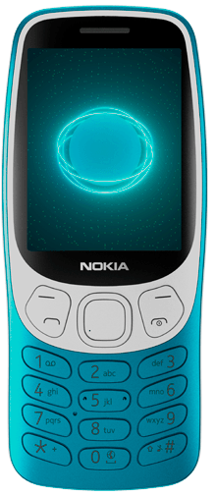
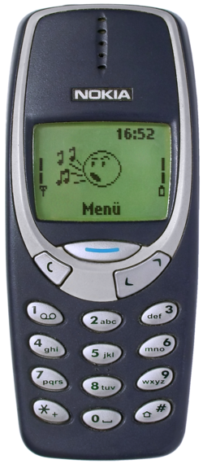
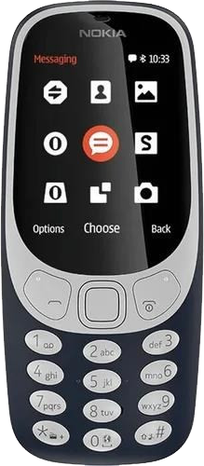
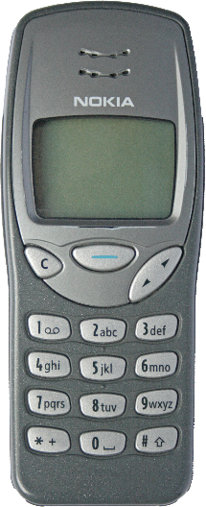
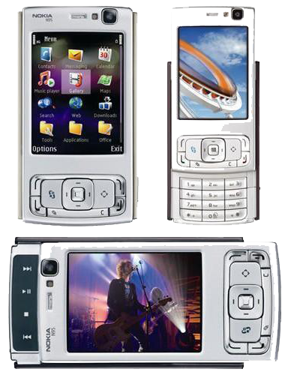
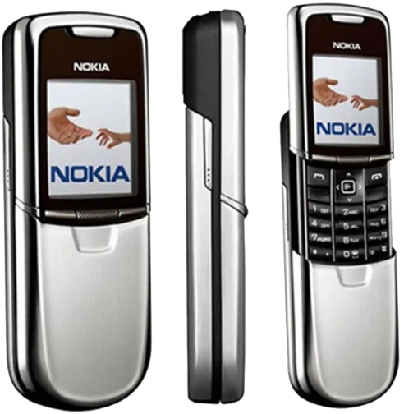
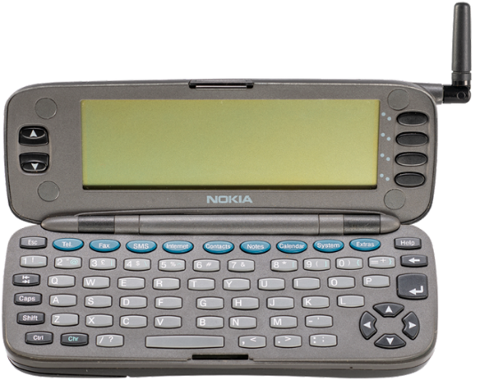
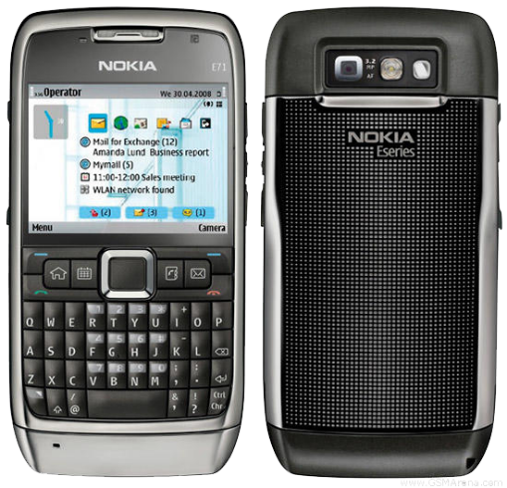
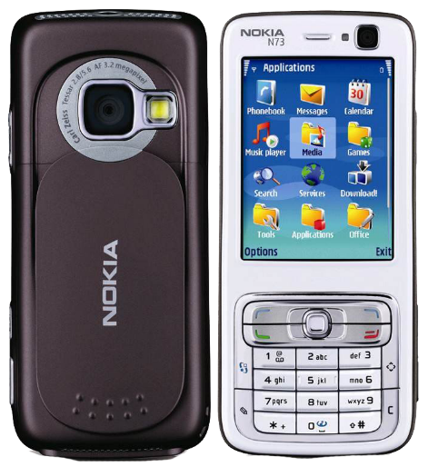
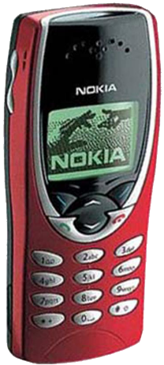
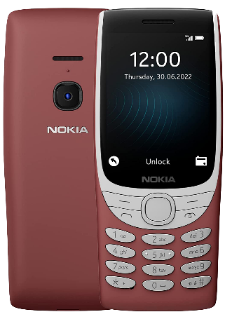
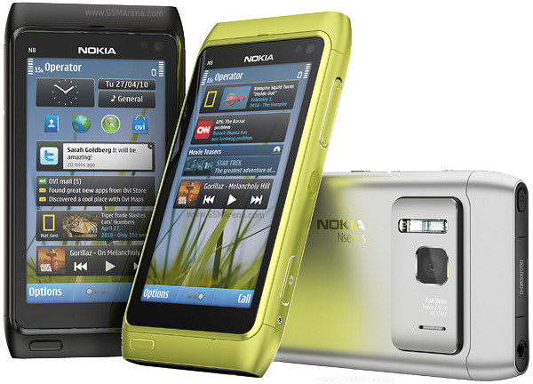
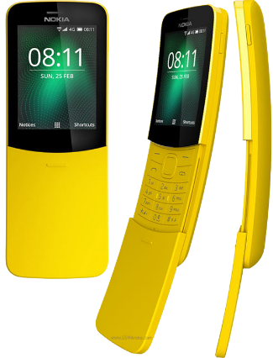
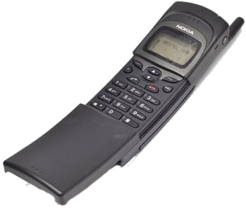
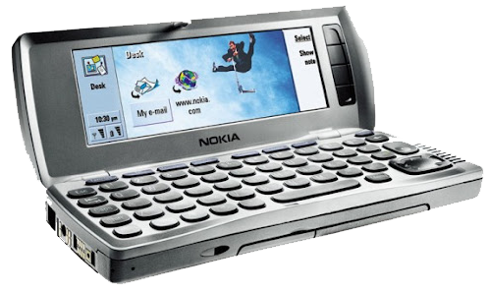

Points of Difference (POD)
Nokia’s main POD was its ability to position different phone families for different user needs:
Business and professional communication – 9xxx Communicator / Eseries Examples: Nokia 9000 Communicator, 9210 Communicator, E71
Youth and expressive design – 3xxx series Examples: Nokia 3210, 3310
Premium design and exclusivity – 8xxx series Examples: Nokia 8110, 8210, 8800
Multimedia and advanced smartphone experience – Nseries Examples: Nokia N73, N95, N8
These model families show that Nokia differentiated itself through a broad and clearly structured portfolio.

Slide 9

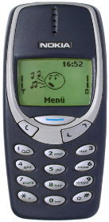

Value Proposition – Nokia
Value proposition:
“The full mix of benefits upon which a brand is positioned.” [1]
Functional value
• Reliable and durable phones
Nokia mainly offered:
Emotional value
• Human connection (“Connecting People”)
Conclusion: Nokia positioned itself as a reliable, simple, and human-centered mobile communication brand.
This supports Nokia’s use of segmented positioning, because mobile phone buyers differ in the benefits they seek, including functionality, durability, price, and image.[4]

Slide 10


Reference
[1] Keller, K.L. (2013) Strategic Brand Management: Building, Measuring, and Managing Brand Equity. 4th edn. Pearson.
[2] Slideshare (2013) STP and Marketing Mix on Nokia. Available at: https://www.slideshare.net/slideshow/nokia-stp-and-ma/26614924#15 (Accessed: 7 April 2026)
[3] Wikipedia contributors (n.d.) List of Nokia products. Available at: https://en.wikipedia.org/wiki/List_of_Nokia_products
[4] Karjaluoto, H., Karvonen, J., Kesti, M., Koivumäki, T., Manninen, M., Pakola, J., Ristola, A. and Salo, J. (2005) Discovering behavioral segments in the mobile phone market. Available at: https://www.researchgate.net/publication/235315029_Discovering_behavioral_segments_in_the_mobile_phone_market (Accessed: 7 April 2026)

