Slide 1

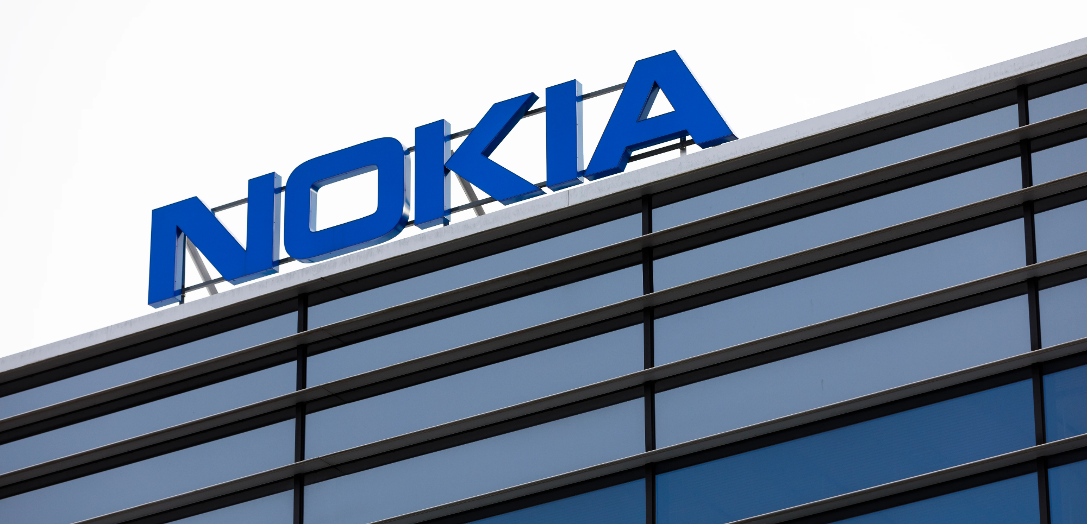
Communication & Brand Equity
How communication builds brand value

Slide 2


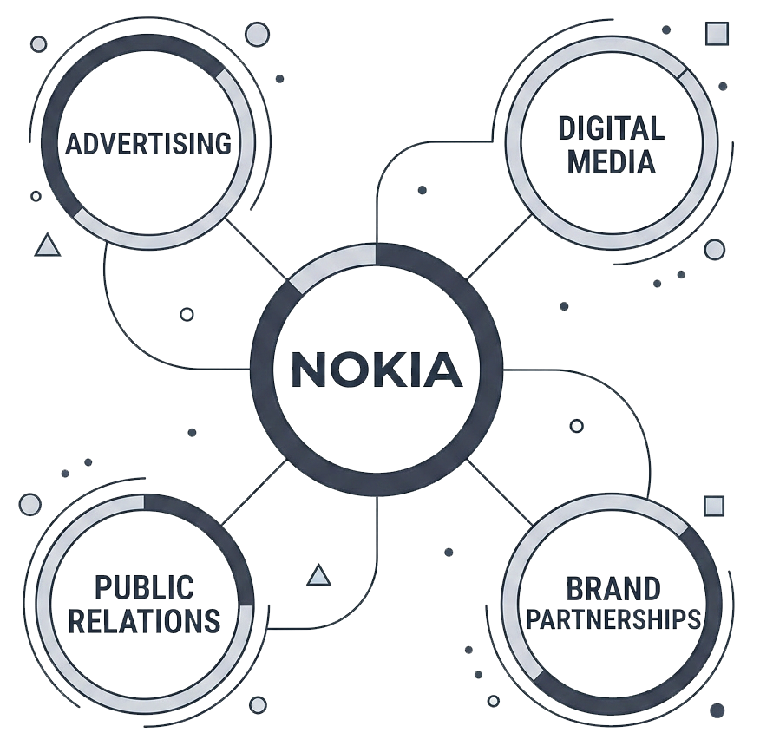




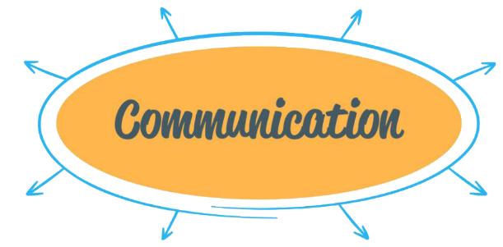




What is Brand Communication?
Integrated Marketing Communications (IMC)
Consistent message across channels
Builds awareness, meaning, and relationships
Tools: advertising, digital, PR, partnerships

Slide 3
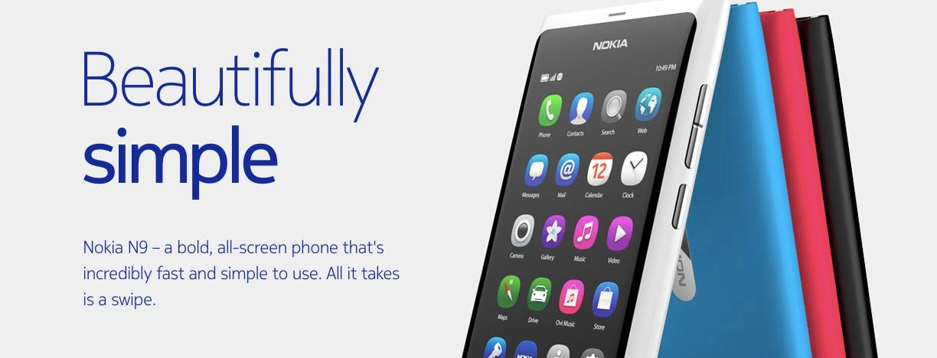


Brand Awareness (Salience)
Campaigns highlight reliability & simplicity
Strong digital presence
Consistent visual identity and tone
Goal: top-of-mind awareness

Slide 4

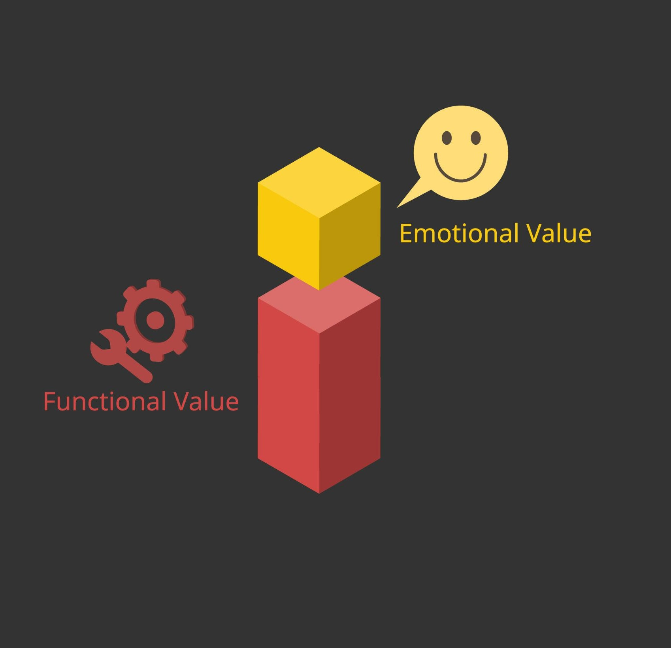

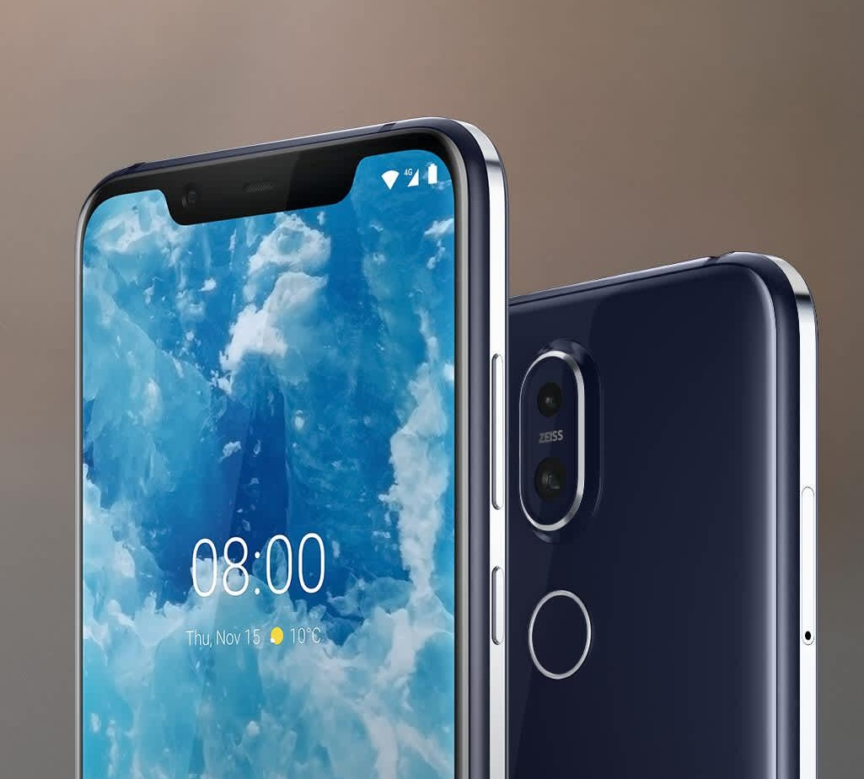



Brand Meaning
(Performance & Imagery)
Performance: durability, battery life, usability
Imagery: trust, nostalgia, “human connection”
Tagline: “Connecting People”
Product storytelling

Slide 5

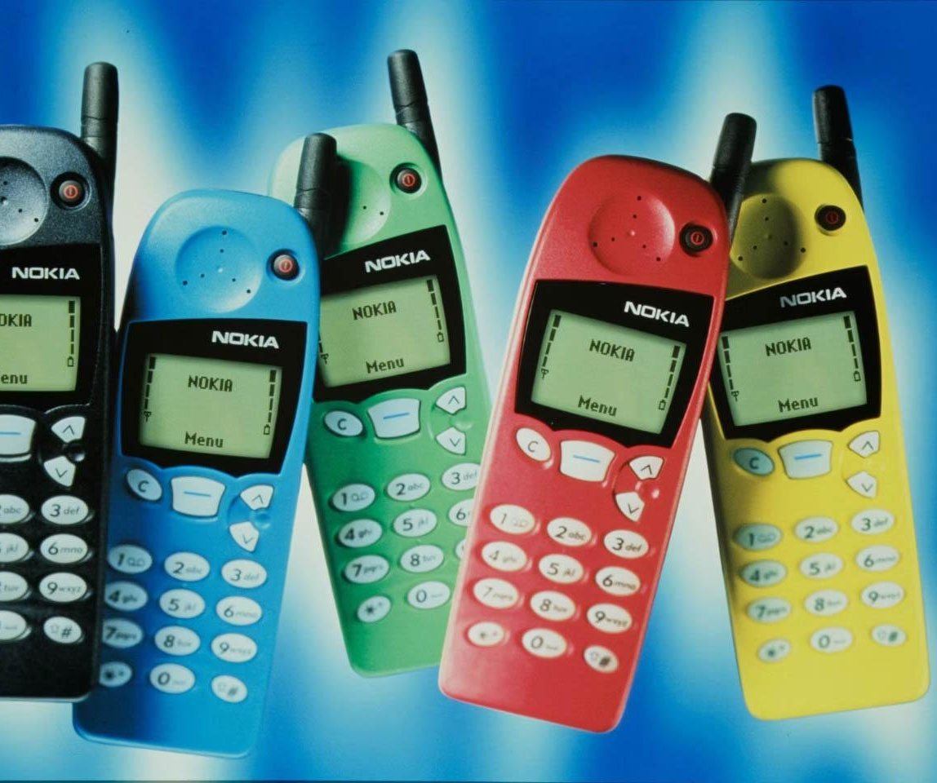
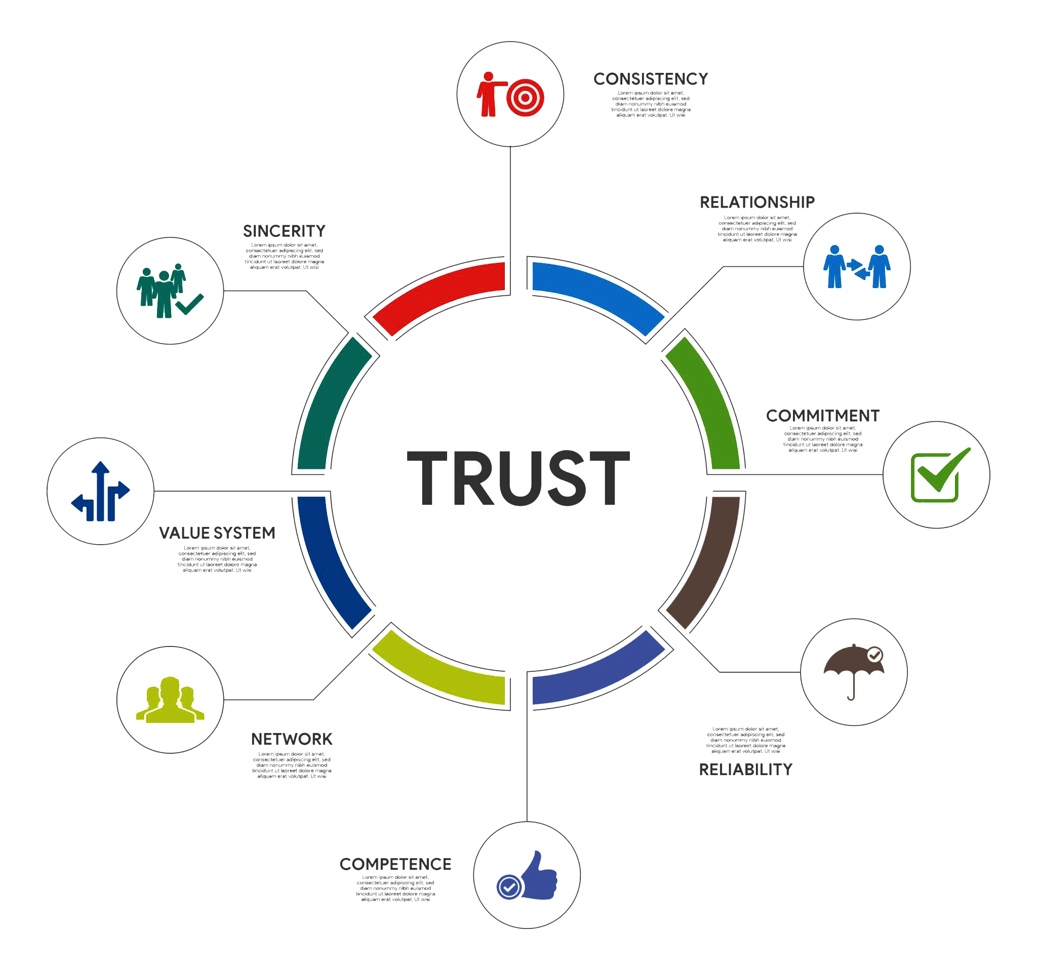

Brand Response (Judgments & Feelings)
Judgments: quality, value for money
Feelings: trust, security, nostalgia
Reviews and social proof
Transparent messaging

Slide 6
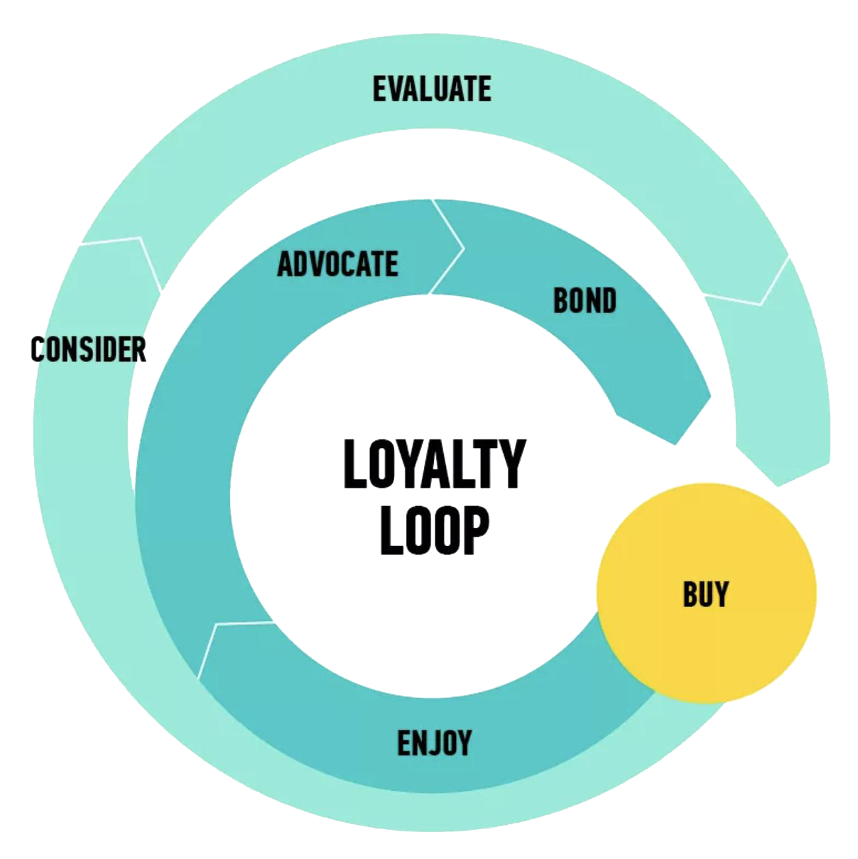
Brand Resonance (Loyalty)
Brand loyalty and repeat purchase
Emotional attachment
Community and brand heritage
Long-term relationship

Slide 7
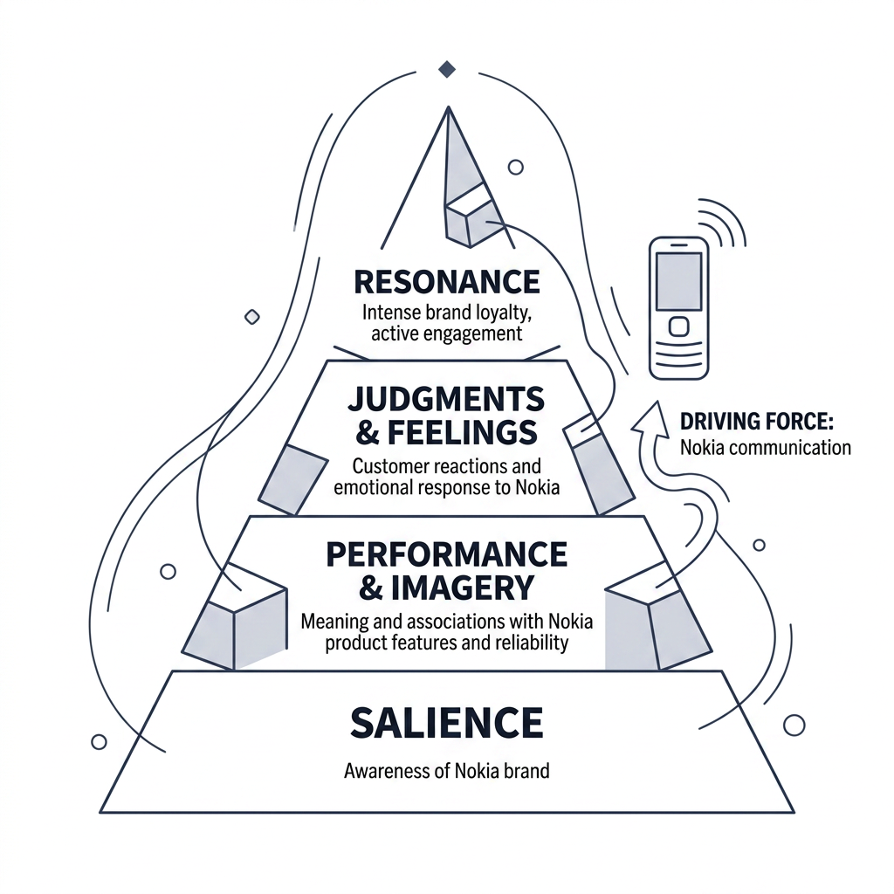
Conclusion
Communication drives all stages of CBBE
Nokia balances functional & emotional messaging
Result: strong, trusted, and loyal brand
IMC consistency + emotional storytelling = lasting brand equity

Slide 8


Reference
[1] Keller, K.L. (2013) Strategic Brand Management: Building, Measuring, and Managing Brand Equity. 4th edn. Harlow: Pearson. Used for: customer-based brand equity, brand awareness, brand meaning, brand responses, and brand resonance.
[2] Pearson Education (course slides, n.d.) Strategic Brand Management – Positioning and Values. Used for: brand communication logic, brand judgments, brand feelings, brand resonance, and the CBBE pyramid.
[3] Nokia (1995) Annual Report 1995. Available at: https://web.lib.aalto.fi/fi/old/yrityspalvelin/pdf/1995/enokia.pdf Used for: evidence of Nokia’s “connecting people” brand messaging in official corporate communication.

