Slide 1

Public Attitudes Toward AI
in Customer Service
Insight for OmniAssist
Insights Division – OmniAssist Technologies
Karthik Ramu
Nargus Batool
Mohammadali Ghaderi

Slide 2
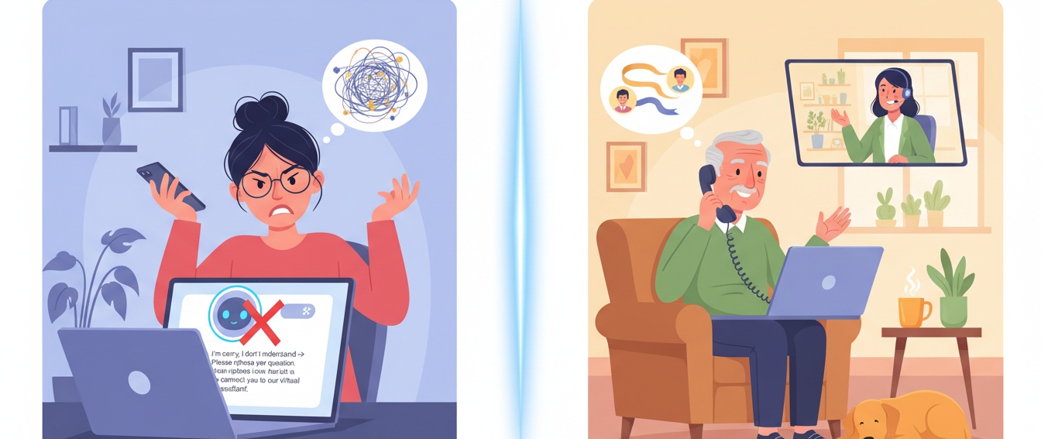
Customers don’t reject AI, they reject AI they can’t Trust.

Slide 3






Business Context & Big Idea
OmniAssist develops AI customer service tools for banking, retail, travel, telecom.
Our results are for the VP of Product and Director of Client Success.
Big Idea
Customer acceptance of AI is driven mainly by trust and positive experience, not tech-savviness—so OmniAssist must design AI that feels reliable, smooth, and supportive from the first interaction.
Data
Insights
Product Decisions

Slide 4


Research Question & Hypotheses
Hypothesis | Status
H1: Higher Trust → higher Preference | Accepted
H2: Higher Convenience → higher Preference | Accepted
H3: Tech comfort differences in Trust & Preference | Rejected
H4: AI frequency differences in attitudes | Partially Accepted
H5: Trust + Helpfulness + Convenience jointly predict Preference | Accepted
RQ:
How do experience and perceptions (trust, convenience, helpfulness, ease) shape public preference for AI vs human customer service?

Slide 5


Construct | Items | Example Statement
Helpfulness | Q4–Q8 | “AI tools help me find the information I need.”
Convenience | Q9–Q13 | “AI systems are available whenever I need assistance.”
Trust | Q14–Q18 | “I believe AI tools provide reliable information.”
Ease / Low Frustration | Q19–Q23 | “Interacting with AI feels smooth and efficient.”
Preference for AI | Q24–Q30 | “I prefer using AI for simple inquiries.”
Methodology & Sample
Online survey, n = 63 respondents.
5 constructs (5-point Likert: 1 = Strongly Disagree, 5 = Strongly Agree):
Helpfulness (Q4–Q8)
Convenience (Q9–Q13)
Trust (Q14–Q18)
Ease / Low Frustration (Q19–Q23)
Preference for AI vs human (Q24–Q30)
Composite scores: mean of items per construct.
Key demographics & experience: age group, tech comfort, AI usage frequency.

Slide 6
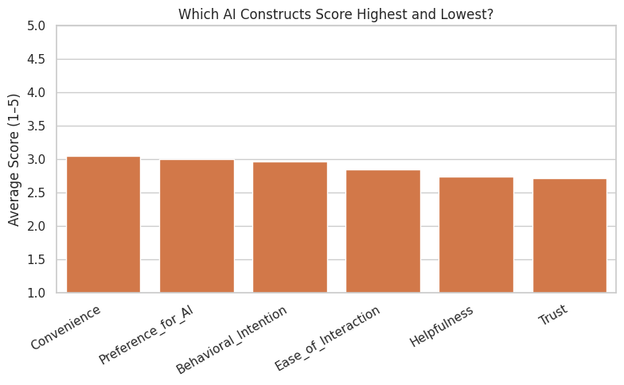
Overall Attitudes Toward AI (Means)
On a 1–5 scale, attitudes are slightly above neutral: Convenience and Preference are around 3.0, while Trust, Helpfulness, and Ease are just below or slightly under 3.
n = 63
Likert 1–5

Slide 7

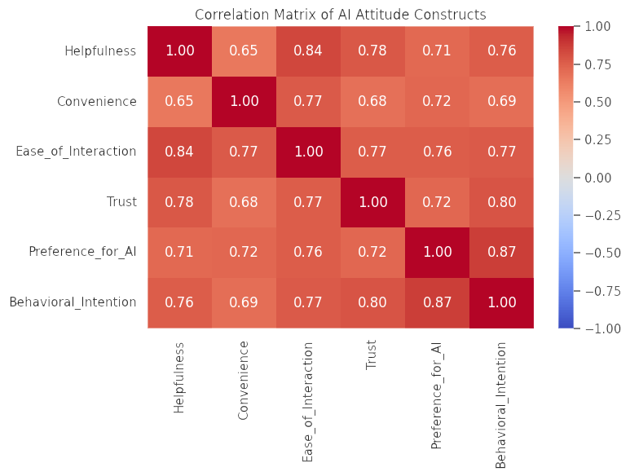
How the Constructs Relate (Correlations)
Trust, Helpfulness, Convenience, Ease, and Preference are all strongly positively correlated.
Trust–Preference: r = 0.735
Convenience–Preference: r = 0.695
All correlations between constructs ≥ ~0.67

Slide 8

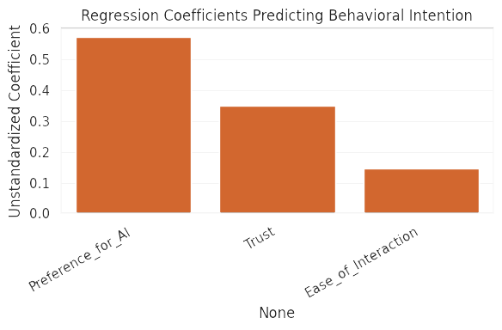

What Drives Preference for AI?
Predictor | Coefficient | p-value
Preference_for_AI | 0.574 | < 0.001
Trust | 0.351 | 0.002
Ease_of_Interaction | 0.146 | 0.252 (not significant)
This confirms that product changes that improve trust, helpfulness, and convenience will strongly increase willingness to use AI.
Model: Preference ~ Trust + Helpfulness + Convenience
R² ≈ 0.81 – “We explain ~81% of the variation in Preference.”
Trust has the strongest coefficient; Helpfulness and Convenience also significant.

Slide 9

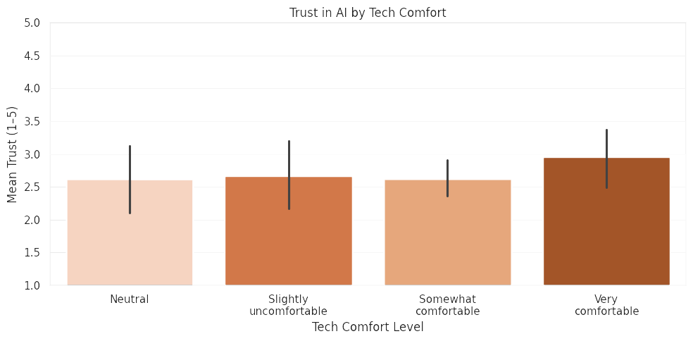
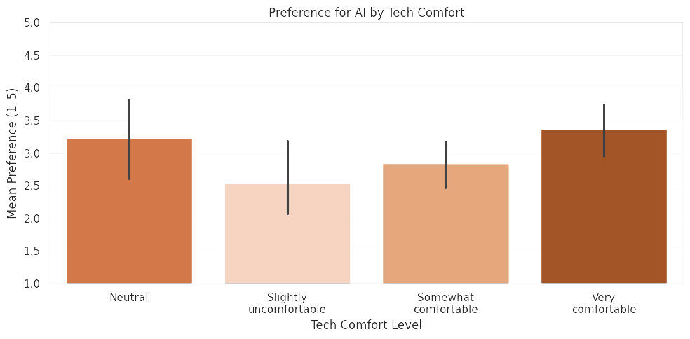
H3 – Does Tech Comfort Change Attitudes?
ANOVA shows no significant differences in Trust or Preference across tech-comfort levels.
p = 0.63 for Trust, p = 0.13 for Preference → H3 rejected.
Attitudes toward AI are not just a ‘techie’ phenomenon – views are similar across comfort levels.

Slide 10
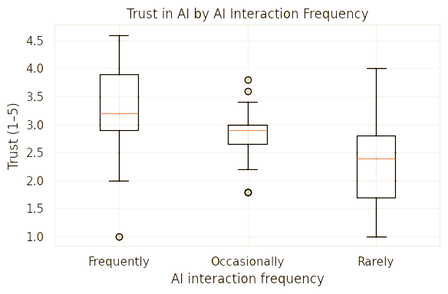

H4 – AI Experience Frequency & Trust
Trust scores differ significantly by AI interaction frequency – F(2,57) ≈ 6.44, p ≈ 0.003.
Frequent users trust AI more than occasional and rare users.
Positive experience with AI builds trust over time.

Slide 11
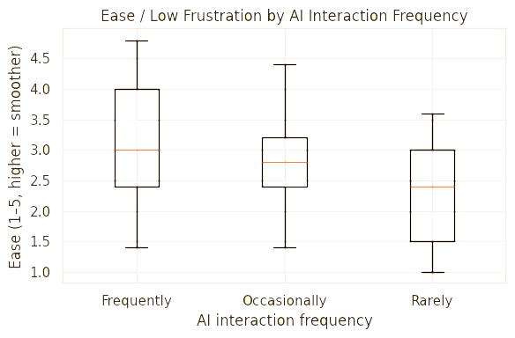


H4 – AI Experience & Ease of Interaction
Ease/low-frustration scores also differ by AI frequency – F(2,57) ≈ 6.01, p ≈ 0.004.”
“Frequent users report smoother interactions and less frustration.”
“No clear difference in Convenience (p ≈ 0.12).”
Users who use AI more often find it smoother and less frustrating, even if they don’t rate it as more convenient.

Slide 12
What This Means for OmniAssist
Insight 1 – Trust as the main lever
Trust strongly predicts Preference (H1 accepted) and is the strongest regression driver (H5).
Recommendation: build trust features – transparency, clear confirmations, robust error handling.
Insight 2 – Convenience still matters
Higher perceived convenience → higher preference (H2).
Recommendation: optimise “time-to-resolution” and highlight 24/7 availability.
Insight 3 – Experience beats demographics
Tech comfort does not split attitudes, but AI frequency does (H3 rejected, H4 partially accepted).
Recommendation: design first-time and low-frequency user journeys with extra guidance and reassurance.
Insight 4 – Role of humans
Recommendation: position AI as first line for simple, transactional tasks, with smooth escalation to human agents for complex or emotional cases.

Slide 13
Q&A
Thank you – we welcome your questions.

Slide 14
Closing statement
To maximize adoption, OmniAssist should design AI that feels trustworthy, smooth, and genuinely helpful from the first interaction, especially for new or hesitant users.
ChatGPT 4o was used only to brainstorm themes and assist with structuring the presentation for the project ‘Public Attitudes Toward AI in Customer Service’. No AI-generated text or analysis appears in the final submitted slides. All content, interpretation, and visuals were produced and verified by the group. Accessed: [2025-12-01]. Available at: https://chat.openai.com/.

