Slide 1

Week 9
URLLIB, Regular Expressions, Beautiful Soup
OGR / GDAL
Pysal / ScipY / MatplotLib

Slide 2
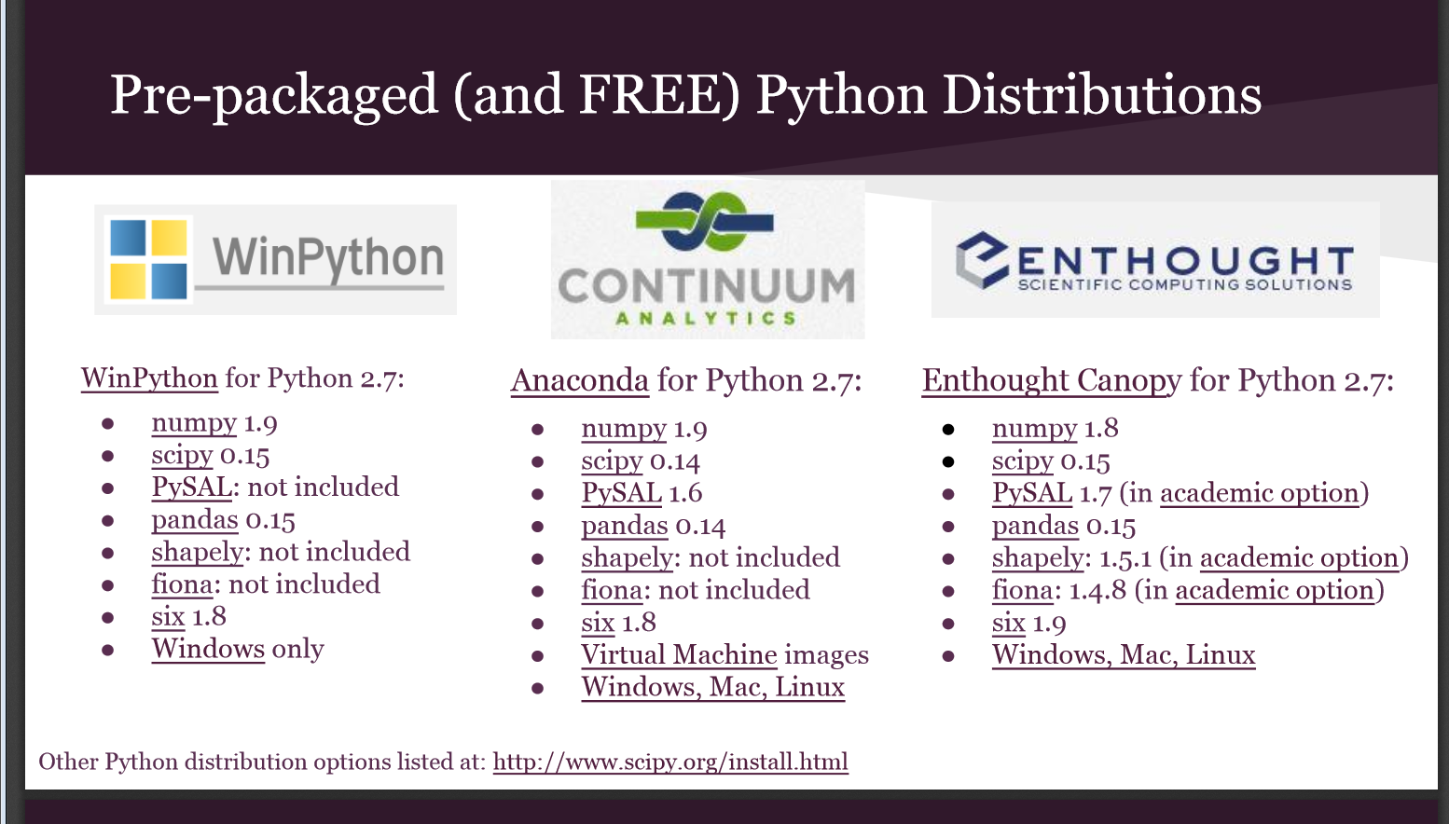
Intro to spatial data Analysis in Python by Jenny Palomino

Slide 3
GIS World
Enterprise
FOSS
ArcGIS
  Industry Standard
  Lots of functions and tools
ERDAS
  Industry Standard
  Lots of functions and tools
PostGIS
OSGEO
  OGR / GDAL
Python
  Pysal / Numpy/ Rasterstats
Orfeo Toolbox
R
  sp, rgdal, colorbrewer

Slide 4
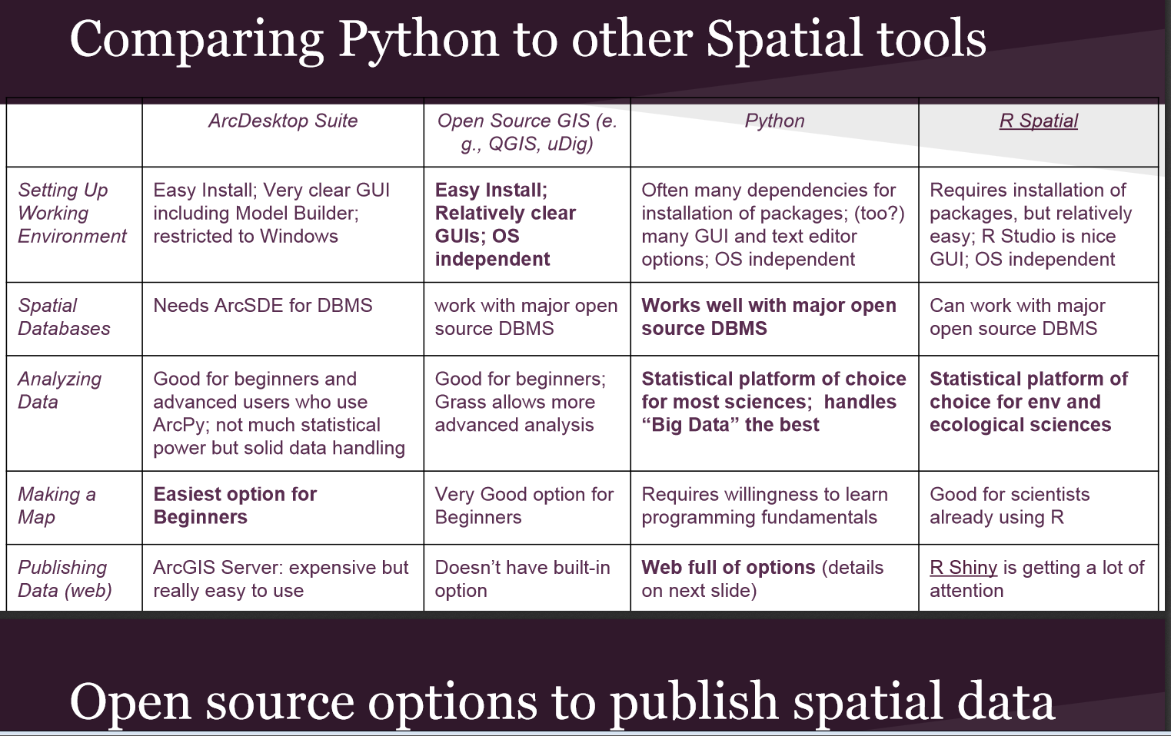
Intro to spatial data Analysis in Python

Slide 5
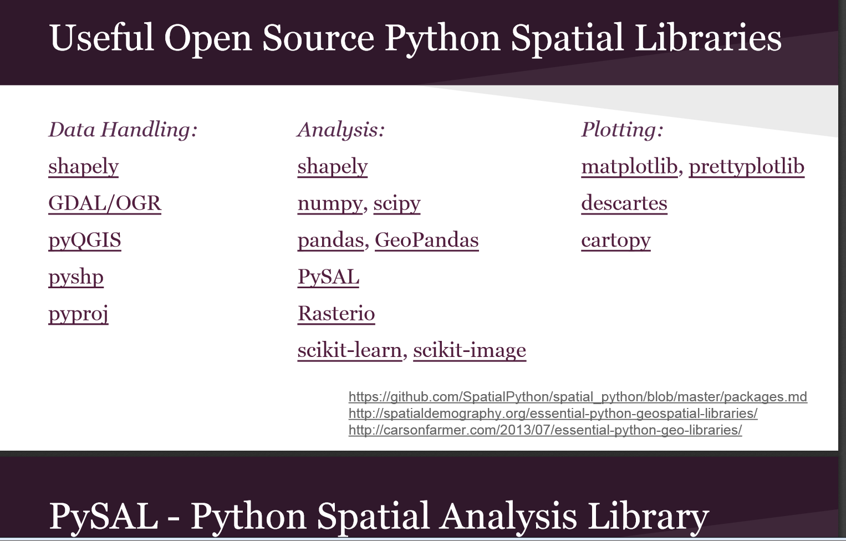
Intro to spatial data Analysis in Python

Slide 6
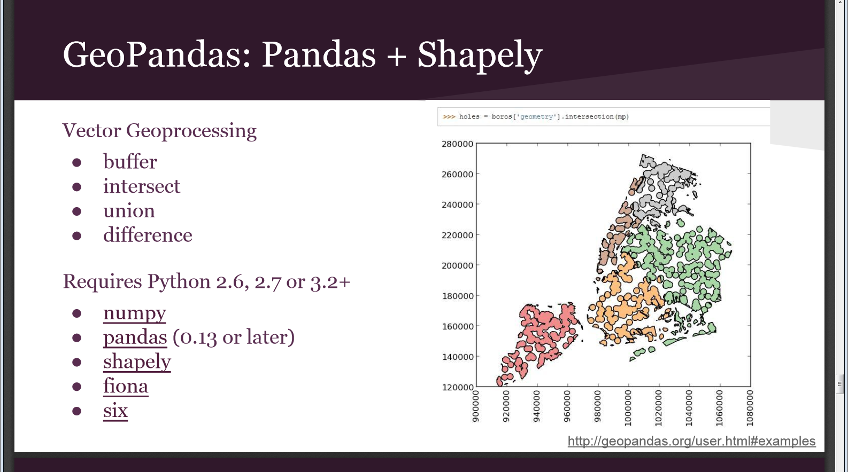
Intro to spatial data Analysis in Python

Slide 7
Conda Environment

Slide 8
My environment
conda install -c conda-forge gdal
#gdal=2.2.0+
conda install -c conda-forge geopandas
conda install -c conda-forge georasters
conda install -c conda-forge geojson
conda install -c anaconda beautifulsoup4
---- No SQL Spatial Databases
conda install -c conda-forge neo4j-python-driver
conda install -c conda-forge pymongo

Slide 9
Freebies
Pyscopg2 – PostgreSQL with PostGIS
Shapely – Analyze vector data
Fiona – read shapefiles, dictionary style
Rasterio – read raster data

Slide 10
URLLIB

Slide 11
Go Online
http://earthenginepartners.appspot.com/science-2013-global-forest/download_v1.0.html
http://commondatastorage.googleapis.com/earthenginepartners-hansen/GFC2013/treecover2000.txt

Slide 12
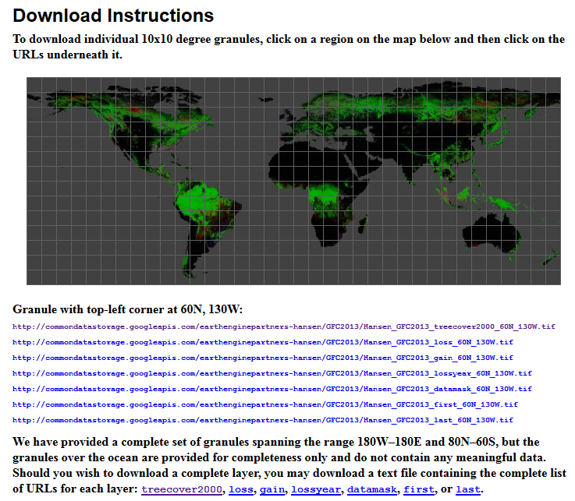
Downloading a File
We want to download all of these tiles.
We are lazy

Slide 13
URLLIB
import urllib
webaddress = r'http://commondatastorage.googleapis.com/earthenginepartners-hansen/GFC2013/treecover2000.txt'
webpg = urllib.request.urlopen(webaddress)
data = webpg.read()

Slide 14
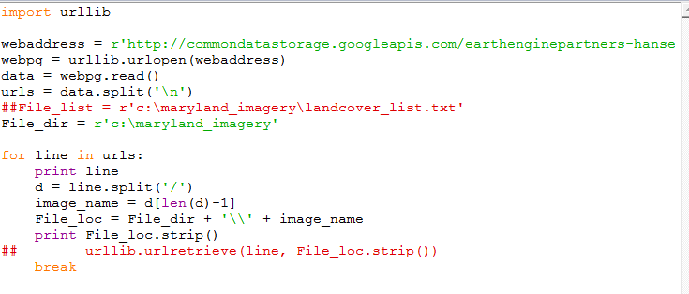
URLLIB

Slide 15
The complete Script
#The script will automate data downloading
import urllib
#Input Parameters here
fileDir = r"e:\maryland_imagery"
webaddress = r'http://commondatastorage.googleapis.com/earthenginepartners-hansen/GFC2013/treecover2000.txt'
#Use urllib to open the url and read it as text string
webpg = urllib.request.urlopen(webaddress)
data = webpg.read()
#Split the text string on the new line character
tiles = data.split(b'\n')
for c, tile in enumerate(tiles):
imagename = "tile_%s" % (c)
fileName = r"%s\%s.tif" % (fileDir, imagename)
print(tile,fileName)
urllib.request.urlretrieve(tile.decode("utf-8"), fileName)
#Remove this after it works
break

Slide 16
ReguLar Expressions

Slide 17
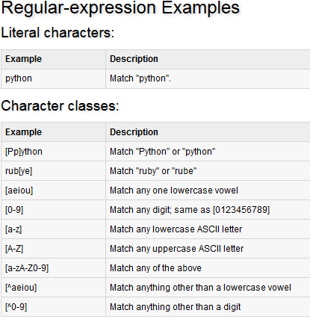
http://www.tutorialspoint.com/python/python_reg_expressions.htm

Slide 18
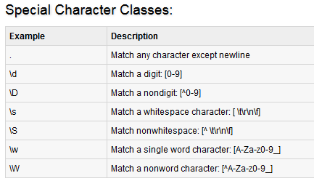
http://www.tutorialspoint.com/python/python_reg_expressions.htm

