Slide 1
GIS 5578
Introduction to Python

Slide 2
Outline
Why Python?
Python programming environment
Python basics

Slide 3
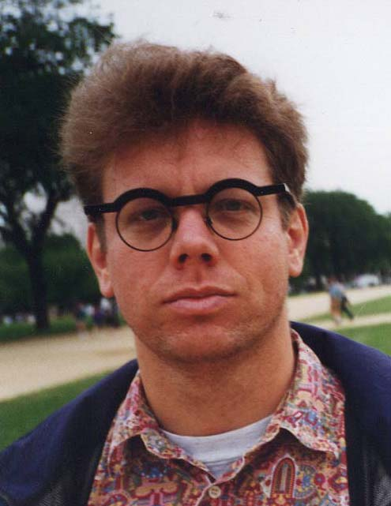
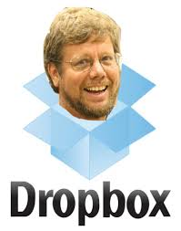
Guido van Rossum (1989), Monty Python fan
http://www.python.org

Slide 4
Why Python for GIS Programming
Interpreter
An interpreter reads a high-level program and executes it, meaning that it does what the program says. It processes the program a little at a time, alternately reading lines and performing computations.
Compiler
A compiler reads the program and translates it completely before the program starts running. In this context, the high-level program is called the source code, and the translated program is called the object code or the executable. Once a program is compiled, you can execute it repeatedly without further translation.

Slide 5
Why Python for scripting?
Ease of use: scripting language, interpreted, high-level
Open-source, object-oriented
Modular, scalable, portable; comes with development tools
On-the-fly testing (Interactive Window); rapid prototyping
Easily ‘glues’ with other languages; installed with ArcGIS 10.x and ArcPro
Large collaborative community (numeric and scientific extensions)
Compact (20,000-line Python is approx. 100,000-line Java or 200,000-line C)
Notes:
Wikipedia: A scripting language or script language is a programming language that supports scripts, programs written for a special run-time environment that can interpret (rather than compile) and automate the execution of tasks which could alternatively be executed one-by-one by a human operator.
Typically scripting languages are intended to be very fast to pick up and author programs in. This generally implies relatively simple syntax and semantics. For example, it is uncommon to use Java as a scripting language due to the lengthy syntax and restrictive rules about which classes exist in which files – contrast to Python, where it is possible to briefly define some functions in a file. A scripting language is usually interpreted from source code or bytecode.

Slide 6
Writing code in Python
Where to write Python code?
  Python command line
  IDLE (interactive interpreter)
IDE (such as IDLE), perform all jobs from one location:
  write
  save
  run
  debug (i.e., test) code

Slide 7
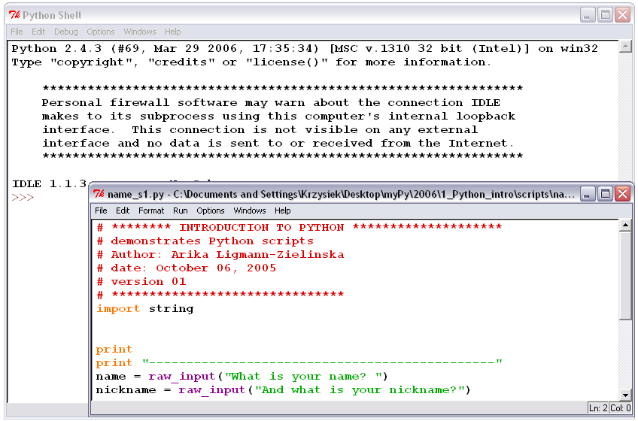
IDLE Interface
Interactive window
  test lines of code
  report messages
  (temporary)
Script window
  write and save code
  (permanent)
Menus
IDLE

Slide 8
Zen of Python
Beautiful is better than ugly.
Explicit is better than implicit.
Simple is better than complex.
Complex is better than complicated.
Flat is better than nested.
Sparse is better than dense.
Readability counts.
Special cases aren't special enough to break the rules.
Although practicality beats purity.
Errors should never pass silently.
Unless explicitly silenced.
In the face of ambiguity, refuse the temptation to guess.
There should be one-- and preferably only one --obvious way to do it.
Although that way may not be obvious at first unless you're Dutch.
Now is better than never.
Although never is often better than *right* now.
If the implementation is hard to explain, it's a bad idea.
If the implementation is easy to explain, it may be a good idea.
Namespaces are one honking great idea -- let's do more of those!

Slide 9
Basic Python structure
Variable: name that represents a value
    placeholder for value
    variable points to a value stored in memory
Expression evaluates to a value (is something)
    2+2 (represents 4)
    “My string”
Statement is an instruction (does/changes something)
    x = 2 (assignment)
    print

Slide 10
Variables in Python
Variables are dynamically typed
  no declaration required
  no type assignment required
  fc = “C:\\ProjectData\\SanDiego.mdb\\Freeways.shp”
  fc = 125
Can hold different data types
  strings, integers, floats, lists, files
Are case sensitive
  fc = “Freeways.shp”
  Fc = 20000
  fC = 3.14
… and so are keywords if / IF / If
Three different variables
Notes:
Dynamic typing: the property of a language where type checks are performed mostly at run time. A variable is dynamically typed when the type of the object(s) it will name is not specified at compile time. A program is dynamically typed if it uses at least one dynamically typed variable. A language supports dynamic typing if it is possible to write dynamically typed programs in it. A language is dynamically typed if most variables in typical programs written in that language are dynamically typed (http://c2.com/cgi/wiki?DynamicTyping).

Slide 11
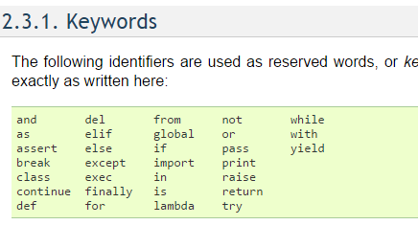
Python Keywords

Slide 12
Important functions
dir – provides a list of all the methods available for an object
type – gives back the type of the object
print – output to screen
range

Slide 13
Variable naming conventions
Upper case versus lower case
  first word lower case; capitalize each successive word
  tableFieldName = “Street”
  acronym at the beginning; use lower case letters
  gdbPath = “C:\\SanDiego.mdb”
  acronym in the middle or at the end; use upper case letters
  inputFC = “Streets.shp”
avoid special characters (for example / \ & % # !)
use descriptive variable names
  sa = s * s
  squareArea = side * side
CODE

Slide 14
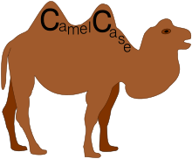
Stick to a Case
CamelCase
snake_case
convention in which an initial capital is used for the first letter of a word forming the second element of a closed compound
Snake case (or snake_case) is the practice of writing compound words or phrases in which the elements are separated with one underscore character

Slide 15
Coding Exercise
Make a new variable name firstName and assign it a string YourFirstname
Make a new variable name firstName and assign it a string YourLastName
Assign variable fullname = firstName + LastName
Print fullname
Is there a G in fullname?

Slide 16
Boolean Expressions
Expression that is either true or false.
“False” in Python:
  False
  0
  None
  SETS
  “”
  ()
  []
  {}
Everything else is “True”

Slide 17
Empty Set (String)
a = ‘’
If a:
print(“A exists!”)
Else:
print(“I guess we’ll just use B”)

Slide 18
Boolean Expressions
== is a comparison operator
others are:
  x != y x is not equal to y
  x > y x is greater than y
  x < y x is less than y
  x >= y x is greater than or equal to y
  x <= y x is less than or equal to y
= is the assignment operator

Slide 19
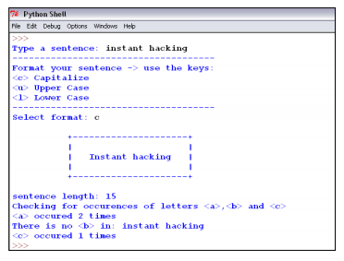
Take Home Exercise 1
  Your goal is to display user input (sentence) in a simple frame.
  You should also apply some basic string formatting: capitalize, upper case all letters, lower case all letters, replace all x with y.
  Finally, you will calculate and display simple stats for the input sentence: its length and the number of times letter ‘a’, ‘b’, and ‘c’ occur in the sentence.

