Slide 1
GIS5778
GIS Programming

Slide 2
Outline
Introduction
  David Haynes (David, Mr. Haynes, Professor Haynes)
    dahaynes@umn.edu
    Office Hours:
      Tuesday 10am-12pmn (MGIS Lab)
      Monday/Wednesday afternoon (appointment)
Why GIS 5578
Software
  Text Editor / IDE
  Github
Syllabus

Slide 3
Geospatial Developer
  Geospatial Libraries
    Python
    Java
  Platforms
    Map Reduce
    Parallel Databases
Developer
  Python
  Java
  Big Data
Geospatial Analysis
  ArcGIS
  GDAL – command line

Slide 5
What’s New
Spatial Analysis
Big Spatial Data
PostgreSQL Development

Slide 6
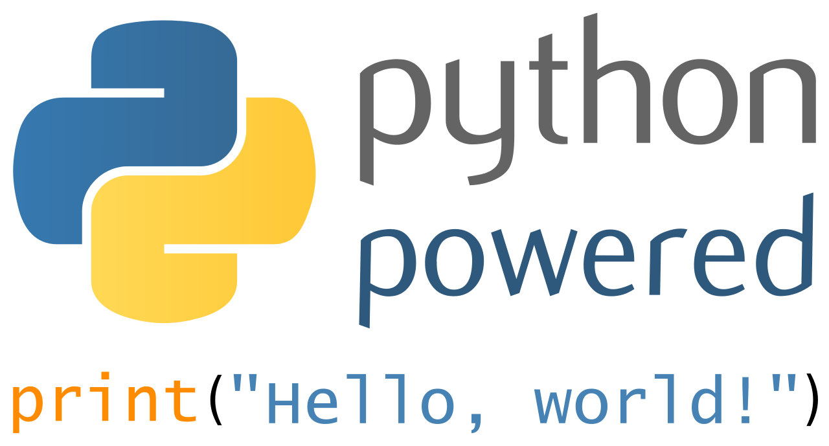
We love Python 3.0

Slide 7
Why learn Python
Fairly simple language to learn
Flexible Object Orientated Language
Automation
Consistency
Reliability

Slide 8

Github classroom

Slide 9
Why use Github
Version control
  No more script_1.py
  Think Microsoft Word track changes, but for code
Sharing
  This doesn’t work, I need help.
  This works and other’s should use it
Portfolio

