Slide 1
Arcpy Toolbox
Subtitle

Slide 2
Choose your tool
Stand Alone
ESRI Toolbox
No graphic user interface
ESRI graphic user interface

Slide 3
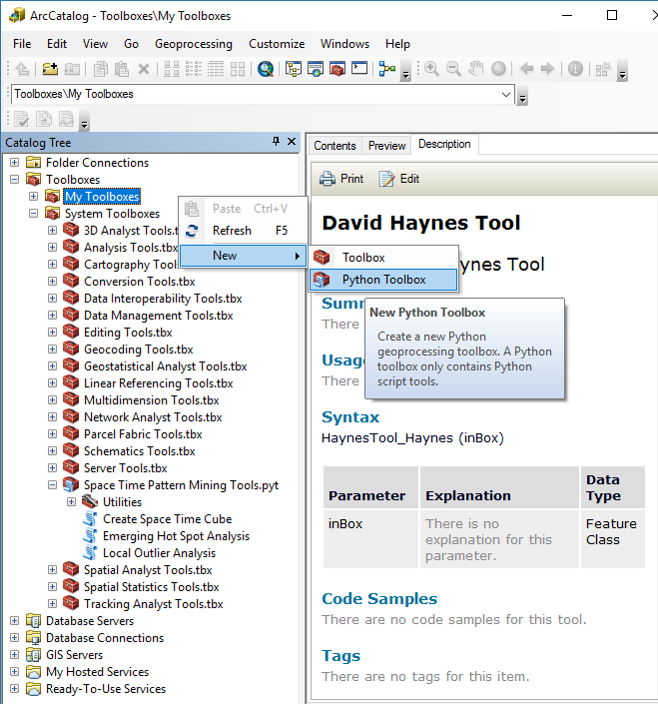
Create a new Python Toolbox - ArcGIS
Open ArcCatalog
Right-Click on the Toolbox
New Python ToolBox

Slide 4
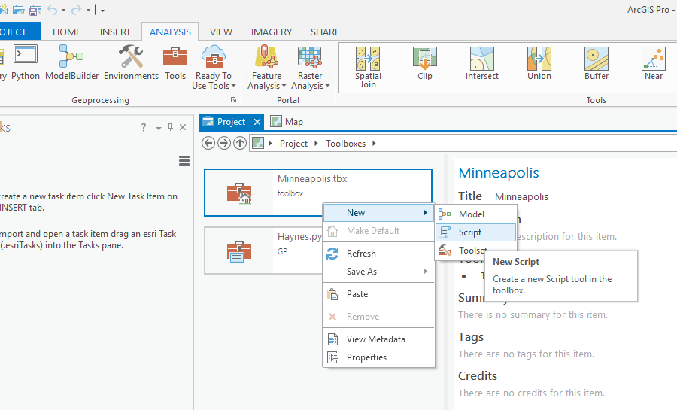
ArcPro
Select the Project Tab
Right click to create a new script

Slide 5
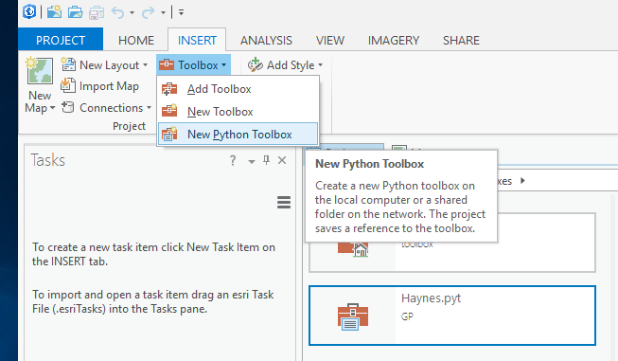
ArcPro – Importing old Toolboxes
Click on the Insert Tab
Click the Toolbox
Add Toolbox will let you import an existing toolbox
New Toolbox creates a new ArcPro Toolbox
New Python Toolbox creates a new ArcMap Toolbox

Slide 6
ArcMAP
Creating an ArcToolbox

Slide 7
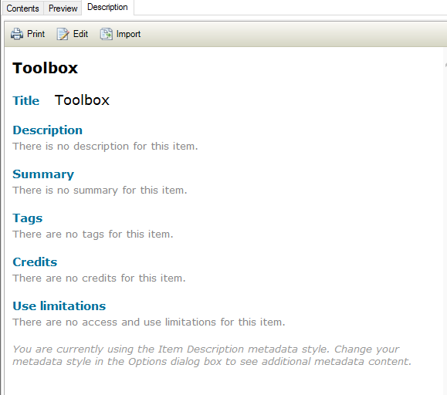
Modify the metadata of your Tool - ArcMap

Slide 8
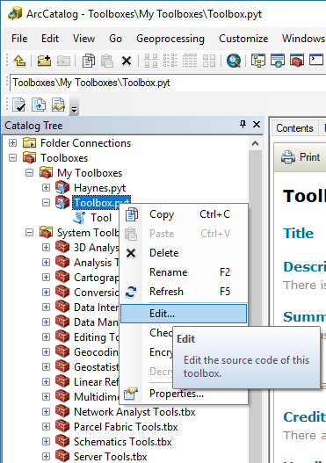
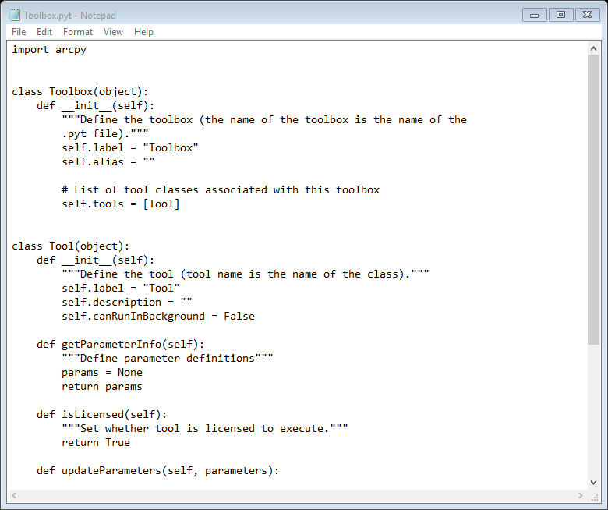
ArcToolBox
Right-click on your toolbox
Click Edit to see your code

Slide 9
Two Classes
ToolBox Class, which can have more than 1 tool
Tool Class

Slide 10
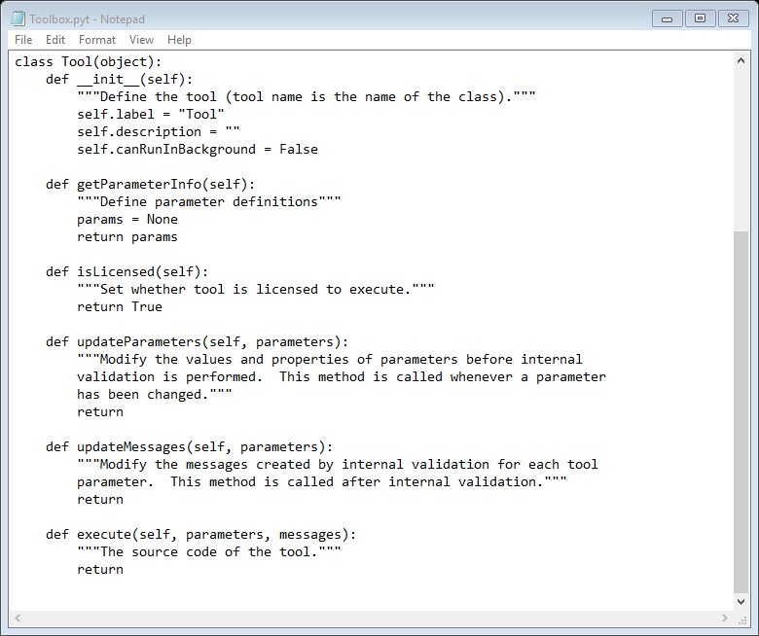
__init__
Initiates the class
getParameterInfo
Define the number of parameters and type
isLicensed
Ignore
updateParameters
Validate the parameter input
updateMessages
Responses sent to the user to verify values are ok
execute
Run the code you have written, main()

Slide 11
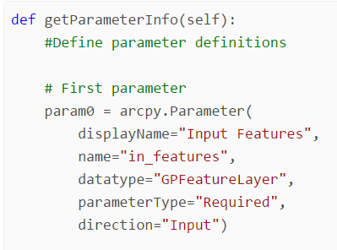
Add an ArcPY parameter
All of these parameters have defaults
displayName = provide a useful name
name = unique name
Datatype = Type of user input. http://pro.arcgis.com/en/pro-app/arcpy/geoprocessing_and_python/defining-parameter-data-types-in-a-python-toolbox.htm
parameterType=“Required”/”Optional”
direction= Input/Output

Slide 12
Code it
Add a parameter
def getParameterInfo(self):
param1= arcpy.Parameter(displayName="Input Features", name="indataset", datatype="DEFeatureClass", parameterType="Required", direction="Input")
#Return a list!! That is what Arcpy UI is exepcting
return[param1]

Slide 13
Parameter object methods
Property name | Read/Write | Value(s) | Description
name | Read-only | String | The parameter name.
direction | Read-only | String: "Input", "Output" | Input/Output direction of the parameter.
datatype | Read-only | String | For a list of parameter data types,
parameterType | Read-only | String: "Required", "Optional", "Derived" | The parameter type.
parameterDependencies | Read/write | Python List | A list of indexes of each dependent parameter.
value | Read/write | Value object | The value of the parameter.
defaultEnvironmentName | Read-only | String | The default environment setting.
enabled | Read/write | Boolean | False if the parameter is unavailable.
altered | Read-only | Boolean | True if the user has modified the value.
hasBeenValidated | Read-only | Boolean | True if the internal validation routine has checked the parameter.
category | Read/write | String | The category of the parameter.
schema | Read-only | Schema object | The schema of the output dataset.
filter | Read-only | Filter object | The filter to apply to values in the parameter.
symbology | Read/write | String | The path to a layer file (.lyrx) used for drawing the output.
message | Read-only | String | The message to be displayed to the user.

Slide 14
Arcpy Field Types
http://pro.arcgis.com/en/pro-app/arcpy/geoprocessing_and_python/defining-parameter-data-types-in-a-python-toolbox.htm

Slide 15
Code it
Add a second parameter
Display Name = Buffer Distance
Name = distance
Field type = GPLong

Slide 16
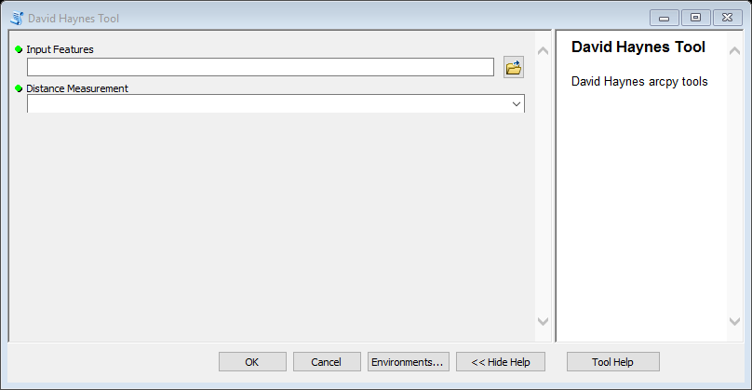
ESRI’s Tool User Interface (UI)

Slide 17
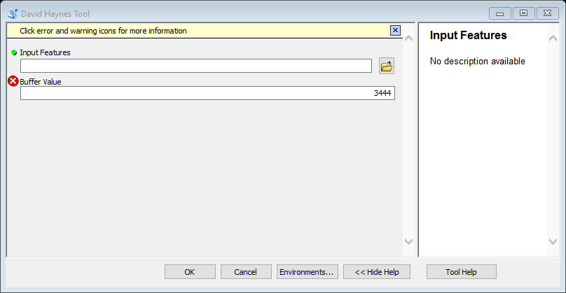
updateMessages
def updateMessages(self, parameters):
"""Modify the messages created by internal validation for each tool
parameter. This method is called after internal validation."""
if parameters[1].value in range(100):
arcpy.AddMessage("Value is good")
else:
parameters[1].setErrorMessage("Out of range")
return

Slide 18
Code it
Add the Buffer process to execute method

Slide 19
def execute(self, parameters, messages):
"""The source code of the tool."""
#arcpy.AddMessage(parameters)
inputFeatures = parameters[0].valueAsText
distance = parameters[1].valueAsText
distance = "%s Feet" % (distance)
arcpy.AddMessage(inputFeatures)
arcpy.Buffer_analysis(inputFeatures, r”c:\work\test.shp”, distance, "FULL", "ROUND", "LIST")

Slide 20
Code it
Add the third parameter
Fix the execution function so you that the script works end to end
param3= arcpy.Parameter()
displayName="Out Features",
name="outdataset",
datatype="DEFeatureClass",
parameterType="Required",
direction="Output"

Slide 21
Buffer Tool
The buffer tool works on any provided shapefile.
However, we want this to only work on point feature classes. We want to provide an error message to our user if they don’t have give a point feature class.
To do this we will use the arcpy.Describe method and the Tool updateParameters and updateMessages functions

Slide 22
updateParameters
def updateParameters(self, parameters):
"""Modify the values and properties of parameters before internalvalidation is performed. This method is called whenever a parameter has been changed."""
if arcpy.Describe(parameters[0].value).shapeType != "Point":
parameters[0].setErrorMessage("Only Point")
return

Slide 23
Code it
Add a fourth parameter that will use a drop down list of provided distance measurements. Such as Feet, Meters, Kilometers..etc
param4= arcpy.Parameter()
displayName="Distance Measurement",
name="unit",
datatype="GPString",
parameterType="Required",
direction="Input"

Slide 24
Modify the getParameterInfo()
def getParameterInfo(self):
param1 = arcpy.Parameter()
param2 = arcpy.Parameter()
param3 = arcpy.Parameter()
param4 = arcpy.Parameter()
param4.filter.type = "Value List"
param4.filter.list = ["Feet", "Meter"]
#Must return a List object
#The order of the returned list affects the order of the boxes as they are displayed
return[param1, param2, param4, param3 ]

Slide 25
Modify the Execute Function
distance_with_unit = "%s %s" % (parameters[1].valueAsText, parameters[2].valueAsText)
arcpy.AddMessage(distance_with_unit)
arcpy.Buffer_analysis(inputFeatures, outputFeatures, distance_with_unit, "FULL", "ROUND", "LIST")

Slide 26
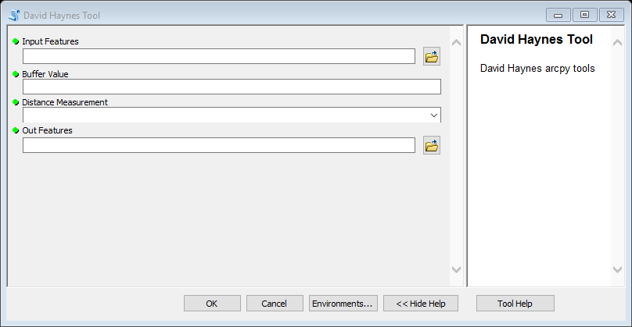
Completed ArcToolBox

Slide 27
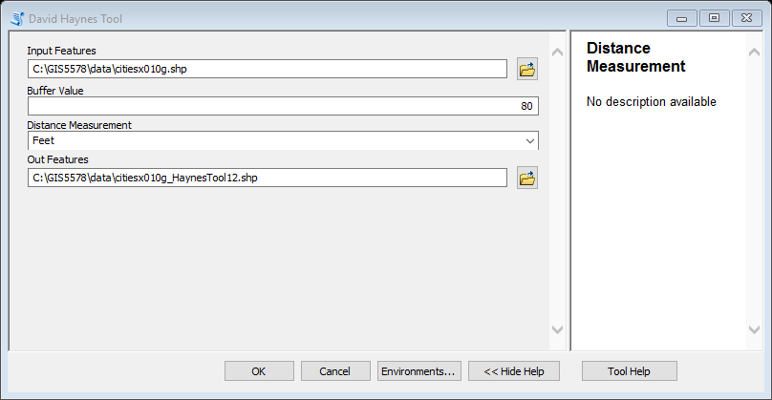
Automated Buffering

Slide 28
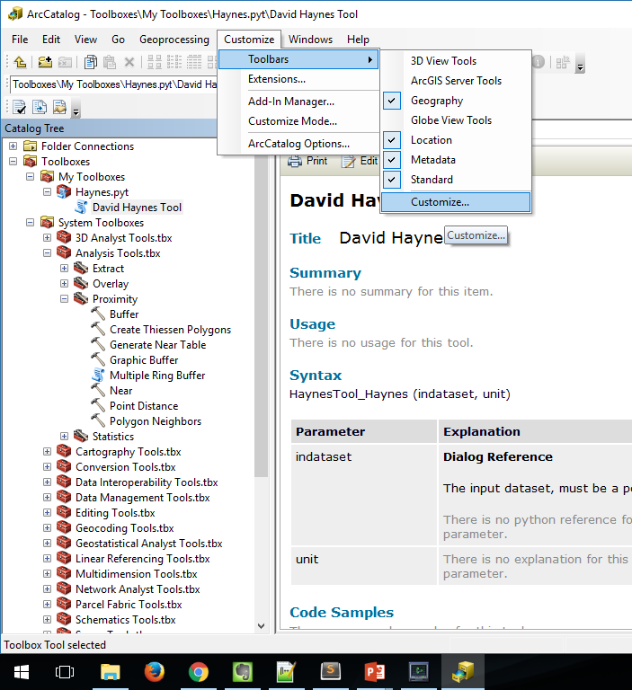
Adding your tool to Arc
Go the main toolbar
Go to customize → customize

Slide 29
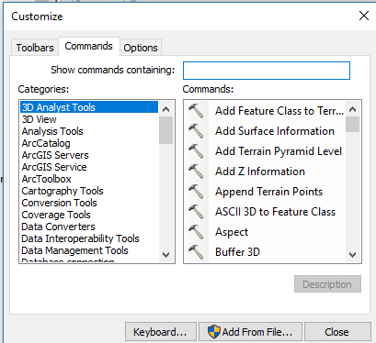
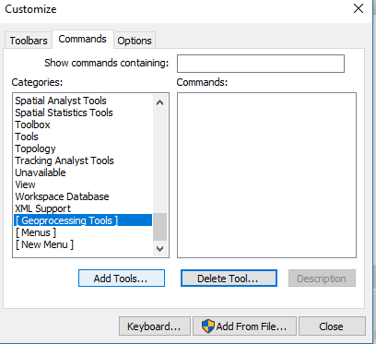
Find the GeoProcessing Tools
Click on the “Commands” tab
Scroll to “Geoprocessing” → Add Tools

Slide 30
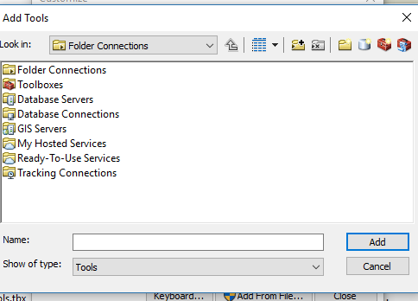
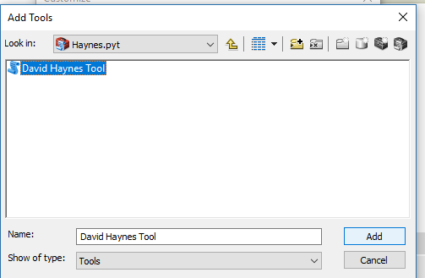
Load your Python Tool
Navigate till you find your python script
Click on the Toolboxes

Slide 31
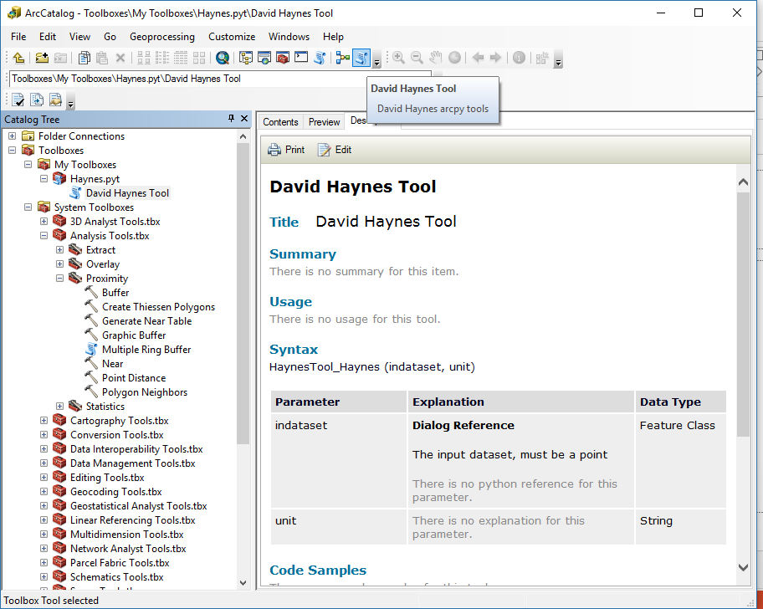
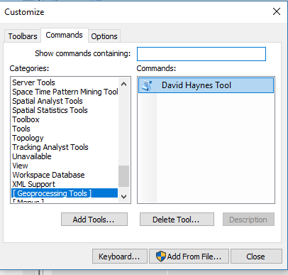
Add the button to your menu bar
Click and drag your tool to the main menu bar

Slide 32
Run Your Tool

Slide 33
ArcPro

Slide 34
ArcPro
ArcPro supports all of the functionality of your scripts but requires you to build them in another program and then import.

Slide 35
ArcPro
Select the Project Tab
Right click to create a new script

Slide 36
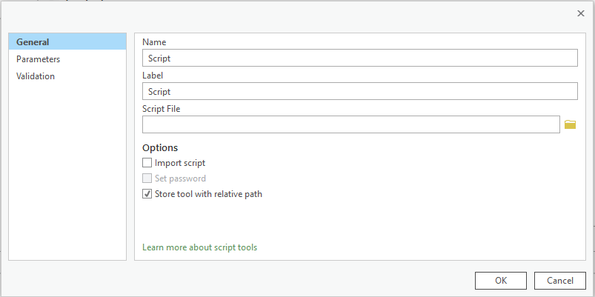
Setup the script

Slide 37
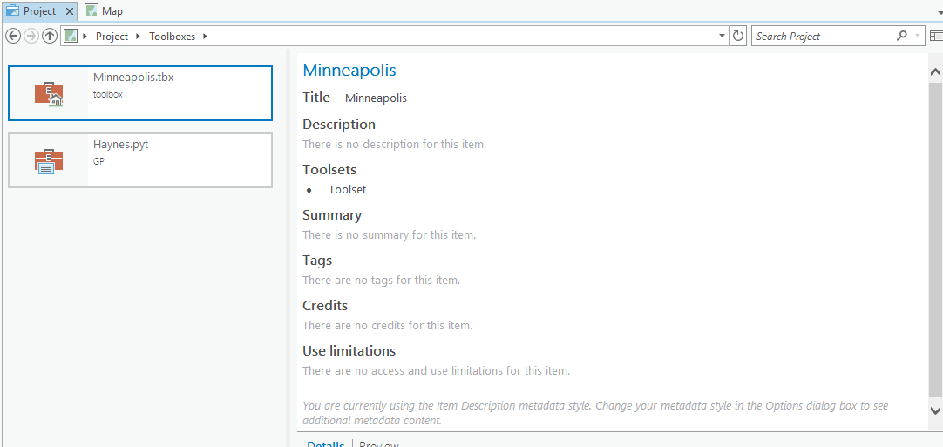
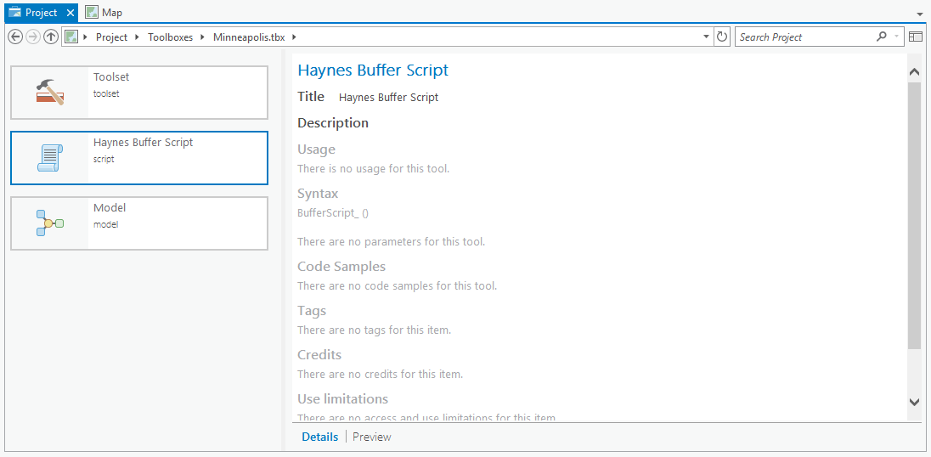
To Access your Script Double-click on Toolbox

Slide 38
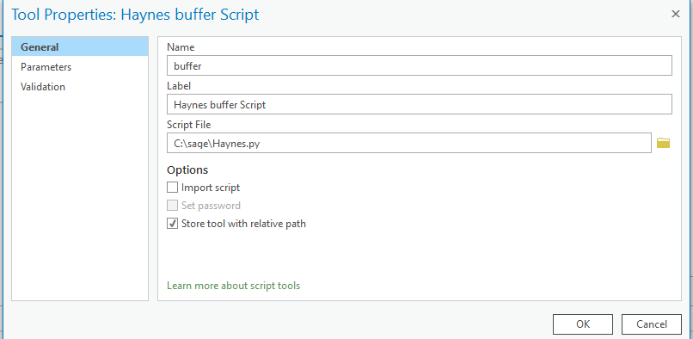
General
Choose a name for your tool
No spaces
Label is a whatever you want
Script file is needed, find an existing file.

Slide 39
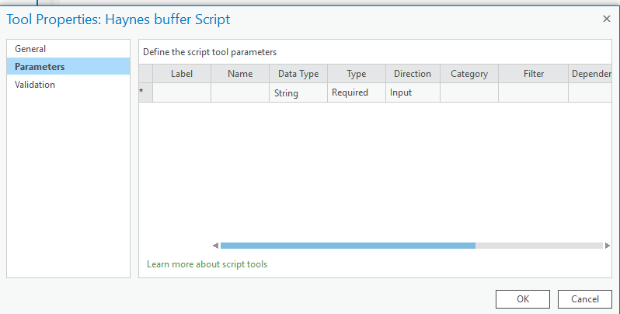
Parameter Definition
You can enter in the names of the parameters.

Slide 40
Command Line tool

Slide 41
Argument parser
def argument_parser():
""" return arguments """
import argparse
parser = argparse.ArgumentParser(description= "A function for buffering shapefiles")
parser.add_argument("--infile", required =True, help="The full path for the infile", dest="infile")
parser.add_argument("--distance", required =True, help="Buffer distance in units", dest="distance")
parser.add_argument("--units", required =True, help="Distance unit", dest="units")
parser.add_argument("--outfile", required =True, help="The full path for the outfile", dest="outfile")
return parser

Slide 42
def main(inShapefile, dist, units, outShapefile):
import arcpy
distance_with_unit = "%s %s" % (dist, units)
arcpy.Buffer_analysis(inShapefile, outShapefile, distance_with_unit, "FULL", "ROUND", "LIST")
if __name__ == '__main__':
args = argument_parser().parse_args()
main(args.infile, args.distance, args.units, args.outfile)

Slide 43
Command Line
c:\Python27\ArcGIS10.5>python buffer.py
--infile c:\work\boundaries_1840_IPUMS_MX_HSLAD_2005_2010.shp
--distance 50
--units Meters
--outfile c:\work\testing5.shp

