Slide 1
Week 10
Hacking ArcMap
Error Catching

Slide 2
Mapping Module
Interface for programmatically accessing components of the mxd
Can’t create generate a new mxd document directly from arcpy

Slide 3
ArcPy Mapping
Download some data from moodle
Open ArcMap
Add a dataset to ArcMap
Open the python terminal in arcpy

Slide 4
Code It!
#The MapDocument is the object name for the mxd
#CURRENT is a key word it can be replaced with a path to a previously existing mxd
mxd = arcpy.mapping.MapDocument("CURRENT")
df = mxd.activeDataFrame
#Alternative code if you have more than 1 data frame. Returns a list containing arcpy dataframe objects
#dataFrames = arcpy.mapping.ListDataFrames(mxd, "*")

Slide 5
Layers in your Dataframe
#Get all layers in the dataframe of mxd.
#Requires two input objects
# 1) Map document object
# 2) Dataframe object
layers = arcpy.mapping.ListLayers(mxd, "*", df)
for l in layers:
print(l.datasetName, l.name)

Slide 6
Modify the Interface
Change the dataframe name
Add a new layer
df.name = “United States”
arcpy.RefreshTOC()
newLayer= arcpy.mapping.Layer(r"c:\work\boundaries_1840_IPUMS_MX_HSLAD_2005_2010.shp")
arcpy.mapping.AddLayer(df, newLayer, "TOP")
#Alternatives are "TOP" / "BOTTOM" / "AUTO_ARRANGE“
arcpy.RefreshActiveView()

Slide 7
Hack ArcMap
import arcpy, time, os
#Path for the new blank mxd, you will delete this.
blankmapPath = r"C:\work\haynes_test4.mxd“
#Path for you final resulting mxd
newmapPath = r"C:\work\haynes_hack.mxd"
open(blankmapPath, "w").close()
print "Created new map document"
#Use Python’s OS module to open the file in ArcMap
os.startfile(blankmapPath)
#Make the computer wait .... in seconds
time.sleep(30)

Slide 8
BREAK

Slide 9
Error Catching

Slide 10
Syntax Errors versus Exceptions
Syntax errors need to be corrected before execution
Exceptions: errors during execution (i.e., run-time errors)
Alt-x (IDLE)

Slide 11
Check for syntax errors
Use IDLE ‘Check Module’ option in file menu
  identifies syntax errors
Script will not run unless syntax errors are fixed

Slide 12
IDLE debugger
step through line by line to find error
step through based on pre-defined break points
monitor values of variables

Slide 13
Narrow error to block or line of code
Numerous ways to find line with error:
  interactive window
  print/AddMessage() statements
  comment out a line
  use debugger
Based on user preferences and type of error

Slide 14
Handling exceptions
Scripts will often produce run-time exceptions
  especially with user interaction/input
  close to impossible to write code for every possible exception

Slide 15
Why handle exceptions?
Run-time errors are nasty
Often terminate execution of code
Good scripts have proper code to prevent cryptic errors:
  if error occurs, message informs user about what happened

Slide 16
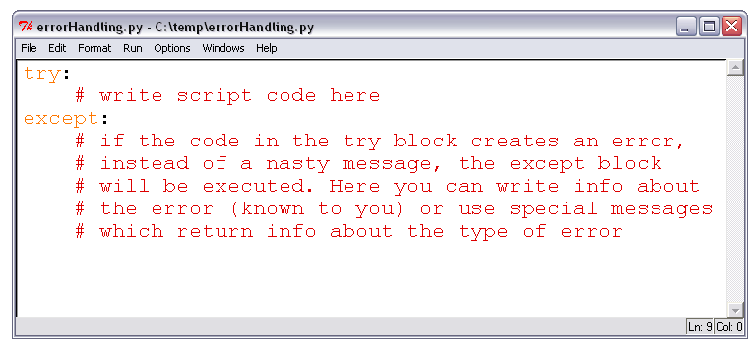
try...except block

Slide 17
Code it
def mydivision(numerator, denominator):
'This function will do division'
print(numerator/denominator)
mydivision(5,0)
5/0
Traceback (most recent call last):
File "<stdin>", line 1, in <module>
ZeroDivisionError: integer division or modulo by zero

Slide 18
Error caught
def mydivision(numerator, denominator):
'This function will do division'
try:
print(numerator/denominator)
except ZeroDivisionError as e:
print("Can't divide by zero")
mydivision(5,0)

Slide 19
Code It
Fix the function so if a letter is entered it provides a message
What else can you catch?

Slide 20
Error Catching
try:
#some code we are trying to catch
#This except will try for all errors raised
except:
#if something bad happens do this
try:
#some code we are trying to catch
Except Specific Error Type:
#if something bad happens do this

Slide 21
Error Catching - Else
try:
#some code we are trying to catch
#This except will try for all errors raised
except:
#if something bad happens do this
try:
#some code we are trying to catch
except Specific Error Type:
#if something bad happens do this
else:
#if nothing bad happens do this

Slide 22
Error Catching - Finally
try:
#some code we are trying to catch
#This except will try for all errors raised
except:
#if something bad happens do this
try:
#some code we are trying to catch
except Specific Error Type:
#if something bad happens do this
else:
#if nothing bad happens do this
finally:
#do this

Slide 23
Advanced error catching
def mydivision(numerator, denominator):
'This function will do division'
try:
print(numerator/denominator)
except (ZeroDivisionError, TypeError) as e:
print("Something occurred")
print(dir(e), e.args)

Slide 24
Where should I use error catching
Don’t imagine that you coded everything correctly.
Use error catching when bringing in new files
Appropriately using error catching
  Don’t construct big try blocks can potentially have many various error types.
  Small try blocks, with specific exceptions
  Add error catching as necessary
  Identify if the errors and attempt to generalize or use excepts
  Don’t add it everywhere

Slide 25

Youtube tutorial on Python error catching

Slide 26
Raise

Slide 27
Raise
The reserved word “raise” can be used in two ways
raise TypeError
  This error will raise a specific type of error (TypeError) that you can catch by surrounding it with a try or except
raise
  When raising without a specific type of error. You raise a runtime error

Slide 28
Raise
a = 3
if a < 4:
raise
else:
print(a)
if a < 4:
raise TypeError
else:
print(a)

Slide 29
ArcPy Error Catching

Slide 30
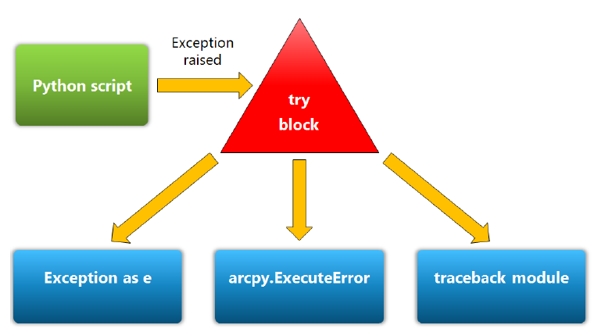
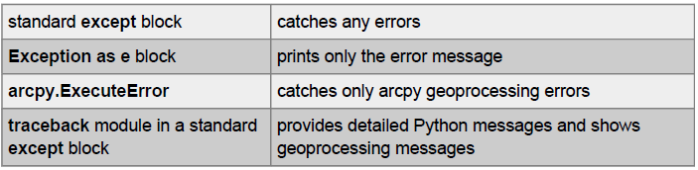
Handling exceptions

Slide 31
try...except block

Slide 32
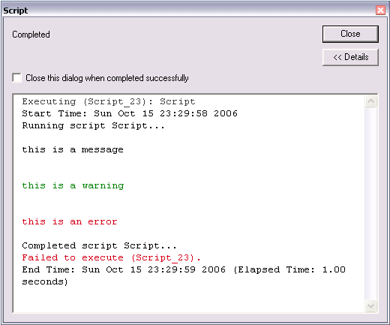
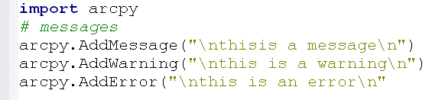
ArcPy messaging
AddError always invokes ‘Failed to execute’ message
Terminates execution
Use appropriately

Slide 33
Checking for errors
# Use try…except blocks with arcpy.GetMessages()
try:
# ... basic code here (normal run)
except:
# ... abnormal termination -> catch the
# exceptional cases
gp.AddError(“oh no:( ”+arcpy.GetMessages())

Slide 34
Checking for errors
arcpy.GetMessages() returns messages from last executed tool
reports geoprocessing errors (not Python errors)
filter messages through:
  GetMessages(0); messages
  GetMessages(1); warnings
  GetMessages(2); errors

Slide 35
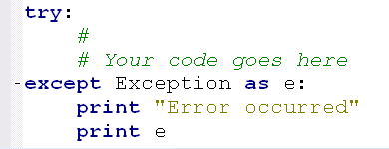
Exception as e
Provides details on exception
Print exception details (using print)

Slide 36
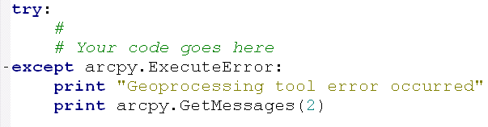
arcpy.ExecuteError
Covers only geoprocessing exceptions

Slide 37
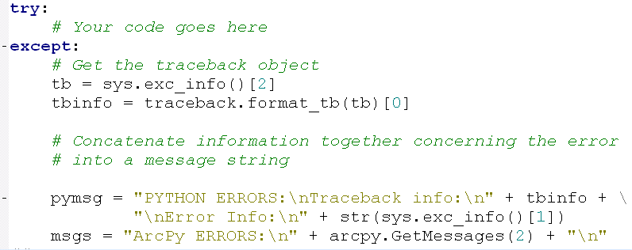
traceback module
Helps tracking down why a script failed
Line of code where it failed
Notes:
Also tb = sys.exc_traceback

Slide 38
Specific errors
Common geoprocessing errors:
  input data does not exist
  output data already exists
  user provided wrong type of data
Test for in if-elif-else statement
  messages be sent to the user
    IDLE: print
    ArcToolbox: AddMessage, AddError, AddWarning

Slide 39
Specific errors
Common geoprocessing errors:
  input data does not exist
  output data already exists
  user provided wrong type of data
Test for in if-elif-else statement
  messages be sent to the user
    IDLE: print
    ArcToolbox: AddMessage, AddError, AddWarning

Slide 40
Check data in ArcCatalog
Check for geoprocessing errors in ArcCatalog
  is ‘overwrite’ on/off? If on, make sure not to try overwriting existing data
  make sure input data exists (e.g., do not try clipping shapefile that does not exist)
  make sure ArcGIS apps are closed
    some tools (e.g. AddField) do not work due to schema lock

Slide 41
A note of caution
Some tools will not run:
  toolbox not added
  toolbox not available (ArcView, ArcEditor, ArcInfo license)
  extension not available (e.g., Spatial Analyst)
  non-existing data (use Exists to test)

Slide 42
ArcCheckProduct
import arcpy
products = [“arcview”, “arceditor”, “arcinfo”]
for p in products:
print(“Checking %s: %s” % (p, arcpy.CheckProduct(p)) )

