Slide 1
Week 3
Control Structures
Files (Open & Close)

Slide 2
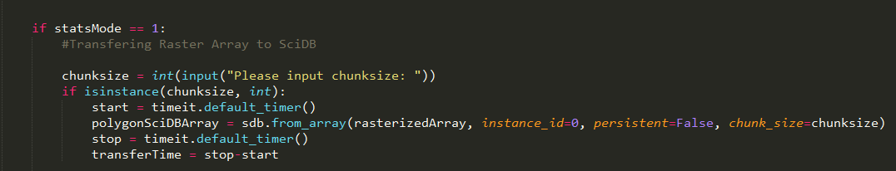
Python
White space sensitive
Indentation sensitive

Slide 3
Control Structures

Slide 4
Learning control structures
If – Then - Else
  Very few programs are straight forward
  Control structures allow you to define options
Loops
  for loops
  while loops

Slide 5
If – Then - Else
#states that b must equal the value for the following statements to be executed
if b == 0:
  pass
  #Do something
#States that if c is true, then do something. Any value that is not zero will evaluate as true
if c:
  pass
  print(“hello class”)

Slide 6
Code It!
Words to test = garage, python
Ask the user to input some text
If the text the user inputs has an ‘a’ then upper case
If the text the user inputs has a ‘e’ then lower case
If the text the user inputs has an a and the last character is an ‘e’, replace it with ‘ers’

Slide 7
Loops
While loops
  Start with an initial true condition
  Run this loop (potentially forever until the condition changes)
  b = 0
  while b < 100:
  print(b)

Slide 8
While loops
Potentially problematic
  If the condition starts as false, then it never runs.
  You might want this to run.
  You never ever evaluate to false so it never leaves the code block

Slide 9
For loops
A safer alternative to while loops.
Execute at least once
Always terminate
Can be combined with iterators and sequences
  for b in range(100):
  print(b)

Slide 10
Code It
Multiplication table 0-12

Slide 11
Comprehension
catchlist = []
for s in stuff:
catchlist)
Catchlist = [s for s in stuff]

Slide 12
BREAK

Slide 13
Files

Slide 14
File Management in Python
Write data to a file to store it permanently
Files are digital books:
  a book is a permanent repository of data
  to read a book, you have to open it
  either read from it or write in it
  when done, close it
open -> read / write -> close

Slide 15
Opening & Closing a file
Open a file: open
Close a file: close
There are a few things you can perform in between
Always close the file when done.
  Otherwise you may lose data
  Other programs will also not be able to access the file.

Slide 16
Opening & Closing a file
Open a file:
newfile = open(filepath,r/w)
Close a file:
newfile.close()
Always close the file when done.
Use ‘WITH’
The advantage of using a with statement is that it is guaranteed to close the file no matter how the nested block exits. If an exception occurs before the end of the block, it will close the file before the exception is caught by an outer exception handler. If the nested block were to contain a return statement, or a continue or break statement, the with statement would automatically close the file in those cases, too.

Slide 17
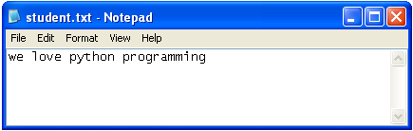
Opening a file for writing
If file does not exist, it will be automatically created
myFile = open(r“C:\work\student.txt", 'w')
#The default method when opening a file is “r”
myFile.write("we love python programming”)
myFile.close()
#If file exists, it will be overwritten

Slide 18
Python 2
Python 3
We had a string object that consisted of strings and bytes
The string object has been redefined, removing the bytes.
There is now a true bytes object.
If you want to write in binary you need to convert the information to the appropriate format.

Slide 19
CODE IT
f = open(r"C:\3D.txt", "w")
#your strings must have the new line character present
f.write("length\nheight\nwidth\n")
f.close()
# now open the file in windows...
# and now read back the content:

Slide 20
Code IT
Exercise 1 (*.txt)
  a string : ‘your name’
  A variable : Address = ‘your address’
  Close the file
Exercise 2 (*.txt)
  Write a list of numbers (1,10001) with each number on a new line
  Write a list of numbers (1,10001) all on the same line
Exercise 3 (*.csv)
  Write a multiplication table (12x12)

Slide 21
Python 2
Python 3
outFilePath = r"C:\work\outdata.csv"
dataset = [[1,1,1,1,1], [5,5,5,5,5], [3,3,3,3,3]]
with open(outFilePath, 'w') as outCSV:
for d in dataset:
print("This is the element %s" % (d) )
elementAsList = str(d)[1:-1]
print(elementAsList)
#This function only writes things that are strings.
#Format your string perfectly
outCSV.write( "%s\n" % (str(d)[1:-1]) )
outFilePath = r"C:\work\outdata4.csv"
dataset = [[1,1,1,1,1], [5,5,5,5,5], [3,3,3,3,3]]
with open(outFilePath, 'w', newline="\n") as outCSV:
for d in dataset:
print("This is the element %s" % (d) )
elementAsList = str(d)[1:-1]
print(elementAsList)
#This function only writes things that are strings.
#Format your string perfectly
outCSV.write( "%s\n" % (str(d)[1:-1]) )

Slide 22
CSV Module
Writing

Slide 23
Python 2
Python 3
#importing the CSV module
import csv
outFilePath = r"C:\work\outdata3.csv"
dataset = [[1,1,1,1,1], [5,5,5,5,5], [3,3,3,3,3]]
#On windows you need to specify the mode= 'wb'
#Or you will get irregular spacing
with open(outFilePath, 'wb') as outCSV:
theWriter = csv.writer(outCSV, delimiter=",")
for d in dataset:
print("This is the element %s" % (d) )
#This CSV module will write all of the elements in the list
#It will do all of your formatting, just get your data in a list format
theWriter.writerow(d)
#importing the CSV module
import csv
outFilePath = r"C:\work\outdata5.csv"
dataset = [[1,1,1,1,1], [5,5,5,5,5], [3,3,3,3,3]]
#If you choose the mode = 'wb' you must write a bytes object
#If you don't specify the newline option in Windows you get irregular spaces
with open(outFilePath, 'w', newline="\n" ) as outCSV:
theWriter = csv.writer(outCSV, delimiter=',')
for d in dataset:
print("This is the element %s" % (d) )
#This CSV module will write all of the elements in the list
#It will do all of your formatting, just get your data in a list format
theWriter.writerow(d)

Slide 24
Opening a file for reading
File for reading opens only if it exists, otherwise error
  myFile = open("student.dxt", 'r')
  Traceback (most recent call last):
  File "<interactive input>", line 1, in ?
  IOError: [Errno 2] No such file or directory: 'student.dxt'
There are several ways of reading a file
*.read() reads entire file
*.read(5) reads first five characters
*.readline() reads one line
*.readlines() reads all lines; puts them into a list of strings

Slide 25
Opening a file for reading
>>> myFile = open("student.txt", 'r')
>>> myFile.read()
'we love python‘
>>> myFile.read()
'‘ #??
Python “remembers” where you finished reading;
if end of file reached, returns an empty string

Slide 26
Standard
Alternative
f = open(r"C:\3D.txt", "r")
#data is lost
f.readlines()
['length\n', 'height\n', 'width\n']
f.close()
f = open(r"C:\3D.txt", "r")
#data is saved to var(content)
content = f.read()
f.close()
print(content)
length
height
width

Slide 27
Standardizd Reading
Python 2
Python 3
f = open(r"c:\work\outdata.csv", "r", newline='\n')
for line in f:
print(line)
f = open(r"c:\work\outdata.csv", "r", newline='\n')
for line in f:
print(line)

Slide 28
Reading data in a loop
Python 2
Python 3
theFilePath = r"c:\work\outdata.csv"
f = open(theFilePath)
dataset = f.read()
for d in f.read().splitlines():
print(d)
theFilePath = r"c:\work\outdata.csv"
f = open(theFilePath)
dataset = f.read()
for d in dataset.splitlines():
print(d)

Slide 29
CSV Module
Reading

Slide 30
Python 2
Python 3
#importing the CSV module
import csv
with open(r"c:\work\outdata5.csv", "rb") as fin:
#The mode "r" or "rb" doesn't matter
theCSV = csv.reader(fin, delimiter=',')
for line in theCSV:
print(line)
#importing the CSV module
import csv
outFilePath = r"C:\work\outdata5.csv"
with open(outFilePath "r") as fin:
theCSV = csv.reader(fin, delimiter=',')
for line in theCSV:
print(line)

Slide 31
CSV Module
List
  Writer
  Reader
Dictionary
  Writer
  Reader

Slide 32
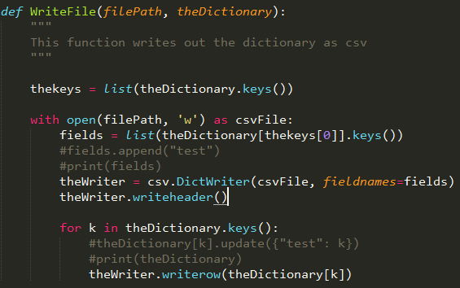
CSV Module
Very good module that is incredibly and flexible and powerful
Tricky at times but you can write very generalizable code

Slide 33
Spatial Data Management Nightmare
A client gives you a geodatabase with important information on it. However, they don’t know the which shapefile or field has the important information. They think they might know the name of it if they saw it. How could you handle this?
Geodatabase:
  Shapefiles
    Each has different attributes

