Slide 1
Week 4
Python Code Structure
Files (Open & Close)
CSV Module

Slide 2
Code Structure
#modules
A collection of code that typically uses objects to perform a task
#functions
One or more statements that perform a task
#statements
A singular line of code

Slide 3
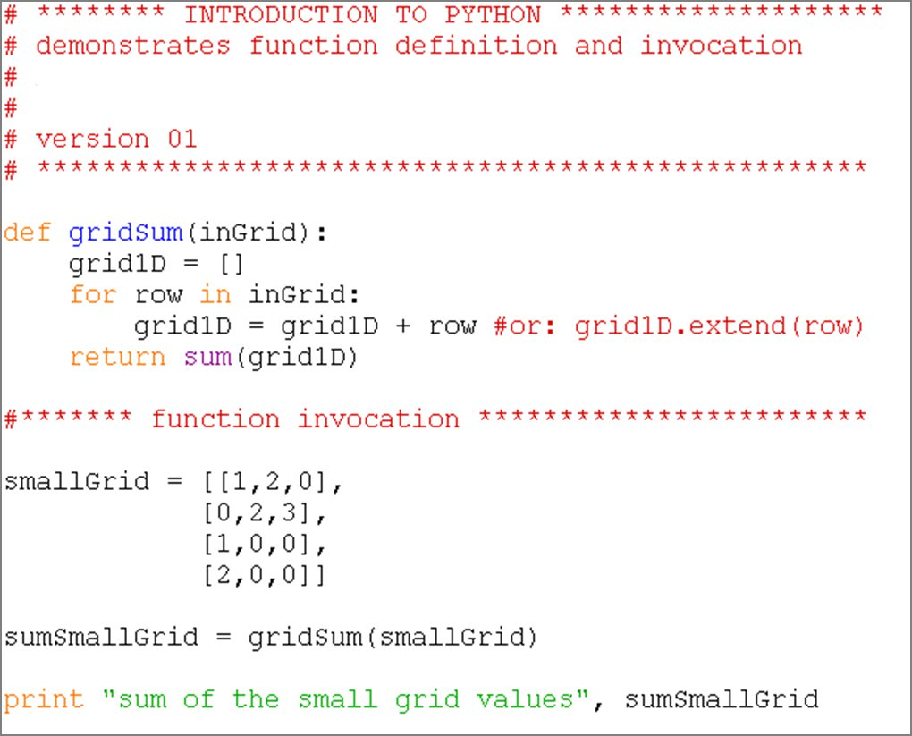
Basic script structure
Indentation: blocks of code
Value Assignment to a variable
Function invocation
Variable: data container
Statements: e.g. “if”, “print”
String text
Notes:
Demonstrate name.py

Slide 4
Files

Slide 5
File Management in Python
Write data to a file to store it permanently
Files are digital books:
  a book is a permanent repository of data
  to read a book, you have to open it
  either read from it or write in it
  when done, close it
open -> read / write -> close

Slide 6
Opening & Closing a file
Open a file: open
Close a file: close
There are a few things you can perform in between
Always close the file when done.
  Otherwise you may lose data
  Other programs will also not be able to access the file.

Slide 7
Opening & Closing a file
Open a file:
newfile = open(filepath,r/w)
Close a file:
newfile.close()
Always close the file when done.
Use ‘WITH’
The advantage of using a with statement is that it is guaranteed to close the file no matter how the nested block exits. If an exception occurs before the end of the block, it will close the file before the exception is caught by an outer exception handler. If the nested block were to contain a return statement, or a continue or break statement, the with statement would automatically close the file in those cases, too.

Slide 8
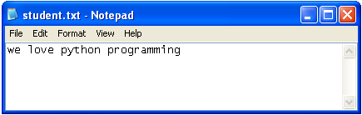
Opening a file for writing
If file does not exist, it will be automatically created
myFile = open(r“C:\work\student.txt", 'w')
#The default method when opening a file is “r”
myFile.write("we love python programming”)
myFile.close()
#If file exists, it will be overwritten

Slide 9
Python 2
Python 3
We had a string object that consisted of strings and bytes
The string object has been redefined, removing the bytes.
There is now a true bytes object.
If you want to write in binary you need to convert the information to the appropriate format.

Slide 10
CODE IT
f = open(r"C:\3D.txt", "w")
#your strings must have the new line character present
f.write("length\nheight\nwidth\n")
f.close()
# now open the file in windows...
# and now read back the content:

Slide 11
Code It
Exercise 1 (*.txt)
  aString : ‘your name’
  aVariable : Address = ‘your address’
  Write both items to a file
  Close the file
Exercise 2 (*.txt)
  Write a list of numbers (1,10001) with each number on a new line
  Write a list of numbers (1,10001) all on the same line
Exercise 3 (*.txt)
  Write a multiplication table (12x12) (tab or comma separated)

Slide 12
Python 2
Python 3
outFilePath = r"C:\work\outdata.csv"
dataset = [[1,1,1,1,1], [5,5,5,5,5], [3,3,3,3,3]]
with open(outFilePath, 'w') as outCSV:
for d in dataset:
print("This is the element %s" % (d) )
elementAsList = str(d)[1:-1]
print(elementAsList)
#This function only writes things that are strings.
#Format your string perfectly
outCSV.write( "%s\n" % (str(d)[1:-1]) )
outFilePath = r"C:\work\outdata4.csv"
dataset = [[1,1,1,1,1], [5,5,5,5,5], [3,3,3,3,3]]
with open(outFilePath, 'w', newline="\n") as outCSV:
for d in dataset:
print("This is the element %s" % (d) )
elementAsList = str(d)[1:-1]
print(elementAsList)
#This function only writes things that are strings.
#Format your string perfectly
outCSV.write( "%s\n" % (str(d)[1:-1]) )

Slide 13
CSV Module
Writing

Slide 14
Python 2
Python 3
#importing the CSV module
import csv
outFilePath = r"C:\work\outdata3.csv"
dataset = [[1,1,1,1,1], [5,5,5,5,5], [3,3,3,3,3]]
#On windows you need to specify the mode= 'wb'
#Or you will get irregular spacing
with open(outFilePath, 'wb') as outCSV:
theWriter = csv.writer(outCSV, delimiter=",")
for d in dataset:
print("This is the element %s" % (d) )
#This CSV module will write all of the elements in the list
#It will do all of your formatting, just get your data in a list format
theWriter.writerow(d)
#importing the CSV module
import csv
outFilePath = r"C:\work\outdata5.csv"
dataset = [[1,1,1,1,1], [5,5,5,5,5], [3,3,3,3,3]]
#If you choose the mode = 'wb' you must write a bytes object
#If you don't specify the newline option in Windows you get irregular spaces
with open(outFilePath, 'w', newline="\n" ) as outCSV:
theWriter = csv.writer(outCSV, delimiter=',')
for d in dataset:
print("This is the element %s" % (d) )
#This CSV module will write all of the elements in the list
#It will do all of your formatting, just get your data in a list format
theWriter.writerow(d)

Slide 15
Opening a file for reading
File for reading opens only if it exists, otherwise error
  myFile = open("student.dxt", 'r')
  Traceback (most recent call last):
  File "<interactive input>", line 1, in ?
  IOError: [Errno 2] No such file or directory: 'student.dxt'
There are several ways of reading a file
*.read() reads entire file
*.read(5) reads first five characters
*.readline() reads one line
*.readlines() reads all lines; puts them into a list of strings

Slide 16
Opening a file for reading
>>> myFile = open("student.txt", 'r')
>>> myFile.read()
'we love python‘
>>> myFile.read()
'‘ #??
Python “remembers” where you finished reading;
if end of file reached, returns an empty string

Slide 17
Standard
Alternative
f = open(r"C:\3D.txt", "r")
#data is lost
f.readlines()
['length\n', 'height\n', 'width\n']
f.close()
f = open(r"C:\3D.txt", "r")
#data is saved to var(content)
content = f.read()
f.close()
print(content)
length
height
width

Slide 18
Standardizd Reading
Python 2
Python 3
f = open(r"c:\work\outdata.csv", "r", newline='\n')
for line in f:
print(line)
f = open(r"c:\work\outdata.csv", "r", newline='\n')
for line in f:
print(line)

Slide 19
Reading data in a loop
Python 2
Python 3
theFilePath = r"c:\work\outdata.csv"
f = open(theFilePath)
dataset = f.read()
for d in f.read().splitlines():
print(d)
theFilePath = r"c:\work\outdata.csv"
f = open(theFilePath)
dataset = f.read()
for d in dataset.splitlines():
print(d)

Slide 20
CSV Module
Reading

Slide 21
Python 2
Python 3
#importing the CSV module
import csv
with open(r"c:\work\outdata5.csv", "rb") as fin:
#The mode "r" or "rb" doesn't matter
theCSV = csv.reader(fin, delimiter=',')
for line in theCSV:
print(line)
#importing the CSV module
import csv
outFilePath = r"C:\work\outdata5.csv"
with open(outFilePath "r") as fin:
theCSV = csv.reader(fin, delimiter=',')
for line in theCSV:
print(line)

Slide 22
CSV Module
List
  Writer
  Reader
Dictionary
  Writer
  Reader

Slide 23
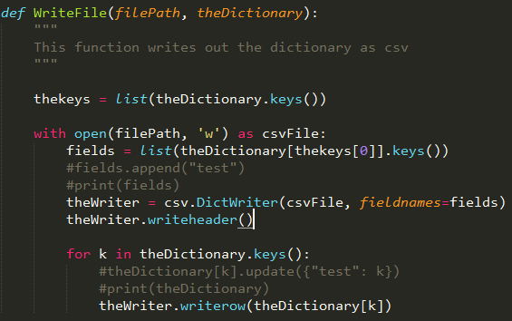
CSV Module
Very good module that is incredibly and flexible and powerful
Tricky at times but you can write very generalizable code

Slide 24
Spatial Data Management Nightmare
A client gives you a geodatabase with important information on it. However, they don’t know the which shapefile or field has the important information. They think they might know the name of it if they saw it. How could you handle this?
Geodatabase:
  Shapefiles
    Each has different attributes

