Slide 1
Modules
Lists and Numpy arrays

Slide 2
Recommended Python Libraries
Numpy
Scipy
Matplotlib
Rpy
GDAL/OGR
Pandas

Slide 3
Numpy
NumPy is the fundamental package needed for scientific computing with Python. It contains:
  a powerful N-dimensional array object
  sophisticated broadcasting functions
  basic linear algebra functions
  basic Fourier transforms
  sophisticated random number capabilities
  tools for integrating Fortran code.
  tools for integrating C/C++ code.

Slide 4
SciPy
SciPy (pronounced "Sigh Pie") is open-source software for mathematics, science, and engineering. The SciPy library depends on NumPy, which provides convenient and fast N-dimensional array manipulation. The SciPy library is built to work with NumPy arrays, and provides many user-friendly and efficient numerical routines such as routines for numerical integration and optimization. Together, they run on all popular operating systems, are quick to install, and are free of charge. NumPy and SciPy are easy to use, but powerful enough to be depended upon by some of the world's leading scientists and engineers. If you need to manipulate numbers on a computer and display or publish the results, give SciPy a try!

Slide 5
Matplotlib
matplotlib is a python 2D plotting library which produces publication quality figures in a variety of hardcopy formats and interactive environments across platforms. matplotlib can be used in python scripts, the python and ipython shell, web application servers, and six graphical user interface toolkits. Matplotlib tries to make easy things easy and hard things possible. You can generate plots, histograms, power spectra, bar charts, error charts, scatterplots, etc, with just a few lines of code.

Slide 6
Rpy
RPy is a simple, easy-to-use interface to R from Python. It enables one to enjoy the elegance of Python programming while having access to the rich graphical and statistical capabilities of R.

Slide 7
Pandas
In computer programming, pandas is a software library written for the Python programming language for data manipulation and analysis. In particular, it offers data structures and operations for manipulating numerical tables and time series. The name is derived from the term "panel data", an econometrics term for multidimensional, structured data sets.

Slide 8
Python Geoprocessing Libraries
https://pythongisresources.wordpress.com/
OSGEO:
  Geographic Data Abstraction Library (GDAL)
  OGR
Shapely | GeoPandas
Fiona (vector) / Rasterio (raster)
Karta
Pysal
PyGeoprocessing
Pyscopg2 | SQLAlchemy2

Slide 9
OSGEO
Geospatial Data Abstraction Library (GDAL/OGR) is a cross platform C++ translator library for raster and vector geospatial data formats that is released under an X/MIT style Open Source license by the Open Source Geospatial Foundation. As a library, it presents a single abstract data model to the calling application for all supported formats. It also comes with a variety of useful commandline utilities for data translation and processing.
GDAL supports over 50 raster formats, and OGR over 20 vector formats.
It provides the primary data access engine for many applications including MapServer, GRASS, QGIS, and OpenEV. It is also utilized by packages such as OSSIM, Cadcorp SIS, FME, Google Earth, VTP, Thuban, ILWIS, MapGuide and ArcGIS. GDAL/OGR is the most widely used geospatial data access library.

Slide 10
Pysal
PySAL grew out of a collaborative effort between Luc Anselin’s group previously located at the University of Illinois, Champaign-Urbana, and Serge Rey who was at San Diego State University.
The project developed when Python was starting to make major inroads in geographic information systems as represented by projects such as the Python Cartographic Library, Shapely and ESRI’s adoption of Python as a scripting language, among others. At the same time there was a dearth of Python modules for spatial statistics, spatial econometrics, location modeling and other areas of spatial analysis, and the role for PySAL was then expanded beyond its support of STARS and GeoDaSpace to provide a library of core spatial analytical functions that could support the next generation of spatial analysis applications.

Slide 11
Lists

Slide 12
Lists == Rasters
Lists are the workhorse for fast analytics
Mutable, have indices, can be sliced
Mylist = []
Methods
  Reverse, sort, insert, extend, append

Slide 13
Python built in operators
min([list])
max([list])
sum([list])

Slide 14
Code Example
Create a list of numbers
Sum the numbers in your list
sum = 0
for x in mylist:
sum = sum + x
Write code to determine these others: maximum, minimum, mean

Slide 15

Numeric Python: numpy
Third party module for fast management of multidimensional data
Source: http://numpy.scipy.org/

Slide 16
Numpy
Numpy is a module
A module (library) is a collection of statements, functions or objects that carry out specific tasks.
Generally modules are generalized pieces of code
  Functions
  Objects

Slide 17
Accessing modules
To access the statement in the module you need to import it
import numpy
Modules when being imported can be name space saved using as.
It is important to keep with standard convention on name space saving of a module.
import numpy as np
Notes:
10

Slide 18
Numpy is arrays
Basic numpy data structure: array
Array: multidimensional container of homogenous data
No mixing of data types allowed
More efficient than standard Python data types for very large grids
Notes:
12
Script: numpy_time.py

Slide 19
Array
Array objects must be full
  no empty cells
NDIM
  Number of dimensions
SIZE
  Total number of elements
SHAPE
  Number of dimensions and the extent of each of the dimensions

Slide 20
Code It
#Import numpy
import numpy as np
#Create an array
npArray = Np.array([3,9,1,6,8])
#Create a list
myList = [3,9,1,6,8]
#Create an array from a list
newArray = np.array(mylist)
#Create a list from a numpy array
newList = list(new_array)

Slide 21
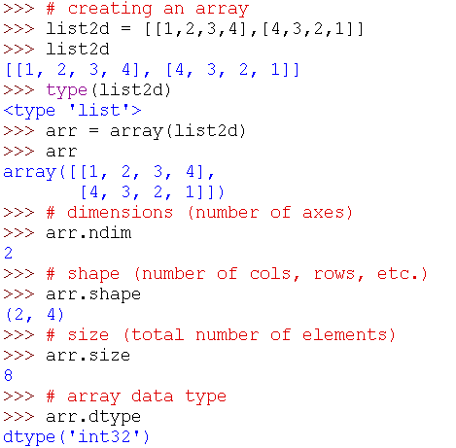
The Array Object

Slide 22
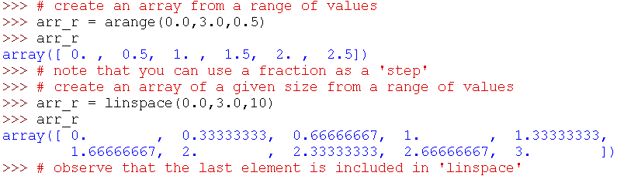
arange (numpy’s range)

Slide 23
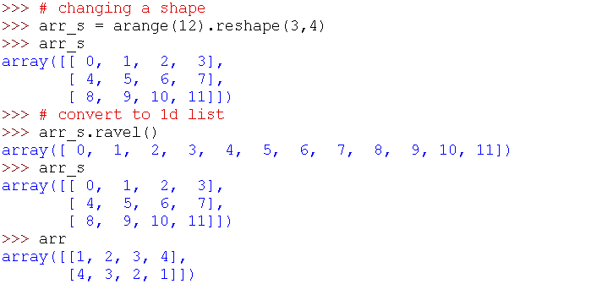
Reshaping Arrays

Slide 24
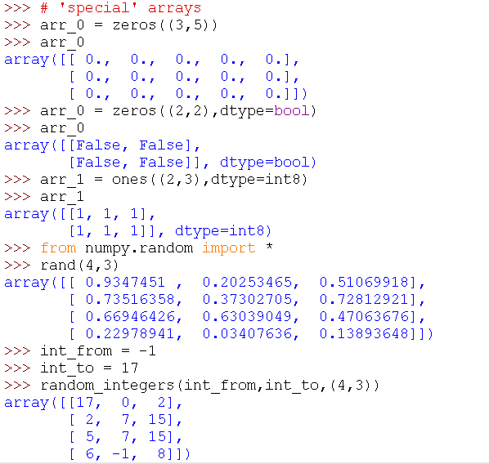
Special Arrays

Slide 25
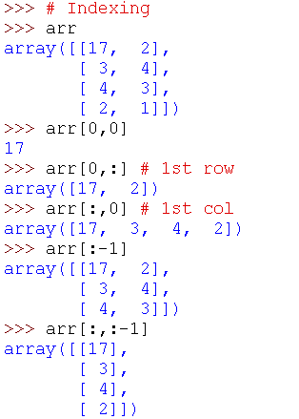
Mulidimensional Indexing

Slide 26
Multidimensional Indexing with list
newlist = [[17,2],[3,4],[4,3],[2,8]]
Newlist [0][0]
Newlist[0][:]
  Return row
Newlist[:][0]
  Not what you want
For i , j in enumerate(newlist):
  Print newlist[i][0]

Slide 27
Numpy can do so much
Array algebra
Matrix algebra
Numpy does Fortran
Numpy can iterate
Numpy does comprehension

