Slide 1
Object Orientated Programming
Part 1 – the Introduction

Slide 2
Modules
Class
Functions
Statements

Slide 3
Module
Pre-existing Class or functions that another person has created

Slide 4
Modules
Import sys, os
What is in the sys module?
  dir(sys)
  Sys.version # gives you the version of python
  Sys.path # gives you the path
  dir(os)
  Os.remove() # Removes files
  Os.rename() # Renames files

Slide 5
Code It
Create a module
Create a function called response
def response(theName):
print("Hello %s" % (theName,))
Save it as greeting.py
Remember the path “C:\work\greeting.py”

Slide 6
Code It, monkey patching
If you have a library that you want to load.
import sys
sys.path.append(r”c:\work”)
import greeting
response(“Jasmine”)

Slide 7
What did you do?

Slide 8
Function Structure
Function is a named sequence of statements that performs a desired operation.
This operation is specified in a function definition.
def add_the_values(parameter1,parameter2,…):
statement1
statement2
return
keyword
Function_name
Variable names
Return is optional

Slide 9
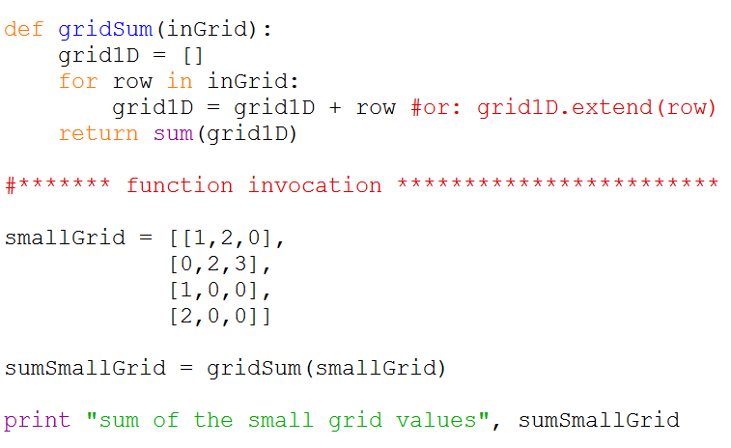
User-defined function: example

Slide 10
Purpose of Object Orientated Programming
Encapsulation
Data Abstraction
Polymorphism
Inheritance

Slide 11
Why use OOP
Two key OOP concepts
  Duplicate code is a Bad Thing.
  Code will always be changed.
Aside from small "throw-away" programs that are written for some single task and only run once, you'll almost always need to update your code to either fix bugs or add new features. A large part of writing good software is writing software that is readable and easy to change.
If you have copy/pasted code in your program, changing it requires making the same change to multiple places in your program. This is problematic. If you miss applying the change to some places, you'll fail to fix the bug everywhere or implement the new feature inconsistently. Duplicate code is a Bad Thing. Having duplicate code in your program is setting yourself up for bugs and headache.
Functions let you get rid of duplicate code. You write the code in a function once, and just call the function everywhere your program needs that code run. Updating the function's code updates it everywhere the function is called automatically. Just as functions makes updating code easier, using object-oriented programming techniques also organizes your code to make changes easier. Code will always be changed.

Slide 12
Python OOP
Python is an object-oriented programming language, which means it manipulates programming constructs called objects. You can think of an object as a single data structure that contains data as well as functions; functions of objects are called methods.

Slide 13
Code It!
Create a class in your greeting module
class response(object):
def __int__():
pass
def HappyResponse(theName):
print("Nice to meet you %s")
def SadResponse(theName):
print("Please don't talk to me %s")

Slide 14
Code It -- continued
If you have a library that you want to load.
import sys
sys.path.append(r”c:\work”)
import greeting
newgreetings.greeting()
newgreetings.HappyResponse(“Marc”)

Slide 15
Variable Scope
A scope is a region of the program, where variables can be declared and referenced.
One example is: an Inside function block variables named in this area can only be referenced within the function.
Types of variables
  Local variables
  Global variables

