Slide 1
Object Oriented
Part 2

Slide 2
Object Orientated Programming
Code composed of self-contained programs, objects
Objects represent entities/concepts (e.g. parcel lot, census tract, resident, watershed, weather)
Objects have structured body (i.e., attributes); perform actions through functions--methods
Functionality built bottom-up; objects as building blocks with interrelationships

Slide 3
The chicken and the egg
To create an object, we need a class
A class is an object template (aka blueprint, specification)
To create an object:
instantiate the class (i.e., call the ‘constructor’ function)
fill data into attribute slots (parameters of the constructor)
assign returned object to a variable
Invoke (i.e., use) object

Slide 4
Objects and classes
Class:Dog
-------------------
Attributes:
name
breed
age
weight
-------------------
Methods:
guard(object)
wag_tail()
bark()
sit()

Slide 5
Defining classes in Script
Initialization with coordinates
class Point():
def __init__(self, x_in, y_in):
self.x = x_in
self.y = y_in
#---------- invocation --------
pointOne = Point(100.00, 200.00)
print pointOne
print pointOne.x
print pointOne.y
<__main__.Point instance at 01236104>
100.0
200.0

Slide 6
Defining classes in IDLE
No initialization; empty class
class Point():
pass
#---------- invocation --------
pointOne = Point()
pointOne.x = 100.00
pointOne.y = 200.00
print pointOne
print pointOne.x
print pointOne.y
<__main__.Point instance at 0123612C>
100.0
200.0
Notes:
pass: (empty blocks are illegal in python, does nothing, placeholder for future code)

Slide 7
Defining a class
Python 2
Python 3
class Point():
def __init__(self, x_in, y_in):
self.x = x_in
self.y = y_in
def __str__(self):
pass
p = Point(2,1)
dir(p)
['__doc__', '__init__', '__module__', '__str__', 'x', 'y']
class Point(object):
def __init__(self, x_in, y_in):
self.x = x_in
self.y = y_in
def __str__(self):
pass
p = Point(2,3)
dir(p)
['__class__', '__delattr__', '__dict__', '__doc__', '__format__', '__getattribute__', '__hash__', '__init__', '__module__', '__new__', '__reduce__', '__reduce_ex__', '__repr__', '__setattr__', '__sizeof__', '__str__', '__subclasshook__', '__weakref__', 'x', 'y']

Slide 8
Extra Built In Class Methods
def __init__(self,):
Initiates the class object
#Many of these come with python now
__del__
Deletes the class object
__str__
String representation of the class object
__repr__
Representation of the class object

Slide 9
Extra Built-IN Class Methods
Initialization with coordinates & overriding default __str__ function
class Point(object):
def __init__(self, x_in, y_in):
self.x = x_in
self.y = y_in
def __str__(self):
return "Point at (" + str(self.x) + "," + str(self.y) + ")"
#return "Point at (%.2f,%.2f)" %(self.x, self.y)
#---------- invocation ----------
pointOne = Point(100.00, 200.00)
print pointOne
print pointOne.x
print pointOne.y
Point at (100.00,200.00)
100.0
200.0
NOTE: __str__ defines a string that
describes the object; is invoked
when using print objectName

Slide 10
Defining A Class Method
Initialization with coordinates, optional arguments (default values)
class Point():
def __init__(self, x_in = 0, y_in = 0):
self.x = x_in
self.y = y_in
def __str__(self):
return "Point at (" + str(self.x) + "," + str(self.y) + ")"
#---------- invocation ----------
pointOne = Point()
pointTwo = Point(100)
pointThree = Point(200,300)
pointFour = Point(y = 400)
Default values at initiation
Customized __str__
Point at (0.00,0.00)
Point at (100.00,0.00)
Point at (200.00,300.00)
Point at (0.00,400.00)

Slide 11
Compare Functions to Class methods
class Point():
def __init__(self,x,y):
#Assigning the x and y values to the object
self.x = x
self.y = y
def __str__(self,):
outString = "Point location is %s,%s" % (self.x, self.y)
return outString
def printPoint(x,y):
print("Point location is %s, %s” % (x,y))

Slide 12
Functions v Class-methods
A function as a method in a class
The dot notation
class Point():
def __init__(self, x_in = 0, y_in = 0,):
self.x = x_in
self.y = y_in
def __str__(self):
return "Point at (%.2f,%.2f)" %(self.x, self.y)
def printPoint(self):
print "Point name: ", self.name
print self
#---------- invocation ----------
pointOne = Point(200,300)
pointOne.printPoint()
pointTwo.printPoint()
Point name: None
Point at (200.00,300.00)
Point name: San Diego
Point at (0.00,0.00)

Slide 13
Build a GIS
What are the basic elements of a GIS
Points
Lines
Polygons
Rasters

Slide 14
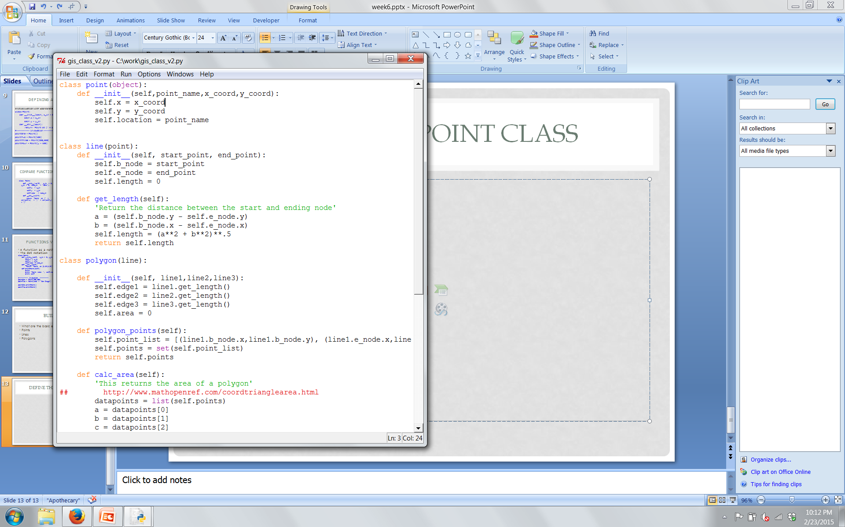
Define the Point Class
Define the class name
How should it be initialized
# of points?
Add name attribute (optional)

Slide 15
2 Points make a Line
Define a new class “Line” that is made up of class point.
Use inheritance to assign the methods of point to line.
Add a method to determine the length of the line

Slide 16
Class Line (SuperClass of point)

Slide 17
3 lines make a Polygon
Create a new class called polygon, that requires 3 line parameters.
The polygon should know how long each of its sides are.

Slide 18
Class polygon Inherits from Line

Slide 19
Determine the Polygon’s Area

