Slide 1
Object Oriented Programmig
Part 2

Slide 2
Basics of Object Orientated Programming
To create an object, we need a class
A class is an object template (aka blueprint, specification)
To create an object:
  instantiate the class (i.e., call the ‘constructor’ function)
  fill data into attribute slots (parameters of the constructor)
  assign returned object to a variable
Invoke (i.e., use) object

Slide 3
Objects and classes
Class:Dog
-------------------
Attributes:
  name
  breed
  age
  weight
-------------------
Methods:
  guard(object)
  wag_tail()
  bark()
  sit()

Slide 4
Build a GIS
What are the basic elements of a GIS
Vector
  Points
  Lines
  Polygons
Rasters
  Pixel

Slide 5
Define the Point Class
Define the class name
How should it be initialized
  # of points?
  Add name attribute (optional)

Slide 6
Class - point
class Point(object):
def __init__(self,x,y):
self.x = x
self.y = y
def __str__():
""" This returns the string representation of the point """
return "X:%s , Y:%s" % (self.x, self.y)
def SetName(self,theName):
""" This function sets the name of the point """
self.name = theName
def ChangeXValue(self, x):
self.x = x
self.PrintXYLocation()
def PrintXYLocation(self):
""" This is a function """
print(self.x, self.y)

Slide 7
2 Points make a Line
Define a new class “Line” that is made up of class point.
Use inheritance to assign the methods of point to line.
Add a method to determine the length of the line

Slide 8
Class - line
class Line(object):
def __init__(self,start,end):
self.start = start
self.end = end
self.CalcLength()
def CalcLength(self,):
X1 = self.start.x
X2 = self.end.x
Y1 = self.start.y
Y2 = self.end.y
#This formula calculates the hypotenuse for two points.
self.length = ((X2-X1)**2 + (Y2-Y1)**2)**.5
return self.length

Slide 9
3 lines make a Polygon
Create a new class called polygon, that requires 3 line parameters.
The polygon should know how long each of its sides are.

Slide 10
Class - polygon
class Polygon(object):
def __init__(self, *args):
self.lineSegments = args
self.line1, self.line2, self.line3 = self.lineSegments
class Polygon(object):
def __init__(self, line1, line2, line3):
self.line1 = line1
self.line2 = line2
self.line3 = line3

Slide 11
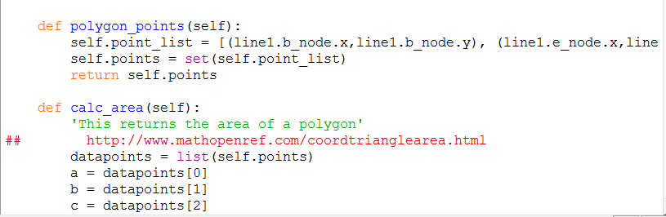
Determine the Polygon’s Area

Slide 12
Raster

Slide 13
Raster
What defines a raster
Starting x,y (Coordinate syste)
Rows & Columns - ?
Values - ?

Slide 14
Build a Raster class
class Raster(object):
def __init__(self, point, res, rows=10, cols=10):
"""
A nice doc string here
"""
if isinstance(point, Point):
self.point = point
self.x = self.point.x
self.y = self.point.y

Slide 15
Inheritance
The ability for a class to get all of the properties of another class.

Slide 16
DataRaster inheriting Raster
class DataRaster(Raster):
def __init__(self, point, res, dataset):
import numpy as np
self.data = np.array(dataset)
rows, cols = self.data.shape
#You only need 1 of these 2 lines below
#Raster.__init__(self,point, res, rows, cols)
#This is the new style ----
super().__init__(point, res, rows, cols)

Slide 17
Expand your class
Which functions from lab3 would be appropriate for your raster class
Add a function that allows a Raster to load a CSV.
Create a function that prompts the user to input every value for a raster they define.
Generalize your statistics functions

