Slide 1
Introduction to Programming with Arc

Slide 2
ArcObjects
The ArcObjects library consists of basic programming objects Esri has created to develop ArcGIS software. ArcObjects are made available to application developers as part of the ArcObjects .NET Software Development Kit (SDK) and the ArcObjects Java SDK.

Slide 3
What is ArcPy?
ArcPy: Python package; provides access to the 700+ tools in ArcToolbox (incl. extensions)
ArcPy contains:
- modules
- classes
- functions
for working with and querying GIS data

Slide 4
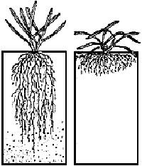
Which do I want to use
ArcObjects
ArcPy
Low level language (.NET) very fast
Building new applications
  New ArcGIS
User specific Applications
Spatial Data Objects
High Level Language
Build on applications on top of existing functionality
Integrate additional components
Data Manipulation

Slide 5
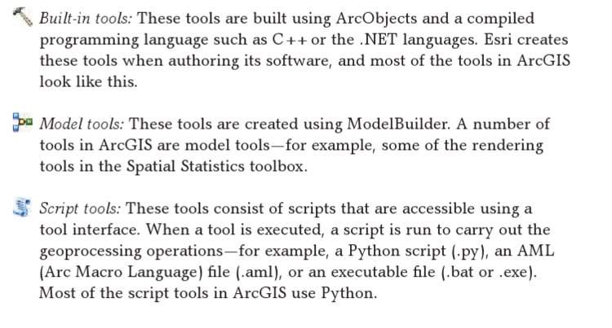
Options Available for Tools

Slide 6
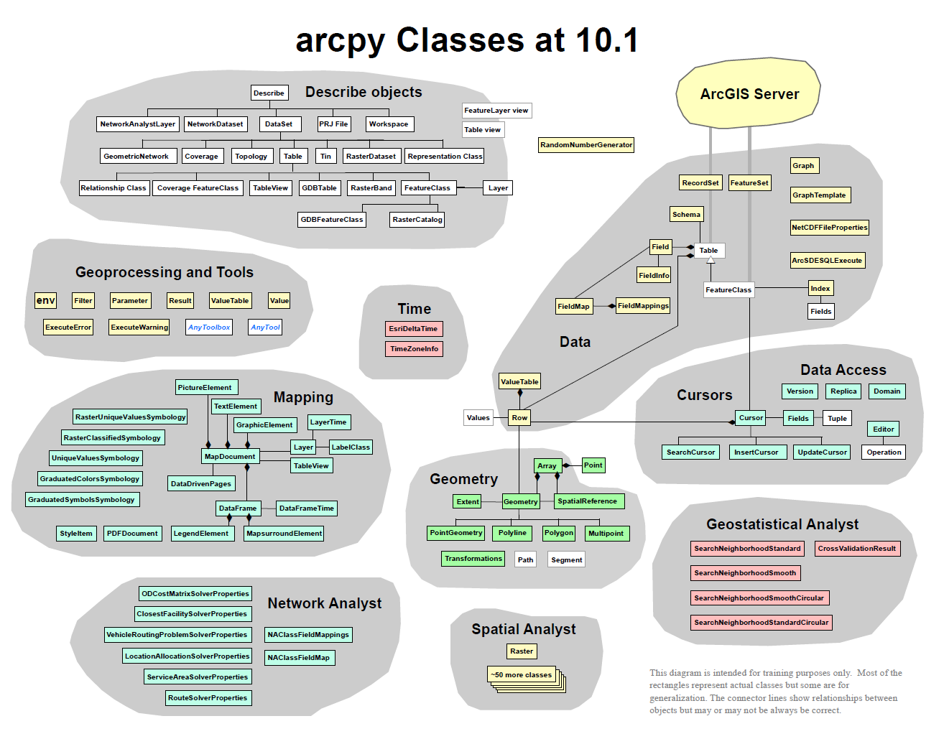

Slide 7
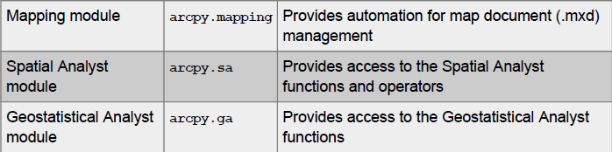
ArcPy Modules

Slide 8
Changes
ArcPro Modules Python 3
ArcMap Modules Python 2
'da', 'ddd', 'edit', 'env', 'fnf_exception', 'ga', 'geoanalytics', 'geocoding', 'geometries', 'geoprocessing', 'glob', 'gp', 'imp', 'import_local', 'locref', 'lr', 'management', 'md', 'mixins', 'mp', 'na', 'numpy', 'os', 'pass_parameterized_attr', 'passthrough_attr', 'pdfdocument', 'ra', 'reviewer', 'sa', 'server', 'sfa', 'stats', 'stpm', 'sys', 'time', 'toolbox', 'utils', 'warnings', 'winreg', 'wmx'
'arcobjectconversion', 'arcobjects', 'arcpy', 'cartography', 'conversion', 'convertArcObjectToPythonObject', 'da', 'ddd', 'edit', 'env', 'f', 'fabric', 'ga', 'geocoding', 'geometries', 'geoprocessing', 'glob', 'gp', 'imp', 'import_local', 'interop', 'lr', 'management', 'mapping', 'md', 'mixins', 'na', 'numpy', 'os', 'passthrough_attr', 'sa', 'schematics', 'server', 'stats', 'stpm', 'sys', 'ta', 'time', 'toolbox', 'utils', 'warnings'

Slide 9
ArcPro – mapping module
Arcpy.mapping is now arcpy.mp
As you will see below, the changes introduced with ArcGIS Pro were significant enough to merit a module name space change. The new name also offers more flexibility in terms of the capabilities arcpy.mp can offer. For example, in addition to map automation, arcpy.mp can also provide project level management.

Slide 10
Accessing the mapping module
ArcPro – Python 3
ArcMap – Python 2
arcPRJ = arcpy.mp.ArcGISProject("Current")
maps = arcPRJ.listMaps('*')
mxd = arcpy.mapping.MapDocument("Current")
dataframes = arcpy.mapping.ListDataFrames(mxd, '*')

Slide 11
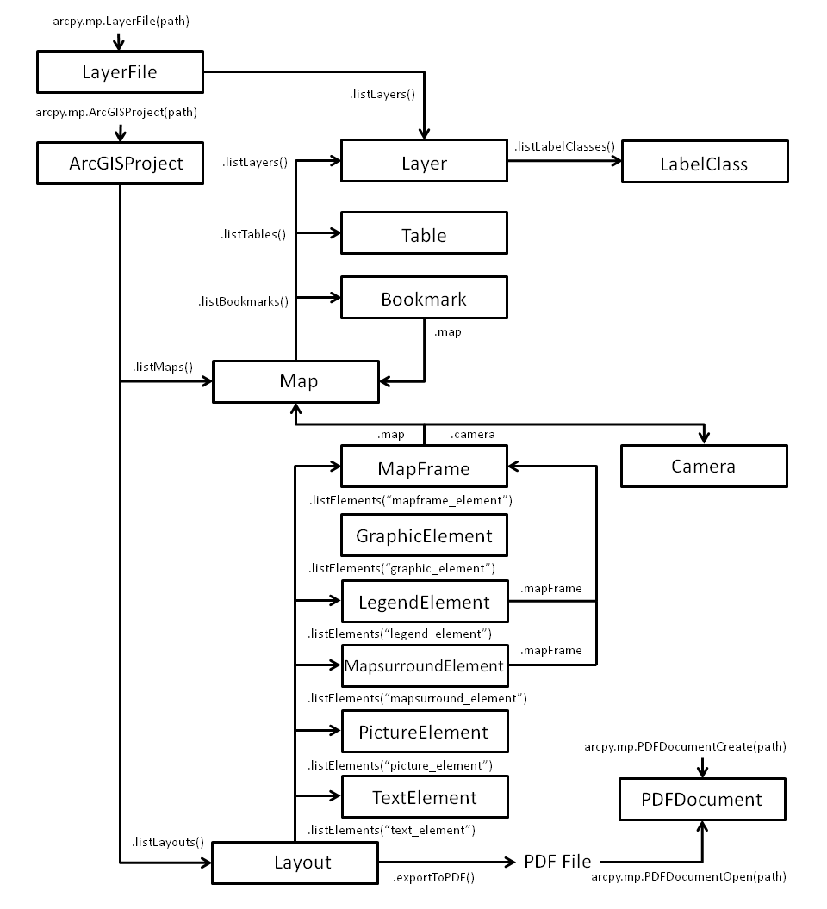

Slide 12
ArcPy Classes
ArcPy includes several classes (e.g., SpatialReference, ValueTable, and Point)
Once instantiated, properties and methods may be used
Classes have one or more constructors

Slide 13
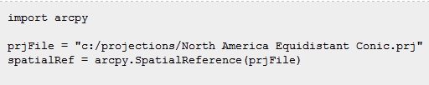
ArcPy Classes
Below, SpatialReference(prjFile) is the class constructor
Creates a spatialRef object by reading a projection file

Slide 14
ArcPy Functions
ALL tools are provided as functions
Not all functions are geoprocessing tools
Also functions for better geoprocessing workflows

Slide 15
ArcPy Functions
Take (optional or required) arguments, return something
Returned value of a non-tool function can be varied (e.g., string, integer, geoprocessing object)
Function returns a geoprocessing object
Also return result object and provide geoprocessing message support

Slide 16
ArcPy Objects / Classes
Cursor
Exceptions
FeatureSets and RecordSets
Fields
General
Geometry
Geostatistical Analyst
Parameter
http://pro.arcgis.com/en/pro-app/arcpy/classes

Slide 17
BREAK

Slide 18
Non-Tool Functions in ArcPy
ArcPy has properties and methods that are not standard tools nor environment settings
    arcpy.Exists()
    arcpy.Usage()
    arcpy.AddMessage()

Slide 19
Does my data exist?
Operating system
ArcPy
Myfile = r”c:\somefile.txt”
import os
if os.path.exists(myfile):
print(myfile)
os.remove(myfile)
import arcpy
theDirectory = r”c:\work”
arcpy.env = theDirectory
arcpy.Exists(“Roads”)
arcpy.overwriteOutput = True

Slide 20
Usage
import arcpy
help(arcpy.env.overwriteOutput)
import arcpy
arcpy.Usage(arcpy.overwriteOutput)

Slide 21
Toolboxes → Modules
Data Management Tools —> management
Analysis Tools —> analysis
Conversion Tools —> conversion
Coverage Tools —> arc
Spatial Analyst Tools —> sa
3D Analyst Tools —> 3d
Spatial Statistics Tools —> stats
Notes:
Why use aliases? Different toolboxes can have the same tool names (‘clip’ in Coverage tools and in Analysis tools) – ArcGIS needs to know which ‘clip’ to use.
21

Slide 22
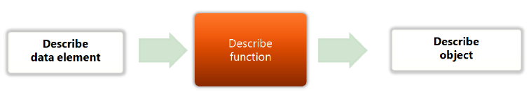
Describe function in ArcPy
Describe returns Describe object
Contains descriptive properties (e.g. folder, geodatabase, feature class, table, raster, layer file)

Slide 23
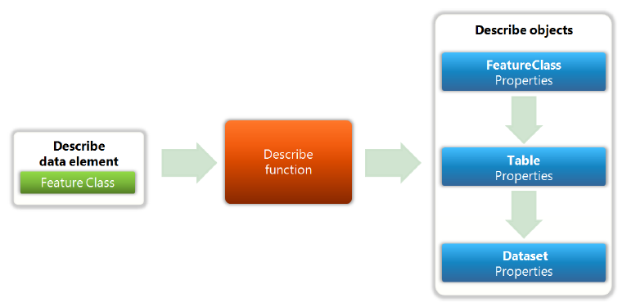
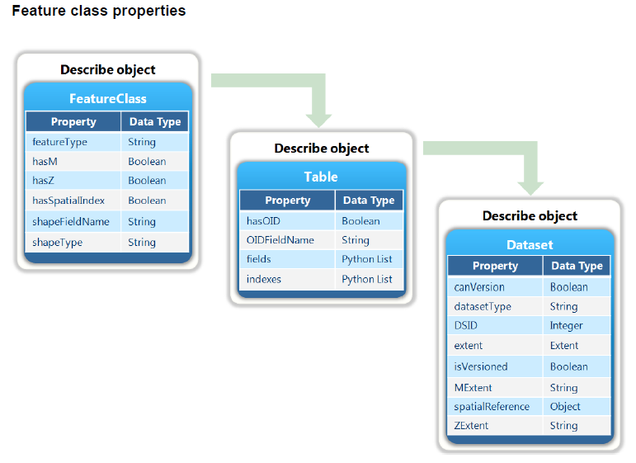
Describe: feature class

Slide 24
Code it!
import arcpy
arcpy.env.workspace = “C:/yourfolderhere/”
dscFC = arcpy.Describe(“us_county”)
print “Shape Type: “ + dscFC._____
print “Feature Type: “ + dscFC._____
print “Extent: “ + __________

Slide 25
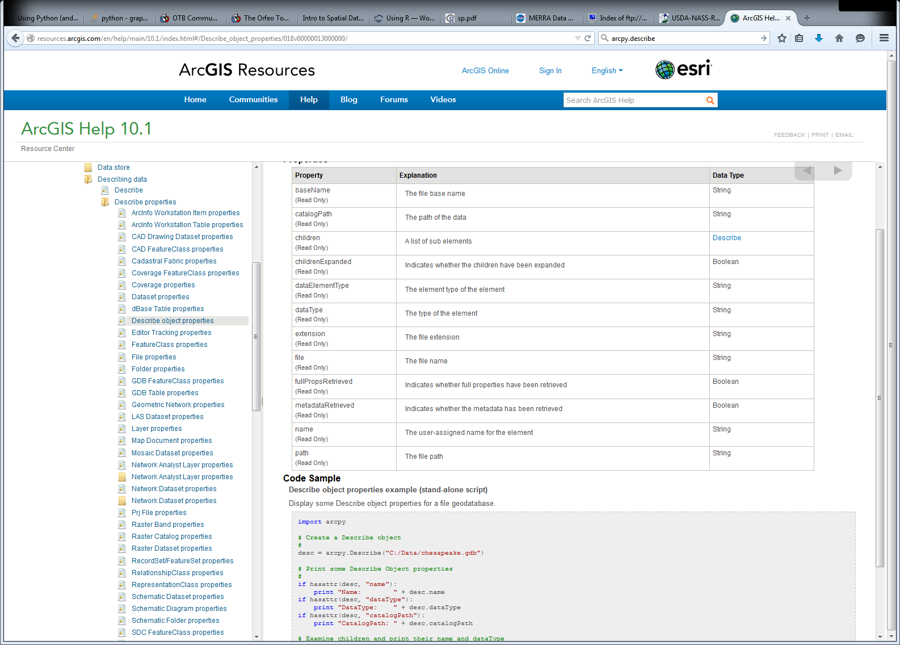
Describe Properties

Slide 26
List feature class example
ListFeatureClasses ({wild_card}, {feature_type}, {feature_dataset})
arcpy.env.workspace
fcList = arcpy.ListFeatureClasses(“*”,“All”)
#Set to a new directory
env.workspace = r'C:\work\hmwk6\extra_shapefiles‘
#all feature classes
fcList = arcpy.ListFeatureClasses(“*”,“All”)
# what if?
fcList = arcpy.ListFeatureClasses(“*c*”, “polygon”)
Notes:
26

Slide 27
Iterating with ArcPy
Want to loop through each value
Do not know how many values are in list
For loop
from arcpy import env
fcList = arcpy.ListFeatureClasses(“*”, “Point”)
for fc in fcList:
arcpy.Buffer_analysis(fc, output, 500)
Notes:
27
You cannot use counted loop since the count is unknown

Slide 28
Data Analysis – Cursor Types
Search Cursor is used to retrieve rows
Insert Cursor is used to insert rows (create data)
Update Cursor is used to update and delete rows (delete data)

Slide 29
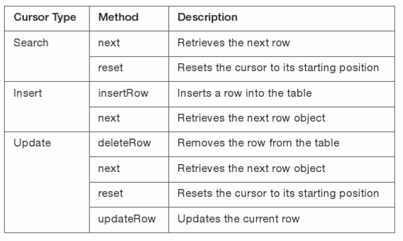
Cursors

Slide 30
With blocks for cursors
Cursor is defined concisely
If there is an error, the cursor always exits and releases arcpy locks
with arcpy.da.SearchCursor(aFeatureClass, listofFields) as cursor:
for rec in cursor:
#The variables rec is assigned to the first row in the shapefile database
print(rec)

