Slide 1

Installing PostgreSQL

Slide 2
Download PostgreSQL
PostgreSQL
  Version 16+
  https://www.postgresql.org/download/
PostGIS (OSX)
  https://postgis.net/install/

Slide 3
Setting up PostGIS (Windows)

Slide 4
Use stack builder
Ignore the versions on the graphics.
If anything doesn’t work. Remove completely and try install again.

Slide 5
Important Things
Install PostgreSQL on port 5432
Install the PostGIS extension 64bit (only install one version)
Create a spatial database
You can enable all of the GDAL Environment variables
user = postgres
password = postgres
Your connection to your local PostrgreSQL database will be
psql –d <database> -U <username>

Slide 6
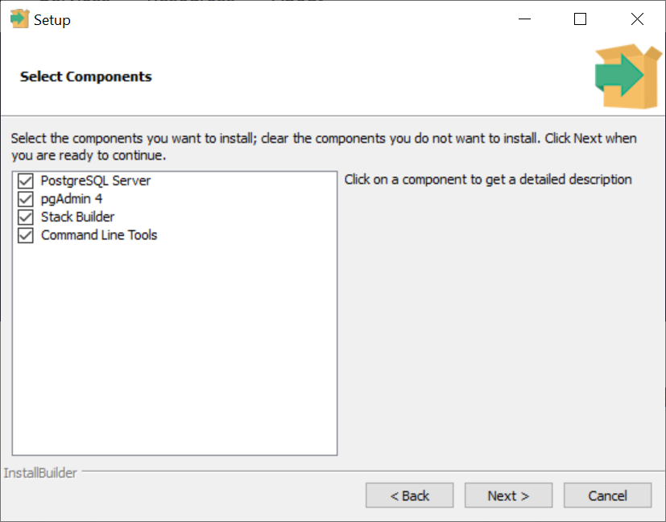
Choose your components

Slide 7
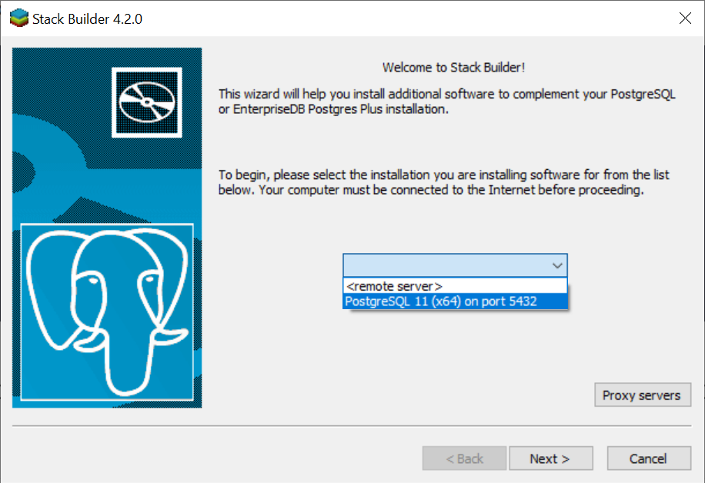
Stack Builder

Slide 8
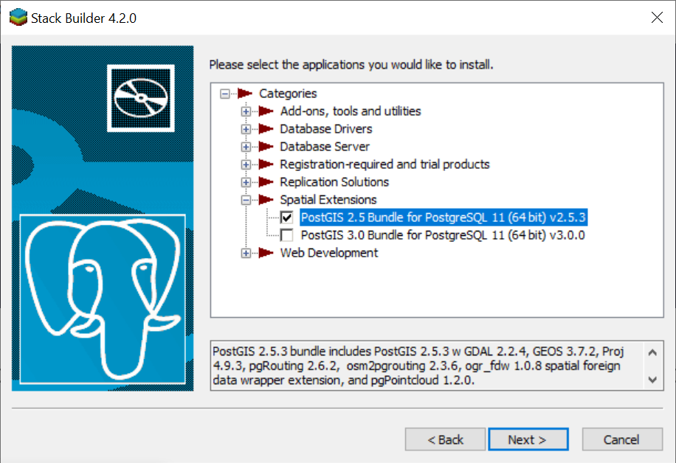
Add the PostGIS extension

Slide 9
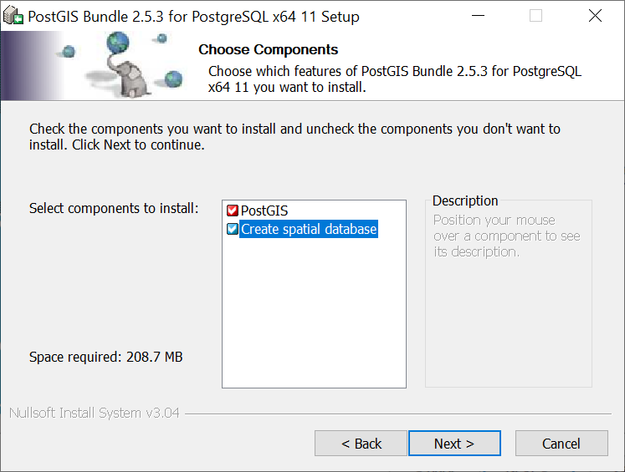
Create Spatial Database

Slide 10
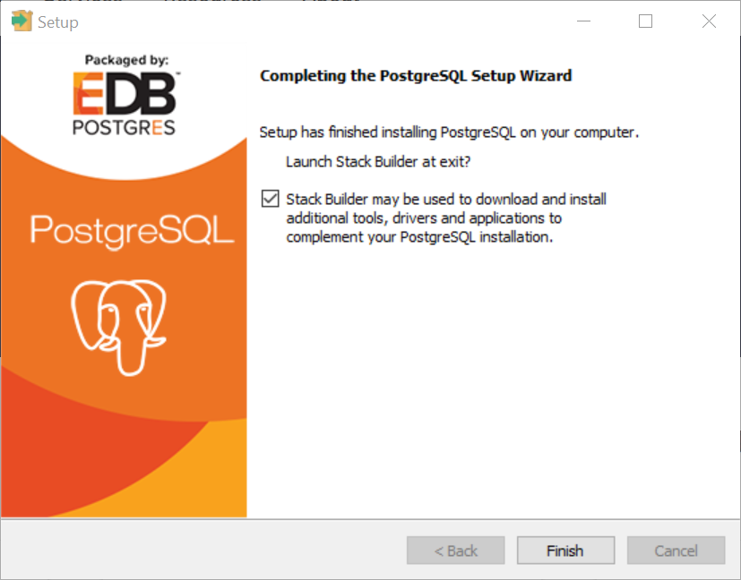
Complete

Slide 11
Setting up a (local) Database

Slide 12
Setting up a (local) Database
When you install PostgreSQL you will choose
User = postgres
Password = postgres
You can change the password but you want it to be something you will never forget.

Slide 13
Xsede Resources

Slide 14
Xsede resources
You have a user name and db that was created with these commands.
CREATE ROLE x500;
CREATE DATABASE x500;
ALTER ROLE x500; PASSWORD 'student'
Change your user password with
ALTER ROLE student PASSWORD 'newpassword'

Slide 15
Best practices for your own machine

Slide 16
Setting up your USER on your (local) machine
The postgres user is very powerful and shouldn’t be used for regular queries. Instead create your own local user and password.
The user(name) and database can have the same name
  You can always create additional databases with new names
CREATE ROLE myname with LOGIN, CREATEDB, CREATEROLE;
ALTER ROLE myname PASSWORD 'secret'
---- log out and login with your new account
CREATE DATABASE myname;

Slide 17
Enable PostGIS
Connect to your new (local) database
CREATE EXTENSION postgis; --for PostGIS v3.0+ PostGIS is just geometry
CREATE EXTENSIONS postgis_raster; --enables raster
See https://postgis.net/install/ for all the GIS related extensions you can install including geocoding. We have PostGIS already installed on Xsede.

Slide 18
SuperUser (optional)
To have full access on your new database cluster, you should provide the user with the superuser capabilities.
ALTER ROLE mysupername with SUPERUSER;
ALTER ROLE mysupername with CREATEDB CREATEROLE LOGIN;

Slide 19
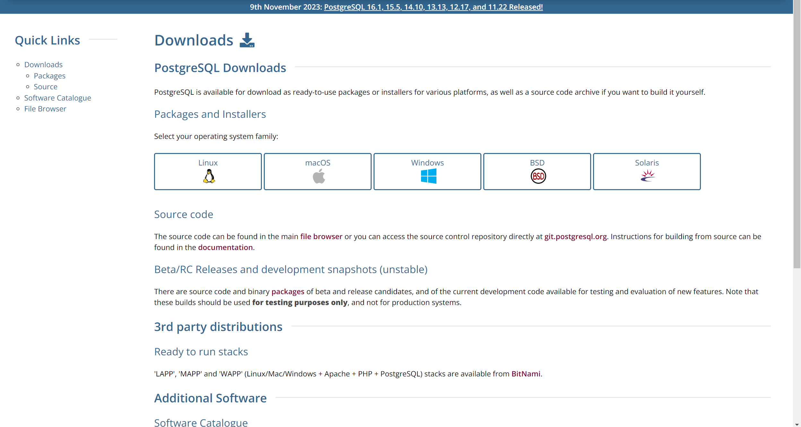
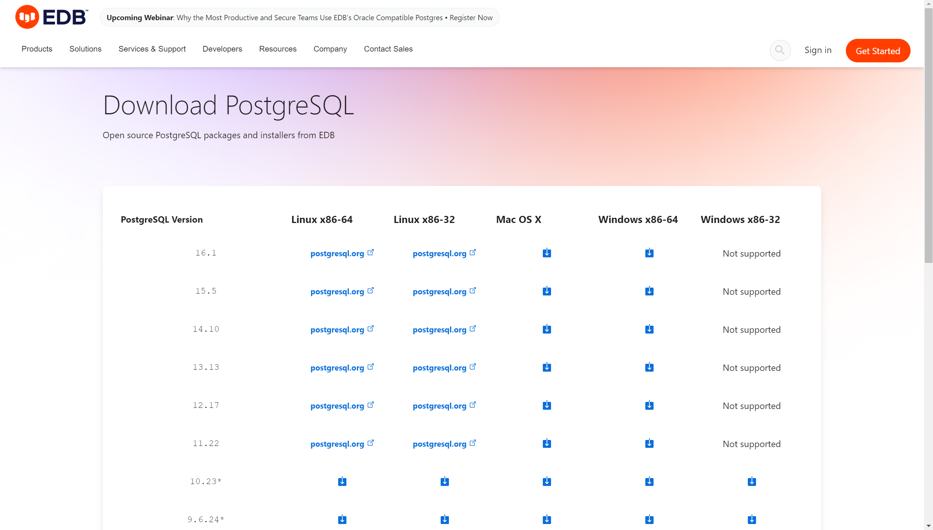
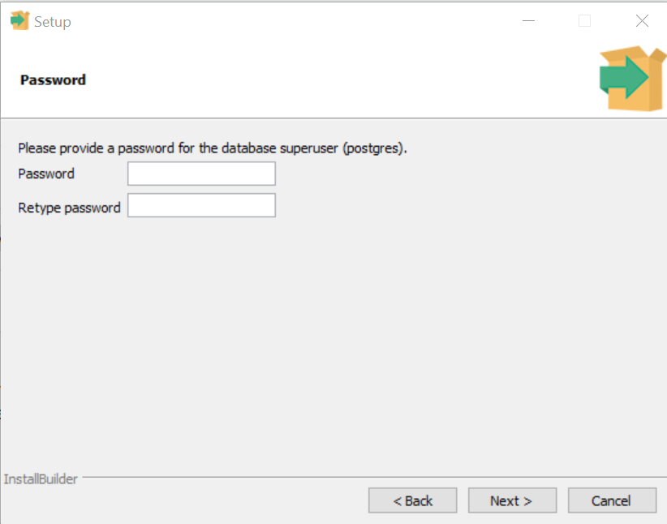
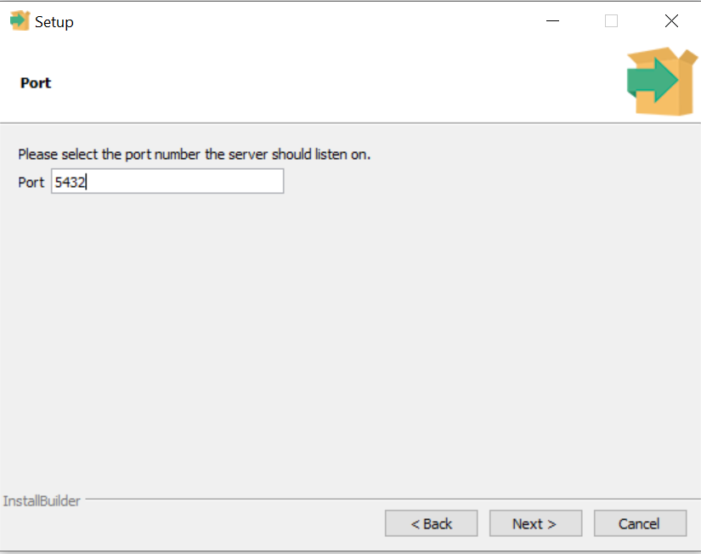
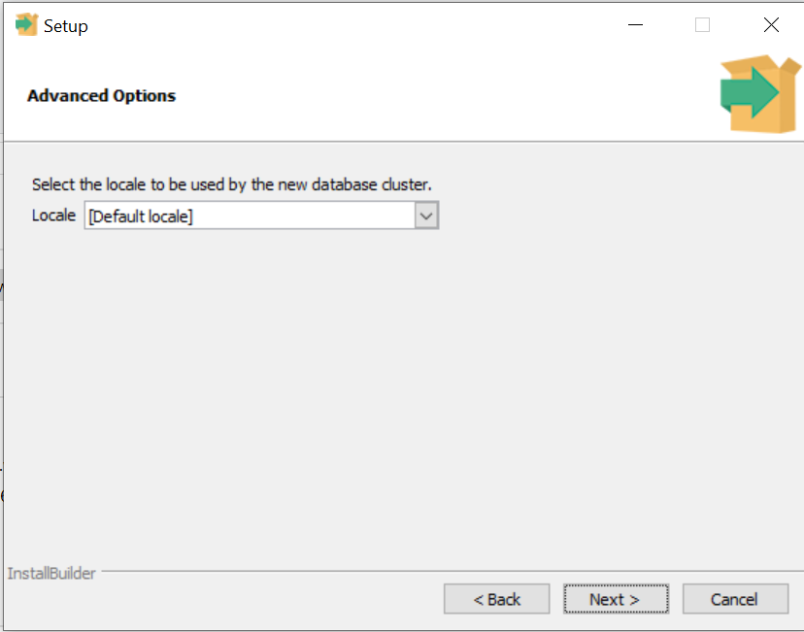
Windows 2024 – Screen shots

Slide 20
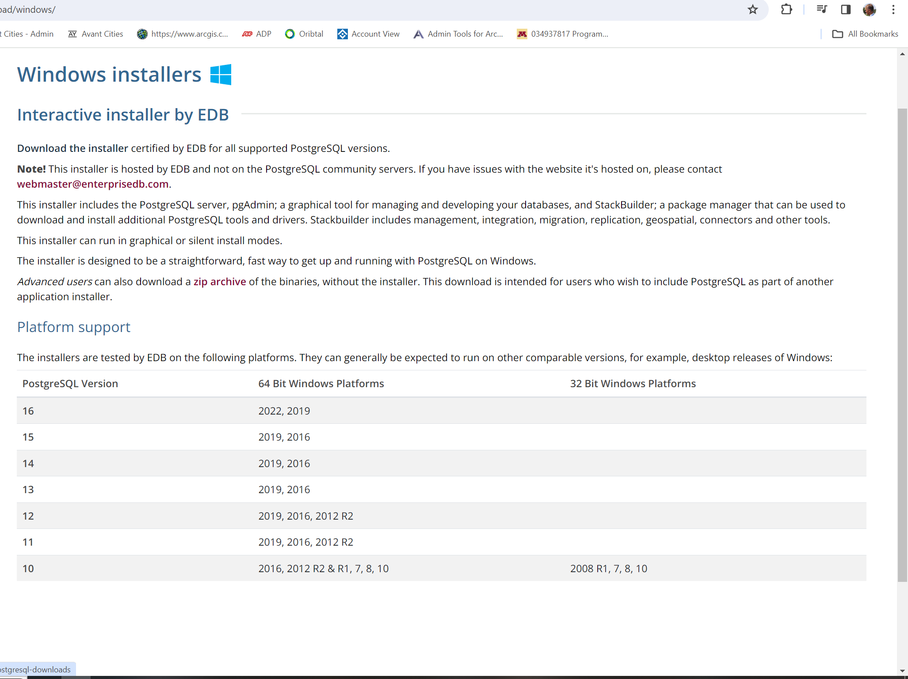
Install the most current version

Slide 21
My Suggestion
user = postgres
password = postgres

