Slide 1
Web Mapping

Slide 2
Web Mapping
What are the components of a web map?

Slide 3
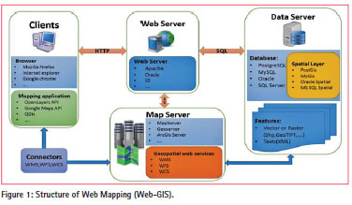
Web Mapping Components

Slide 4
Web Mapping Components
Web Mapping Libraries
  OpenLayers
  Leaflet
  Cesium
WebMap Server
  Arc Server
  Geo Server
Geospatial Datasets
  Arc Server
  PostgreSQL w/ PostGIS

Slide 5
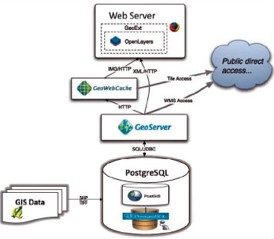
Open Source Web Mapping Components

Slide 6
WebGIS 2.0
History of web mapping
https://www.slideshare.net/stevenfeldman/history-of-web-mapping
Users can be interactive with the map
Users can submit spatial queries

Slide 7
What should you use
MapBox
Mapnik
MapServer**
  Created by the University of Minnesota
GeoServer
ArcServer

Slide 8
Cool web maps and visualizations
https://www.healthlandscape.org/
https://data.terrapop.org/terrascope
https://vizhub.healthdata.org/gbd-compare/
https://bl.ocks.org/syntagmatic/ba569633d51ebec6ec6e
https://bl.ocks.org/mbostock/3711652

Slide 9
Web Mapping

Slide 10

Know your Services
WFS
WMS
WCS

Slide 11
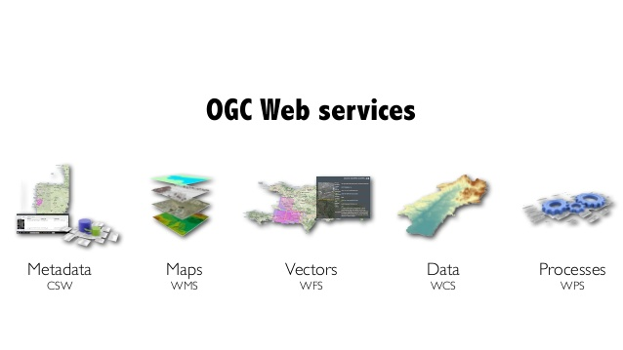
Web Geospatial Services

Slide 12
Web Processing Services
Standardizes the way we process and execute geospatial functions
  Publish – GetCapabilities, provides general information on the operations and access methods available.
  Describe – DescribeProcess, provide full description about a single WPS process. Including input and output parameters.
  Execute – ExcecuteProcess, processes the request based on the input parameters.

Slide 13
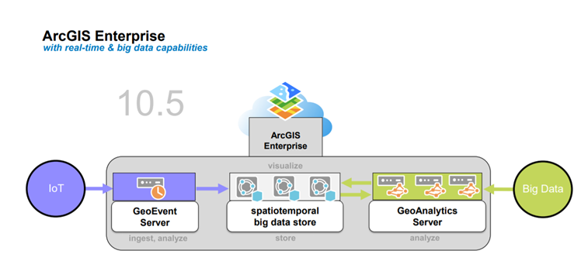
ArcGIS Enterprise
Spatiotemporal big data store

