Slide 1
Big Spatial Data

Slide 2
What is Big Data?

Slide 3
What is Big Data?
Volume
Variety
Velocity

Slide 4
What is big spatial data
Volume
  Raster Data
Velocity
  Location requests
  Movement data
Variety

Slide 5
Do we have problems?
Problems
  Loading large datasets?
  Indices
  Querying

Slide 6
Future big spatial data types
Think of data structures?
  Point cloud
  TIN
Analysis
  Modeling / Simulation
  Long tail questions

Slide 7
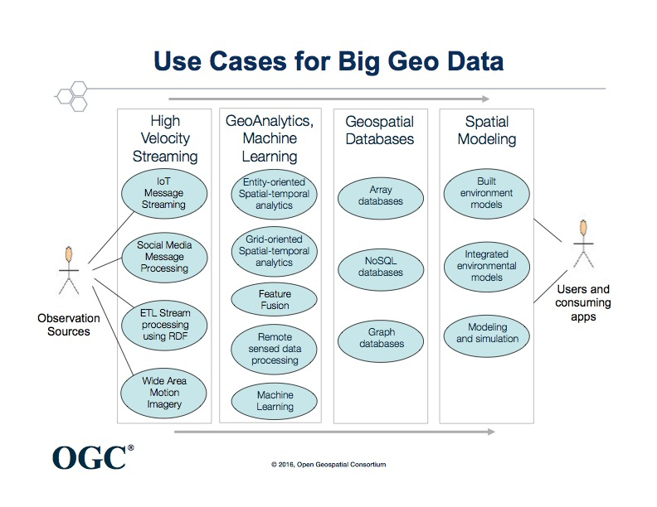

Slide 8



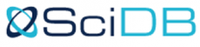
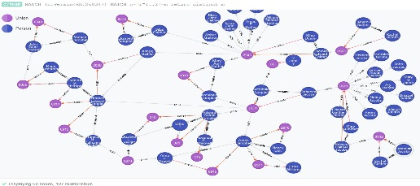
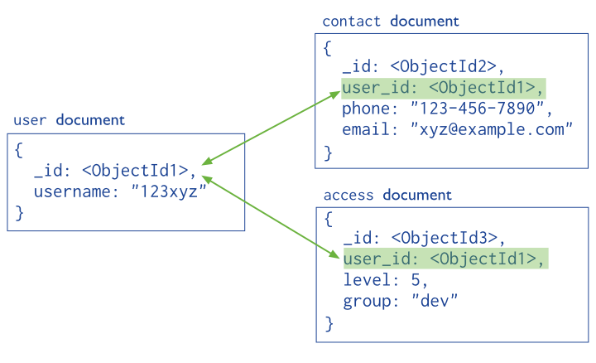
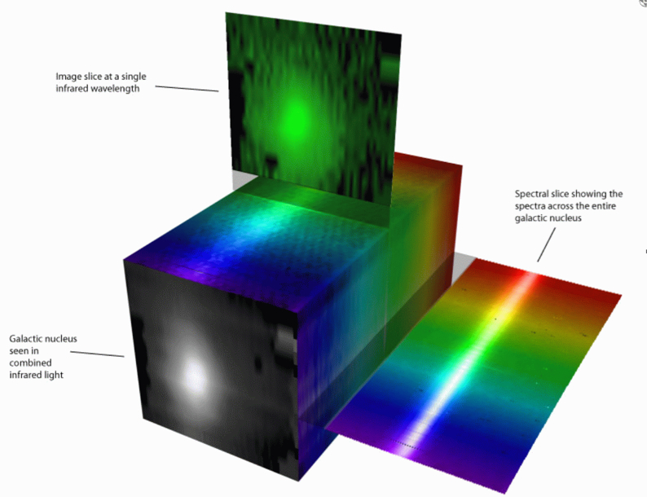
NoSQL Spatial Databases

Slide 9

Will PostgreSQL survive?

Slide 10

PostgreSQL & PostGIS
PostGIS Add-ons
  Geocoding
  Routing
  Point Cloud
PostgreSQL Extensions
  CitusDB
  AgensDB (Graph)

Slide 12
SQL vs NoSQL
SQL
NoSQL
Organized
Requires a consistent format
Indices
Uses a common standardized language
Structures are database dependent
No Indices
No common language

Slide 13
Videos
Graph
  https://www.youtube.com/watch?v=d-nxFHYsxN0
Raster
  https://www.youtube.com/watch?v=AYB5Sw80Vfs
MongoDB
  https://www.youtube.com/watch?v=yfMDCS_UOcw

