Slide 1
Web Mapping

Slide 2

Know your Services
WFS
WMS
WCS

Slide 3
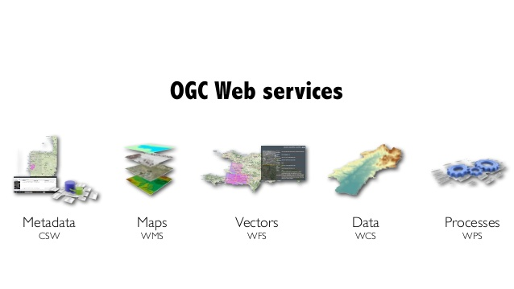
Web Geospatial Services

Slide 4
Web Processing Services
Standardizes the way we process and execute geospatial functions
  Publish – GetCapabilities, provides general information on the operations and access methods available.
  Describe – DescribeProcess, provide full description about a single WPS process. Including input and output parameters.
  Execute – ExcecuteProcess, processes the request based on the input parameters.

Slide 5
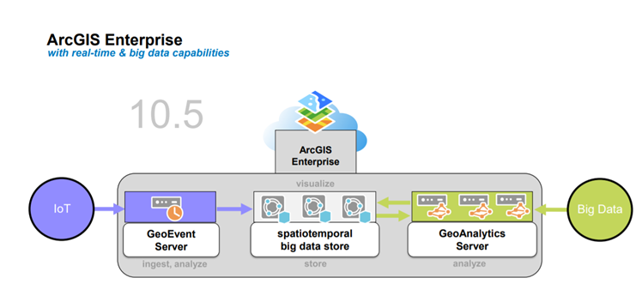
ArcGIS Enterprise
Spatiotemporal big data store

Slide 6
Video SpatioTemporal Data Store
https://youtu.be/sC875Mc2_-I

Slide 7
DEMO
How to host a geospatial service using ArcGIS Desktop

Slide 8
ArcGIS Desktop
Add Layers (shapefiles) to your map.
Style your map as necessary

Slide 9
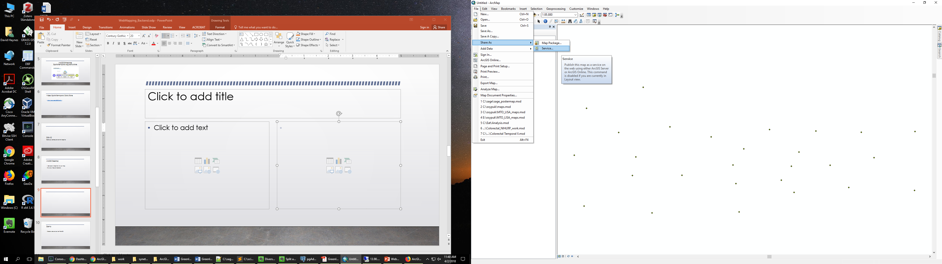
Create a Service
File -> Share As -> Service

Slide 10
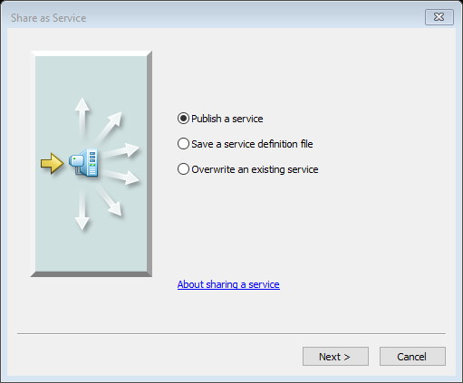
Publish a service

Slide 11
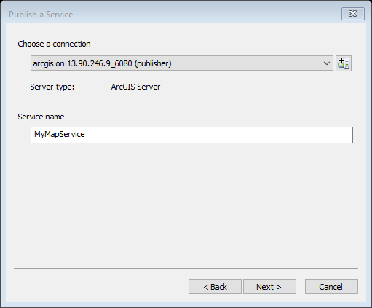
Create a new service or choose an existing service

Slide 12
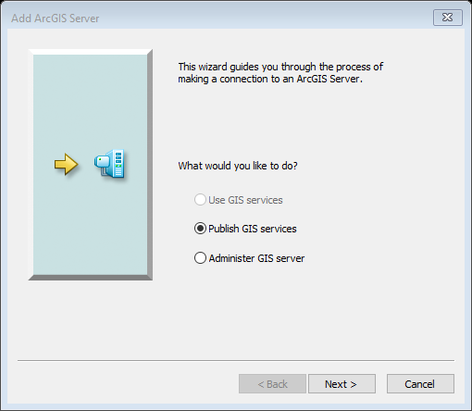
Server URL
ArcGIS Server
User Name
  ‘student’
Password
  ‘student’

Slide 13
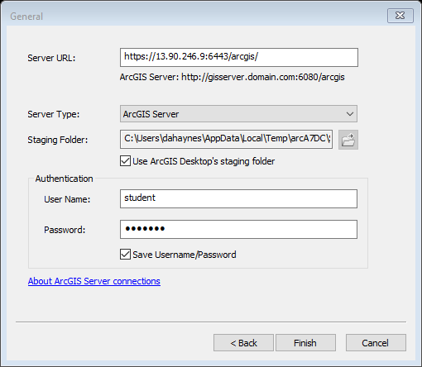
ArcServer settings

Slide 14

Choose a service name
Remember to use your initials at the end (e.g., counties_dh).

Slide 15
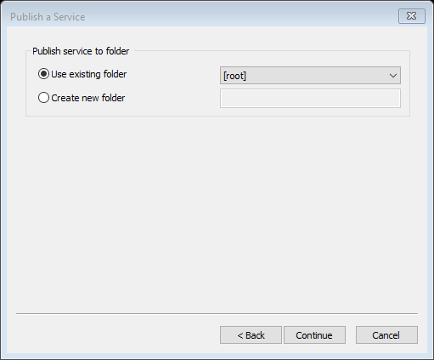
Publish to the root
Choose root folder as the folder to copy the files to for publishing.
Additional folder structures would allow for namespacing.

Slide 16
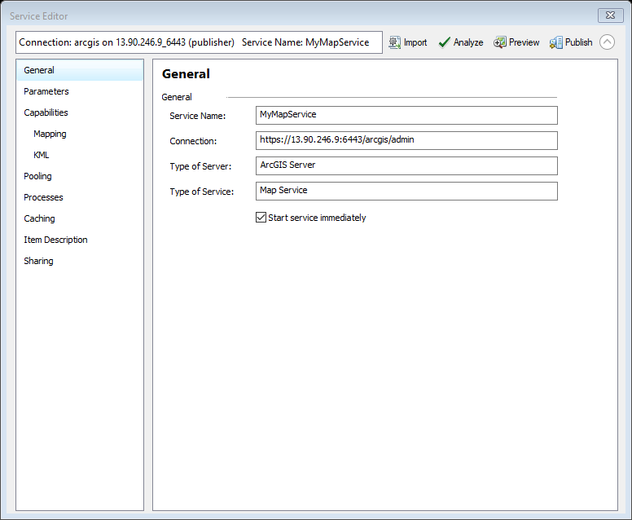

Slide 17
Overview
Analyze
  Returns a list of errors, warnings. Don’t publish until you correct these issues.
Publish
  Publish the service

Slide 18
General
Service name
Connection

Slide 19
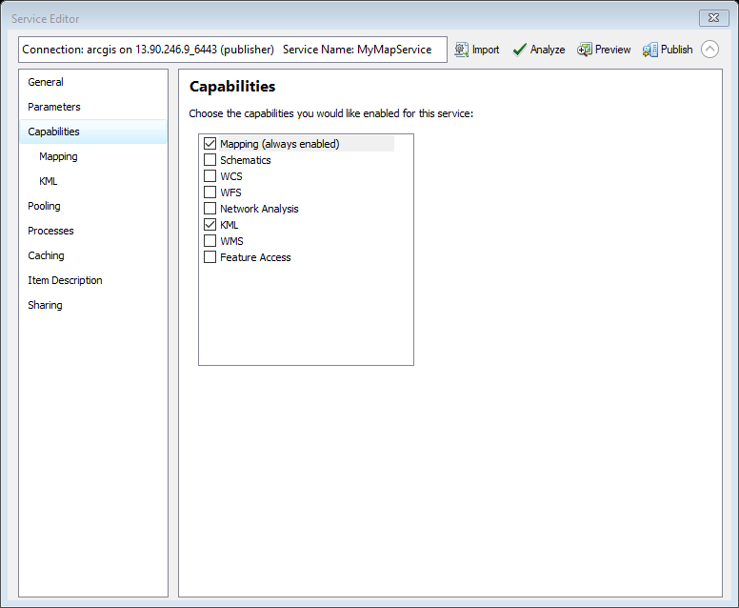
Capabilities
Mapping
  Mapping (Do not CHANGE)
  KML
  WMS

Slide 20
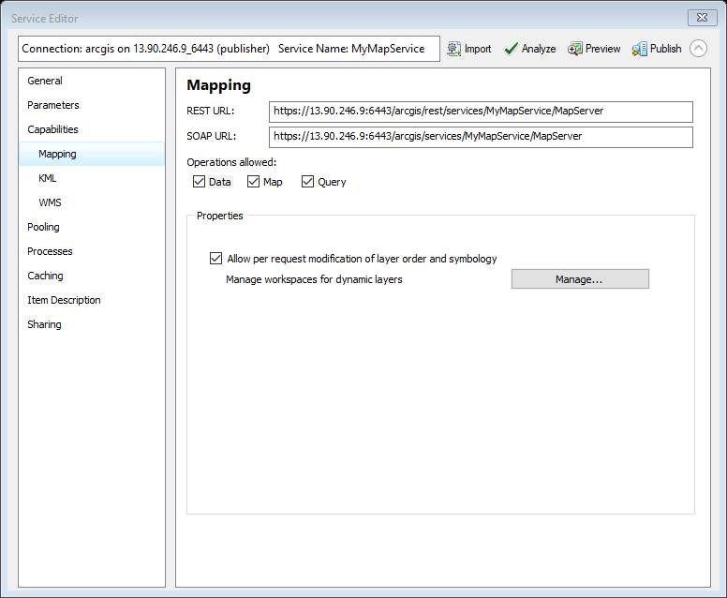
Capabilities → Mapping
REST URL
SOAP URL

Slide 21
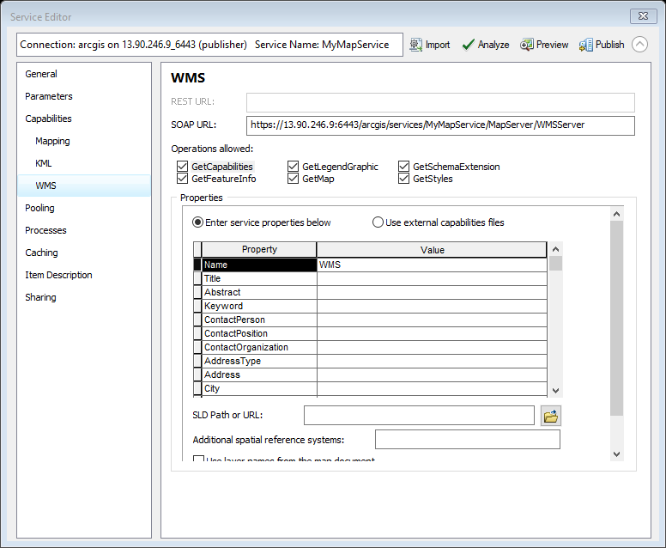
Capabilities → WMS
Operations allowed
  GetCapabilities
  GetFeatureInfo
  GetLegendGraphic
  GetMap
  GetSchemaExtension
  GetStyles
  SLD Path

Slide 22
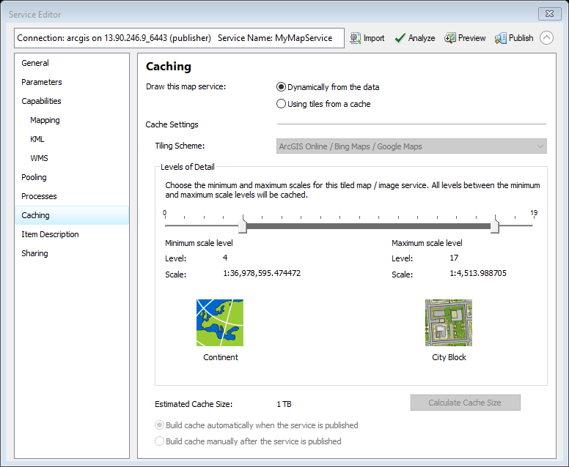
Caching
Set the visible scale range

Slide 23
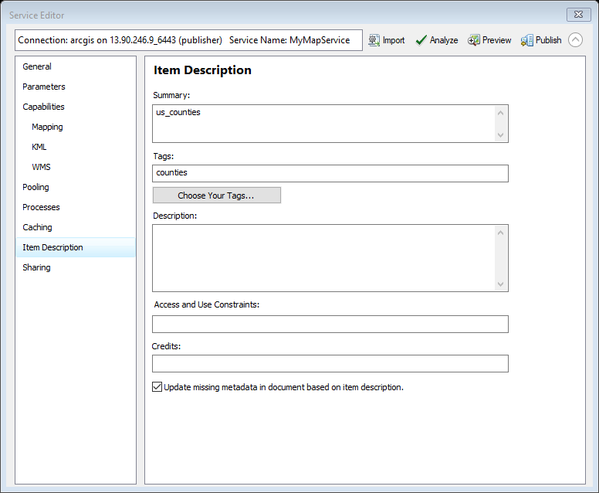
Item Description
Summary
Tags
Descriptions
Access and Use constraints
Credits

Slide 24
Demo
Create web service from PostGIS

Slide 25
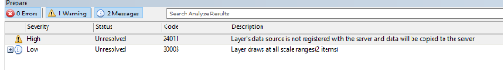
Errors & Warnings
24011 – Data is not on the server and will be copied.
30003 – Layer draws at all scales

Slide 26
Publish & View content
https://13.90.246.9:6443/arcgis/rest/
ESRI instructions
http://enterprise.arcgis.com/en/server/latest/get-started/windows/tutorial-publishing-a-map-service.htm

Slide 27
BREAK

Slide 28
DEMO
How to host a geospatial service using a remote PostgreSQL server

Slide 29
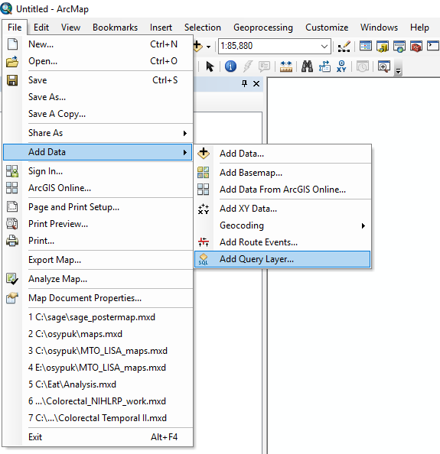
Add a Data Query Layer
File → Add Data → Add Query Layer

Slide 30
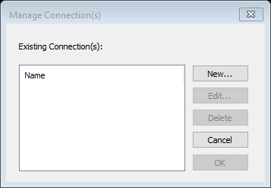
Make a new connection in ArcGIS
Choose new connection

Slide 31
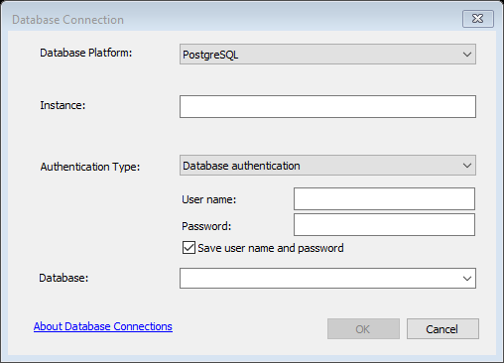
Select PostgreSQL
Choose from the Dropdown: PostgreSQL
Instance: Host address
User name: x500
Password: ‘your password’
Database: x500

Slide 32
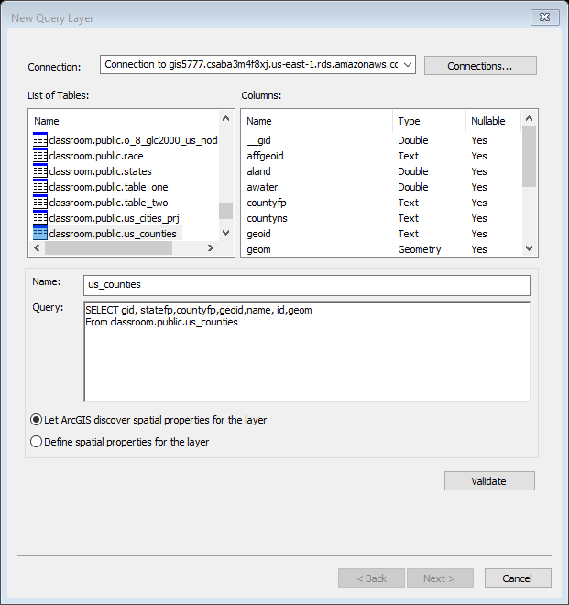
Add the layer
Make sure you are connecting to the remote repository

Slide 33
Create a Service
File -> Share As -> Service

Slide 34
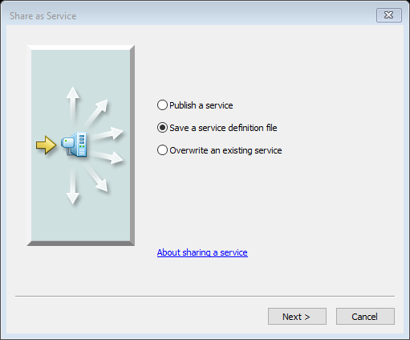
Service Definition File
https://enterprise.arcgis.com/en/server/10.3/publish-services/linux/creating-a-service-definition-in-arcgis-for-desktop.htm

Slide 35
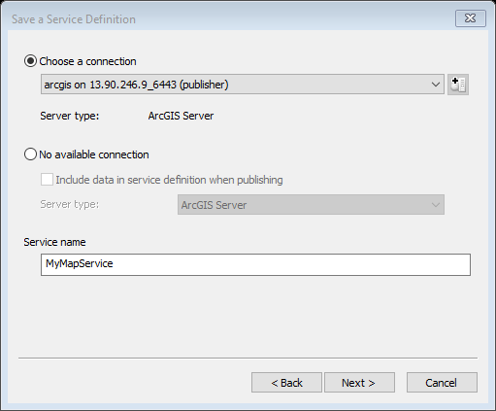
Setting up the Service
Use the previous connection
Create a name for the service

Slide 36
Publish to the root
Choose root folder as the folder to copy the files to for publishing.
Additional folder structures would allow for namespacing.

Slide 37
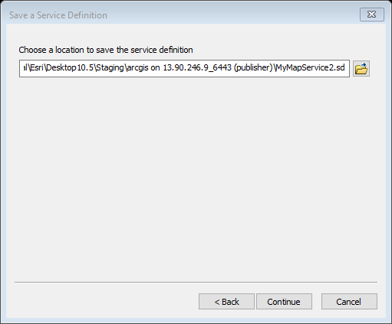
Save the Service Definition File
Choose a “local” directory to save your file
C:\work\MyMapService2.sd

Slide 38
Review Service
Analyze
Stage (not publish) to create file

Slide 39
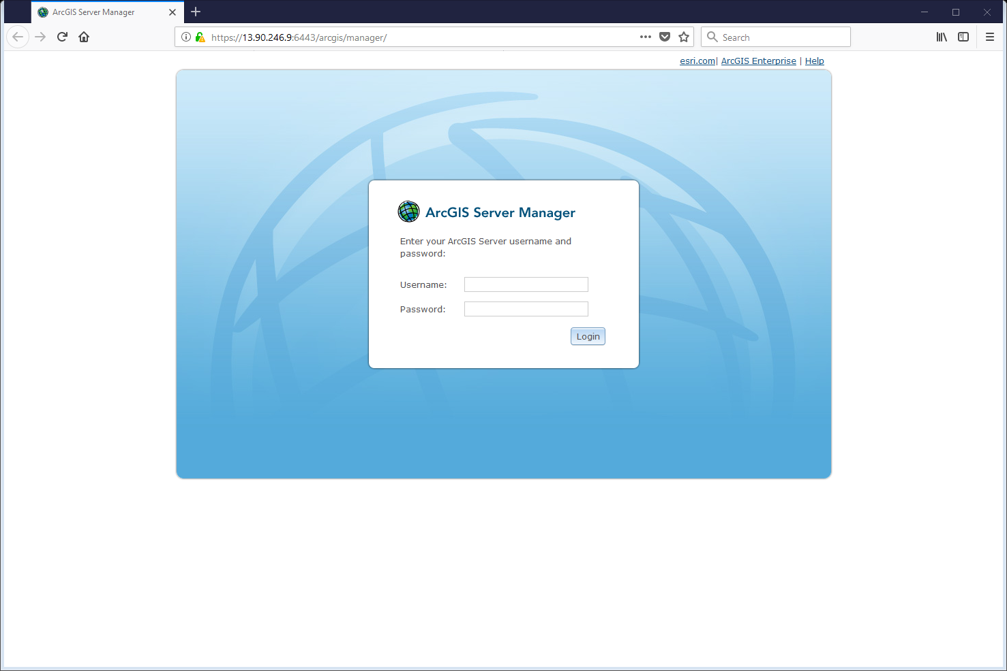
Login to ArcServer manager
https://13.90.246.9:6443/arcgis/manager/

Slide 40
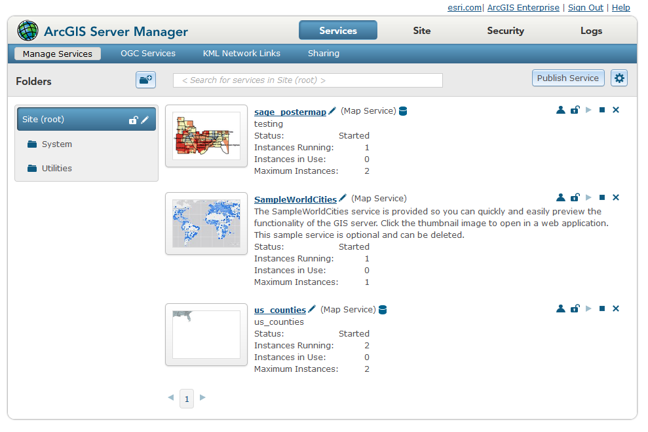
Publish a remotely hosted dataset

Slide 41
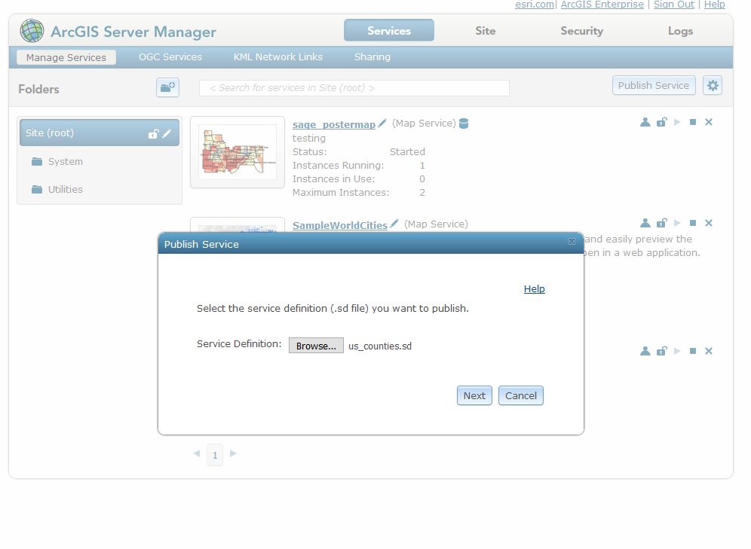
Add Service Definition file
Publish Service → Browse to location of *.sd file
Next

Slide 42
ESRI Instructions for publishing other services
https://enterprise.arcgis.com/en/server/latest/publish-services/linux/how-to-publish-a-service.htm

Slide 43
PostgreSQL is Special
PostgreSQL is so commonly used ESRI has already done all of the hard work for you. However, if you use a different database there are some steps you need to take so that ArcServer will be able to connect to your database.
https://enterprise.arcgis.com/en/server/10.3/publish-services/linux/registering-your-data-with-arcgis-server-using-manager.htm
https://enterprise.arcgis.com/en/server/latest/publish-services/linux/overview-register-data-with-arcgis-server.htm

Slide 44
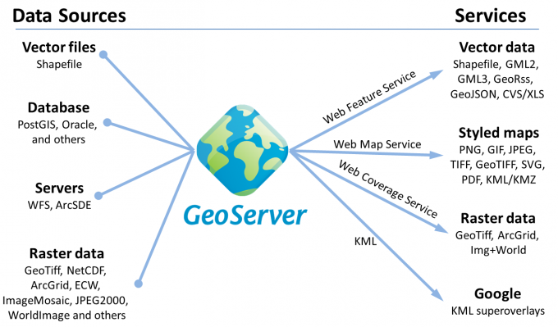
GeoServer

Slide 45
SLD

