Slide 1
Installing ArcGIS Server

Slide 2
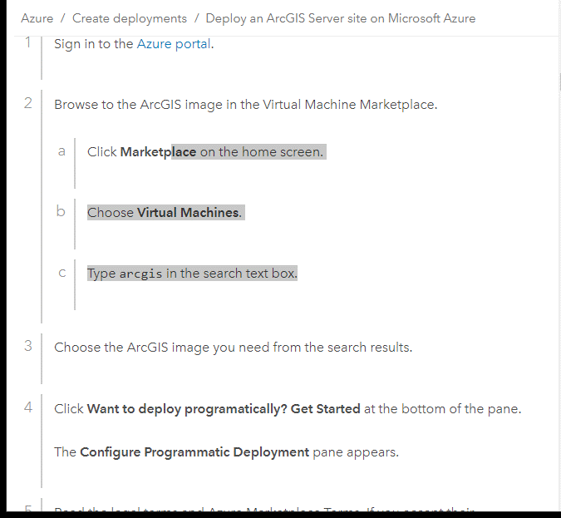
Cloud Services
Azure and AWS have some preconfigured VM that you can use.

Slide 3
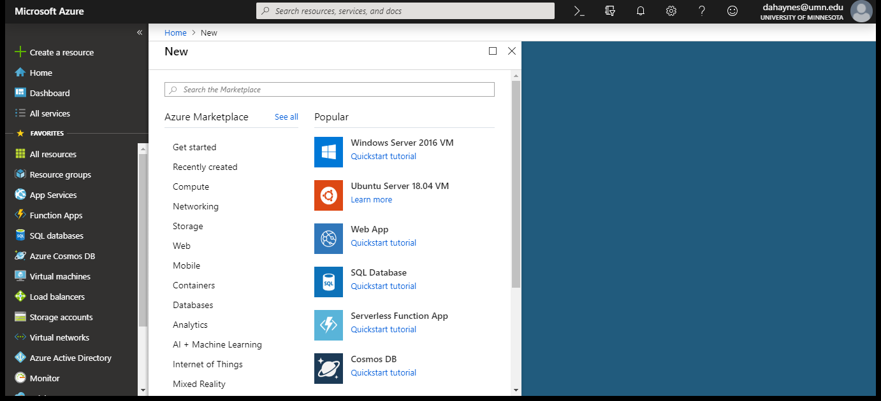
Azure Portal – User Interface

Slide 4
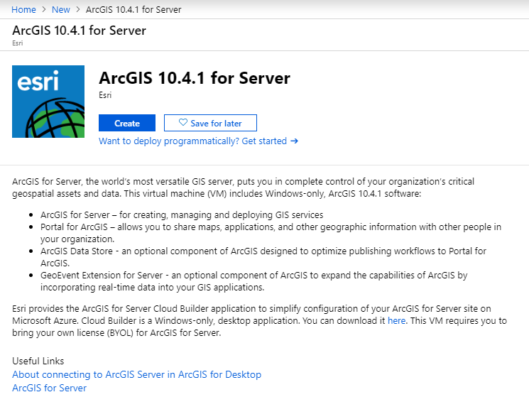

Slide 5
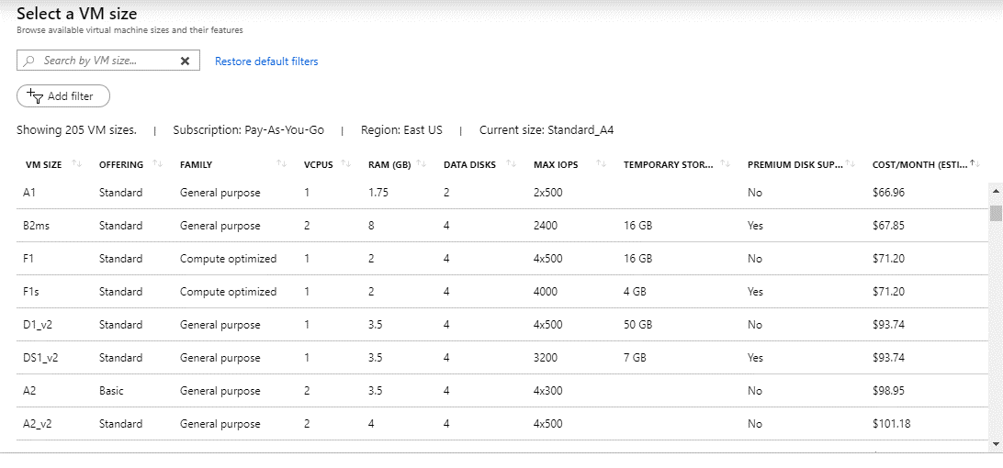
Virtual Machine Hardware Specification

Slide 6
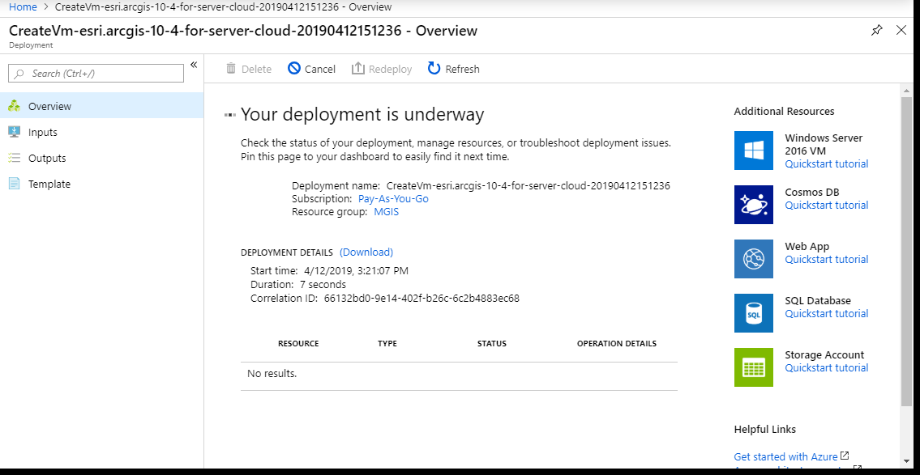
Deploy your system

Slide 7
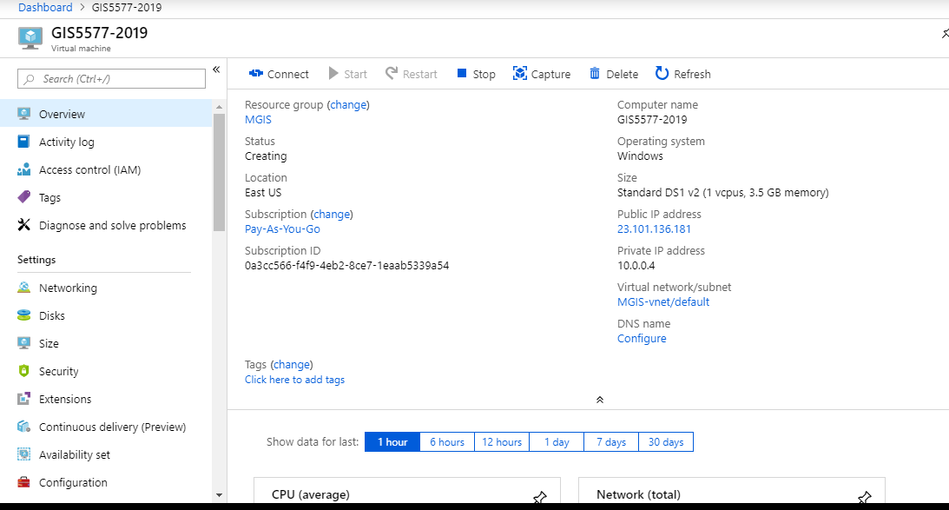
Azure Portal Controls

Slide 8
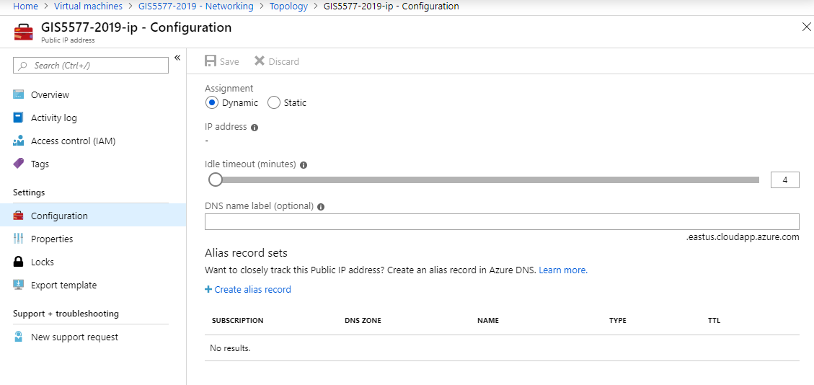
Setting up the public network

Slide 9
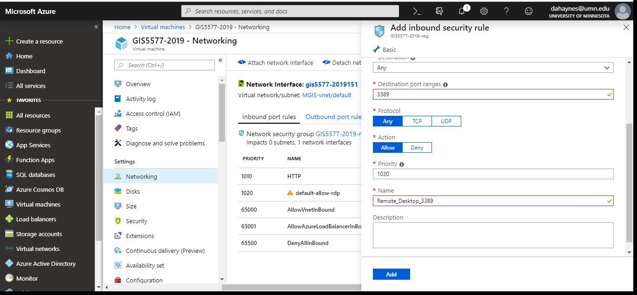
Security Rules
In Bound
Out Bound

Slide 10
Security Rules
In Bound
  Add Rules that allow or restrict access to the VM based on ports
  Some systems (databases) are well known and are preconfigured.
  Lots of custom configurations are possible. (Talk to your security team)
Out Bound
  Add rules that allow or restrict access of the VM to the public.
  This is based on your client application needs

