Slide 1
Publishing WebServices with ArcGIS

Slide 2
ArcGIS Desktop
Add Layers (shapefiles) to your map.
Style your map as necessary

Slide 3
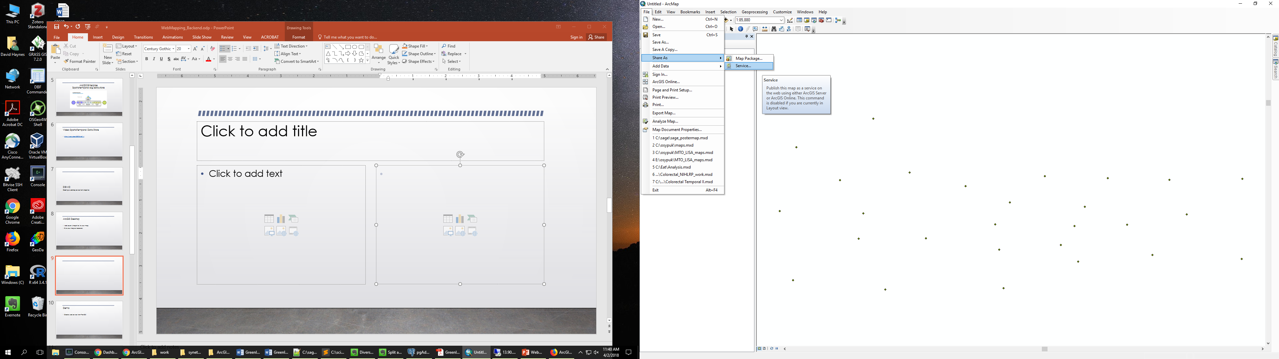
Create a Service
File -> Share As -> Service

Slide 4
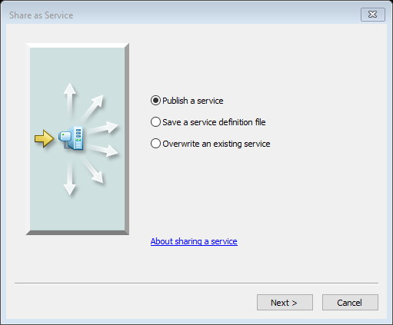
Publish a service

Slide 5
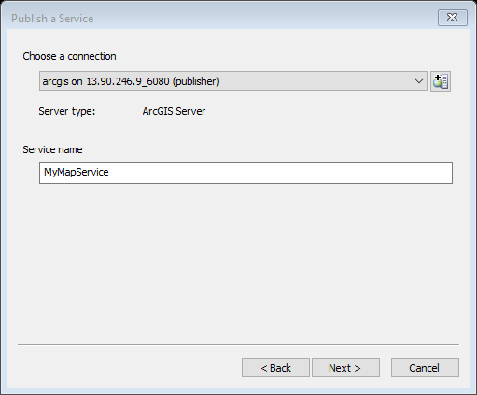
Create a new service or choose an existing service

Slide 6
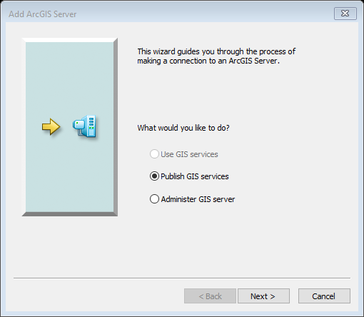
Server URL
ArcGIS Server
User Name
  ‘student’
Password
  ‘student’

Slide 7
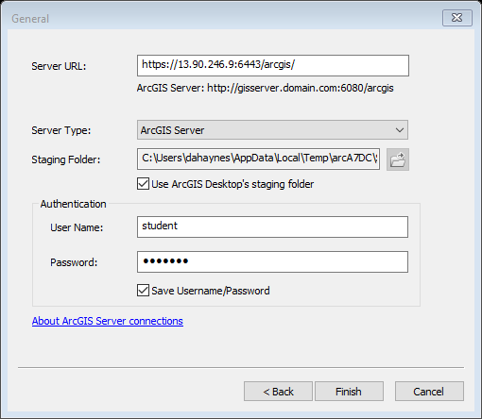
ArcServer settings

Slide 8

Choose a service name
Remember to use your initials at the end (e.g., counties_dh).

Slide 9
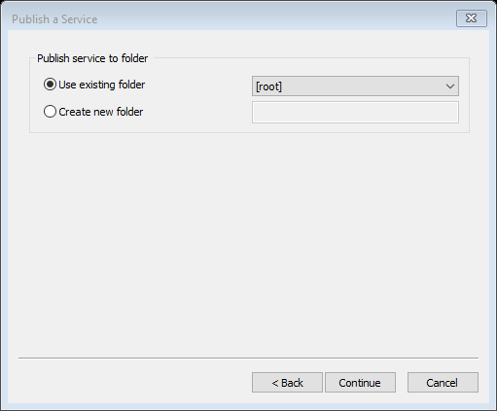
Publish to the root
Choose root folder as the folder to copy the files to for publishing.
Additional folder structures would allow for namespacing.

Slide 10
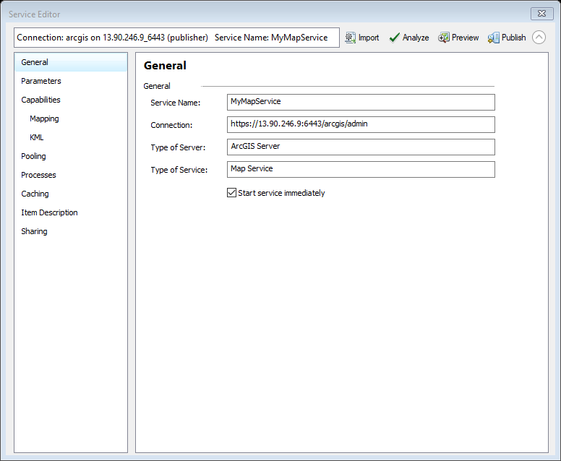

Slide 11
Overview
Analyze
  Returns a list of errors, warnings. Don’t publish until you correct these issues.
Publish
  Publish the service

Slide 12
General
Service name
Connection

Slide 13
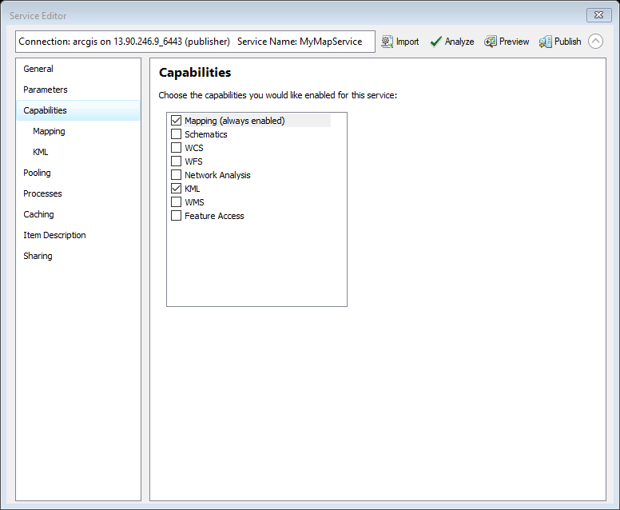
Capabilities
Mapping
  Mapping (Do not CHANGE)
  KML
  WMS

Slide 14
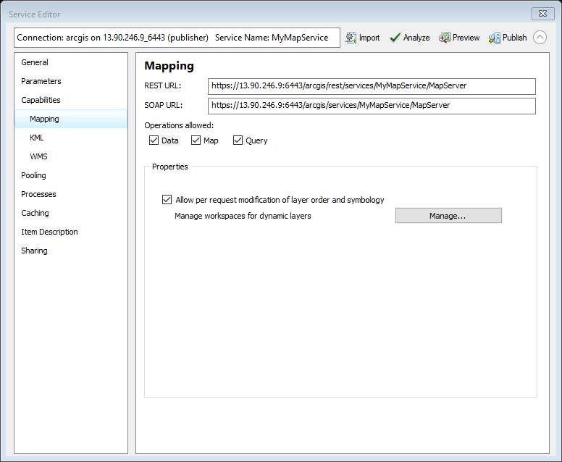
Capabilities → Mapping
REST URL
SOAP URL

Slide 15
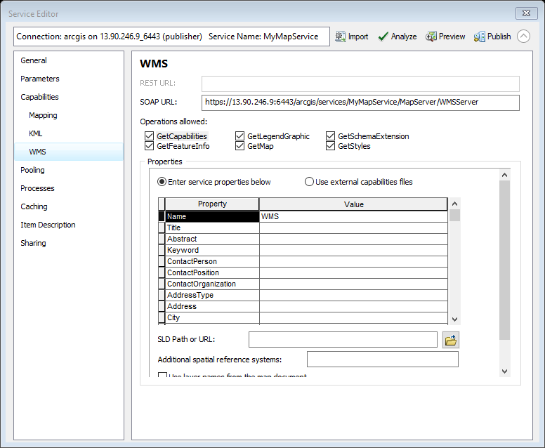
Capabilities → WMS
Operations allowed
  GetCapabilities
  GetFeatureInfo
  GetLegendGraphic
  GetMap
  GetSchemaExtension
  GetStyles
  SLD Path

Slide 16
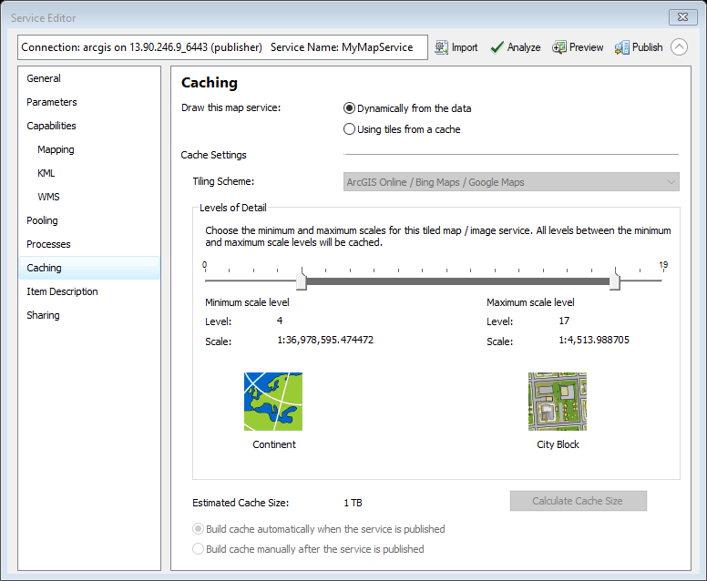
Caching
Set the visible scale range

Slide 17
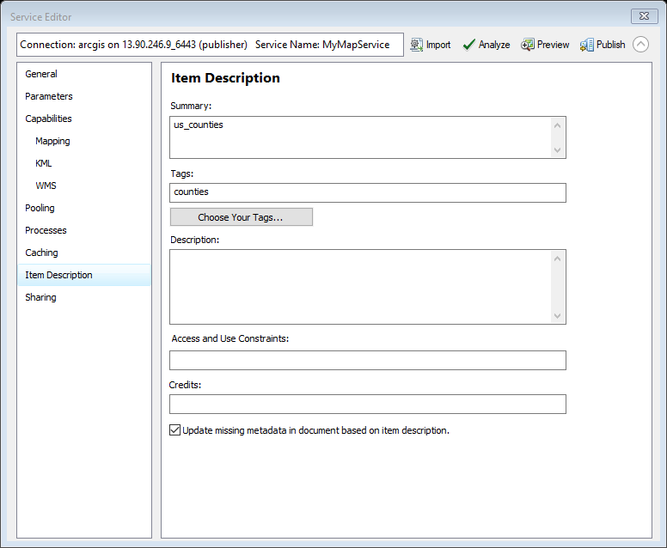
Item Description
Summary
Tags
Descriptions
Access and Use constraints
Credits

Slide 18
Demo
Create web service from PostGIS

Slide 19
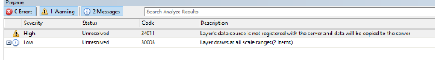
Errors & Warnings
24011 – Data is not on the server and will be copied.
30003 – Layer draws at all scales

Slide 20
Publish & View content
https://13.90.246.9:6443/arcgis/rest/
ESRI instructions
http://enterprise.arcgis.com/en/server/latest/get-started/windows/tutorial-publishing-a-map-service.htm

Slide 21
BREAK

Slide 22
DEMO
How to host a geospatial service using a remote PostgreSQL server

Slide 23
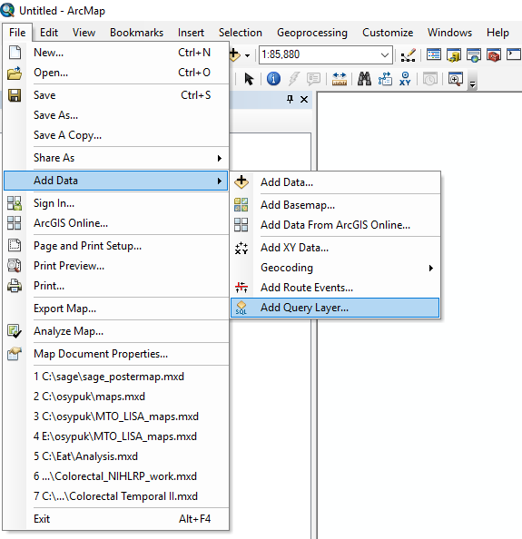
Add a Data Query Layer
File → Add Data → Add Query Layer

Slide 24
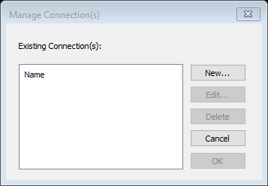
Make a new connection in ArcGIS
Choose new connection

Slide 25
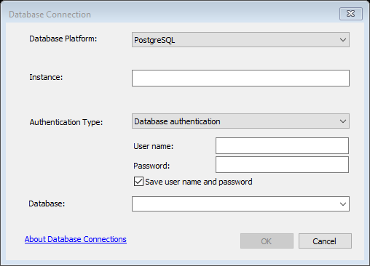
Select PostgreSQL
Choose from the Dropdown: PostgreSQL
Instance: Host address
User name: x500
Password: ‘your password’
Database: x500

Slide 26
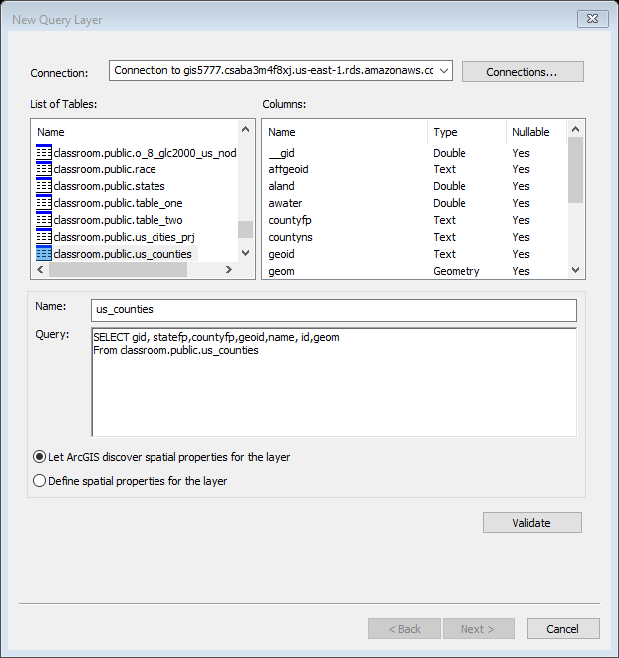
Add the layer
Make sure you are connecting to the remote repository

Slide 27
Create a Service
File -> Share As -> Service

Slide 28
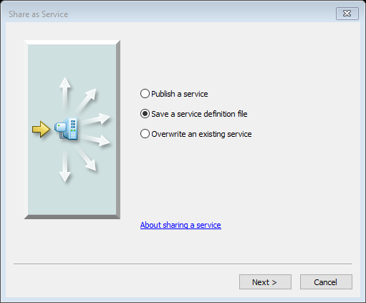
Service Definition File
https://enterprise.arcgis.com/en/server/10.3/publish-services/linux/creating-a-service-definition-in-arcgis-for-desktop.htm

Slide 29
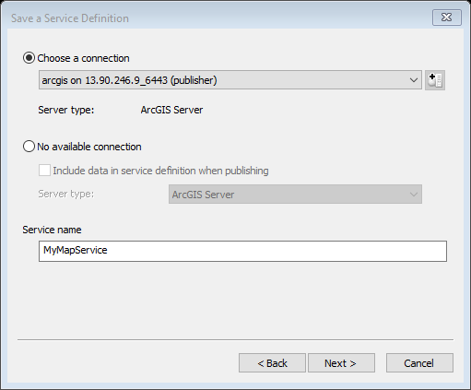
Setting up the Service
Use the previous connection
Create a name for the service

Slide 30
Publish to the root
Choose root folder as the folder to copy the files to for publishing.
Additional folder structures would allow for namespacing.

Slide 31
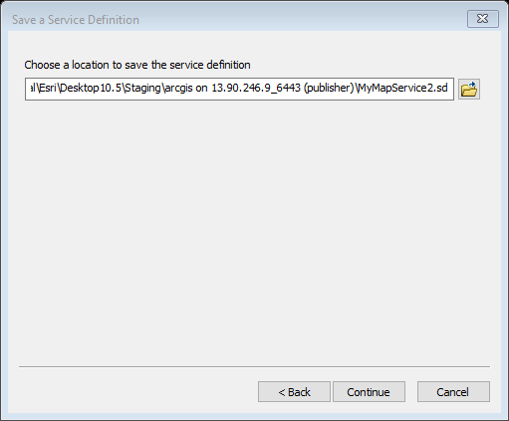
Save the Service Definition File
Choose a “local” directory to save your file
C:\work\MyMapService2.sd

Slide 32
Review Service
Analyze
Stage (not publish) to create file

Slide 33
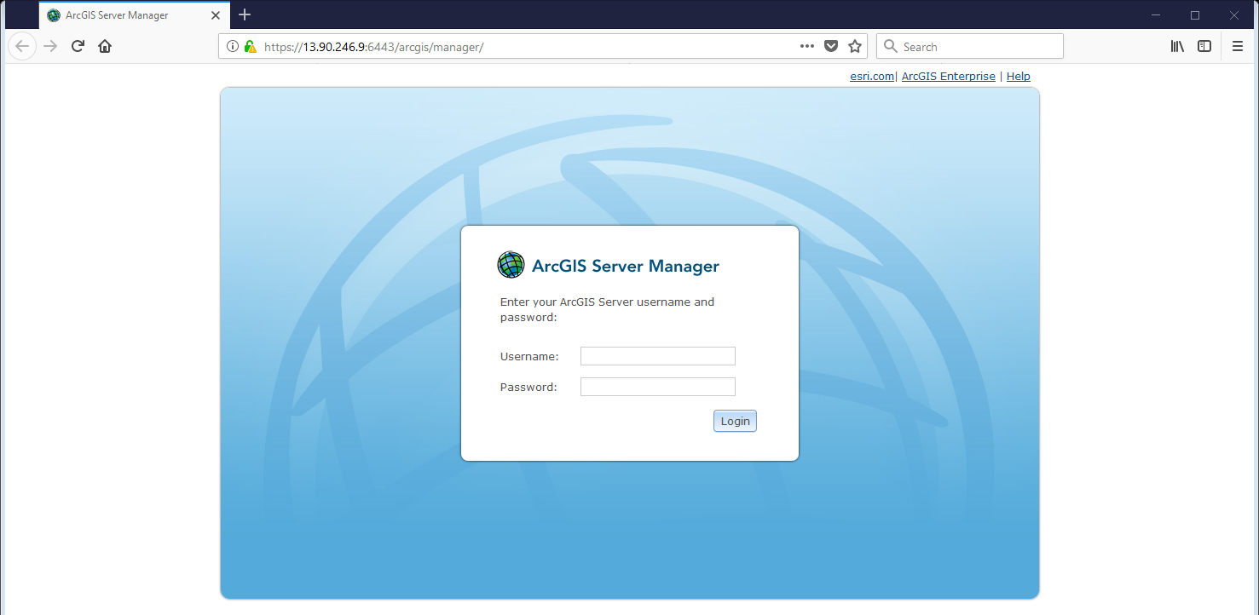
Login to ArcServer manager
https://tgis3.uspatial.umn.edu/arcgis/manager/

Slide 34
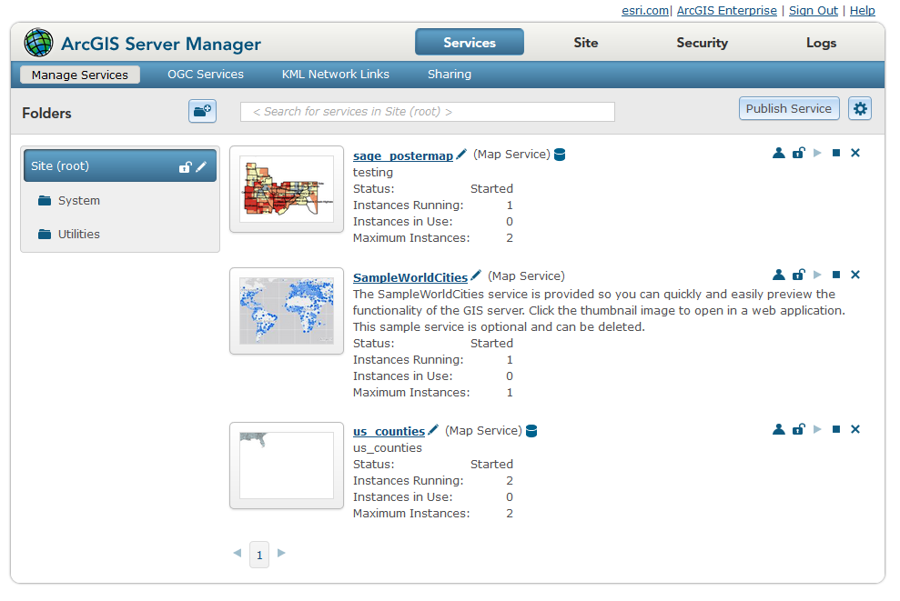
Publish a remotely hosted dataset

Slide 35
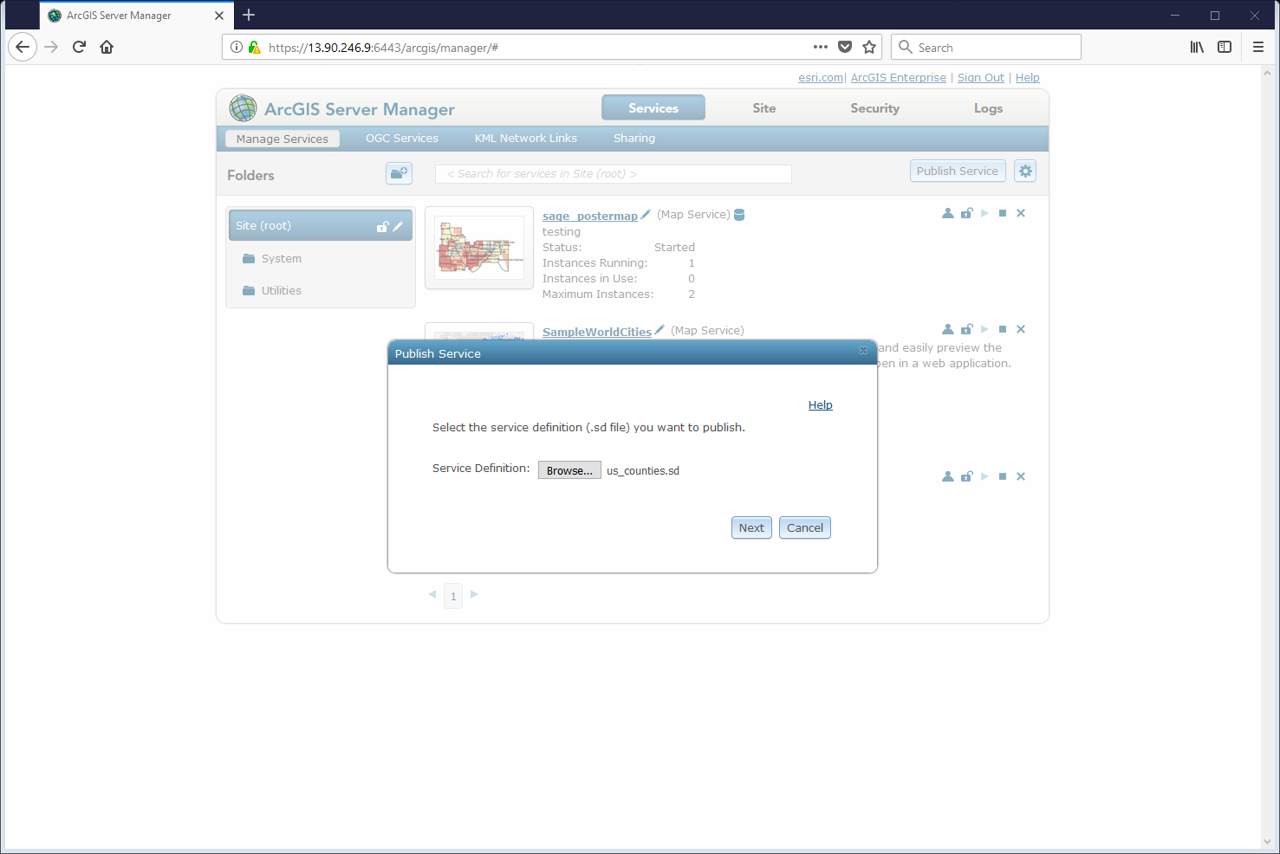
Add Service Definition file
Publish Service → Browse to location of *.sd file
Next

Slide 36
ESRI Instructions for publishing other services
https://enterprise.arcgis.com/en/server/latest/publish-services/linux/how-to-publish-a-service.htm

Slide 37
PostgreSQL is Special
PostgreSQL is so commonly used ESRI has already done all of the hard work for you. However, if you use a different database there are some steps you need to take so that ArcServer will be able to connect to your database.
https://enterprise.arcgis.com/en/server/10.3/publish-services/linux/registering-your-data-with-arcgis-server-using-manager.htm
https://enterprise.arcgis.com/en/server/latest/publish-services/linux/overview-register-data-with-arcgis-server.htm

Slide 38
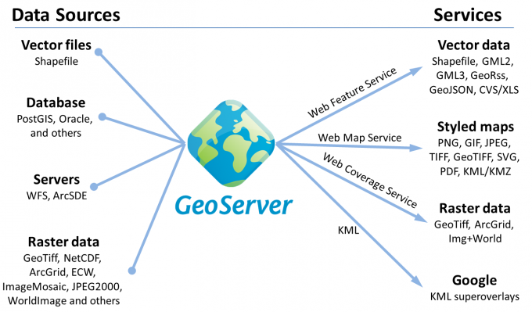
GeoServer

