Slide 1
Publishing to WebServices Using ArcPro

Slide 2
ArcGIS Desktop
Add Layers (shapefiles) to your map.
Style your map as necessary

Slide 3
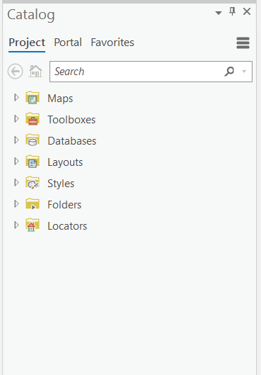
Find your Catalog View

Slide 4
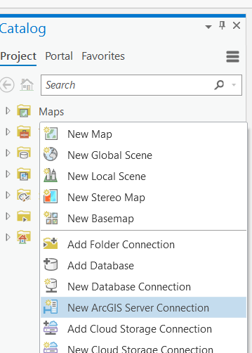
Add a ArcGIS Server Connection
Right Click → New ArcGIS Server Connection

Slide 5
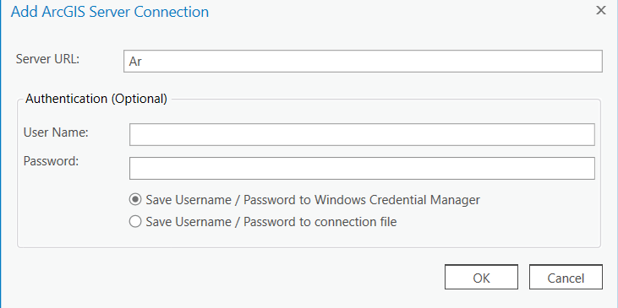
Setting up ArcGIS Server
ArcGIS Server URL
User Name
x500 credential
Password
500 credentials

Slide 6
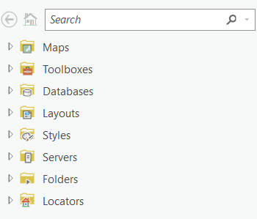
New Arc Server
You should have a new Arc Server
Click the Arrow down to see connections

Slide 7
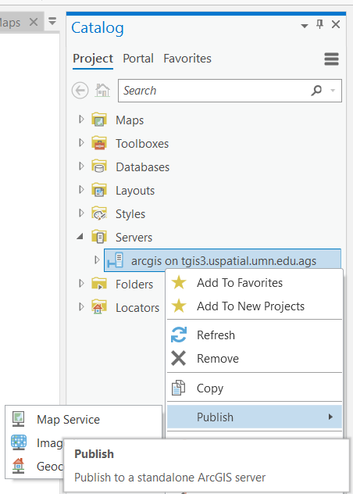
Create a new service
Right-Click on your desired server
Publish → Map Service

Slide 8
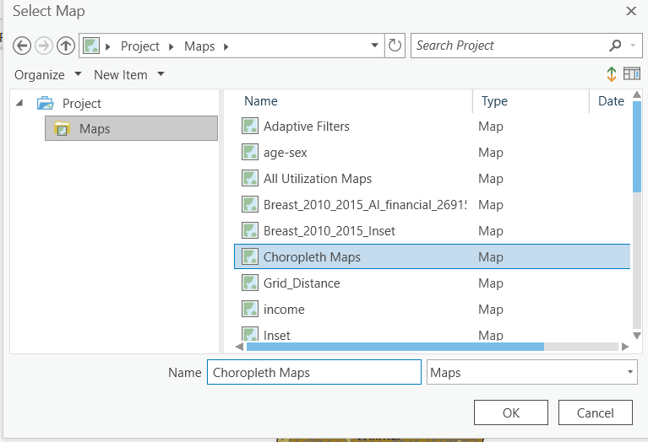
Select your map
ArcPro will require to choose 1 map for creating a map service
** Make sure all of your styles are correct

Slide 9
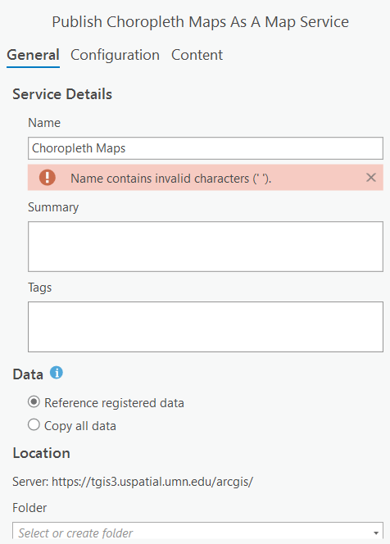
Configure your map service
Name = map_[your initials]
Summary = provide a description of your project
Tags
Data = Copy All Data
When sharing a feature layer to ArcGIS Enterprise with the Copy all data option, the service will always be published to your hosting server.
When sharing a feature layer to ArcGIS Enterprise with the Reference registered data data option, it's shared as a dependent layer to a map image layer.
Folder

Slide 10
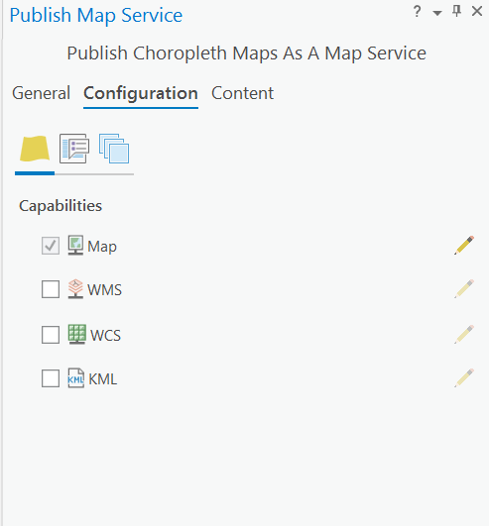
Configure Services
You can change the services that are available here
Map ~ WMS (Map is a subset of the features available in WMS)
You can edit each service further

Slide 11
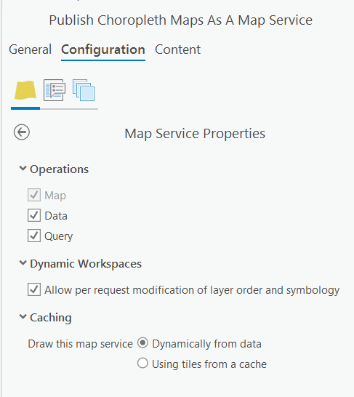
Map Service Configuration
Operations
Keep all the selected options
Dynamic Workspaces
Allow modifications of symbology
Caching
Dynamic = small dataset
Cache = large dataset**

Slide 12
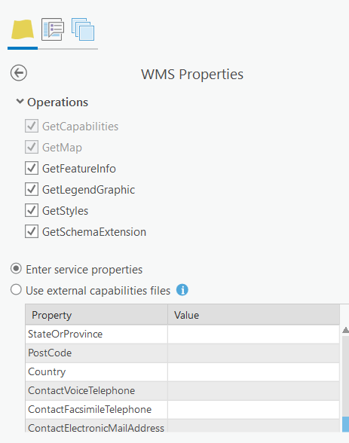
WMS Configuration (Part 1)
Notice the additional capabilities
These are standard WMS (API Calls)
Keep them enabled

Slide 13
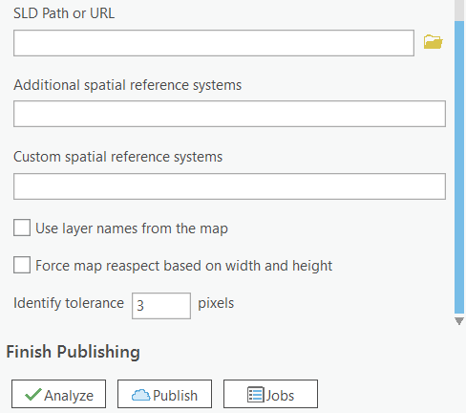
WMS Configuration (Part 2)
SLD
This is for loading from an existing SLD
Spatial Reference Systems
Leave blank unless necessary
Layer Name
Analyze
Fix any errors.
Publish

Slide 14

Success!

Slide 15
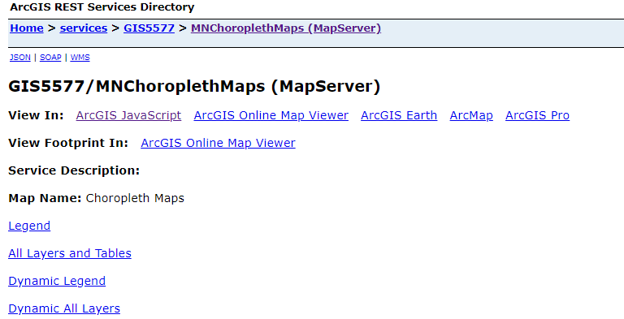
View Map Service
Click “Manage the map service”
Click “ArcGIS JavaScript”

Slide 16
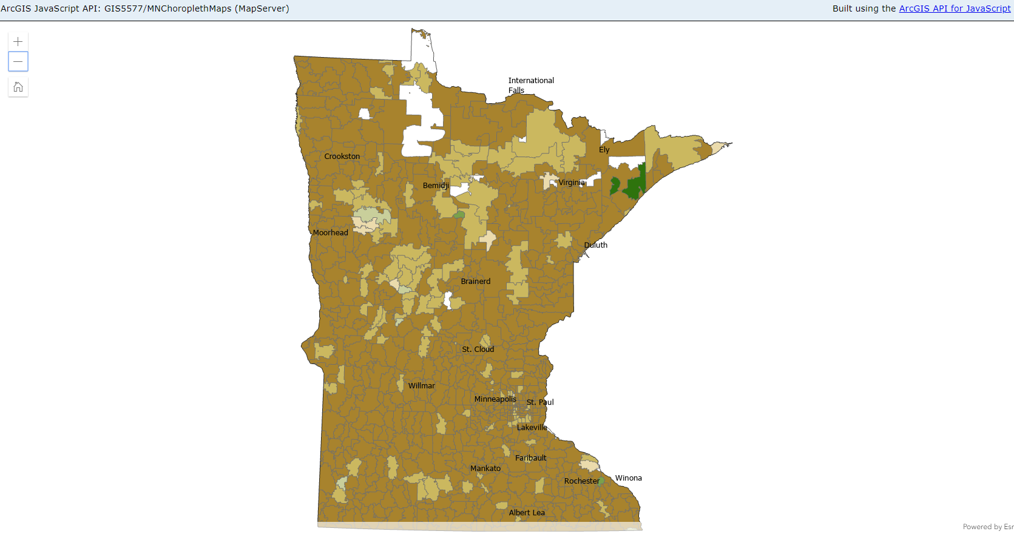

Slide 17
Share Web Layer
Saves to your ArcGIS Online

Slide 18
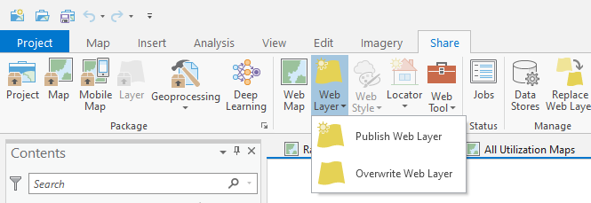

Slide 19
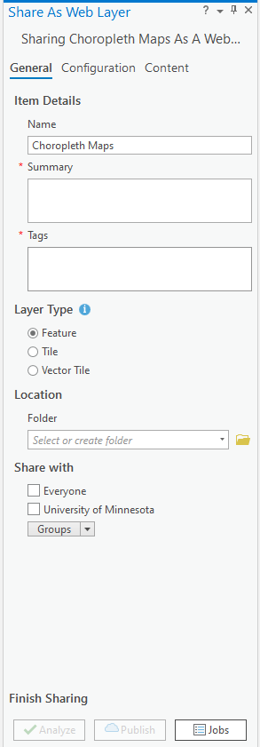
Create Web Layer
Name = Any text (Notice spaces are ok)
Summary = abstract of your map
Tags = keywords
Layer Type
Feature
Tile
Vector Tile
Share with
Determine Public or Private Access

Slide 20
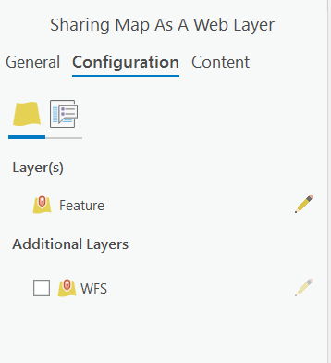
Web Layer Configuration
Layers to publish
Only WFS are available.
Check the edits

Slide 21
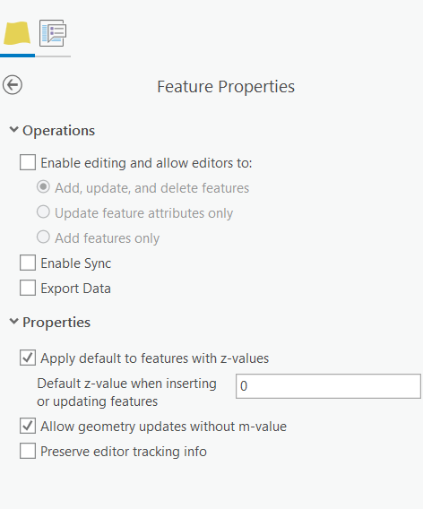
Web Layer Configuration→ Editing
Only use this if you want to enable editing.
Also you need to have a geodatabase available to store the data.

Slide 22
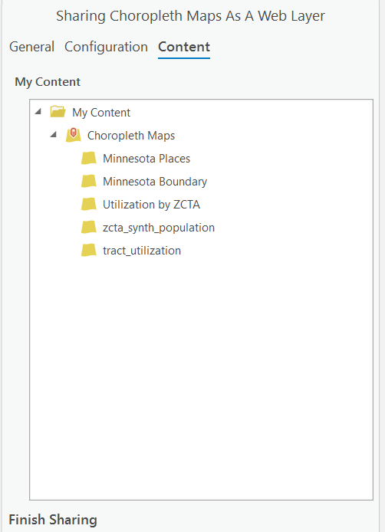
Web Layer Configuration → Content
What Content will be publish
Analyze
Fix any errors.
Publish

Slide 23
Success!

Slide 24
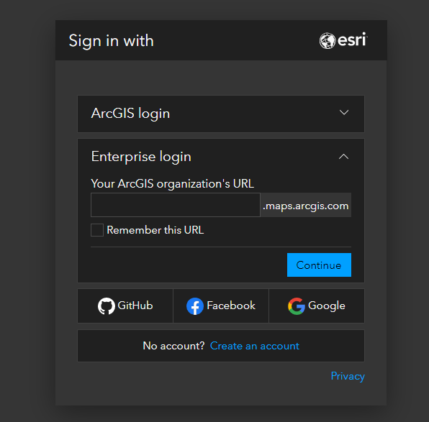
Finalize
In this demo, I made my web map private

Slide 25
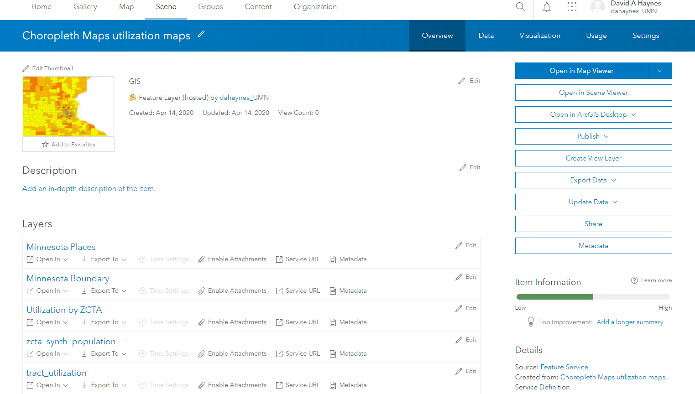
Go to your map
Open in Map Viewer

Slide 26
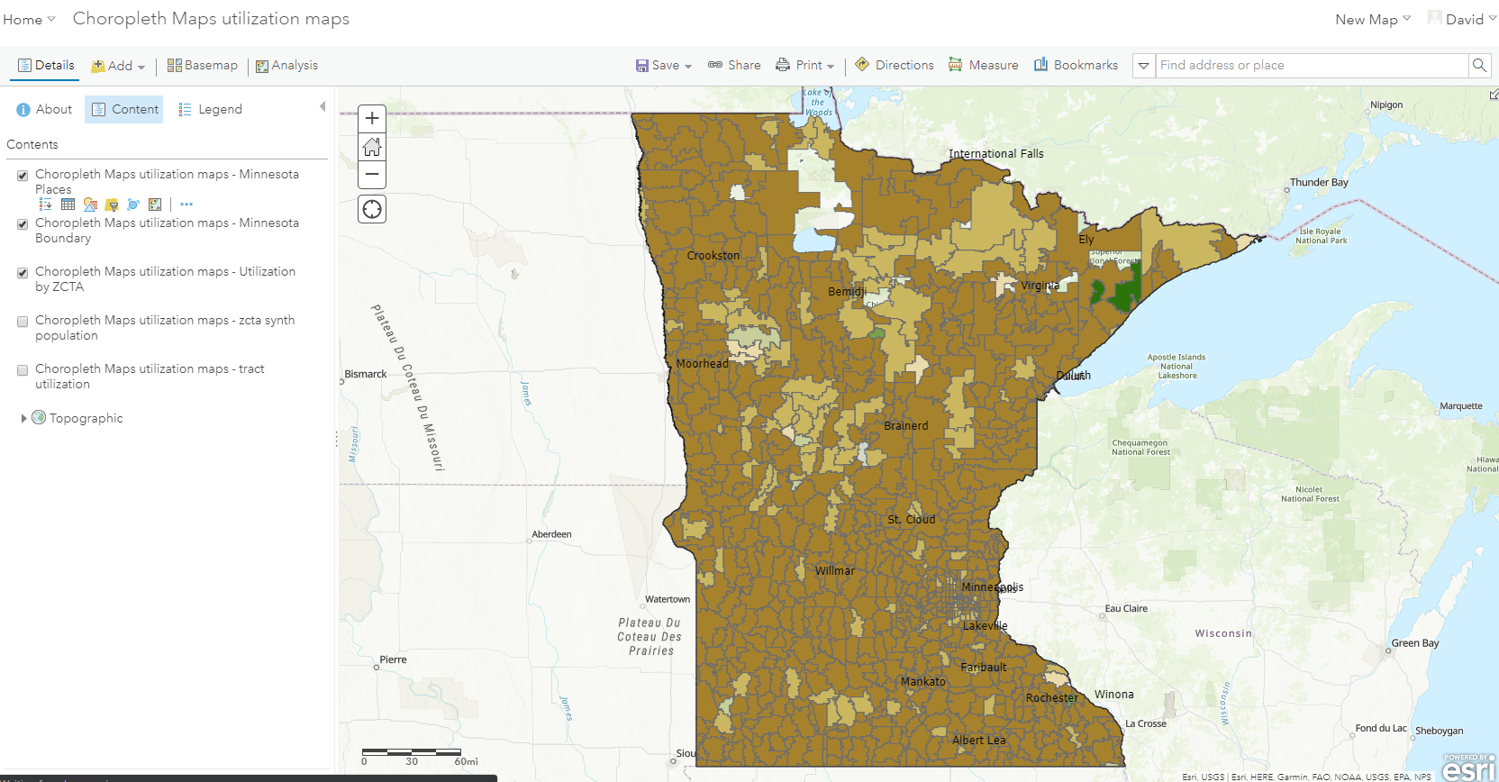

Slide 27
Publish as Web Services (ArcServer)
Share as Web Layer (ArcGIS Online)

