Slide 1
Publishing to ArcServer Using ArcPro

Slide 2
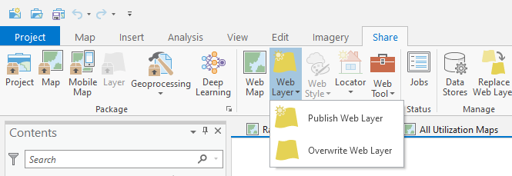

Slide 3
