Slide 1
Installing ArcGIS Server

Slide 2
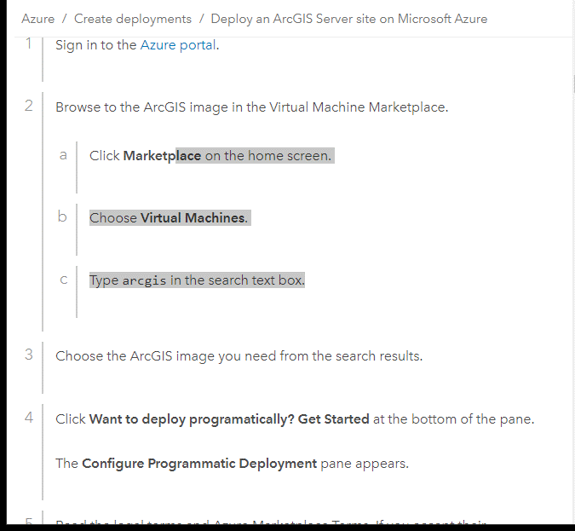
Cloud Services
Azure and AWS have some preconfigured VM that you can use.

Slide 3
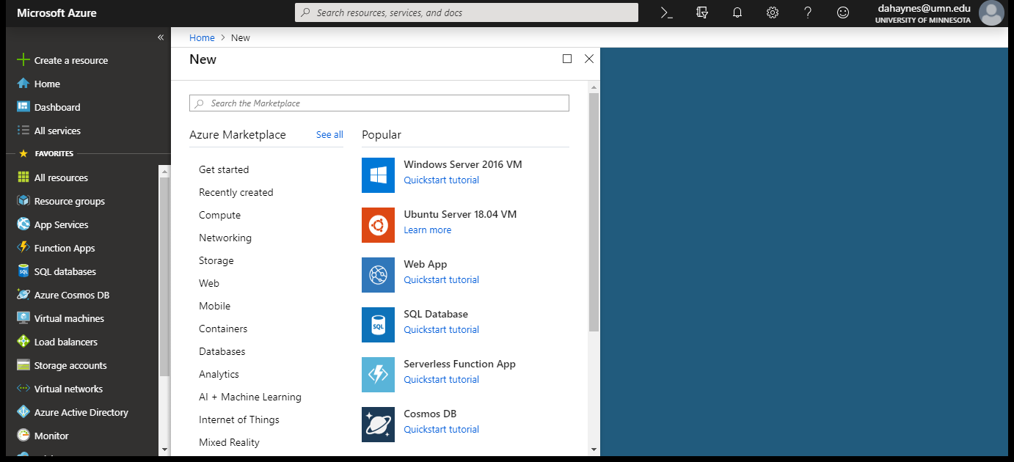
Azure Portal – User Interface

Slide 4
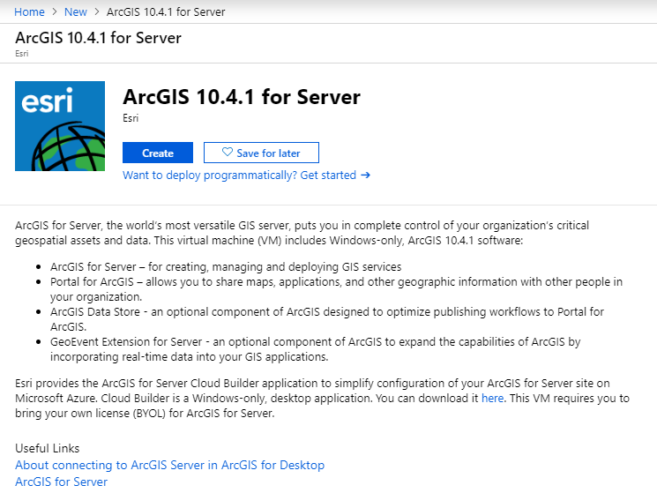

Slide 5
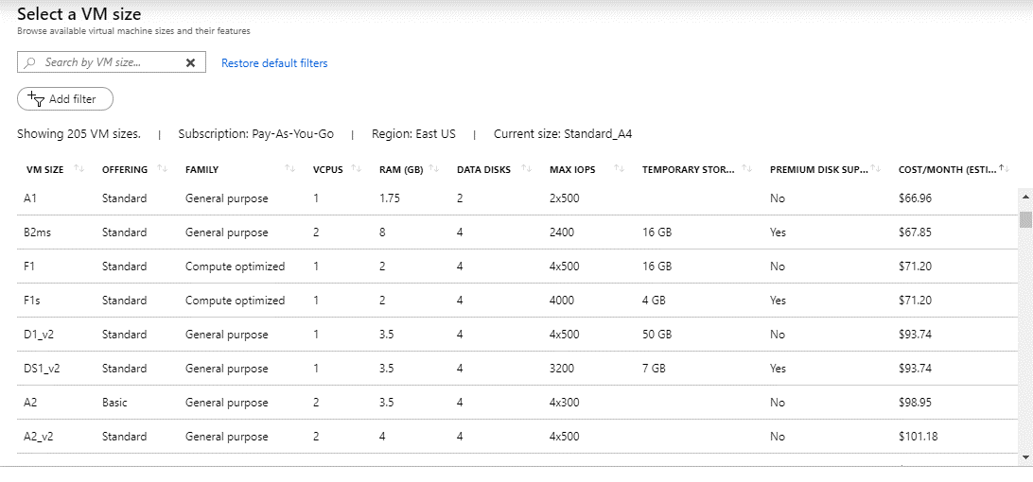
Virtual Machine Hardware Specification

Slide 6
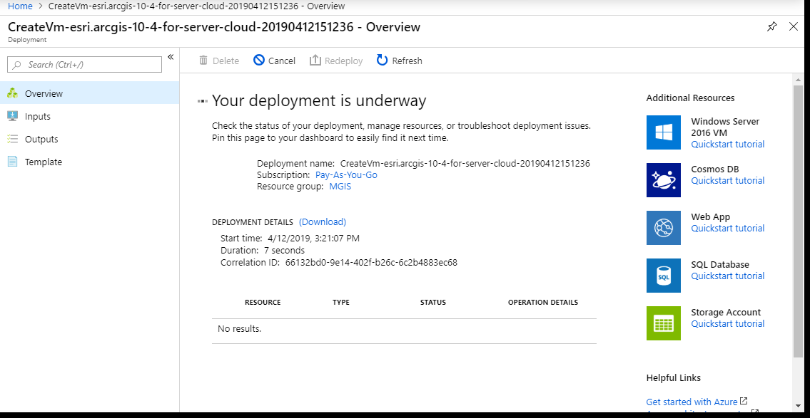
Deploy your system

Slide 7
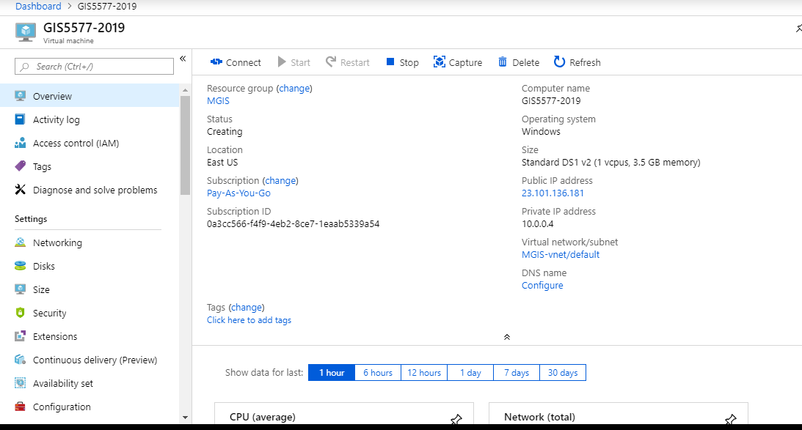
Azure Portal Controls

Slide 8
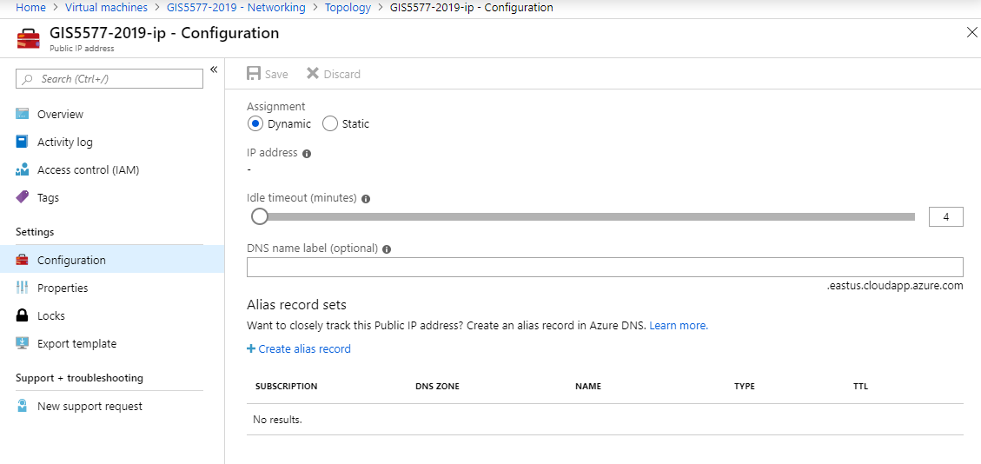
Setting up the public network

Slide 9
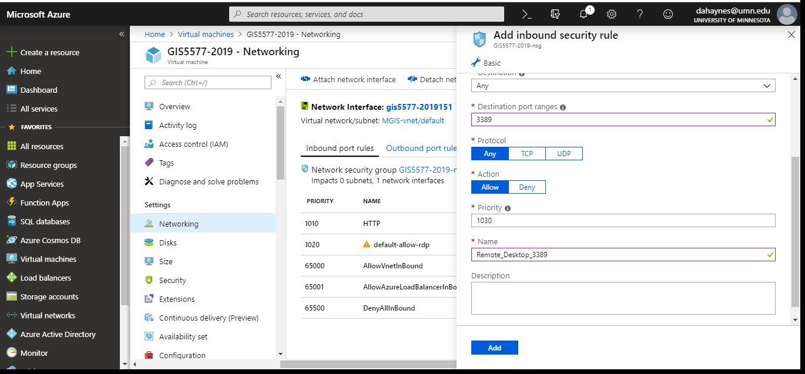
Security Rules
In Bound
Out Bound

Slide 10
Security Rules
In Bound
  Add Rules that allow or restrict access to the VM based on ports
  Some systems (databases) are well known and are preconfigured.
  Lots of custom configurations are possible. (Talk to your security team)
Out Bound
  Add rules that allow or restrict access of the VM to the public.
  This is based on your client application needs

Slide 11
Setting up ArcServer (blank VM)

Slide 12
ArcServer on the Cloud
Azure
Amazon Web Services
https://aws.amazon.com/marketplace/search/results/ref=gtw_navgno_search_box?page=1&searchTerms=Esri
https://enterprise.arcgis.com/en/server/latest/cloud/azure/deploy-gis-server-on-azure.htm

Slide 13
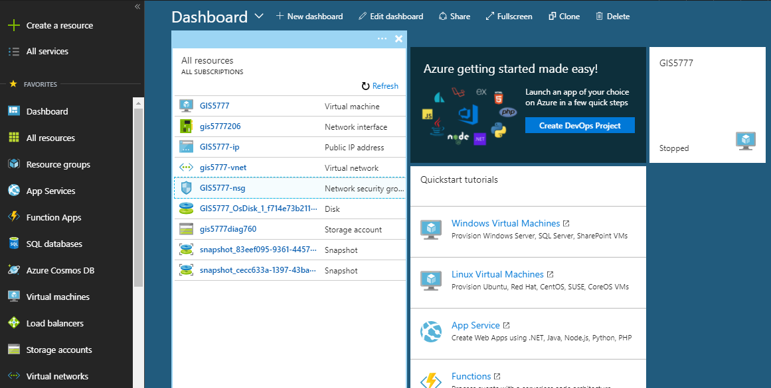
Azure Dashboard

Slide 14
Azure Setup
Use remote desktop to login to the machine
  Install software
  Load files for hosting
Configure machine ports

Slide 15
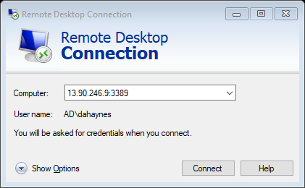
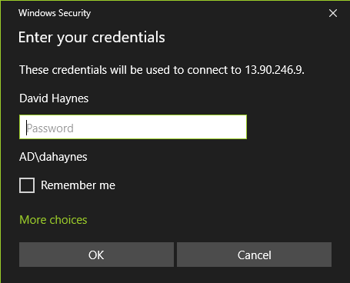
Demo remote desktop

Slide 16
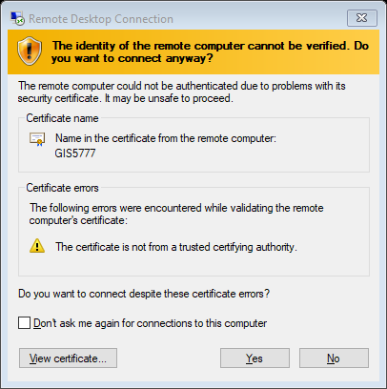
Accept the certificate

Slide 17
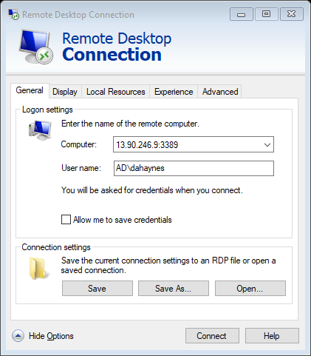
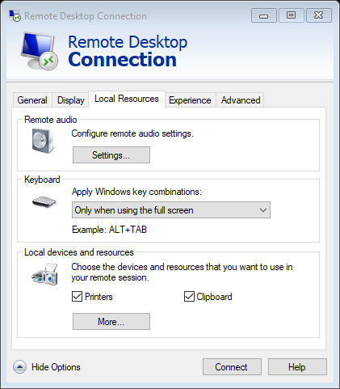
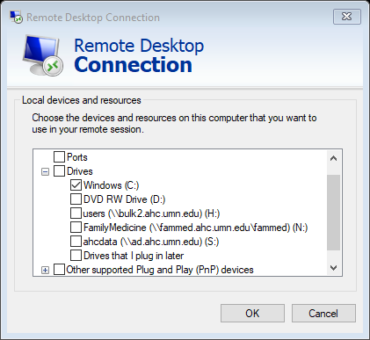
Modify remote desktop connection

Slide 18
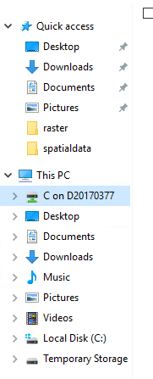
Loading data
Now I have access to the C drive on the local machine.
This makes it easier for moving files

Slide 19
Adding ports
HTTP
  6080
HTTPS
  6443
Allow Remote Desktop Connection
  3389

Slide 20
Adding rules
Service – (HTTP, HTTPS)
Port Number
Rule Priority
Name

Slide 21
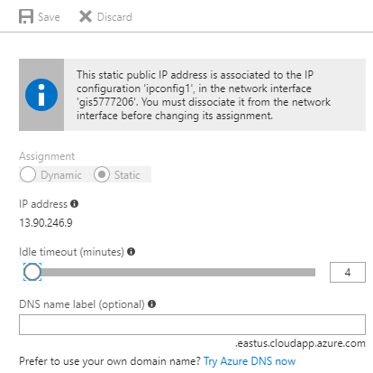
Setup your VM to persist at a particular URL

