Slide 1
GIS 5578
Introduction to PostgreSQL (Spatial Databases) and PostGIS

Slide 2
Geospatial Developer
Geospatial Data Scientist
Geospatial Analysis
Developer
ArcGIS
GDAL
Python
Java
Spark
Geospatial Libraries
  Python
  Java
Platforms
  Map Reduce
  Parallel Databases
Object Orientated Programming
  Python
  R
Spatial Data Management and Analysis
  PostgreSQL with PostGIS

Slide 3



Geospatial Data Scientist
  Spatial Data Management
    Vector Data
    Raster Data
  Spatial Analysis
  Object Orientated Programming
    Classes
    Functions
    Specified Loops
    Control Structures
  Domain Specific Libraries
Geospatial
Data Scientist

Slide 4
Syllabus
This course is structured so that it gives equal balance to programming and GIS spatial analysis. I recommend that students taking this course should have some previous experience with programming. It is equally important that students have a strong background in GIScience / spatial analysis.

Slide 5
Code Things
Text Editor
  Notepad ++
  Sublime
Software
  PostgreSQL 9.6
  Github
Optional Software
  QGIS – highly recommend!
  ArcPro / ArcGIS 10.x – for data visualization
  Python 3.5? – optional

Slide 6
Class Resources
PostgreSQL
  Online Documentation (https://www.postgresql.org/docs/)
  Beginning Databases with PostgreSQL (Neil Matthew)
PostGIS
  Mastering PostGIS
  PostGIS Documentation (https://postgis.net/)
  PostGIS Essentials
Github
  ProGit (https://git-scm.com/book/en/v2)

Slide 7
Class Resources
David Haynes
  dahaynes@umn.edu
Other students in class, Canvas forum
  Ask questions on the forum – required participation points.

Slide 8
PostgreSQL
Open source relational database management system
ACID compliant
Triggers, views, foreign keys,
Numerous programming interfaces: C/C++, Java, Perl, Python, Ruby, R

Slide 9
PostgreSQL extensions
PostGIS
PostPic
Pl\Proxy
TexCaller
CStore
HStore

Slide 10
Why PostGIS
PostGIS is used by a number of federal organizations and large companies that use PostgreSQL with PostGIS for storing and analyzing their data.
Contains support for both raster and vector operations.
Supports point cloud
Proj4 compatibility
Geometry Engine Open Source ( GEOS )—Advanced geometry-processing support
Geospatial Data Abstraction Library ( GDAL )—Provides many advanced raster processing features
Great user community

Slide 11
Data Life Cycle

Slide 12
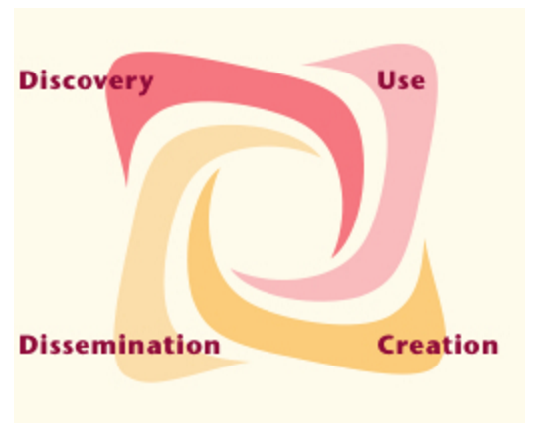
Knowledge Life-Cycle

Slide 13
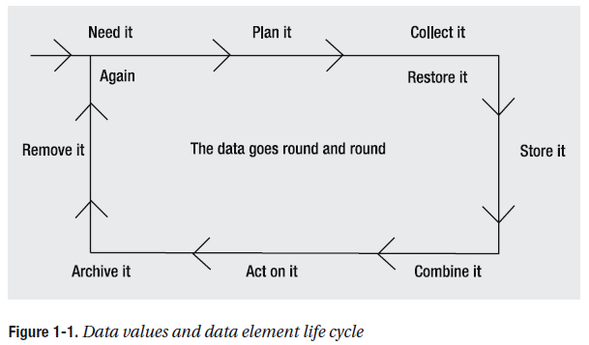
Data life cycle
or find it
Beginning relational data modeling Allen, Sharon. Terry, Evan - Page 9

Slide 14
Data life cycle example
Need
  Calculate Solar Insolation
    Promote alternative energy

Slide 15
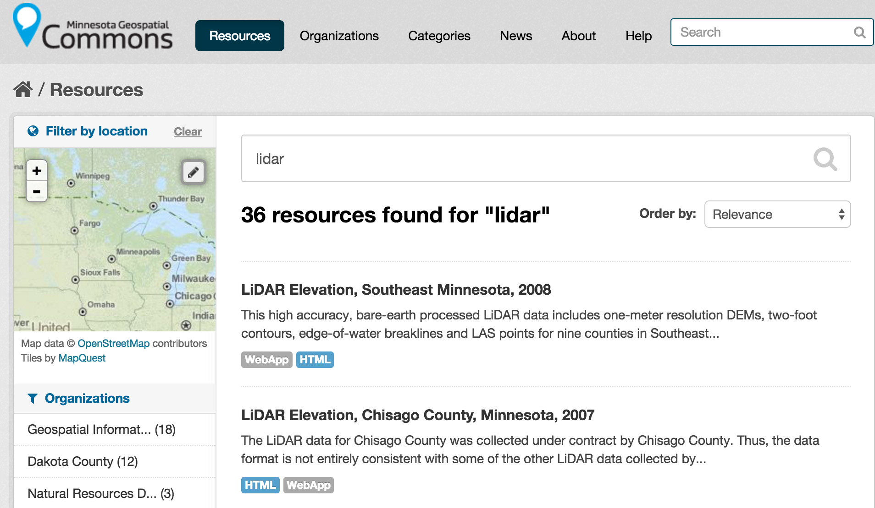
Data life cycle example
Plan
Available data
  MN lidar data
  Building footprints???

Slide 16
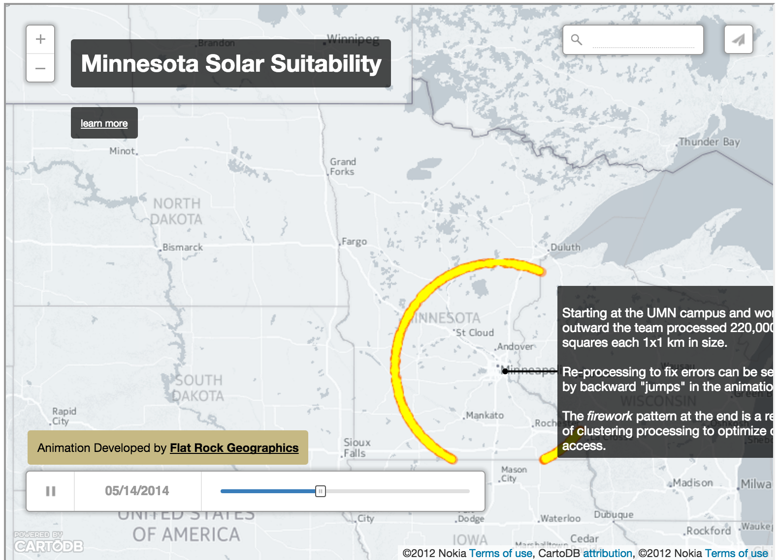
Data life cycle example
Collect, store and combine

Slide 17
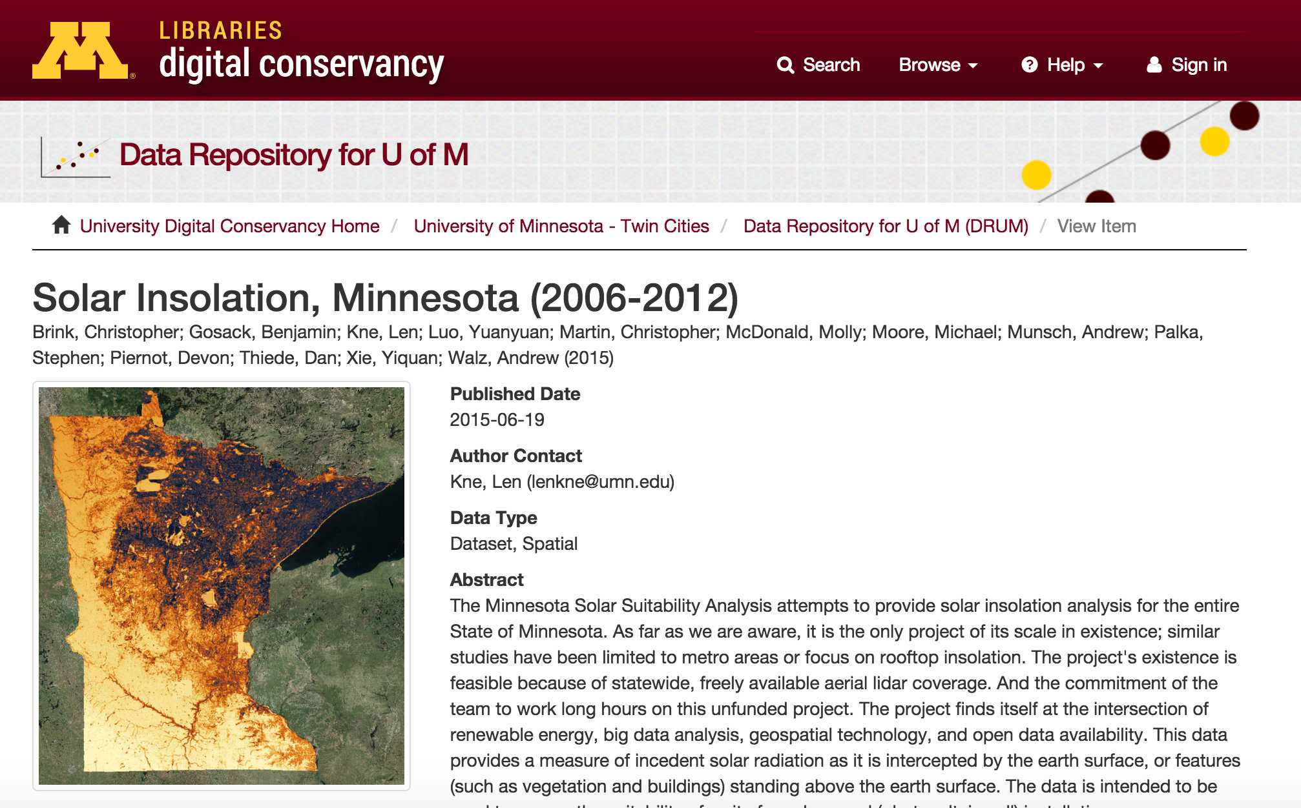
Data life cycle example
Act, archive and remove ... and don't forget the metadata

Slide 18
Data life cycle
or find it
Beginning relational data modeling Allen, Sharon. Terry, Evan - Page 9

Slide 19
Database models
Flat Files (No-DB)
Relational Database
Hierarchical Models
Network Models (Node JS)
NoSQL
New SQL

Slide 20

Types of database models -
Flat files
"ID","test"
1,"One"
2,"Two"
...
+ Easy to understand, interoperable
- Repeat data, not scalable - maybe AWK

Slide 21

Types of database models - Hierarchical
+ Easy to understand, good performance
- duplicate data, only one parent
Beginning relational data modeling Allen, Sharon. Terry, Evan - Page 28

Slide 22

Types of database models - Network
+ Can have multiple parents
- Need to keep pointers
Beginning relational data modeling Allen, Sharon. Terry, Evan - Page 30

Slide 23

Types of database models - Objects
+ Good integration with programming objects
- Many standards
http://en.wikipedia.org/wiki/Object-relational_model

Slide 24

Relational Model

Slide 25


Other Database Types
Different Categories
Column Store Hadoop, Amazon SimpleDB
Document Store MongoDB, Solr
BigTable Google App Engine
Key-value Store DynamoDB, Cassandra
Graph Neo4J
SPARQL

