Slide 1
Data Life Cycle

Slide 2
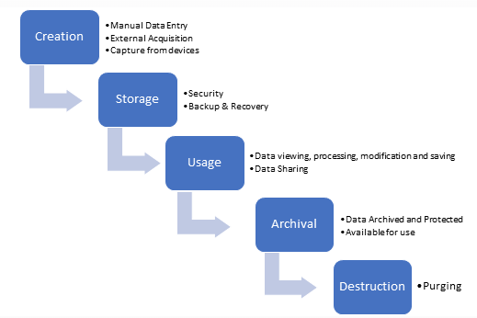
Data Cycle
https://www.dataworks.ie/5-stages-in-the-data-management-lifecycle-process/

Slide 3
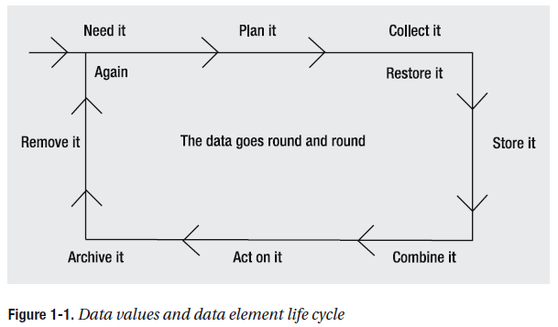
Data life cycle
or find it
Beginning relational data modeling Allen, Sharon. Terry, Evan - Page 9

Slide 4
Data life cycle example
Need
  Calculate Solar Insolation
    Promote alternative energy

Slide 5
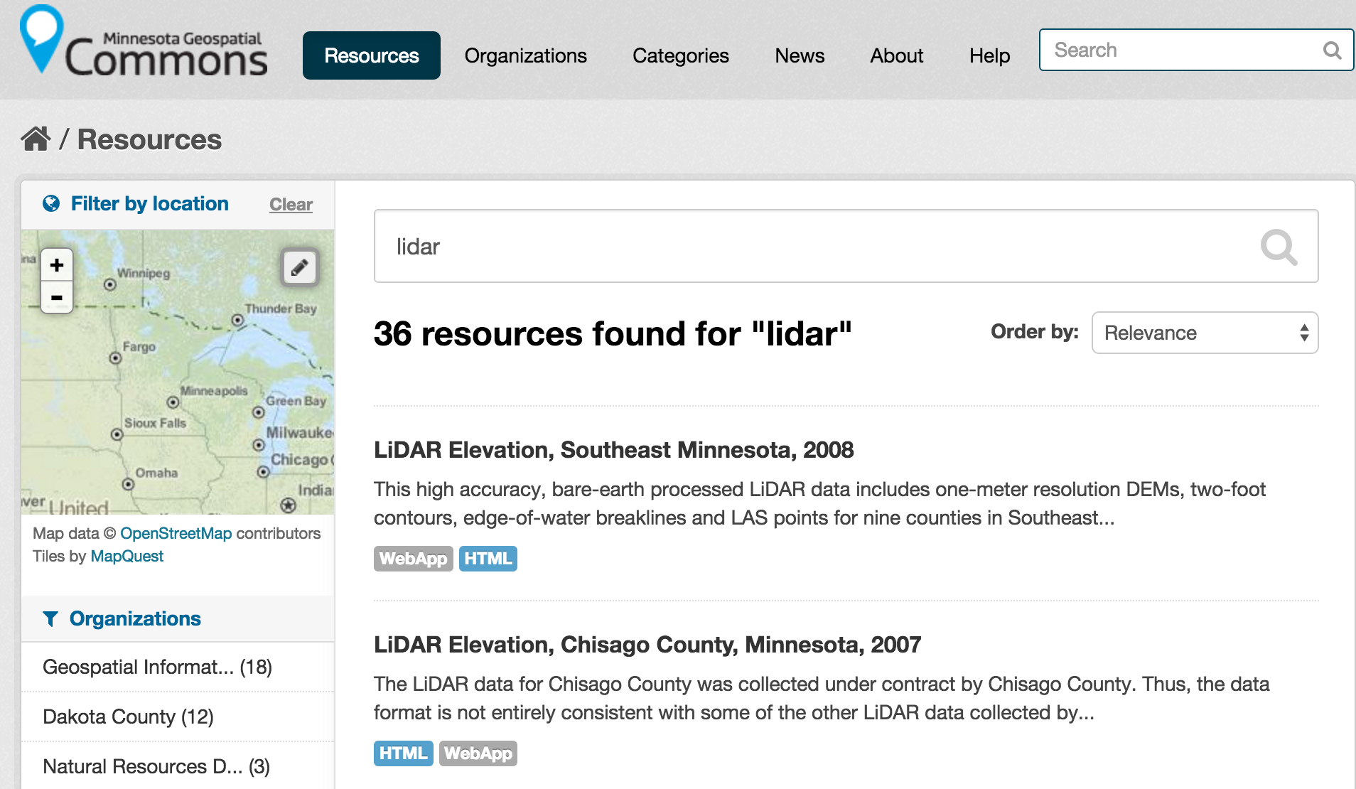
Data life cycle example
Plan
Available data
  MN lidar data
  Building footprints???

Slide 6
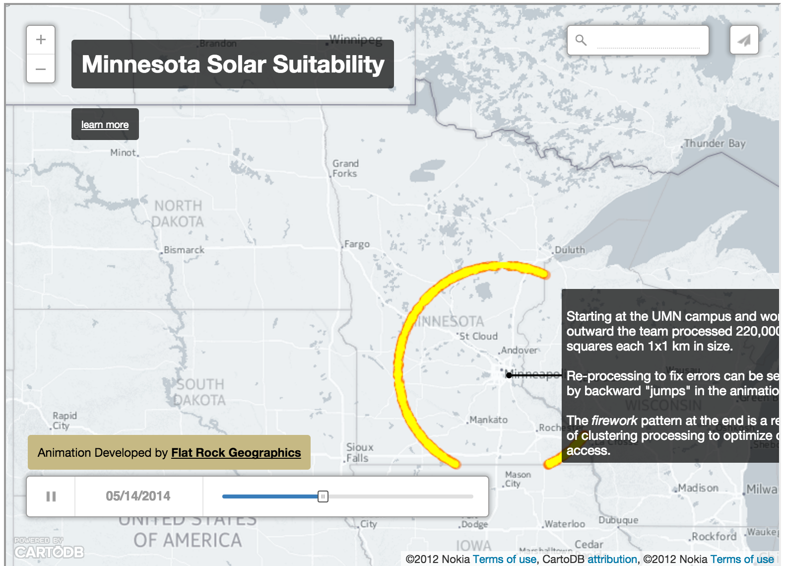
Data life cycle example
Collect, store and combine

Slide 7
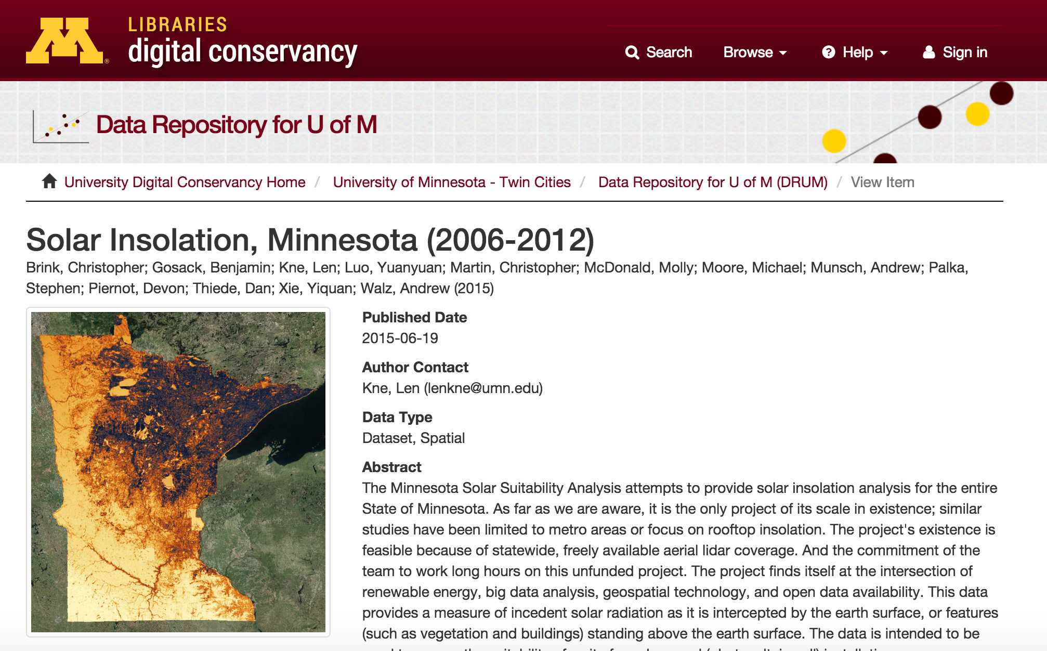
Data life cycle example
Act, archive and remove ... and don't forget the metadata

Slide 8
Data life cycle
or find it
Beginning relational data modeling Allen, Sharon. Terry, Evan - Page 9

Slide 9
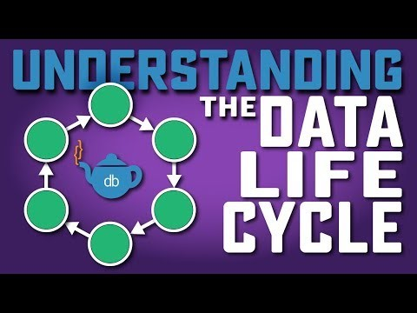
Data Life-Cycle
https://www.youtube.com/watch?v=5I2bYqeFQy4

Slide 10
Database Models

Slide 11
Database models
Flat Files (No-DB)
Relational Database
Hierarchical Models
Network Models (Node JS)
NoSQL
New SQL

Slide 12

Types of database models -
Flat files
"ID","test"
1,"One"
2,"Two"
...
+ Easy to understand, interoperable
- Repeat data, not scalable - maybe AWK

Slide 13

Types of database models - Hierarchical
+ Easy to understand, good performance
- duplicate data, only one parent
Beginning relational data modeling Allen, Sharon. Terry, Evan - Page 28

Slide 14

Types of database models - Network
+ Can have multiple parents
- Need to keep pointers
Beginning relational data modeling Allen, Sharon. Terry, Evan - Page 30

Slide 15

Types of database models - Objects
+ Good integration with programming objects
- Many standards
http://en.wikipedia.org/wiki/Object-relational_model

Slide 16


Other Database Types
Different Categories
Column Store Hadoop, Amazon SimpleDB
Document Store MongoDB, Solr
BigTable Google App Engine
Key-value Store DynamoDB, Cassandra
Graph Neo4J
Array SciDB
SPARQL

Slide 17
Spatial Database Exploration
Neo4j – Graph
MongoDB – Document / No SQL
CitusDB – Parallel RDBM
SciDB – ArrayDB

Slide 18

Relational Model

Slide 19
More Info?
https://medium.com/practicum-bootcamp/database-models-ec4f0dba8985

