Slide 1
Database Management

Slide 2
SQL
SELECT
FROM
WHERE
[GROUP BY]
ORDER BY

Slide 3
SQL
SELECT --- Return data (3)
FROM --- Define data sources (1)
WHERE --- Filter data (2)
[GROUP BY]
ORDER BY --- Organize the return of data (4)

Slide 4
SQL
SELECT [DISTINCT] [COUNT(DISTINCT xxx)]
FROM [JOIN]
WHERE [IN]
[GROUP BY]
[HAVING] – filter on the group by
ORDER BY

Slide 5
Codd's rules for a RDBMS
There are 12 rules
Not every relational DB follows all 12 rules
There are good reasons to follow the rules
There are good reasons to not follow the rules

Slide 6
CRUD
Create
  Insert
  Copy
Read
Update
Delete

Slide 7
Create Statement
Create a table, often people will refer to this as the DDL (Data Definition Language).
  https://www.postgresql.org/docs/11/sql-createdatabase.html
Creating table
  What is the purpose of this table?
  How will it be used?
  What is necessary?

Slide 8
PSQL String Datatypes
char(#) – number of characters to store
character(#) – number of characters to store
varchar(#) – number of characters to store
character varying(#) – number of characters to store
text – variable length string

Slide 9
Create Table Statement
CREATE TABLE family (
first_name char(15),
last_name character(15),
middle_name char
);

Slide 10
CODE IT
INSERT into something (first_name, last_name) VALUES (‘David’ ‘Haynes’);
INSERT into something (middle_name) VALUES ('apricot');

Slide 11
PSQL Numeric Datatypes
bit(#) / varbit(#) – length of the bit string
smallint – 2byte integer
int / integer (4 byte integer)
biginteger (8 byte integer)
smallserial – auto incrementing integer value (2 byte)
serial – auto incrementing integer value (4 byte)
bigserial – auto incrementing integer value ( 8 byte)
numeric(length,precision) – length is total digits, precision digits after decimal
double precision – 8 byte floating point number
real – 4 byte floating point number
money – currency value
bool / boolean – true or false

Slide 12
PSQL Date/Time Datatypes
Date – Displayed ‘YYYY-MM-DD’
Timestamp – Displayed ‘YYYY-MM-DD HH:MM:SS’
Timestamp without time zone – Displayed ‘YYYY-MM-DD HH:MM:SS’
Timestamp with time zone – Displayed ‘YYYY-MM-DD HH:MM:SS-TZ’
Time – Displayed as ‘HH:MM:SS’
Time without time zone – Displayed as ‘HH:MM:SS’
Time with time zone – Displayed as ‘HH:MM:SS-TZ’

Slide 13
Cheep Store
https://www.gobankingrates.com/saving-money/shopping/things-can-still-buy-dollar/
https://perchance.org/object

Slide 14
Create a Table
CREATE TABLE store_items (
item_name text,
item_owner text
);
GRANT INSERT ON store_items TO students;

Slide 15
CODE IT
Insert your candy into the table Halloween_candy in the database classroom
INSERT INTO store_items (item_name, item_owner) VALUES (‘Hammer’, ‘David Haynes’);

Slide 16
Normalization
Codd’s Rules for RDBMS
  Normalization -Get rid of duplicate data
  Universal Properties
    No duplicates
    The order of attributes and records is unimportant
    All attribute values are atomic. They hold only one value at a time.
  1st Normal Form
    Primary Key

Slide 17
CODE IT
Our table has lots of duplicates and no primary key, what should we do.
Scrap the table and start all over?

Slide 18
Alter Table
ALTER TABLE store_items ADD item_id bigserial;

Slide 19
ALTER TABLE
ALTER TABLE [ IF EXISTS ] [ ONLY ] name [ * ]
RENAME [ COLUMN ] column_name TO new_column_name
ALTER TABLE [ IF EXISTS ] [ ONLY ] name [ * ]
RENAME CONSTRAINT constraint_name TO new_constraint_name
ALTER TABLE [ IF EXISTS ] name
RENAME TO new_name
ALTER TABLE [ IF EXISTS ] name
SET SCHEMA new_schema
ALTER TABLE ALL IN TABLESPACE name [ OWNED BY role_name [, ... ] ]
SET TABLESPACE new_tablespace [ NOWAIT ]
where action is one of:
ADD [ COLUMN ] [ IF NOT EXISTS ] column_name data_type [ COLLATE collation ] [ column_constraint [ ... ] ]
DROP [ COLUMN ] [ IF EXISTS ] column_name [ RESTRICT | CASCADE ]
ALTER [ COLUMN ] column_name [ SET DATA ] TYPE data_type [ COLLATE collation ] [ USING expression ]
https://www.postgresql.org/docs/11/sql-altertable.html

Slide 20
Breakout Rooms

Slide 21
Candy Purchases
ALTER TABLE store_items RENAME TO store_order;
ALTER TABLE store_items add purchased_date timestamp;
ALTER TABLE store_items add customer_id integer;

Slide 22
Customer_id
We added a new column
  Is it useful?
  Can we populate it?

Slide 23
UPDATE
UPDATE candy_purchases
SET customer_id = 1
WHERE store_items = ‘David Haynes’;
Row 1 = Values 1-10
Row 2 = Values 20-30
Row 3 = Values 30-40

Slide 24
Update your time stamp
UPDATE store_items
SET purchased_date = '10/31/2017 10:05'
WHERE item_owner = 'David Haynes'

Slide 25
Update multiple fields at the same time
UPDATE <table>
SET <field1> = <value1>, <field2> = <value2> …

Slide 26
CODE IT
Insert your records into the table again (2 or more times)
Choose a new time stamp
  Time stamp must be in the range 10/30/2021 anytime – 11/01/2024 anytime
  How can you make sure you won’t update your existing records

Slide 27
CREATE TABLE store_items
(
transaction_id SERIAL PRIMARY KEY,
customer_id integer REFERENCES candy_customer(customer_num),
purchased_date timestamp
);

Slide 28
CODE IT
Sales
  Employee_id, product, number of sales,
Suppliers
  Company name, address, city, state, country, employees, founded, products
Customers
  First name, last name, address, birthday, has_children, salary

Slide 29
BREAK

Slide 30
Normal Forms

Slide 31
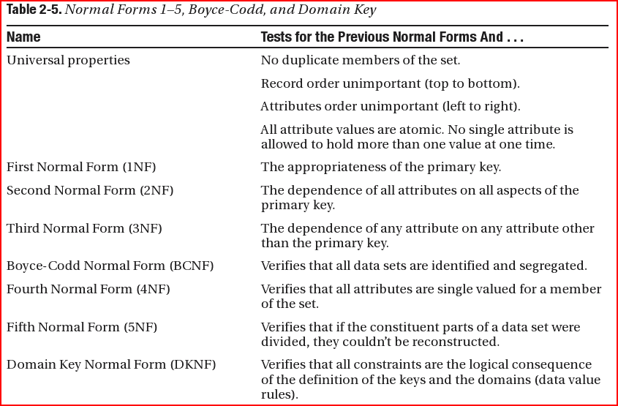
Normal forms
Beginning relational data modeling Allen, Sharon. Terry, Evan - Page 41

Slide 32
Student# | Advisor | Adv-Room | Class1 | Class2 | Class3
1022 | Jones | 412 | 101-07 | 143-01 | 159-02
4123 | Smith | 216 | 201-01 | 211-02 | 214-01

Slide 33
First normal form (1NF)
There must be no duplicate instances (duplicate members of the set).
Instances are unordered (top to bottom).
Data elements are unordered (left to right).
No single column describing a single instance is allowed to hold multiple values at one time.
No columns repeated

Slide 34
1NF - No columns repeated
Student# | Advisor | Adv-Room | Class#
1022 | Jones | 412 | 101-07
1022 | Jones | 412 | 143-01
1022 | Jones | 412 | 159-02
4123 | Smith | 216 | 201-01
4123 | Smith | 216 | 211-02
4123 | Smith | 216 | 214-01

Slide 35
Second normal form (2NF)
No columns repeated
Every non-key attribute is functionally dependent on the primary key (Create separate tables for sets of values that apply to multiple record).
In our example, Class is not functionally dependent on Student# (PK?)

Slide 36
2NF
Student
Student# | Advisor | Adv-Room
1022 | Jones | 412
4123 | Smith | 216
1NF
Student# | Advisor | Adv-Room | Class#
1022 | Jones | 412 | 101-07
1022 | Jones | 412 | 143-01
1022 | Jones | 412 | 159-02
4123 | Smith | 216 | 201-01
4123 | Smith | 216 | 211-02
4123 | Smith | 216 | 214-01
Registration
Student# | Class#
1022 | 101-07
1022 | 143-01
1022 | 159-02
4123 | 201-01
4123 | 211-02
4123 | 214-01

Slide 37
Third normal form (3NF)
No columns repeated
Every non-key attribute is functionally dependent on the primary key
No transitive functional dependencies
In our example, eliminate fields that do not depend on the key - adv-room is dependent on advisor not student.

Slide 38
3NF
Registration
Student
Student# | Class#
1022 | 101-07
1022 | 143-01
1022 | 159-02
4123 | 201-01
4123 | 211-02
4123 | 214-01
Student# | Advisor
1022 | Jones
4123 | Smith
1522 | Jones
Faculty
Advisor | Adv-Room
Jones | 412
Smith | 216
See http://support.microsoft.com/kb/283878

Slide 39
Bad IDEA on id columns
Registration
Student
Student# | Class#
1022 | 101-07
1022 | 143-01
1022 | 159-02
4123 | 201-01
4123 | 211-02
4123 | 214-01
Student# | Advisor | Faculty_id
1022 | Jones | 400
4123 | Smith | 401
1522 | Jones | 400
Faculty
Faculty_id | Advisor | Adv-Room
400000 | Jones | 412
 | Smith | 216
Address_id | Address | City | State | zip
4000000
1022
See http://support.microsoft.com/kb/283878

Slide 40
Address_id
Registration
Student
Student# | Class#
1022 | 101-07
1022 | 143-01
1022 | 159-02
4123 | 201-01
4123 | 211-02
4123 | 214-01
Address_id | Student# | Advisor | Faculty_id
2 | 1022 | Jones | 400
4 | 4123 | Smith | 401
 | 1522 | Jones | 400
Faculty
Address_id | Faculty_id | Advisor | Adv-Room
1 | 400000 | Jones | 412
 |  | Smith | 216
Address_id | Address | City | State | zip
1
2
See http://support.microsoft.com/kb/283878

Slide 41
Relational DB
Relationships (cardinality)
  One to one
  One to many
  One to none
  Many to many

Slide 42
PSQL Functions

Slide 43
String Functions
https://www.postgresql.org/docs/9.5/static/functions-string.html

Slide 44
PSQL String Functions
Concatenate text
SELECT '1' || ' apple' as new_column
Split_part
SELECT split_part('dogs, cats, alligators', ',', 3) as animal_i_fear
Repeat
SELECT repeat('dogs', 3)
Length
SELECT length(repeat('dogs', 3))

Slide 45
PSQL Date/Time Functions
https://www.postgresql.org/docs/9.5/static/functions-datetime.html
Date_part
SELECT date_part('year', '01-01-2015'::date) as year
Now
SELECT date_part('year', now()) as year
SELECT date_part('minute', now()) as minute

Slide 46
Query the table
When was the most item sold?

