Slide 1
Spatial Databases

Slide 2
History of Spatial Data in Databases

Slide 3
History of GIS
ArcInfo – 1982
ESRI released a subset of ARC/INFO known as PC ARC/INFO for MS-DOS in 1987
Windows version used a dBase tables (instead of INFO) for tabular data.
Open Geospatial Consortium – Simple Features
ESRI releases shapefiles – 1990
PostGIS - 2000

Slide 4
PostGIS
Well Known Text (WKT)
  Use this function for information
  ST_AsText(geom)
Well Known Binary (WKB)
  Store spatial information in the database
  ST_AsGeometry(wkt) convert text into geometry type

Slide 5
PostGIS Simple Feature Data Types

Slide 6
Data Types
Geometry
  Polygon (Multi)
  Polyline (Multi)
  Point (Multi)
Geography
  Polygon (Multi)
  Polyline (Multi)
  Point (Multi)

Slide 7
Geometry
Geography
The basis for the PostGIS geometry type is a plane.
The shortest path between two points on the plane is a straight line.
Geometries calculations (areas, distances, lengths, intersections, etc) can be calculated using cartesian mathematics and straight line vectors.
The basis for the PostGIS geographic type is a sphere.
The shortest path between two points on the sphere is a great circle arc.
Calculations using the geographic data type (areas, distances, lengths, intersections, etc) must be calculated on the sphere.
The measurements are more calculated, and must take the actual spheroidal shape of the world into account.

Slide 8
PostGIS Geometry / Geography Conversion
Geometry to Geography
  Geography(geom) as geog
  Must be in the lat/long projection (4326)
Geography to geometry
  geography::geom as geom
  Any geography field can be cast to geometry

Slide 9
Spatial Reference Id Table
SELECT *
FROM spatial_ref_sys
Resources
Epsg.org
http://spatialreference.org/ref/epsg/

Slide 10
Spatial Views
DON’T DELETE EVER
  Geometry_columns
  Geography_columns
  Raster_columns
  Raster_overviews

Slide 11
Code It!
Build a point
SELECT ST_GeometryFromText('Point('|| -91.3232 || ' ' || 42.1212 || ')',4326)
SELECT 'SRID=4326; POINT(-91.3232 42.1212)'::geometry

Slide 12
Add geometry to Table
SELECT 'SRID=4326; POINT(-91.3232 42.1212)'::geometry
INTO new_table;
CREATE TABLE new_table as
SELECT ST_GeometryFromText('Point('|| -91.3232 || ' ' || 42.1212 || ')',4326)

Slide 13
Add cities.csv to database
SELECT id, x, y,
ST_GeometryFromText('Point(‘|| x|| ' ' || y || ')',4326) as geom
INTO us_cities
FROM cities

Slide 14
Modify Cities Table : CODE IT
Add the geometry column
Update the cities table
Check out the geometry_columns table

Slide 15
Loading Data

Slide 16
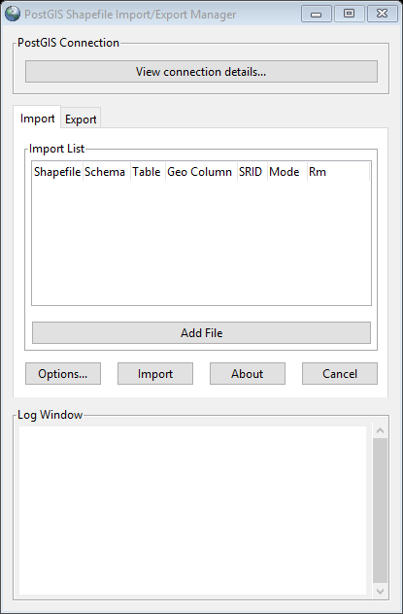
Shp2pgsql GUI
pgAdmin III supports shp2pgsql-gui.exe
GUI can be found here
C:\Program Files\PostgreSQL\9.6\bin\postgisgui

Slide 17
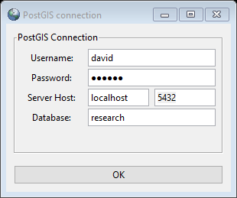
Connect to the Database
Enter in the following information
  Username
  Password
  Localhost
  Port
  Database

Slide 18
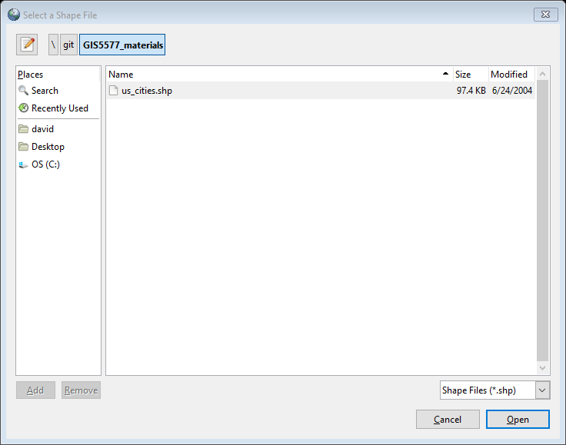
Shp2pgsql GUI
Add the file or shapefiles that you would like to load into the system.

Slide 19
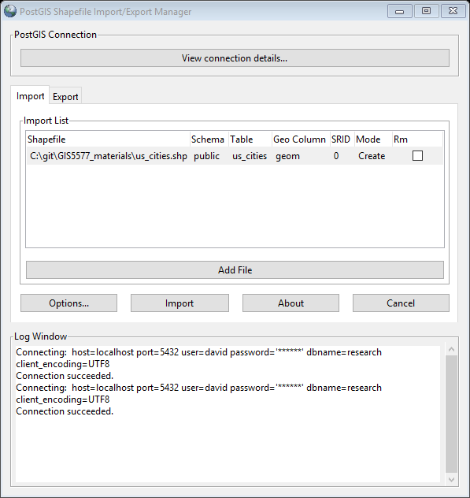
Shp2pgsql GUI
Set the Spatial Reference ID (SRID)
Choose the table name
Choose schema, default schema is public

Slide 20
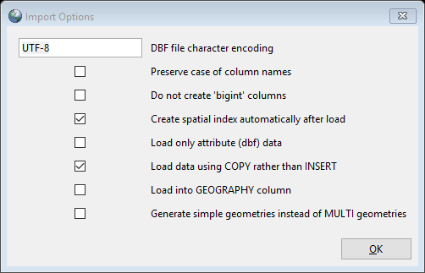
Shp2pgsql GUI

Slide 21
Command Line
shp2pgsql –I –s <srid> <filepath.shp> <tablename> | psql –h <host > –d <database> -p <port> -U <username>

Slide 22
Command line explained
You need to find the path where the shp2pgsql.exe exists
shp2pgsql –I –s <srid> <filepath.shp> <tablename> > <filepath>
psql –h <host > –d <database> -p <port> -U <username> -f <filepath>
Host = ‘local host’ on your computer
Port = 5432 is the default for PostgreSQL

Slide 23
Visualizing Data

Slide 24
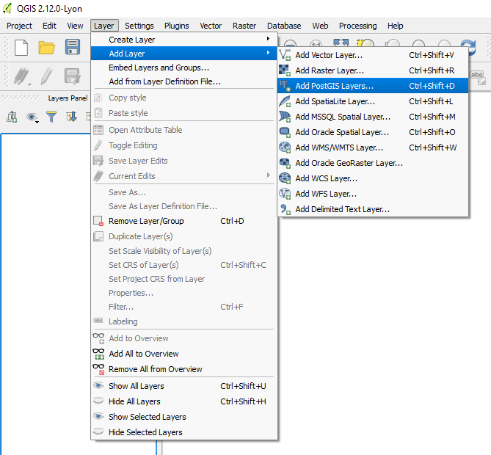
QGIS and PostGIS
Add PostGIS Layer

Slide 25
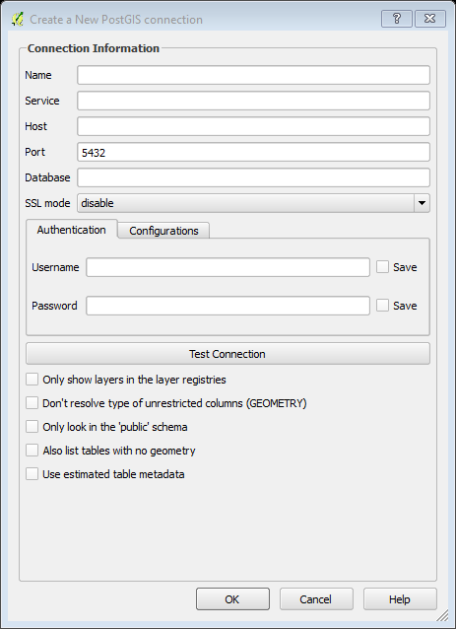
QGIS Connection
Add the database connection values.
  Host
  Port
  Database
  Username
  Passworkd
QGIS will save these values.

Slide 26
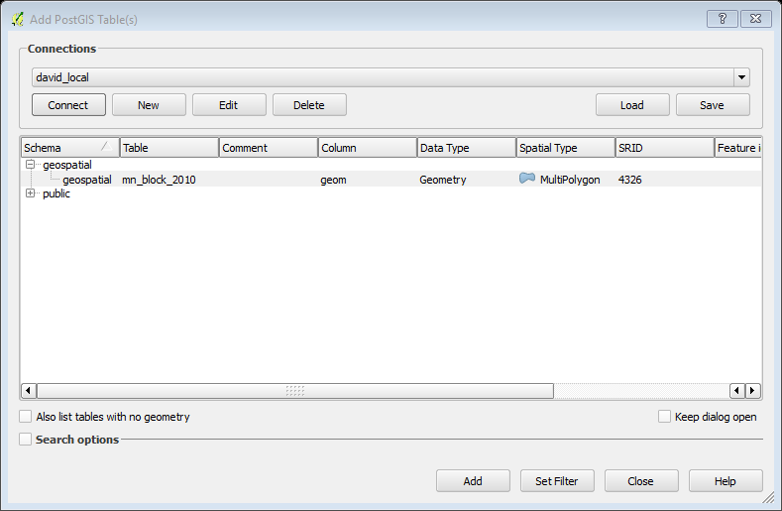
QGIS Add GeoTable
Connect to your database
Find the GeoTable
Add the GeoTable to the map

Slide 27
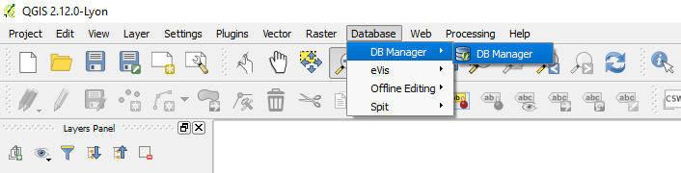
QGIS Database Connection
Add the QGIS Plugin
DBManager
Database → DB Manager → DB Manager

Slide 28
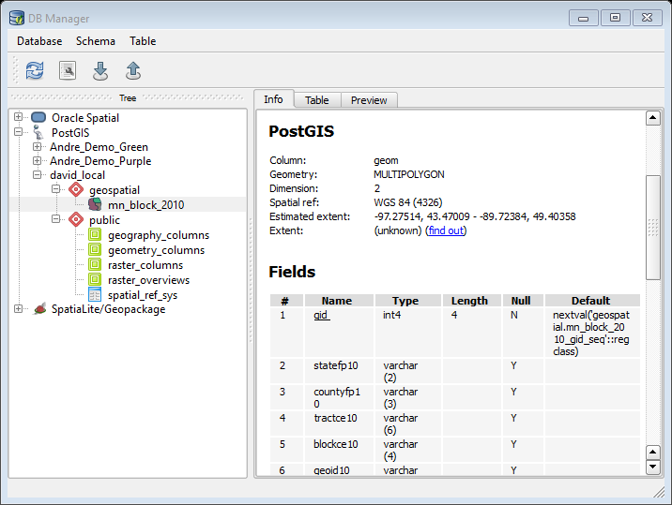
QGIS Database Connection
Connect to PostGIS Database
View Tables
  Select the table

Slide 29
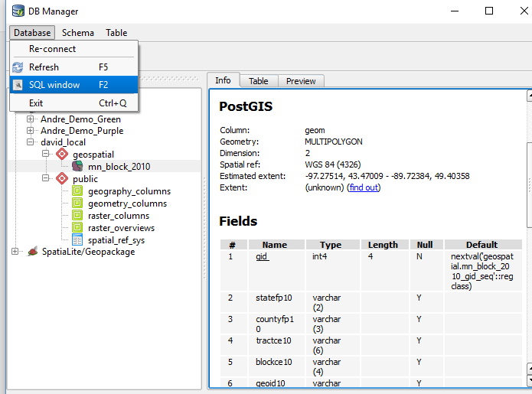
QGIS Database Connection
Database → SQL Window

Slide 30
QGIS Database
SELECT c.gid, c.areaname, c.geom
FROM cities c
INNER JOIN us_states s on ST_Within(c.geom, s.geom)
WHERE s.name = 'Minnesota'

Slide 31
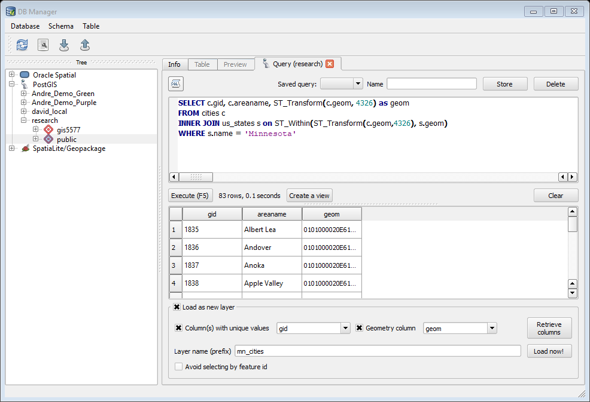
Add Layer to Map

Slide 32
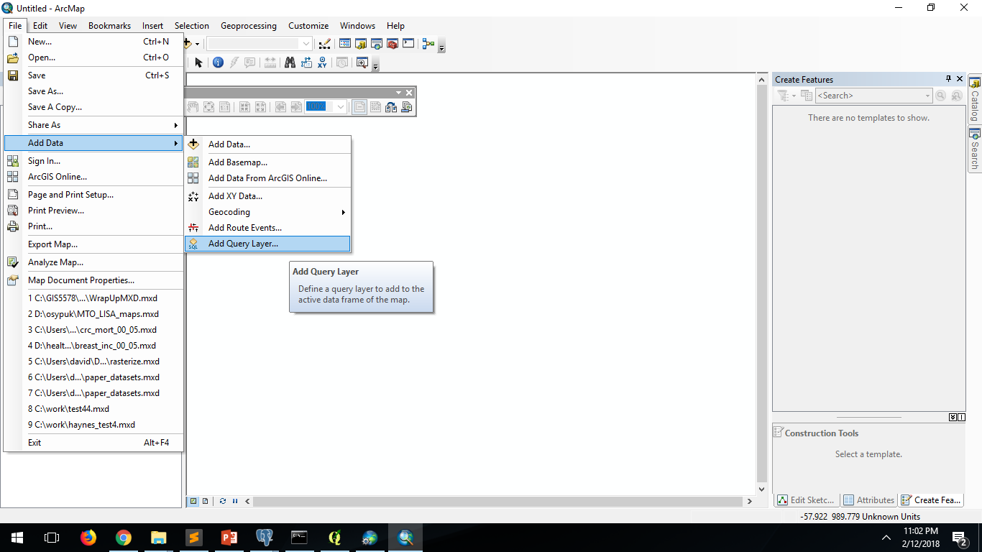
ArcMap
Add Data

Slide 33
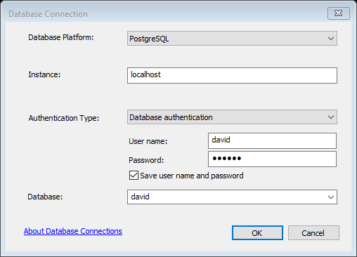
ArcMap Connection
Database = PostgreSQL
Instance = host address
User name
Password
Database = Database name
  This won’t activate until you have authenticated a username, password

Slide 34
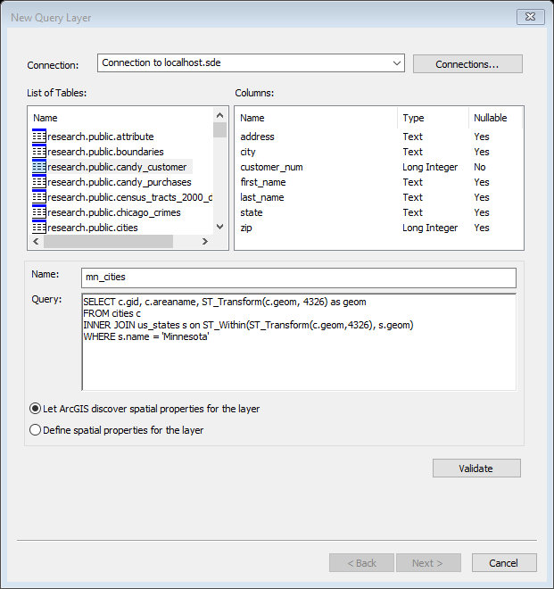
ArcMap Connection
Write your own SQL statement
Choose a name for the layer
Click Validate
  If the SQL is valid, click Next

Slide 35
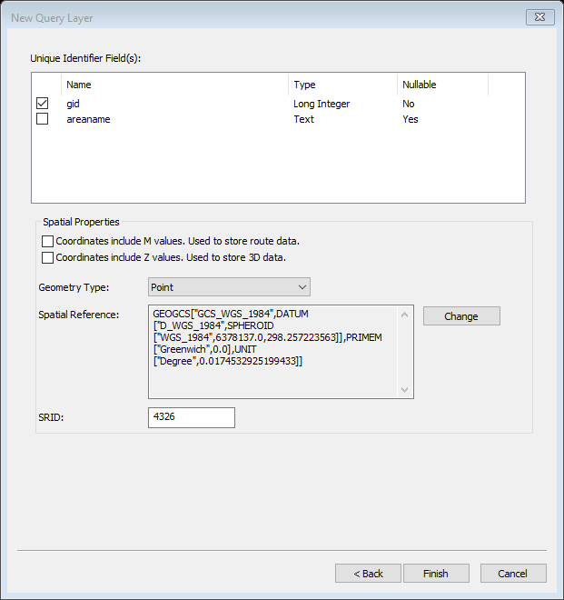
ArcMap Connection
Choose a Unique Identifier
  Sometimes ArcMap prefers string over integers
Verify the SRID
Finish to load layer

Slide 36
Spatial Operations with PostGIS

Slide 37
PostGIS
Spatial Operation
  Measurements
    ST_Area, ST_Distance, ST_Centroid
  Intersect
Spatial Operators
  ST_Intersection
  ST_Within
  ST_CoveredBy

Slide 38
CODE IT
Find all of the cities within Minnesota
Project the cites in 26916.
SELECT c.gid, c.areaname, c.geom
FROM cities c
INNER JOIN us_states s on ST_Within(c.geom, s.geom)
WHERE s.name = 'Minnesota'

Slide 39
CODE IT
Count the cities by states?
Which state has the most cities?
What state had the largest area?
  Did you project?
  What projection is appropriate?

Slide 40
CODE IT
Which MN cities are closest to the state of MN centroid?

