Slide 1
Spatial Queries

Slide 2
Spatial Predicates
http://edndoc.esri.com/arcsde/9.0/general_topics/understand_spatial_relations.htm

Slide 3
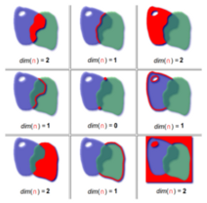
This Photo by Unknown Author is licensed under CC BY-SA

Slide 4
Spatial Predicates
Provides a terminology or semantics that allow for the expression of topological relationships.

Slide 5
Spatial Predicates
Disjoint
Equals
Touches
Crosses
Overlaps
Contains
Within

Slide 6
Dimensionally Extended 9 Intersection Matrix
This is 3 x 3 table that allows for mathematical expression of these relationships
https://docs.safe.com/fme/html/FME_Desktop_Documentation/FME_Transformers/Transformers/spatialrelations.htm

Slide 7
DE-9IM
Candidate
 | Interior | Boundary | Exterior
Interior
Boundary
Exterior
Base

Slide 8
Spatial Query Types

Slide 9
Query types
Point query/point-in-polygon query
  Parameter: coordinates
  What objects exists at these coordinates?
Window/range query
  Parameter: region defined by coordinates
  What objects are located in this region?
Distance and Buffer Zone queries
  Parameters: buffer object and distance
  What objects are there within given distance from buffer?

Slide 10
Query types (2)
Path queries (network structure required)
  Parameters: network locations
  What is the shortest route from A to B?
Join and Range queries
  Spatial objects and relationships
  Spatial predicates: points, windows, buffers, paths
  Overlaying roads and waterworks GIS layers and displaying the result according to relative height (river, bridge, aqueduct) is a spatial join

Slide 11
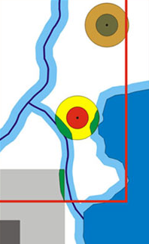
Query types (3)
Feature approach – feature vectors
Neighborhood search
Spatial-Query-by-Sketch
  Multimedia (2D) search instead of alphanumeric

Slide 12
Database Indices

Slide 13
What is an index
An index is a copy of selected columns of data from a table that can be searched very efficiently that also includes a low-level disk block address or direct link to the complete row of data it was copied from. Some databases extend the power of indexing by letting developers create indexes on functions or expressions. (Wikipedia)

Slide 14
Indices
B-tree
Hash
GiST
SP-GiST
GIN
BRIN

Slide 15
B-Tree
Very common.
Handles equality and range queries
>, >=, =, <=, <

Slide 16
Hash
Very popular for datasets that grow in size

Slide 17
Functional Indices
Indices that use one or more expressions. Functional indices are potentially very powerful as they allow for more precise indices if they support queries people use.
create index cruts_322_us_climate_year on cruts_322_us_climate using btree(date_part('year', sample_date));

Slide 18
Demo – Point in Polygon Test
Identify the Minnesota counties that contain cities?
Climate data joining
Brief description of the datasets being used.

Slide 19
Question 1
For each geographic feature what is the average temperature in July 2005.
  Census tract
  County
  State

Slide 20
Question 2
For each geographic unit, identify those that do not have any us cities
  Census tract
  County
  State

Slide 21
Question 3
Calculate area for each geographic feature, what is the largest county in the continental United States?
Calculate the difference between the attribute area and the calculated area.
Calculate the population density people / per square mile

Slide 22
Question 4
For this question choose an interstate road.
For each geographic unit, identify the features that an the road goes through
  Census tract
  County

Slide 23
Question 5
For each geographic feature, find all adjacent geographic features to the state of Iowa which are not Iowa features.
  Census tract
  County

Slide 24
Question 6
For each geographic feature, identify which county has the most roads?
  Census tract
  County

Slide 25
Question 7
Identify which us cities are not within 30 kilometers of any road?
Identify which us cities are within 5 kilometers of any interstate road.

Slide 26
Question 8
Choose a state for this analysis.
Identify for that particular state, which cities are furthest from the state centroid.

Slide 27
Question 9
What is the monthly average of cloudy days in Maine?
What state has the highest average cloudy days for 2008?

Slide 28
Question 10
Choose your own time period.
Identify the road segments that by county are the windiest?
Identify the road segments that by county are the hottest?

