Slide 1

Database Indices

Slide 2
What is a database
Organized collection of structured information, or data, typically stored electronically in a computer system.
How is this different from a computer program (Python / R / Java)

Slide 3


What is the purpose of these tools

Slide 4
Programming vs Database
Ignore data frames. Searching raw text. (Programming or Database)
Searching a delimited file. (Programming or Database)
Allowing multiple users to find something in a file (Programming or Database)
Organizing storage, standardizing extraction processes. (Programming or Database)

Slide 5
What makes a database so fast?
Indices
Knowing the data structure

Slide 6
What is an index
An index is a copy of selected columns of data from a table that can be searched very efficiently that also includes a low-level disk block address or direct link to the complete row of data it was copied from. Some databases extend the power of indexing by letting developers create indexes on functions or expressions. (Wikipedia)

Slide 7
PostgreSQL Indices
B-tree
Hash
GiST
SP-GiST
GIN
BRIN

Slide 8
B-Tree
Very common.
Handles equality and range queries
>, >=, =, <=, <

Slide 9
Hash
Very popular for datasets that grow in size

Slide 10
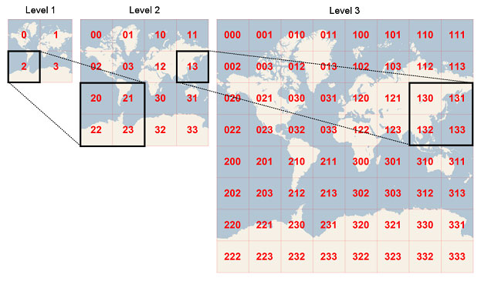
GeoHash

Slide 11
Code It
Create a GeoHash for the United States
text ST_GeoHash(geometry geom, integer maxchars=full_precision_of_point);
https://postgis.net/docs/ST_GeoHash.html
Returns a GeoHash representation (http://en.wikipedia.org/wiki/Geohash) of the geometry. A GeoHash encodes a point into a text form that is sortable and searchable based on prefixing. A shorter GeoHash is a less precise representation of a point. It can also be thought of as a box, that contains the actual point.

Slide 12
Functional Indices
Indices that use one or more expressions. Functional indices are potentially very powerful as they allow for more precise indices if they support queries people use.
CREATE INDEX cruts_322_us_climate_year on cruts_322_us_climate USING btree(date_part('year', sample_date));
https://www.postgresql.org/docs/9.1/sql-createindex.html
CREATE INDEX cruts_322_us_climate_spatial on cruts_322_us_climate USING Gist(ST_Transform(geom, 26915))
https://postgis.net/workshops/postgis-intro/indexing.html

Slide 13
Functional Indices (Continued)
CREATE INDEX cruts_322_us_climate_all_index_year on cruts_322_us_climate_all_index USING btree(date_part('year', sample_date));
CREATE INDEX cruts_322_us_climate_all_index_month on cruts_322_us_climate_all_index USING btree(date_part('month', sample_date));
CREATE INDEX cruts_322_us_climate_all_index_year_month on cruts_322_us_climate_all_index USING btree(date_part('year', sample_date), date_part('month', sample_date));

Slide 14
Demo – Point in Polygon Test
Identify the Minnesota counties that contain cities?
Climate data joining
Brief description of the datasets being used.

Slide 15
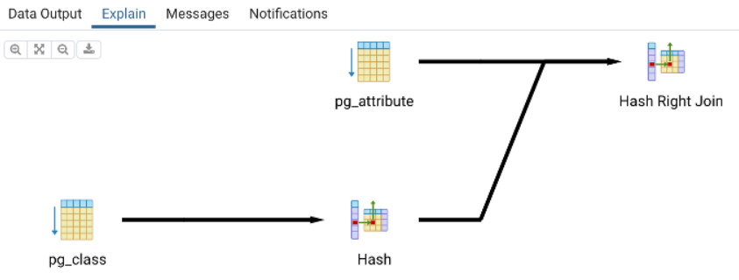
Writing “fast” SQL
Query Planner
EXPLAIN at the top of your SQL
PgAdmin4 “Explain tab”
https://dataschool.com/sql-optimization/what-is-a-query-plan/
https://thoughtbot.com/blog/reading-an-explain-analyze-query-plan
https://use-the-index-luke.com/sql/explain-plan/postgresql/operations

