Slide 1
Spatial Queries

Slide 2
Demo – Point in Polygon Test
Identify the Minnesota counties that contain cities?
Climate data joining
Brief description of the datasets being used.

Slide 3
Question 1
For each geographic feature what is the average temperature in July 2005.
  Census tract
  County
  State

Slide 4
Question 2
For each geographic unit, identify those that do not have any us cities
  Census tract
  County
  State

Slide 5
Question 3
Calculate area for each geographic feature, what is the largest county in the continental United States?
Calculate the difference between the attribute area and the calculated area.
Calculate the population density people / per square mile

Slide 6
Question 4
For this question choose an interstate road.
For each geographic unit, identify the features that an the road goes through
  Census tract
  County

Slide 7
Question 5
For each geographic feature, find all adjacent geographic features to the state of Iowa which are not Iowa features.
  Census tract
  County

Slide 8
Question 6
For each geographic feature, identify which county has the most roads?
  Census tract
  County

Slide 9
Question 7
Identify which us cities are not within 30 kilometers of any road?
Identify which us cities are within 5 kilometers of any interstate road.

Slide 10
Question 8
Choose a state for this analysis.
Identify for that particular state, which cities are furthest from the state centroid.

Slide 11
Question 9
What is the monthly average of cloudy days in Maine?
What state has the highest average cloudy days for 2008?

Slide 12
Question 10
Choose your own time period.
Identify the road segments that by county are the windiest?
Identify the road segments that by county are the hottest?

Slide 13
Rasters

Slide 14
Raster
Raster datatype
Each pixel has 1 value
Raster may have multiple bands. Bands do not have to refer to RGBIR.
Bands may refer to anything. Each band must have the same spatial resolution.
Bands

Slide 15
GDAL Reference
Python Geospatial Development
Python Geospatial Development - Third Edition Paperback – May 23, 2016
by ErikWestra (Author)

Slide 16
Loading Raster
raster2pgsql -C -x -I -Y -F -t 250x250 -s 4326 [raster_path] [raster_table] > [filelocation]
psql –h -U x5000 -d x500 –f [filelocation]
Piping…
raster2pgsql -C -x -I -Y -F -t 250x250 -s 4326 [raster_path] [raster_table] | psql –h -U x5000 -d x500 –f [filelocation]

Slide 17
Raster flags
-s Spatial reference ID
-t Tile size “250x250” must specify both dimensions
-C Add constraints
-x If you have a global raster you must add this
-I Add the index
-Y Use copy statement (speeds things up)
-F Add the file name

Slide 18
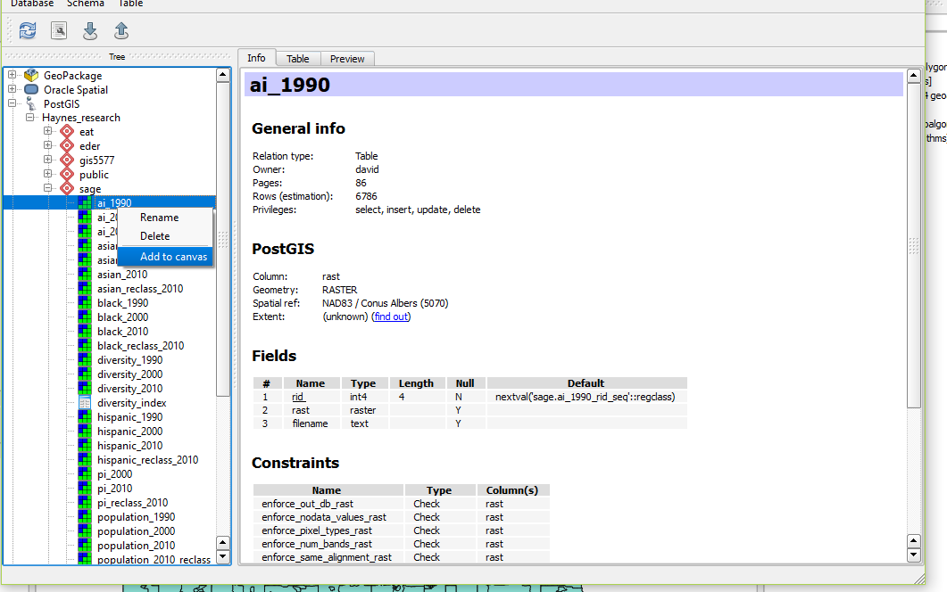
Visualizing Raster
Only available in QGIS
Database → Database Manager
Activate Database find raster table → Add to Canvas
*** This can take a while. Items like color ramp can also disappear.

Slide 19
Querying Rasters
SELECT name, ST_Clip(r.rast, p.geom) as geom
FROM states
WHERE lower(name) = ‘minnesota’

Slide 20
Querying Rasters
WITH dataset as
(
SELECT name, ST_SummaryStats(ST_Clip(r.rast, p.geom))
FROM states
WHERE lower(name) = ‘minnesota’
)
SELECT *
FROM dataset

