Slide 1

Entity Relationship Diagram

Slide 2
Relational Databases
Why do you need a database?
  Keep track of things
What is important for designing a database?
  Normalization
  Capturing your information
    De-nomarlization
  Use of Database
    Access, name consistency, documentation

Slide 3
ER Diagram
A diagram use in database design to visual
  Entities (Table Concepts)
  Relationships (Potential Joins)

Slide 4
Tables
Need to have
  Primary key
  Field (column) names
  Field (column) types
Imagine that these are permanent and will never change

Slide 5
Relationships
Relationships are a result of normalization
  No repeated column, no repeated rows
  Small tables that hold relevant information
1 to 1
1 to Many
Many to Many

Slide 6
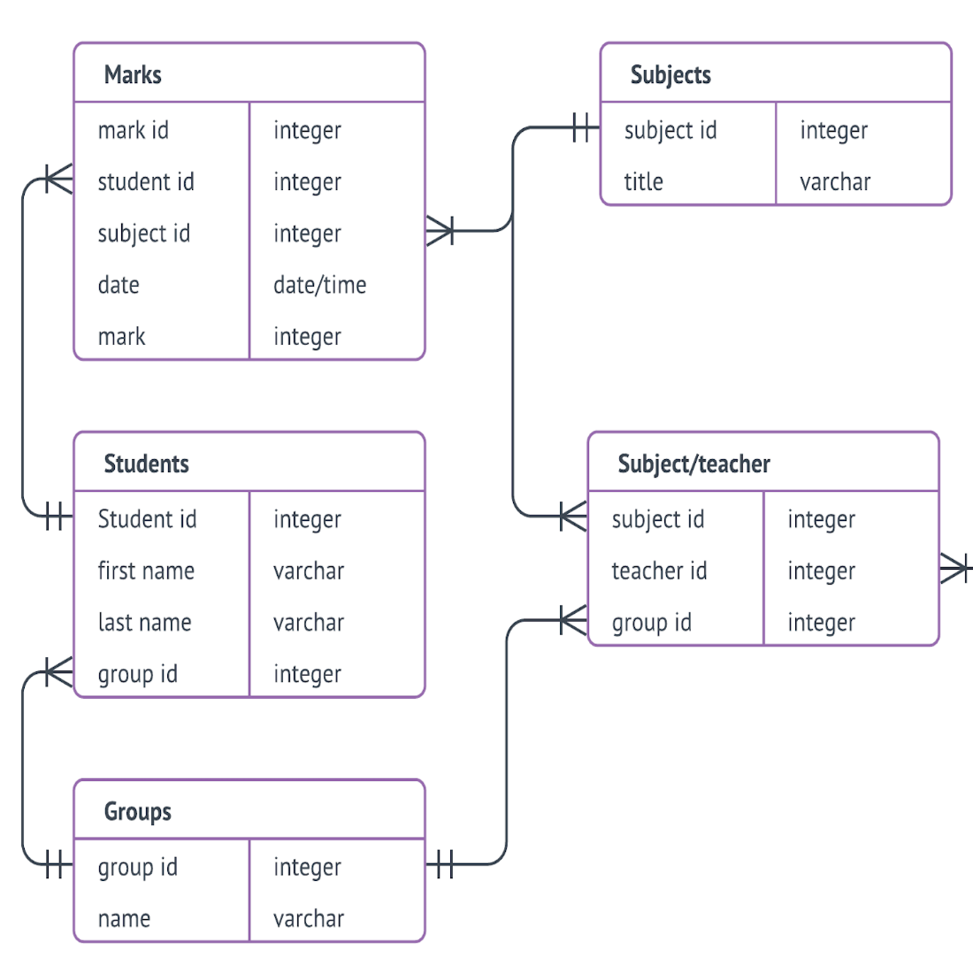

Slide 7
Groups
Has 2 fields
Group_id (Primary key)
Name (varchar)
A primary key in a field/column in a relational database that is unique for each record. It is a unique identifier for each record.

Slide 8
Students
Has 4 fields
Student_id (Primary key)
First_name (varchar)
Last_name (varchar)
Group_id (foreign key)
A foreign key is a field in one table that uniquely identifies a row of another table.

Slide 9
Relationship (Many to 1)
Relationships are expressed between foreign and primary keys.
Student (Table) has the foreign key (group_id) Many students belong to 1 group.

Slide 10
Candy Database
Sales
Production (Ingredients)
Marketing
Pay Roll

Slide 11
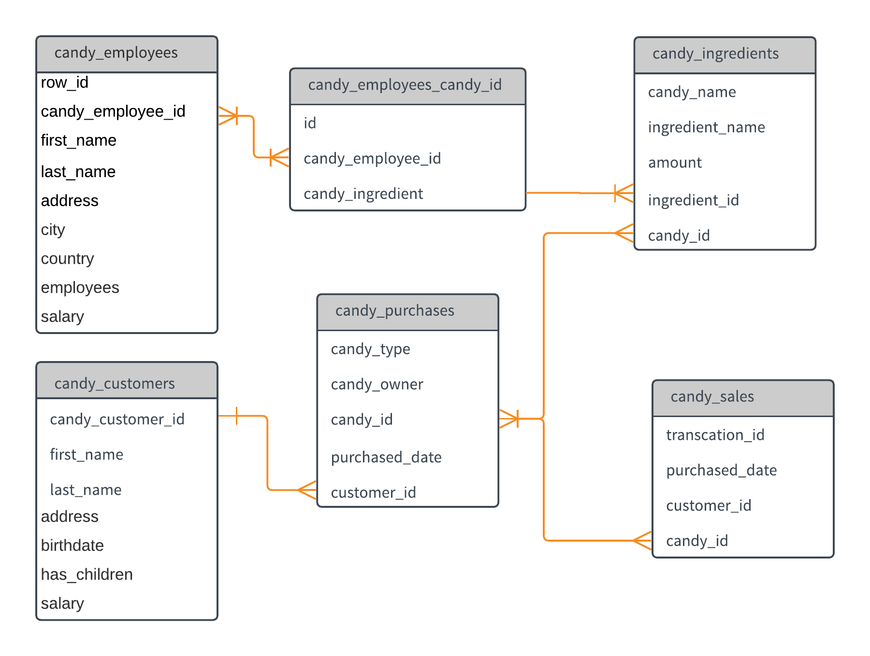

Slide 12
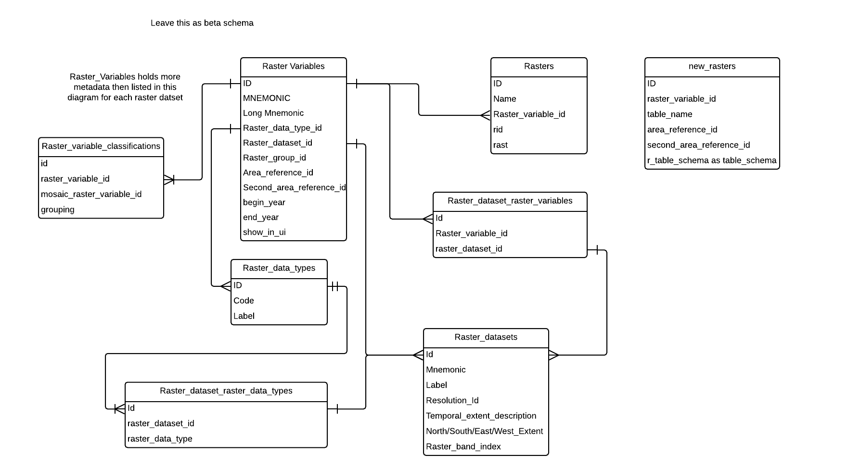

Slide 13
