Slide 1

Rasters

Slide 2
Raster
Raster datatype
Each pixel has 1 value
Raster may have multiple bands. Bands do not have to refer to R G B IR.
Bands may refer to anything. Each band must have the same spatial resolution.
Bands

Slide 3
GDAL Reference
Python Geospatial Development
Python Geospatial Development - Third Edition Paperback – May 23, 2016
by Erik Westra (Author)
GDAL OGR Cookbook
https://pcjericks.github.io/py-gdalogr-cookbook/

Slide 4
Loading Raster
raster2pgsql -C -x -I -Y -F -t 250x250 -s 4326 [raster_path] [raster_table] > [filelocation]
psql –h -U x5000 -d x500 –f [filelocation]
Piping…
raster2pgsql -C -x -I -Y -F -t 250x250 -s 4326 [raster_path] [raster_table] | psql –h -U x5000 -d x500 –f [filelocation]

Slide 5
Raster flags
-s Spatial reference ID
-t Tile size “250x250” must specify both dimensions
-C Add constraints
-x If you have a global raster you must add this
-I Add the index
-Y Use copy statement (speeds things up)
-F Add the file name (Optional)

Slide 6
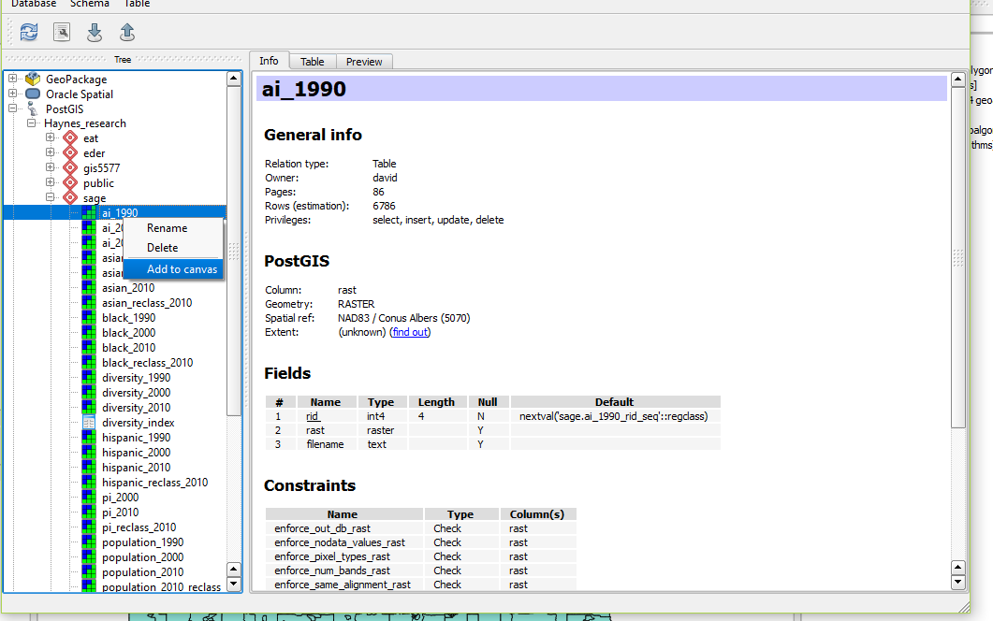
Visualizing Raster
Only available in QGIS
Database > Database Manager
Activate Database find raster table > Add to Canvas
*** This can take a while. Items like color ramp can also disappear.

Slide 7
Querying Rasters
SELECT name, ST_Clip(r.rast, p.geom) as geom
FROM states
WHERE lower(name) = ‘minnesota’

Slide 8
Querying Rasters
WITH dataset as
(
SELECT name, ST_SummaryStats(ST_Clip(r.rast, p.geom))
FROM states
WHERE lower(name) = ‘minnesota’
)
SELECT *
FROM dataset

