Slide 1
Database Administration

Slide 2
Database Versioning

Slide 3
Database transactions
A transaction is an application-defined unit of work performed against a database.
A transaction starts, modifications are made against the database, then the transaction is committed or rolled back.
Once the transaction is committed, the changes made by the transaction become visible to other users and applications.

Slide 4
Transaction "ACID" Properties
Atomic—A transaction exhibits all-or-nothing behavior. If it is committed, all of its changes apply to the database. If it is rolled back, none of its changes apply.
Consistent—A transaction leaves the database in a consistent state.
Isolation—A transaction can isolate its changes from other transactions until it commits them. Other users do not see the work internal to the transaction while it is in progress.
Durable—Once a transaction commits, its results are persistent.
To achieve these properties, database management systems use a variety of locking mechanisms to ensure that multiple concurrent transactions are shielded or isolated from each other.
http://help.arcgis.com/en/arcgisdesktop/10.0/help/index.html#/What_is_a_transaction/002700000002000000/

Slide 5
A simple transaction
UPDATE study_area
SET total_roads = temp_roads.total_roads
FROM temp_roads
WHERE temp_roads.id = study_area.id;

Slide 6
Chaining Commands is really a transaction
BEGIN;
-- Create a table
CREATE TEMP TABLE temp_roads
( id integer,
total_roads numeric);
-- Populate the table
\COPY temp_roads
FROM 'c://workspace//total_roads_by_cell.csv'
WITH CSV HEADER;
-- Update another table
UPDATE study_area
SET total_roads = temp_roads.total_roads
FROM temp_roads
WHERE temp_roads.id = study_area.id;
COMMIT;

Slide 7
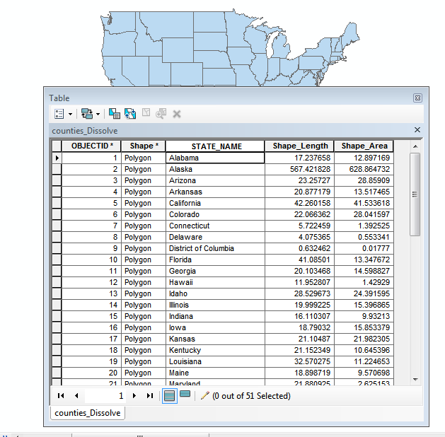
Does ArcMap create transaction

Slide 8
ArcGIS Transactions
Edits are not saved to the database table until you:
  save an Edit Session in a non-versioned Geodatabase
  compress a versioned Geodatabase
WARNING ArcGIS Desktop sees the changes before it is committed to the database

Slide 9
Versioning
Versioning is the mechanism that enables concurrent multi-user geodatabase editing in Geodatabases.
http://www.esri.com/news/arcuser/0110/files/versioning101.pdf
http://weaintplastic.github.io/web-development-field-guide/Collaboration/Database_Versioning/The_Concept_of_Database_Versioning

Slide 10
Why versioning?
Prevent schema locks
  Happens when more than one person tries to edit the same feature class (row)
Fit a business model
  Divide work among people/groups
  Authorization
Protect authoritative source

Slide 11
Versioning
Base Table
DEFAULT
Production
Editor 1
Editor 2
Version Tree

Slide 12
Versioning terms
base table - the "database" table that holds the feature class
version - specific state of the geodatabase
version tree - multiple versions
parent and child versions
DEFAULT version - the first version

Slide 13
Version Access
Private - Only owner can edit and view
Protected - Only owner can edit, other users can view
Public - All users can edit and view
The access level for the DEFAULT version is "private".

Slide 14
Versioning scenarios
Non-versioned
Direct editing of the DEFAULT version
Two-tiered version tree
Surrogate DEFAULT version
Multi-tier version tree
Cyclical version tree
Move-to-base

Slide 15
Versioning scenarios
Non-versioned
  Good for quick edits
  Need to rollback? Don't save the changes
  WARNING ArcGIS Desktop sees the changes before it is committed to the database
  Changes go directly to base table

Slide 16
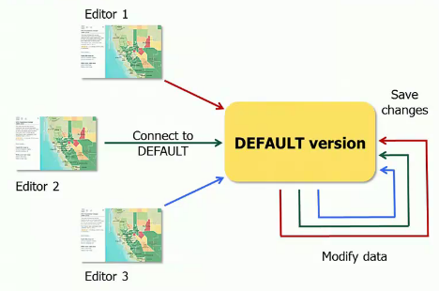
Versioning scenarios
Direct editing of the DEFAULT version
  One version
  Creates unnamed temp version for each editor
  Message when there are changes from another user when trying to save, may need to reconcile conflicts

Slide 17
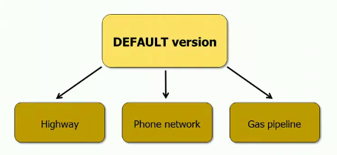
Versioning scenarios
Two-tiered version tree
  Versions based off the default version
  DEFAULT version not protected - any version can change the DEFAULT version

Slide 18
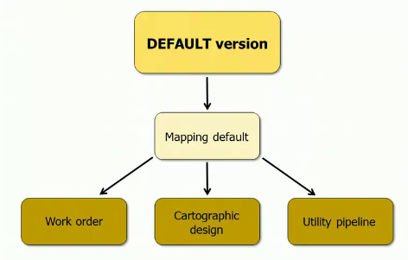
Versioning scenarios
Surrogate DEFAULT version
  "Mapping default" is the parent of the other versions
  "Mapping default" is the surrogate of the DEFAULT version
  Control access to DEFAULT version - reconcile/post made by admin

Slide 19
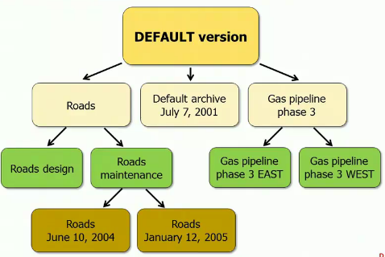
Versioning scenarios
Multi-tier version tree
  Support long transaction
  Batch reconcile and post processes

Slide 20
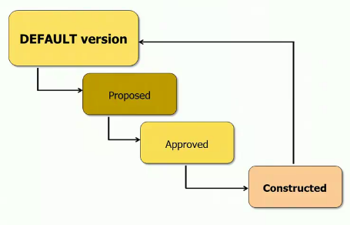
Versioning scenarios
Cyclical version tree
  Trickier permissions

Slide 21
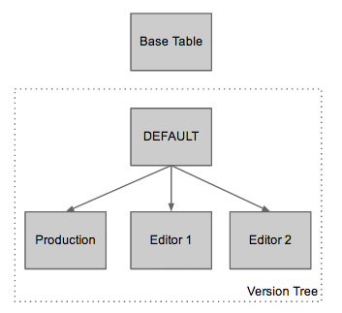
Versioning scenarios
Move-to-base
  Combine versioning and move-to-base
  No compress needed to move DEFAULT version changes to base table, database will see changes in DEFAULT immediately

