Slide 1
Web Mapping

Slide 2
Web Mapping
What are the components of a web map?

Slide 3
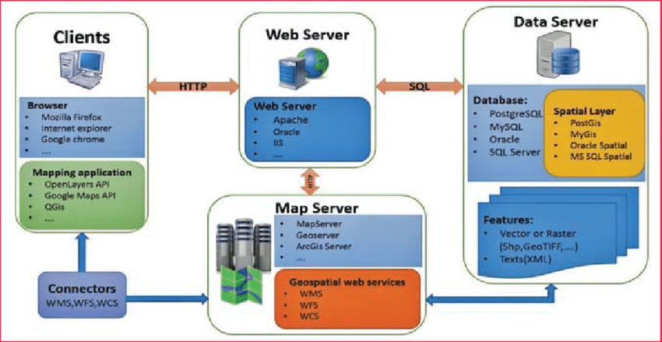
Web Mapping Components

Slide 4
Web Mapping Components
Web Mapping Libraries
  OpenLayers
  Leaflet
WebMap Server
  Arc Server
  Geo Server
Geospatial Datasets
  Arc Server
  PostgreSQL w/ PostGIS

Slide 5
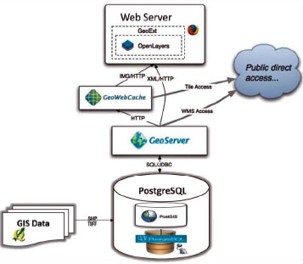
Open Source Web Mapping Components

Slide 6
WebGIS 2.0
History of web mapping
https://www.slideshare.net/stevenfeldman/history-of-web-mapping
Users can be interactive with the map
Users can submit spatial queries

Slide 7
What should you use
MapBox
Mapnik
MapServer**
  Created by the University of Minnesota
GeoServer
ArcServer

Slide 8
Cool web maps and visualizations
https://www.healthlandscape.org/
https://data.terrapop.org/terrascope
https://vizhub.healthdata.org/gbd-compare/
https://bl.ocks.org/syntagmatic/ba569633d51ebec6ec6e
https://bl.ocks.org/mbostock/3711652

Slide 9
Setting up ArcServer on the Cloud

Slide 10
ArcServer on the Cloud
Azure
Amazon Web Services
https://enterprise.arcgis.com/en/server/latest/cloud/azure/deploy-gis-server-on-azure.htm
https://aws.amazon.com/marketplace/search/results/ref=gtw_navgno_search_box?page=1&searchTerms=Esri

Slide 11
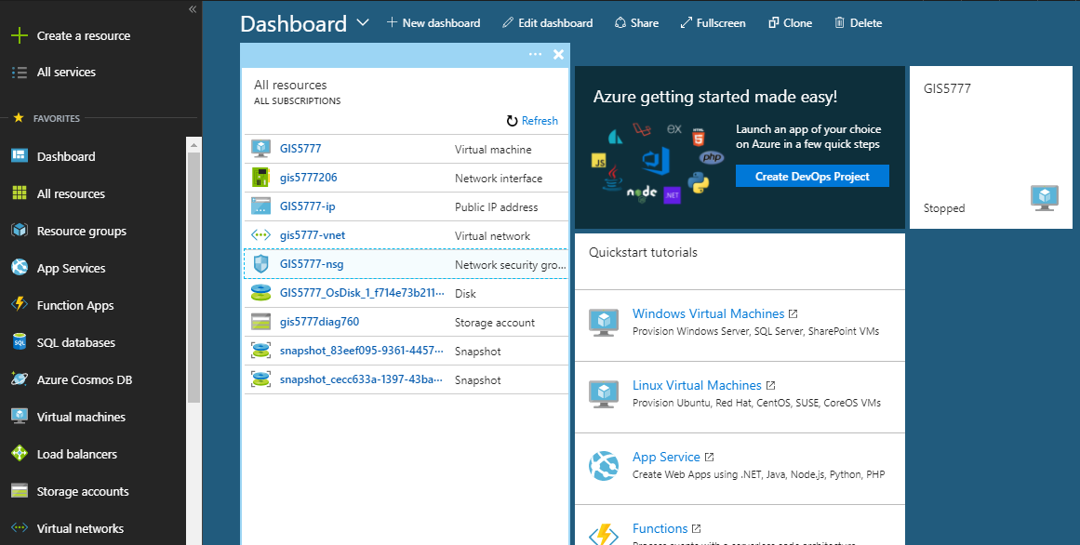
Azure Dashboard

Slide 12
Azure Setup
Use remote desktop to login to the machine
  Install software
  Load files for hosting
Configure machine ports

Slide 13
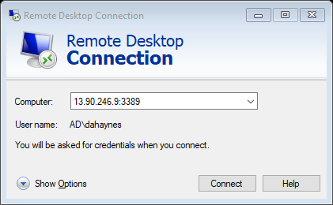
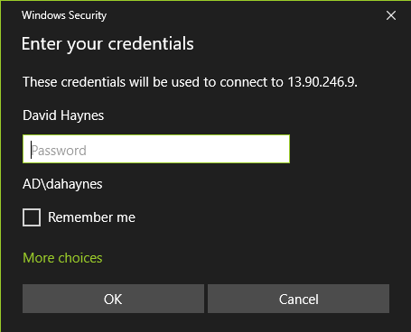
Demo remote desktop

Slide 14
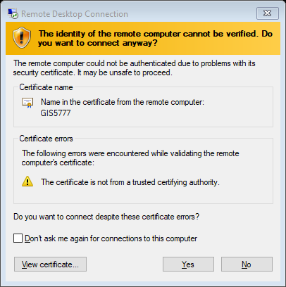
Accept the certificate

Slide 15
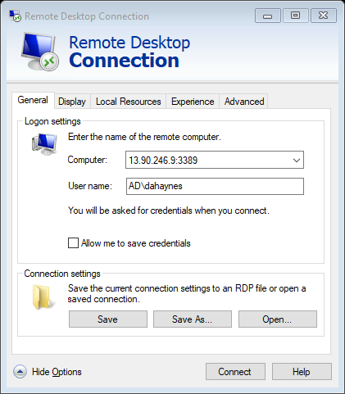
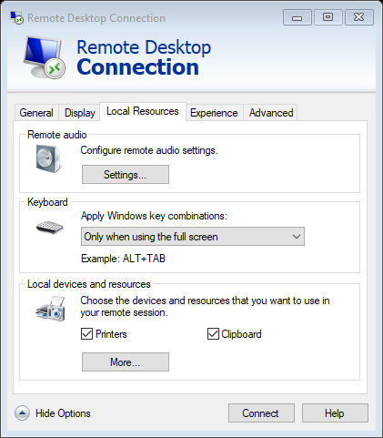
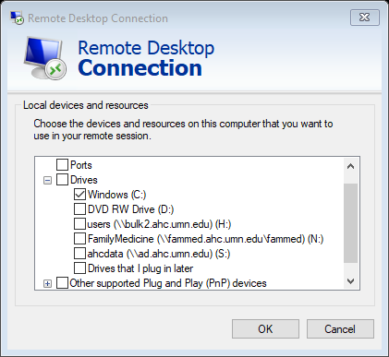
Modify remote desktop connection

Slide 16
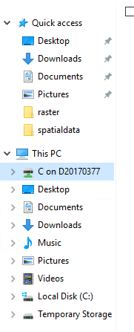
Loading data
Now I have access to the C drive on the local machine.
This makes it easier for moving files

Slide 17
Adding ports
HTTP
  6080
HTTPS
  6443
Allow Remote Desktop Connection
  3389

Slide 18
Adding rules
Service – (HTTP, HTTPS)
Port Number
Rule Priority
Name

Slide 19
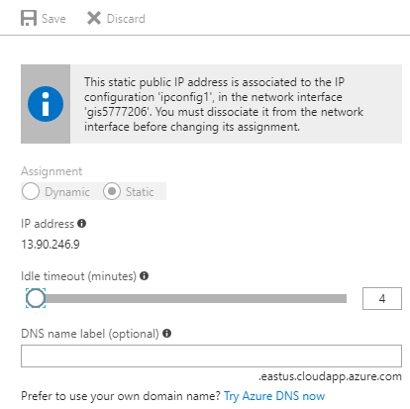
Setup your VM to persist at a particular URL

