Slide 1
CAREQUEUE
01 REGISTER
Hospital Emergency
Management System
02 PRIORITIZE
03 ASSIGN RESOURCES
Computational Thinking and Programming
04 RECORD TREATMENT
Python • Flask • SQLite • Pytest
Presented by: Geetha Krishna Venkatesh Maroju
Registered ID: 2601150056

Slide 2
PROBLEM & MOTIVATION
What problem does CareQueue solve?
A small hospital workflow problem translated into a testable software system.
Scattered intake
Unclear priority
Limited resources
Weak traceability
Patient details and symptoms need a consistent registration path.
Waiting order should reflect operator-entered severity and arrival time.
Doctor, bed, and equipment availability must be visible before assignment.
Treatment start, completion, notes, and release events should be recorded.
PROJECT OBJECTIVE
The objective of this project is to develop an educational prototype of a Hospital Emergency Management System that streamlines patient registration, prioritizes patients based on severity, manages the allocation of doctors, beds, and medical equipment, and maintains treatment records. The system incorporates input validation, automated testing, and data visualization to improve workflow organization, resource utilization, and the reliability of patient information.
CAREQUEUE • COMPUTATIONAL THINKING & PROGRAMMING
02

Slide 3
SYSTEM WORKFLOW
From registration to treatment completion
1
2
3
4
5
Register
→
Prioritize
→
Check resources
→
Treat
→
Complete
Name, phone,
age, severity
Critical → Urgent
→ Normal
Doctor and bed
availability
Assign resources
and start time
Outcome, notes,
release resources
Supporting functions
Search and filter by patient details or severity
Wait-time and resource alerts
Dashboard charts and CSV export
Treatment history and notes
CAREQUEUE • COMPUTATIONAL THINKING & PROGRAMMING
03

Slide 4
COMPUTATIONAL THINKING
Problem decomposition: one problem, focused modules
Each module owns one responsibility and communicates through shared patient/resource records.
01
02
03
04
05
Patient intake
→
Priority queue
→
Resource rules
→
Start treatment
→
History & export
/patients
/queue-management
doctor_suggestion()
resource_rules()
/treat-next
/history
/history.csv
Abstraction
Separation of concerns
Why it matters
Helper functions hide details like route code calls queue, doctor, and equipment logic.
HTML templates handle presentation; Flask handles workflow; SQLite persists state.
Modules can be tested independently and changed without rewriting the whole app.
CAREQUEUE • COMPUTATIONAL THINKING & PROGRAMMING
04

Slide 5
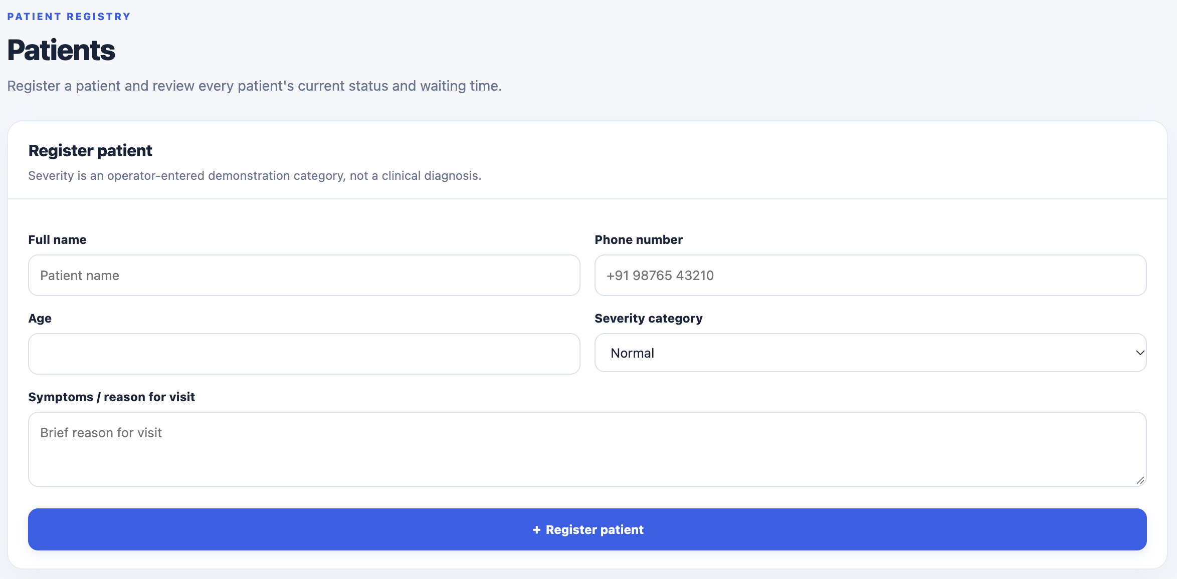
VALIDATION
Patient registration: validate before changing state
Input validation protects the database from invalid or duplicate active records.
IMPLEMENTATION PATTERN
if not name or not symptoms:
flash("Required fields are missing")
return redirect(url_for("index"))
# Additional checks validate age, severity,
# phone format, and duplicate active patients.
Validation rules
Abstraction
Required name, age 0–120, valid severity, phone validation, and duplicate-active-patient rejection.
Registration route validates the form before inserting a patient row.
CAREQUEUE • COMPUTATIONAL THINKING & PROGRAMMING
05

Slide 6
DIVIDE AND CONQUER
Merge Sort is now used for waiting-queue ordering
app.py — merge_sort()
def merge_sort(items, key):
if len(items) <= 1: return items.copy()
mid = len(items) // 2
left = merge_sort(items[:mid], key)
right = merge_sort(items[mid:], key)
merged, i, j = [], 0, 0
while i < len(left) and j < len(right):
if key(left[i]) <= key(right[j]):
merged.append(left[i]); i += 1
else:
merged.append(right[j]); j += 1
merged.extend(left[i:])
merged.extend(right[j:])
return merged
INPUT
Normal • Critical • Urgent
↓ divide into halves
↓ sort each half recursively
↓ merge in priority order
Ordering key
Time complexity
Space complexity
(severity, created_at, id)
O(n log n) best/average/worst for Merge Sort.
O(n) auxiliary storage; stable ordering for equal keys.
CAREQUEUE • COMPUTATIONAL THINKING & PROGRAMMING
06

Slide 7
GREEDY STRATEGY
Start treatment: choose the best next available match
The system makes a local choice from current state; it does not search all possible schedules.
1
Pick next patient
Lowest severity number, then earliest arrival
2
Suggest specialty
Keyword rules select a matching doctor specialty
3
Choose resources
First suitable available doctor + available bed
4
Commit changes
Set patient in treatment and reserve resources
Greedy property: each step chooses a feasible resource now. Limitation: no guarantee of globally optimal allocation.
CAREQUEUE • COMPUTATIONAL THINKING & PROGRAMMING
07

Slide 8
PATTERN RECOGNITION
Rule-based suggestions connect symptoms to demo equipment
Simple pattern matching, explicit rules, and transparent output — not a trained AI model.
app.py — resource_rules()
def resource_rules(symptoms, severity):
text = symptoms.lower()
requested = []
if any(w in text for w in ("breath", "oxygen")):
requested.extend(["Oxygen cylinders", "Patient monitors"])
if any(w in text for w in ("fracture", "injury", "fall")):
requested.append("Wheelchairs")
return list(dict.fromkeys(requested))
Example A
“shortness of breath” → oxygen cylinder + patient monitor
Example B
“fall / fracture” → wheelchair suggestion
Example C
“IV fluid” → infusion pump suggestion
CAREQUEUE • COMPUTATIONAL THINKING & PROGRAMMING
08

Slide 9
ITERATION AND GENERATORS
CSV export uses a generator to yield rows on demand
The generator formats one record at a time instead of building a second list of all formatted rows.
app.py — iter_csv_rows()
What yield does
def iter_csv_rows(rows):
yield ["Patient ID", "Name", "Phone", ...]
for row in rows:
yield [row["id"], row["name"], row["phone"], ...]
writer = csv.writer(output)
writer.writerows(iter_csv_rows(rows))
Returns the next row when requested; it does not create one list containing every formatted row.
Why use it?
Cleaner row-by-row processing and less intermediate memory than a second formatted-row list.
CAREQUEUE • COMPUTATIONAL THINKING & PROGRAMMING
09

Slide 10
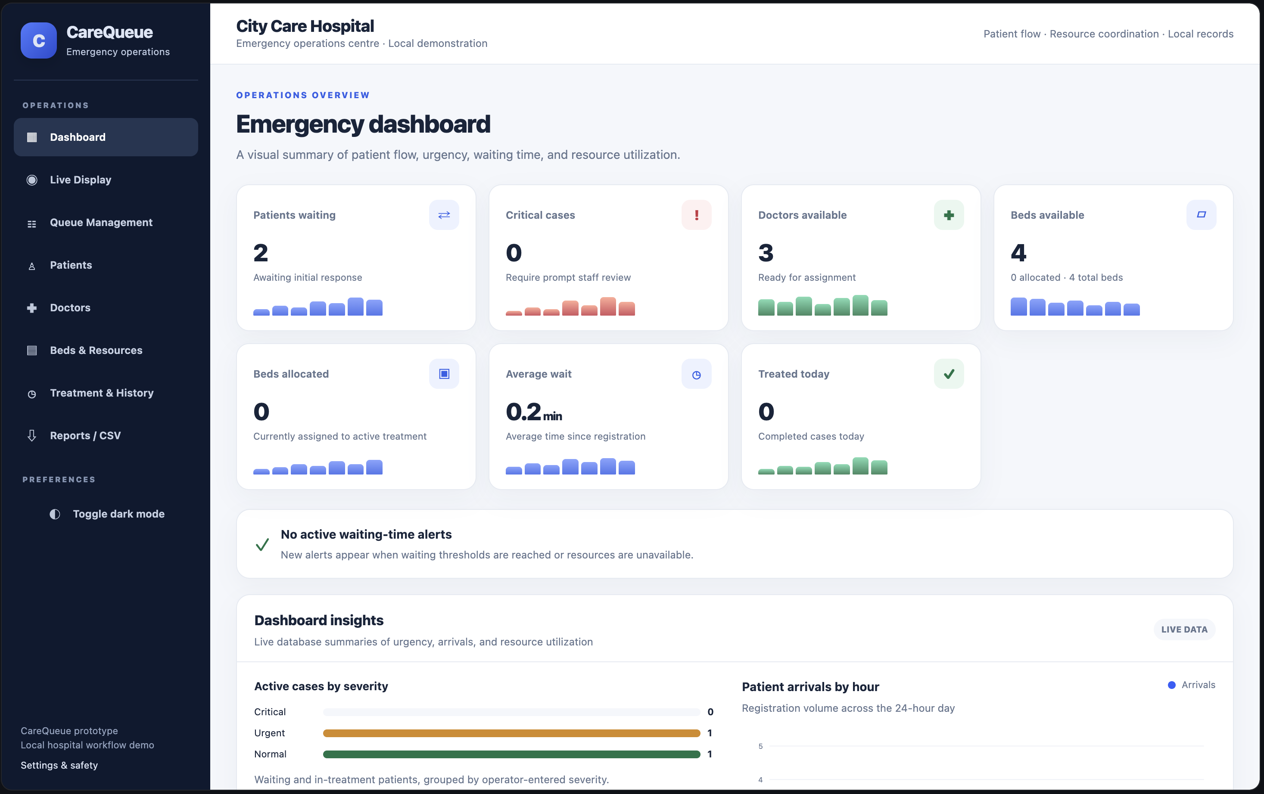
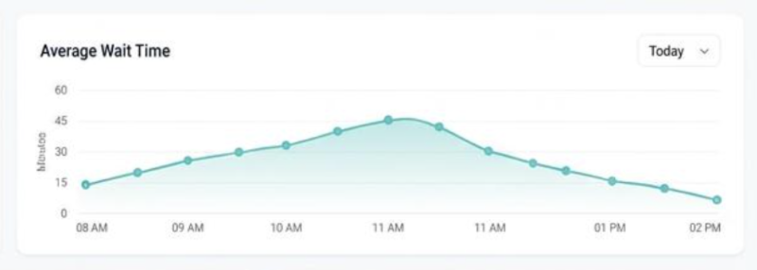
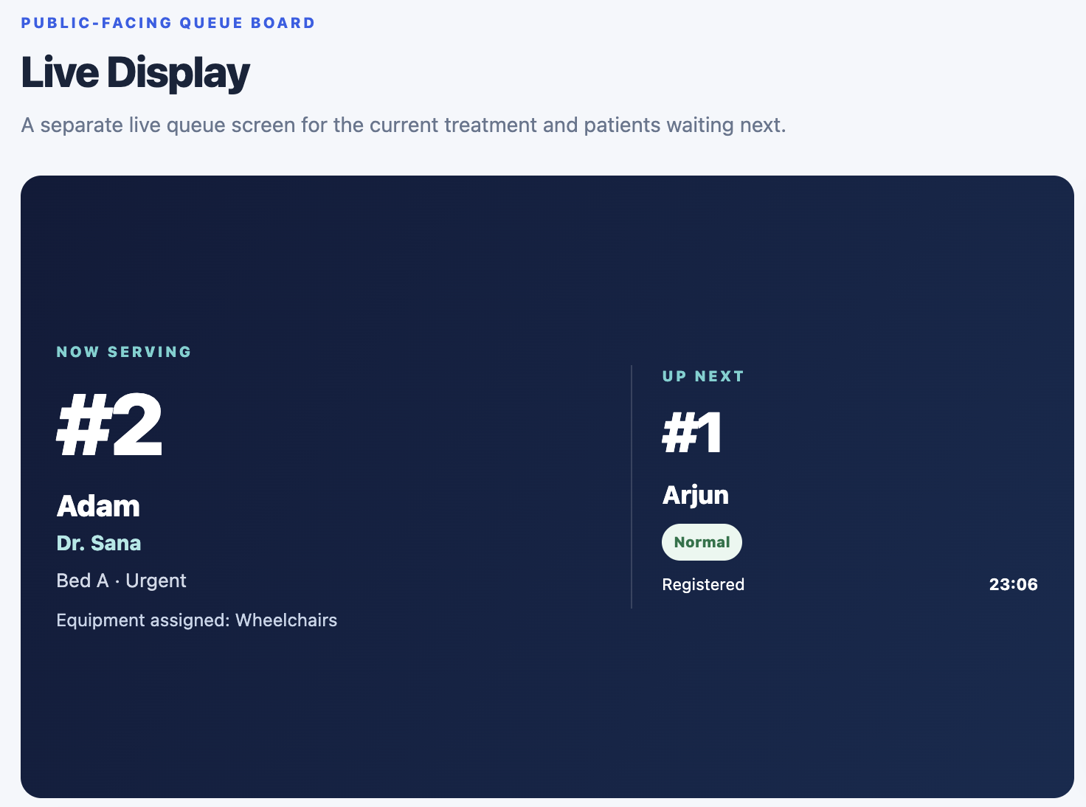
VISUAL ANALYTICS
Dashboard: summaries + charts make state visible
Charts are calculated from patient records and timestamps, not manually typed sample counts.
CAREQUEUE • COMPUTATIONAL THINKING & PROGRAMMING
10

Slide 11
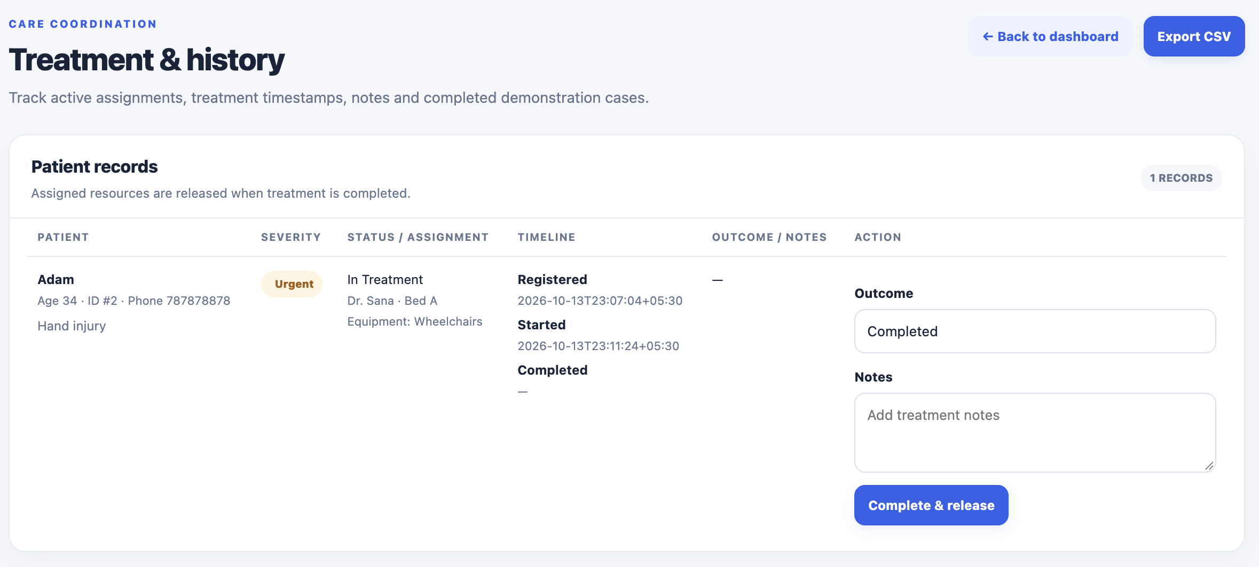
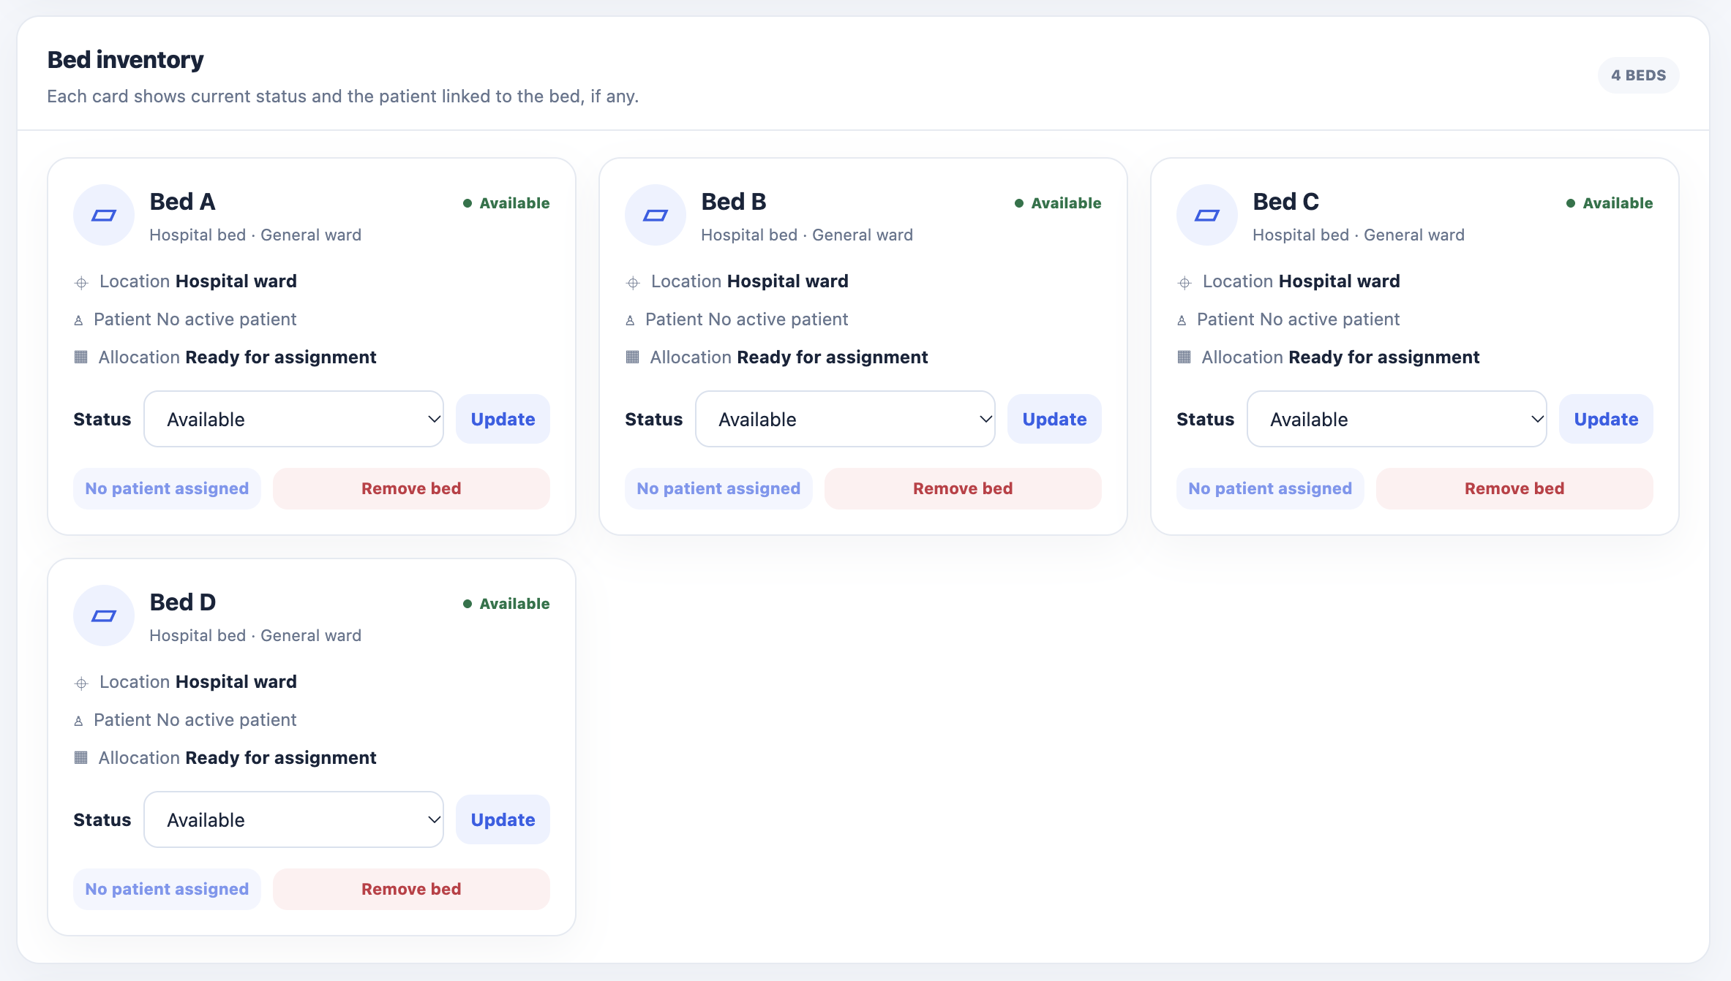
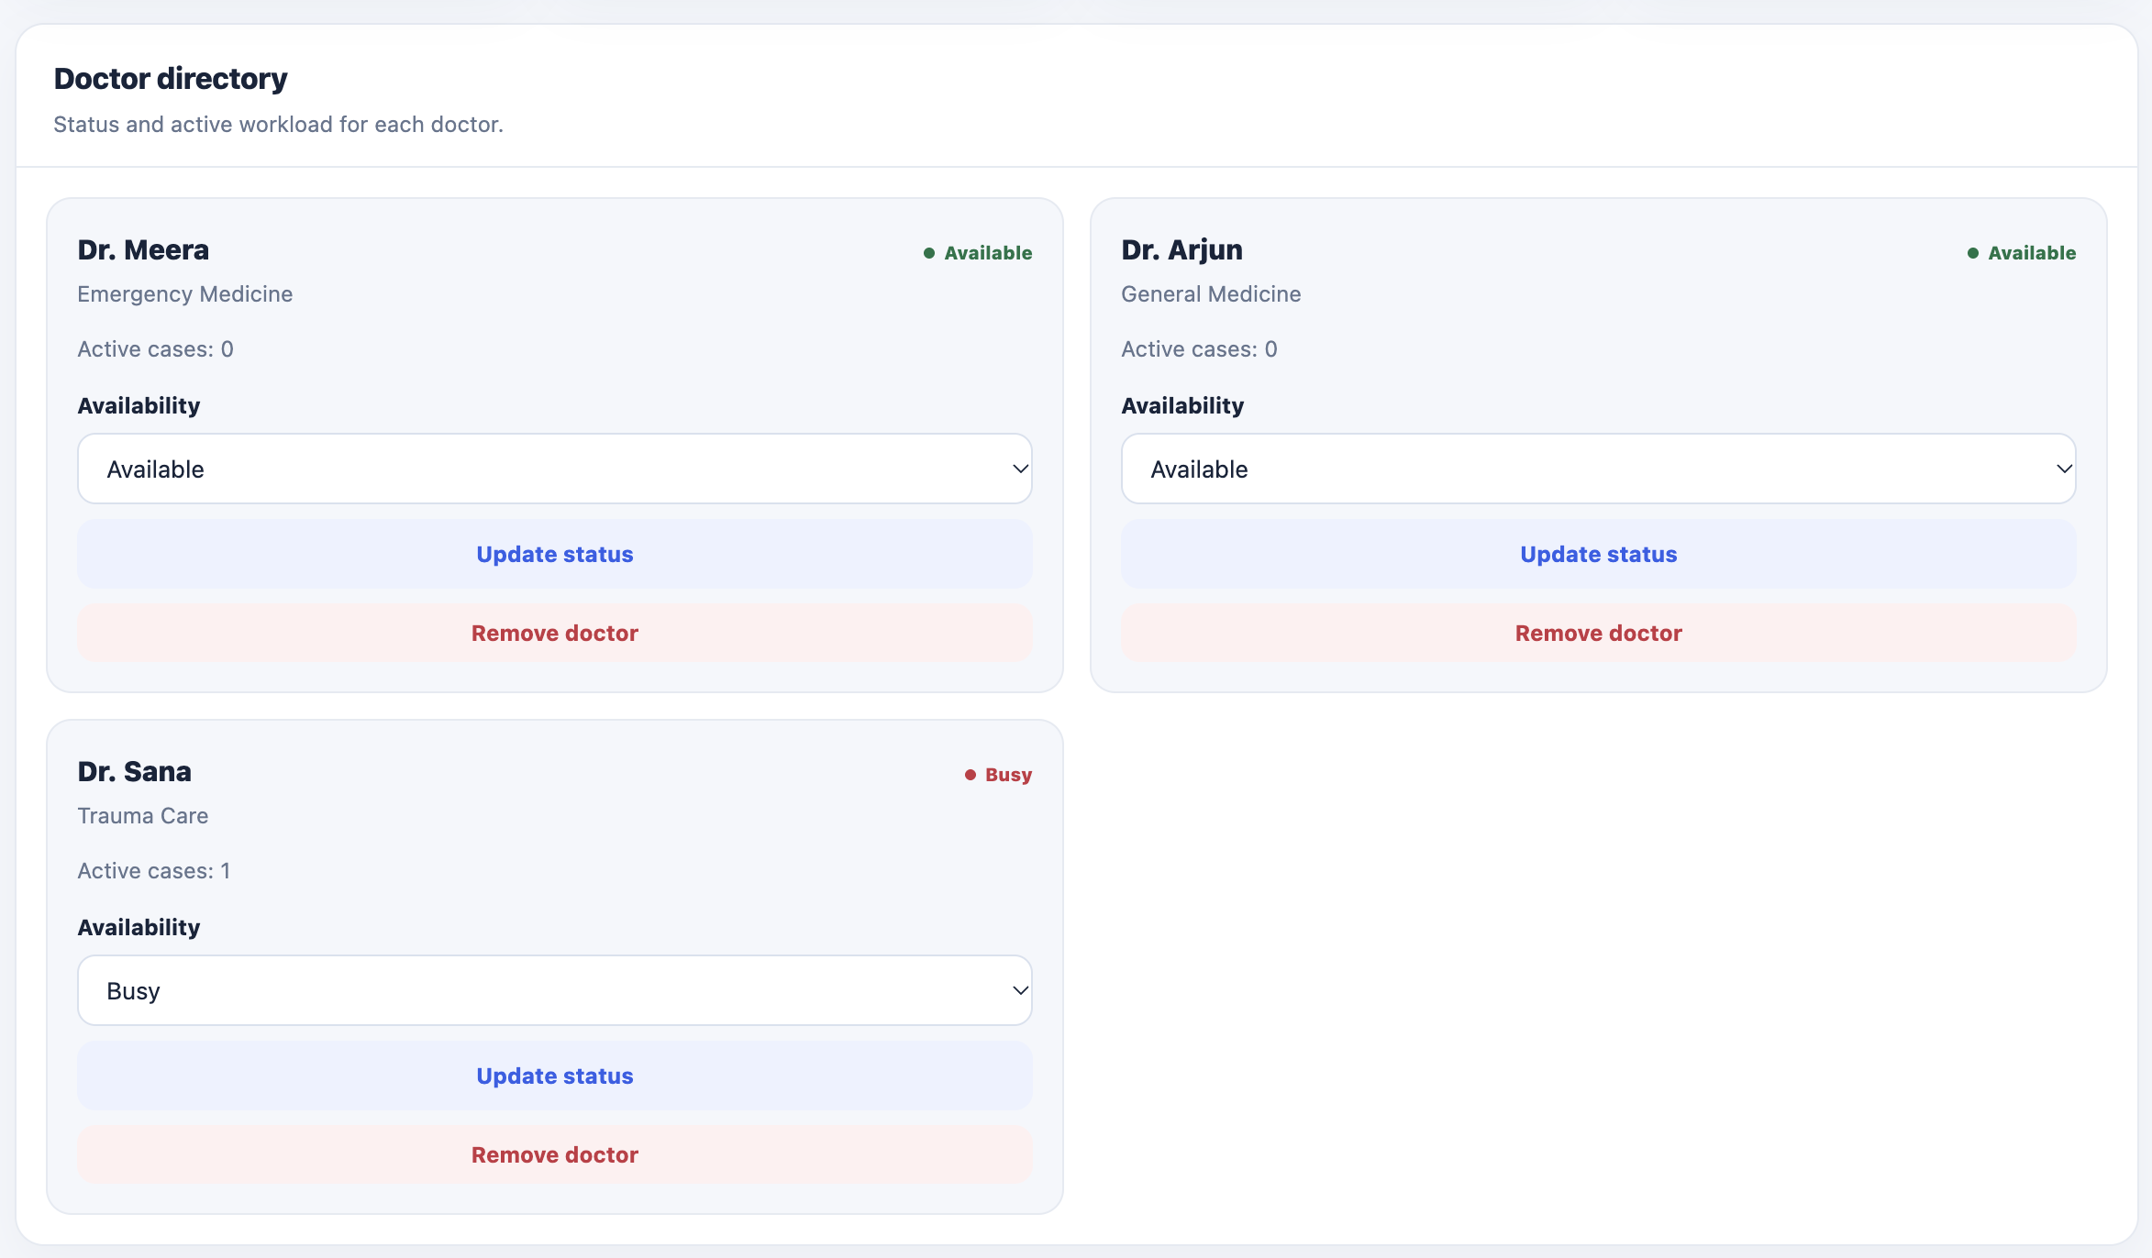
WORKING FEATURES
Resource management and treatment history
The visual interface is evidence of the workflow — the underlying state changes are handled in Flask and SQLite.
Beds & Resources: inventory, status filters, availability, assigned patient, and equipment quantities.
CAREQUEUE • COMPUTATIONAL THINKING & PROGRAMMING
11

Slide 12
PERSISTENCE AND CORRECTNESS
SQLite keeps the workflow state consistent
Relational records allow the application to link patients, doctors, beds, and equipment assignments.
patients
doctors
beds
assignments
Severity, symptoms, status, timestamps, doctor_id, bed_id
Name, specialty, available / busy / off duty
Identifier and available / occupied / cleaning / reserved
Patient, equipment, quantity, assigned_at, released_at
TRANSACTION IDEA
BEGIN IMMEDIATE
select highest-priority waiting patient
select available doctor and bed
update patient status + assigned resources
update doctor / bed status
COMMIT
# Roll back on error
Why transaction boundaries matter
They reduce the risk of partially applying treatment-start changes if a database operation fails.
CAREQUEUE • COMPUTATIONAL THINKING & PROGRAMMING
12

Slide 13
SOFTWARE QUALITY
Testing validates the behaviour, not just the appearance
The current suite covers route integration and state changes; two focused tests were added for Merge Sort and generator CSV rows.
Registration
Priority
Required fields, age/severity, phone, duplicates
Critical → Urgent → Normal; tie-break by arrival
Resources
History / export
Allocation, unavailable resources, release on completion
Treatment timestamps, notes, CSV header and patient row
Navigation
Also Include
Separate live display, queue, patients, doctors, resources
Merge Sort order and non-mutating behaviour; generator CSV header
RUN LOCALLY
python -m pytest -v
CAREQUEUE • COMPUTATIONAL THINKING & PROGRAMMING
13

Slide 14
CONCLUSION
Implemented concepts
Current limitations
Future work
Decomposition, Merge Sort, greedy allocation, rule-based matching, generators, persistence, testing.
Demo inventory, operator-entered severity, local SQLite, no production authentication or hospital integration.
Role-based access, audit trails, stronger clinical governance, concurrency tests, and deployment hardening.
CAREQUEUE
Register • Prioritize • Allocate • Record
Thank you
CAREQUEUE • COMPUTATIONAL THINKING & PROGRAMMING
14

