Slide 1
Agrarian Crop & Fertilizers Proposal Utilizing Machine Learning Approach
GUIDED BY, PRESENTED BY,
Mr. Gunasekaran,M.E. Melvingnanaliyes
PROFESSOR, CSE. Ragul Raj Praveenkanth

Slide 2
INTRODUCTION
Organic manure provides all the nutrients that are required by plants but in limited quantities.
It helps in maintaining C:N ratio in the soil and also increases the fertility and productivity of the soil.
It improves the physical, chemical and biological properties of the soil.

Slide 3
LITERATURE SURVEY

Slide 4
S.No | Paper | Journal | Inference | Methodology | Issues
[1] | Crop yield prediction in cotton for regional level using random forest approach | Spatial Information Research (2021) - Springer | DESCRIPTION: cotton yield is predicted for regional level. FEATURES CONSIDERED: climatic condition, land surface. | Random Forest | Accuracy is low less records are present in dataset

Slide 5
S.No | Paper | Journal | Inference | Methodology | Issues
[2] | Field and crop specific manure application on a dairy farm based on historical data and machine learning. | Computers and Electronics in Agriculture 175 (2020): 105599 - Elsevier | DESCRIPTION: Predicting future P yields to balance the P in manure. FEATURES CONSIDERED: N , P, irrigation and soil status and local weather condition | Gradient Boosting Machine | Accuracy is low

Slide 6
S.No | Paper | Journal | Inference | Methodology | Issues
[3] | Precision agriculture using IoT data analytics and machine learning | Journal of King Saud University-Computer and Information Sciences (2021). - Elsevier | DESCRIPTION: to predict apple yield in orchards. FEATURES CONSIDERED: PH, Phosphorous, Potassium, Nitrogen and organic carbon. | Linear regression | less parameters are considered

Slide 7
S.No | Paper | Journal | Inference | Methodology | Issues
[4] | Prediction of Land Suitability for Crop Cultivation Based on Soil and Environmental Characteristics Using Modified Recursive Feature Elimination Technique With Various Classifier | IEEE Transactions on Computational Social Systems (2021). | DESCRIPTION: recursive feature elimination is used to select appropriate features from a data set for crop prediction. FEATURES CONSIDERED: soil characteristics and environmental factors | Bagging | suitable for smaller dataset

Slide 8
S.No | Paper | Journal | Inference | Methodology | Issues
[5] | Crop Suitability and Fertilizer Recommendation Using Data Mining Techniques. | In Progress in Advanced Computing and Intelligent Engineering(2019) - Springer | DESCRIPTION: It recommends the crop and fertilizer suitable for the region. FEATURES CONSIDERED: Soil micronutrients and Macronutrients, seasonal rainfall, temperature. of the dirt. | Random Forest algorithm, k-Means clustering. | Implementation is difficult. Slow real time prediction.

Slide 9
Paper | Dataset | Inference | Methodology | Issues
Crop yield prediction in cotton for regional level using random forest approach | climatic condition https://en.climate-data.org/asia/india/maharashtra-747/ land features https://farmech.dac.gov.in/FarmerGuide/MH/index1.html | Accuracy is 69 % | Random Forest | Accuracy is low less records present in dataset
Field and crop specific manure application on a dairy farm based on historical data and machine learning. | weather condition https://en.climate-data.org/asia/india/jammu-and-kashmir-751/ | Accuracy is 63 % | Gradient Boosting Machine | Accuracy is low
Precision agriculture using IoT data analytics and machine learning | departments of Soil and Pathology, Kashmir. | Accuracy is 70%. | Linear regression | less parameters are considered
Prediction of Land Suitability for Crop Cultivation Based on Soil and Environmental Characteristics Using Modified Recursive Feature Elimination Technique With Various Classifier | environment factors www.tnau.ac.in soil characteristics Department of Agriculture, Sankarankovil Taluk, Tenkasi. | Accuracy is 85% | Bagging | suitable for smaller dataset
Crop Suitability and Fertilizer Recommendation Using Data Mining Techniques. | http://www.smart-fertilizer.com/ | Accuracy is 87% | Random Forest algorithm, k-Means clustering. | Implementation is difficult. Slow real time prediction.

Slide 10
PROBLEM FORMULATION
Due to massive population growth, availability of limited renewable resources and rapid changes in environmental factors, which affects crop productivity and profit. Most of the farmers use chemical fertilizers to increase crop yield, which leads to a severe impact on soil. Identifying the equivalent organic manures is a research issue.

Slide 11
OBJECTIVE
To recommend an organic manure to increase the crop yield.

Slide 12
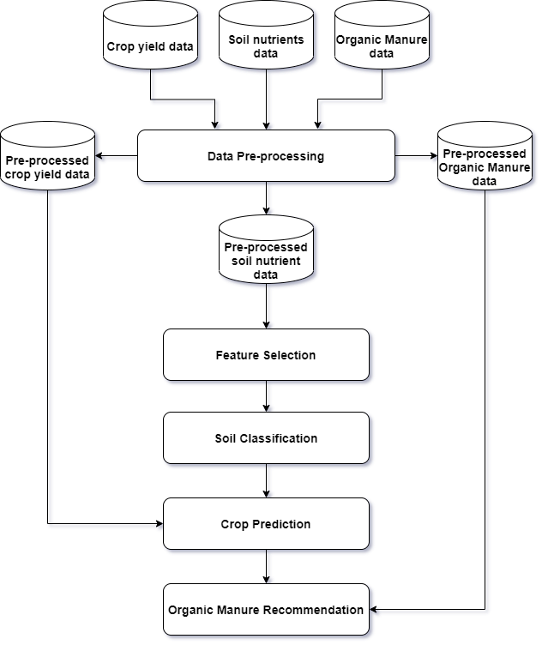
METHODOLOGY

Slide 13
DATASET COLLECTION
From soil health card website.
DATA PRE-PROCESSING
Noisy data and missing values are removed during data cleaning process.
FEATURE SELECTION
Recursive feature elimination is a wrapper technique that selects the relevant
features based on the Z - Score and Ranking method.
SOIL CLASSIFICATION
The soil in the farm field is classified based on soil textures.
CROP PREDICTION
The crop yield is predicted by mapping nutrients needed for the crop and soil
nutrient level.
Random Forest algorithm is used for soil classification and crop prediction.
ORGANIC MANURE RECOMMENDATION
The hierarchical clustering algorithm is used to recommend the organic manure and
its composition.

Slide 14
IMPLEMENTATION PLATFORM
LANGUAGE : Python
PLATFORM : Google Colab

Slide 15
WORKS COMPLETED
Literature survey
Dataset collected
Feature Selection

Slide 16
EXPECTED OUTCOME
A recommendation system is designed and developed to suggest organic manure for the crop.

Slide 17
ACTION PLAN
S.NO | TASKS | FROM | TO
1. | Literature survey
2. | Dataset Collection
3. | Data Pre processing
4. | Feature selection
5. | Soil Classification
6. | Crop Prediction
7. | Manure recommendation
8. | Report Submission

Slide 18
REFERENCES
[1] Prasad, N.R., Patel, N.R. & Danodia, A. Crop yield prediction in cotton for regional level using random forest approach. Spat. Inf. Res. 29, 195–206 (2021).
[2] Mollenhorst, Herman, Michel HA de Haan, Jouke Oenema, and Claudia Kamphuis. "Field and crop specific manure application on a dairy farm based on historical data and machine learning." Computers and Electronics in Agriculture 175 (2020): 105599.
[3] Akhter, Ravesa, and Shabir Ahmad Sofi. "Precision Agriculture using IoT Data Analytics and Machine Learning." Journal of King Saud University-Computer and Information Sciences” (2021).
[4] Mariammal, G., A. Suruliandi, S. P. Raja, and E. Poongothai. "Prediction of Land Suitability for Crop Cultivation Based on Soil and Environmental Characteristics Using Modified Recursive Feature Elimination Technique With Various Classifiers." IEEE Transactions on Computational Social Systems (2021).

Slide 19
[5] Chougule, Archana, Vijay Kumar Jha, and Debajyoti Mukhopadhyay. "Crop suitability and fertilizers recommendation using data mining techniques." In Progress in Advanced Computing and Intelligent Engineering, pp. 205-213. Springer, Singapore, 2019.
[6] Gopal, PS Maya, and R. Bhargavi. “A novel approach for efficient crop yield prediction” Computers and Electronics in Agriculture 165 (2019):104968.
[7] Chaudhary, Archana, Savita Kolhe, and Raj Kamal. “An improved random forest classifier for multi-class classification.” Information Processing in Agriculture 3, no. 4 (2016): 215-222.
[8] Whitmire, Christopher D., Jonathan M. Vance, Hend K. Rasheed, Ali Missaoui, Khaled M. Rasheed, and Frederick W. Maier. "Using Machine Learning and Feature Selection for Alfalfa Yield Prediction." AI 2, no. 1 (2021): 71-88.
[9] Suresh, G., A. Senthil Kumar, S. Lekashri, and R. Manikandan. "Efficient crop yield recommendation system using machine learning for digital farming." International Journal of Modern Agriculture 10, no. 1 (2021): 906-914.

Slide 20
THANK YOU

