Slide 1
Inclusive Language Commitment
Arm is committed to making the language we use inclusive, meaningful, and respectful. Our goal is to remove and replace non-inclusive language from our vocabulary to reflect our values and represent our global ecosystem.
Arm is working actively with our partners, standards bodies, and the wider ecosystem to adopt a consistent approach to the use of inclusive language and to eradicate and replace offensive terms. We recognise that this will take time. This course may contain references to non-inclusive language; it will be updated with newer terms as those terms are agreed and ratified with the wider community. We recognise that some of you will be accustomed to using the previous terms and may not immediately recognise their replacements. Please refer to the following examples:
When introducing the AMBA AXI Protocols, we will use the term ‘Manager’ instead of ‘Master’ and ‘Subordinate’ instead of ‘Slave’.
When introducing the architecture, we will use the term ‘Requester’ instead of ‘Master’ and ‘Completer’ instead of ‘Slave’.
Contact us at education@arm.com with questions or comments about this course. You can also report non-inclusive and offensive terminology usage in Arm content at terms@arm.com.

Slide 2
An Introduction to Computer Architecture
Module 1

Slide 3
This Course
Aims to introduce the key concepts and ideas in computer architecture
Explores the design of modern microprocessors
Examines important trends and current and future challenges

Slide 4
Module Syllabus
What is computer architecture?
Computer architecture arena and design goals
Historical performance of computer architecture
Future trends with multicore processors, systems on chip (SoCs), and beyond
Notes:
This module introduces what computer architecture is and why it is important. It will also give an overview of the computer architecture arena and its design goals. We will also look at some historical information of computer architecture performance over the years. Finally, we will look at an overview of future trends of computer architecture, such as multicore processors, SoCs, and beyond.

Slide 5
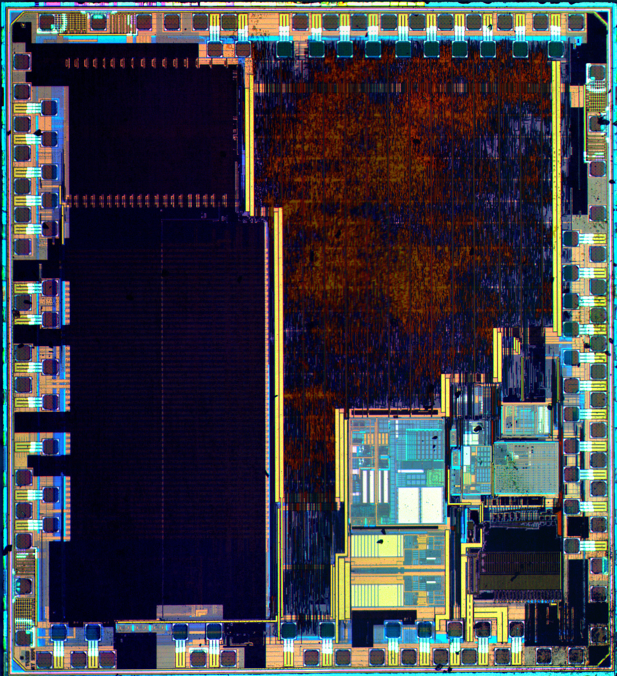

Introduction
The modern microprocessor is often the engine behind how we communicate and work.
It has helped to create our digital world where communication, computation, and storage is almost free.
It underpins many scientific breakthroughs and can help us make better use of the world’s limited resources
Die photo of Arm Cortex-M3 Microcontroller
with 16KB flash memory and 4KB RAM¹
Google Data Center²
1. By Zeptobars, CC BY 3.0
2. By Connie Zhou, CC BY-NC 4.0
Notes:
The modern microprocessor powers our IT infrastructure and underpins numerous trillion-dollar markets such as e-commerce, finance, and digital media. They also support the powerful simulation and data processing techniques that are essential tools in much of today’s scientific research.
The real impact of computing has come from the ability to very rapidly both increase performance and reduce costs. Today, microprocessors are deployed in their billions to create a world where communication, computation, and storage is almost free. Power requirements have also steadily reduced, creating new markets such as the Internet-of-Things (IoT) where the lowest power devices are actually able to scavenge the power needed to operate from their environment.

Slide 6
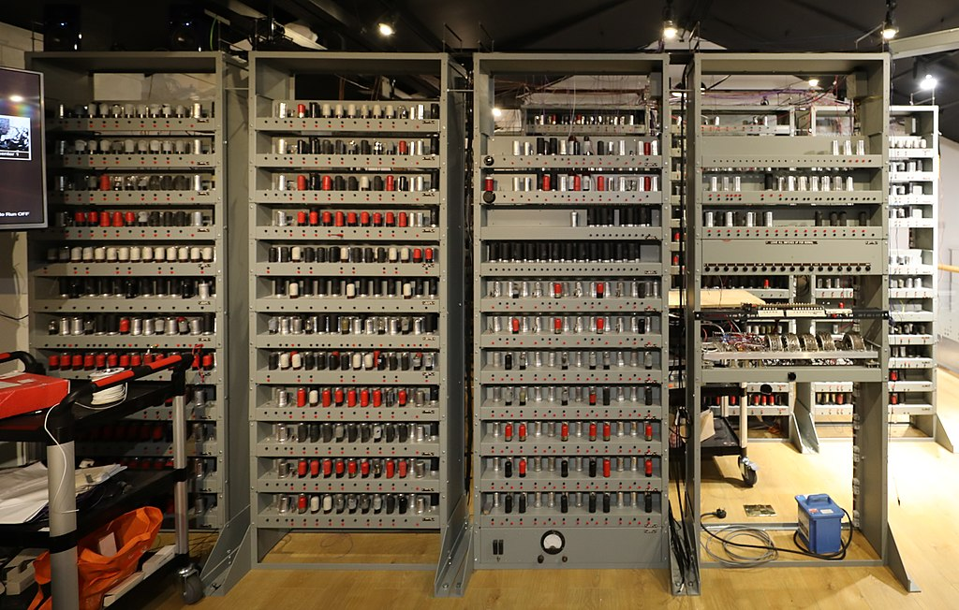
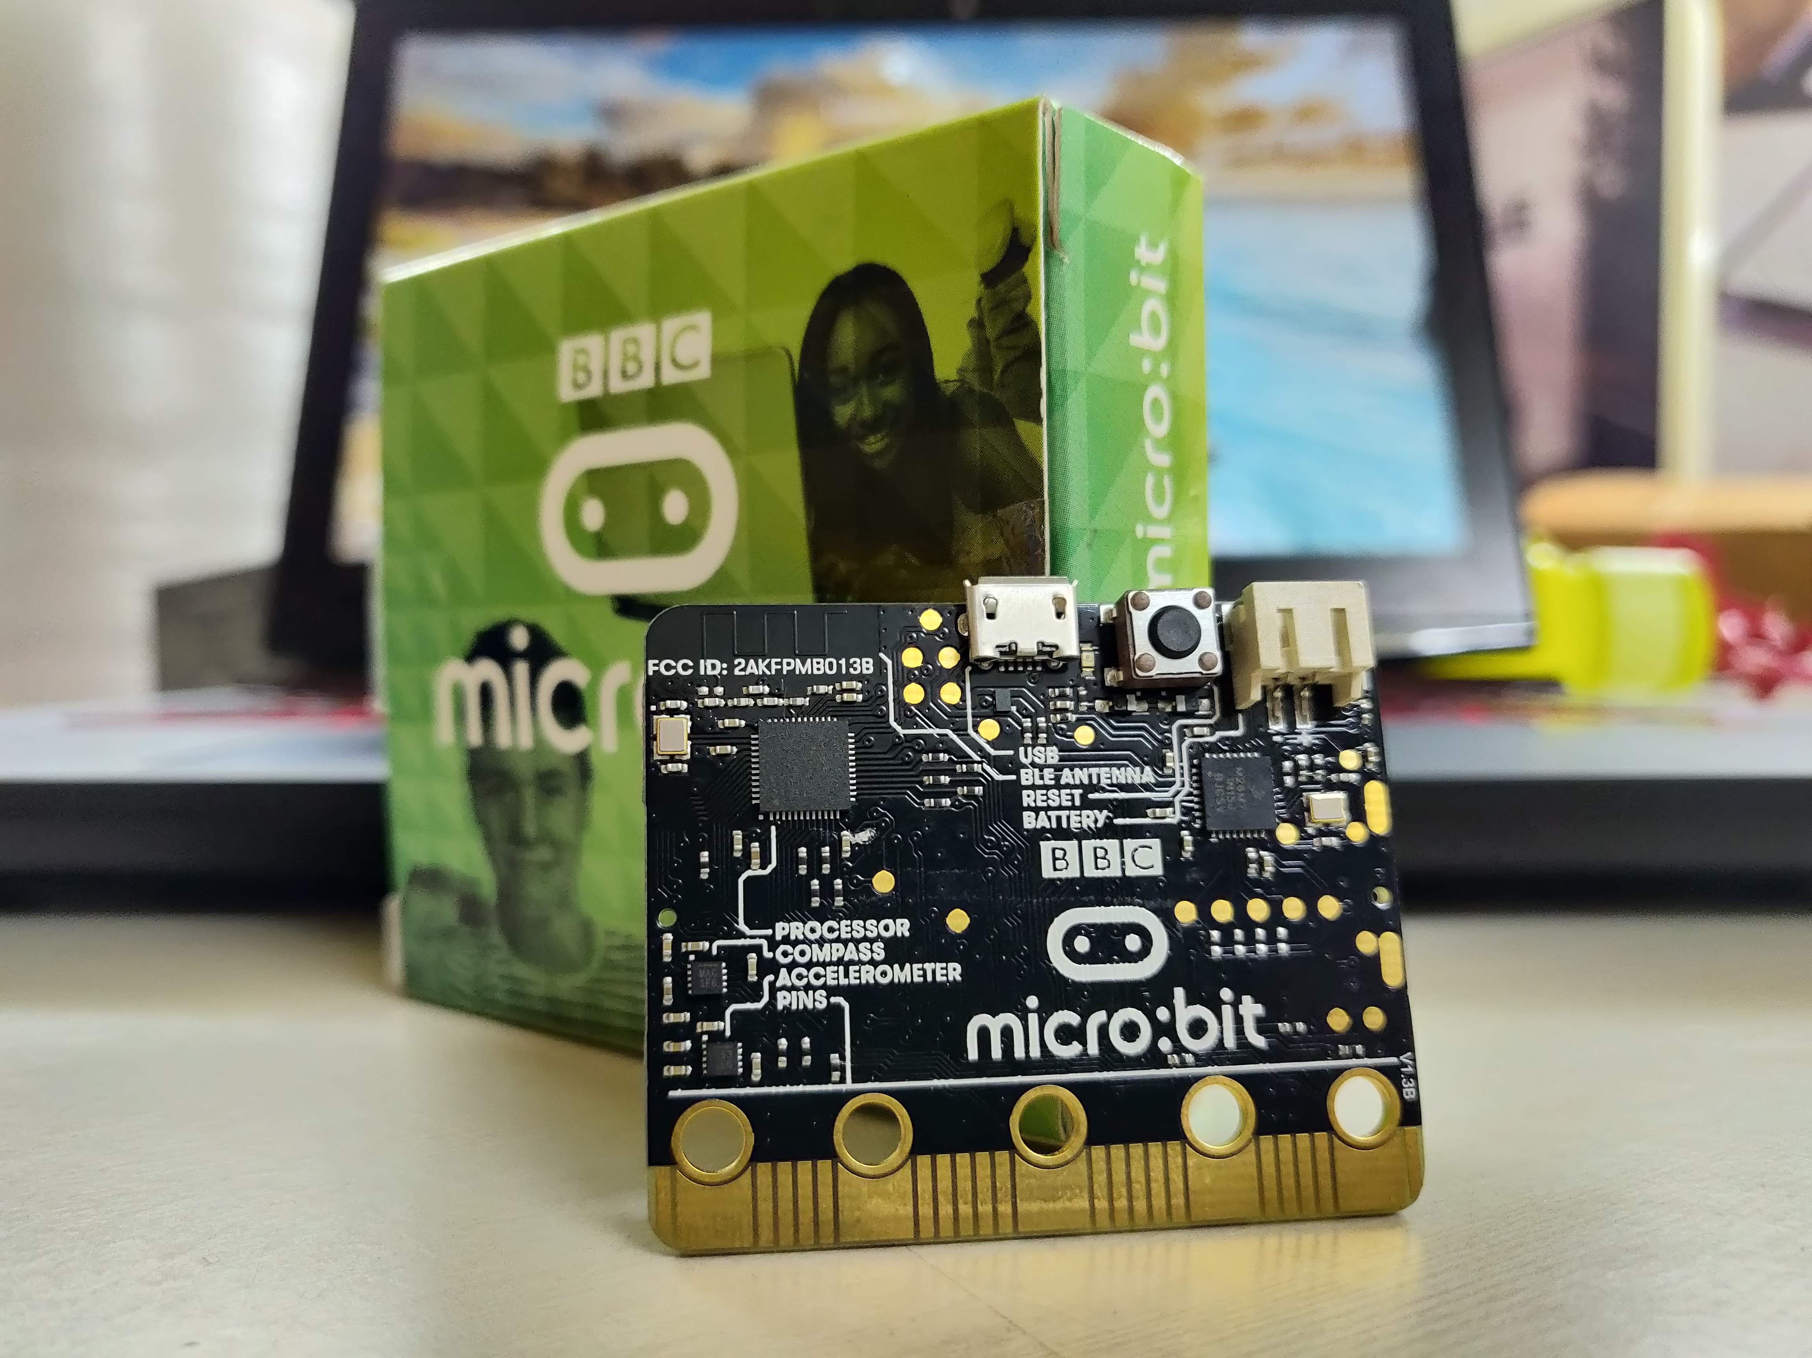
Introduction
The modern computer is less than 100 years old.
The first electromechanical and valve-based machines were produced in the 1930s and 1940s.
Today’s machines are many orders of magnitude faster, lower power, more reliable, and cheaper.
EDSAC replica (2018)¹
BBC Micro Bit (2015) Arm Cortex-M0²
1. EDSAC photo, CC BY-SA 4.0
2. Aruld, CC BY-SA 4.0
Notes:
Progress has been sustained and rapid since the first mechanical and valve-based computers were designed in the 1930s and 1940s. New markets were quickly established as fabrication technology improvements allowed smaller, faster, more reliable, and lower cost machines to be built. These new markets established demand and investment for further technology advances; this virtuous cycle was then repeated.
EDSAC
EDSAC was the first fully operational electronic stored-program computer. Work was started in 1947, and it ran its first programs in 1949. Other early machines included the University of Manchester’s Baby and the IBM SSEC. Interesting electrically driven mechanical calculators were also built in the late 1930s, including Konrad Zuse’s Z1 (https://en.wikipedia.org/wiki/Z1_(computer)).
In 2010, a project to build a working replica of EDSAC (https://www.tnmoc.org/edsac) was started at the National Museum of Computing. The aim was to have a fully working machine by 2019.

Slide 7
Levels of Abstraction
Architecture
A set of specifications that allows developers to write software and firmware
These include the instruction set.
Microarchitecture
The logical organization of the inner structure of the computer
Hardware or Implementation
The realization or the physical structure, i.e., logic design and chip packaging
Notes:
It is useful to identify distinct levels of abstraction when describing the process of design.
Architecture
This defines the instruction set, as well as exception and memory models that are relied upon by the operating system and hypervisor. The Arm architecture also includes definitions of the system registers, debug and trace architectures, and details of the virtual memory system.
Beyond the CPU, it is often helpful to define other components and interfaces that make it easier for hardware and software to interoperate, sometimes called “Systems Architectures” – together CPU and system architectures create platform definitions that operating systems can rely on.
Note: the terms “Architecture” and Instruction Set Architecture or “ISA” are often both used interchangeably.
What we are defining here is the “hardware-software interface.”
Microarchitecture – a specific implementation of the architecture.
What the architecture does not describe is how a processor is built, this we call microarchitecture. An easy way to understand microarchitecture is to imagine having two cars. Both cars can get you to the same destination, but both can be built very differently. In a similar way, you can have two processors implementing the same architecture, but with different microarchitectures. Meaning that they are built in very different ways.
The only constraint here is that we meet the specification so that different microarchitectural designs remain functionality equivalent. Different microarchitectures may aim to make different trade-offs in terms of performance and cost (e.g., area, power consumption, or complexity). Other important aims beyond performance may include security, reliability, or predictable performance.
Implementation
A particular physical realization of the microarchitecture, e.g., the hardware itself. We can select parameters for a given microarchitecture and then implement the design using different circuits, gates, and transistors (i.e., using different fabrication technologies). Different implementations may also target and operate at different clock frequencies. Even for the same technology node (e.g., 28 nm or 10 nm), there will be many choices, e.g., favoring performance or power efficiency.

Slide 8
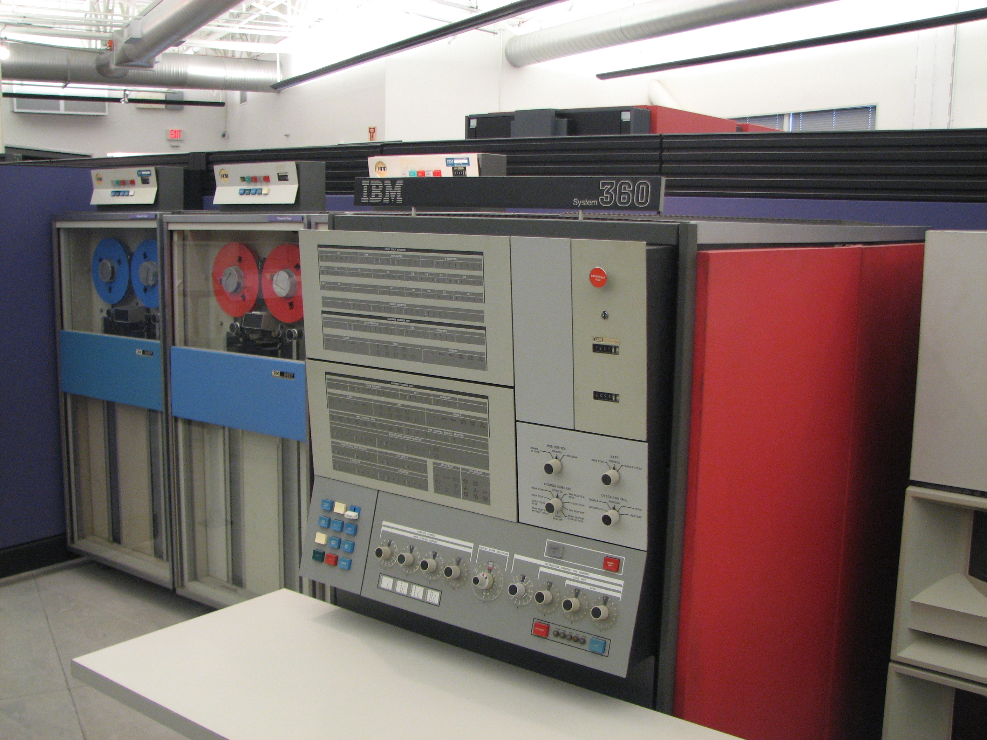
Architecture Specifications
The architecture specifies a contract between the hardware and software.
Many different compatible processors may be implemented, e.g., to meet different power consumption, cost, area, and performance goals.
When a software is written to conform with an architecture specification, it can be portable.
IBM System/360
Source of photo: Erik Pitti, CC-BY-2.0
Notes:
We will talk more about the design of the architecture and instruction set later. It needs to be designed carefully as it will determine what the hardware must implement. It will also limit the information that we are able to communicate from the compiler to our processor.
The IBM System/360 (as shown in the photograph) was the first family of compatible processors – initially consisting of six compatible computers. The performance of the fastest machine was 50 times that of the slowest. Prior to this, perhaps surprisingly, IBM’s product line consisted of numerous incompatible machines.
Chief architect: Gene Amdahl (we will hear about “Amdahl’s law” later)
Project manager: Fred Brooks (author of the seminal book “The Mythical Man-Month” (Turing award winner)
https://en.wikipedia.org/wiki/IBM_System/360

Slide 9
Computer Architecture
Computer architecture is much more than the task of defining the instruction-set or high-level architecture.
The computer architect must contribute to, and understand, all levels of design in order to deliver the most appropriate design for a particular application and target market.
Notes:
The different levels of design include the architecture, microarchitecture, and implementation. Design choices at each level have implications for the others; their design is interrelated and cannot be undertaken in isolation.
Must also remember we are designing with what are often very tight constraints in terms of power, performance, and cost (area).
“Computer architecture is the science and art of selecting and interconnecting hardware components to create computers that meet functional, performance, and cost goals” Mark Hill, University of Wisconsin

Slide 10
Computer Architecture
Computer architecture is concerned with how best to exploit fabrication technology to meet marketplace demands.
e.g., how best might we use five billion transistors and a power budget of two watts to design the chip at the heart of a mobile phone?
Computer architecture builds on a few simple concepts, but is challenging as we must constantly seek new solutions.
What constitutes the “best” design changes over time and depending on our use-case. It involves considering many different trade-offs.
Notes:
The challenge is that what constitutes the “best” design for a computer depends on many things that change, e.g., the fabrication technology and the applications that we want to run. We actually require a range of designs that make different cost, area, power, and performance trade-offs. We are not simply converging on one optimal architecture or design.
The same is true for many design problems, of course. Think about the design of an aeroplane. The “best” design is dependent on the materials and technologies available and the target market (capacity, range, budget, etc.).

Slide 11
Computer Architecture
Each level of design imposes different requirements and constraints, which change over time.
History and economics: there is commercial pressure to evolve in a way that minimizes disruption and possible costs to the ecosystem (e.g., software).
There is also a need to look forward and not design for yesterday’s technology and workloads!
Design decisions should be carefully justified through experimentation.
Markets
Applications
Operating Systems
Programming languages and compilers
Architecture
Microarchitecture
Hardware
Fabrication Technology
Notes:
We identified three distinct levels of abstraction when designing a processor (shown in blue)
We can extend these to factors beyond the processor itself that will influence and constrain our processor design, e.g., the particular fabrication technology that we have access to, or the target market and applications that our processor will be designed for.

Slide 12
The Computer Architecture Arena
Computer
architecture
Application
characteristics
Markets
New
applications
Technology
Source: “Early 21st Century Processors,” S. Vajapeyam and M. Valero, IEEE Computer, April 2004
Notes:
https://www.computer.org/csdl/magazine/co/2001/04/r4047/13rRUIIVl7s
The diagram (reproduced in a slightly simplified form from the paper) shows the “computer architecture arena” and the major “players”: applications, architecture, technology, and markets.
All of these affect each other to some extent, the lines/arrows represent strong or fundamental (thick lines) effects.
Advances in semiconductor technology produce smaller transistors that in turn enable new applications and markets. These markets themselves may actually influence the underlying fabrication technology (e.g., the creation of fabrication technologies optimized for mobile applications). The underlying technology also has a fundamental effect on computer architecture as a technology’s characteristics constrain what is possible (e.g., clock frequency, transistor count, power) and what design is best (i.e., due to the relative cost of communication vs. computation). Packaging and memory technology will also exert similar influences.
Similarly, application characteristics will impact architectural design choices as they will define what is the common-case, i.e., what we should optimize our processor design for. For example, we might consider which operations are most common and the forms and amount of different types of parallelism.
Markets will define many goals such as cost, performance, size, security, reliability, power, time-to-market, etc.

Slide 13
Design Goals I
Functional – hard to correct (unlike software). Verification is perhaps the highest single cost in the design process. We also need to test our chips once they have been manufactured, again this can be a costly process and requires careful thought at the design stage
Performance – what does this mean? No single best answer, e.g., sports car vs. off-road 4x4 vehicle – performance will always depend on the “workload”
Power – a first-order design constraint for most designs today. Power limits the performance of most systems.
Notes:
Fixing functional problems: some patching is sometimes possible, e.g., microcode fixes from Intel, and other workarounds might be possible too.
Why is low-power consumption so important?
We may wish to minimize energy consumption to maximize battery life or minimize the size and cost of the final product
High-performance designs are limited by power consumption due to the limits and costs of supplying/removing power/heat. It is simply not possible to have all the transistors on a chip switching at the same time at a high clock frequency, some part of the chip must remain idle (or “dark”)
(“Dark Silicon and the End of Multicore Scaling”
https://www.cc.gatech.edu/~hadi/doc/paper/2011-isca-dark_silicon.pdf)
The market dictates the relative importance of different design goals – this often involves the computer architect having to make difficult trade-offs.

Slide 14
Design Goals II
Security – e.g., the ability to control access to sensitive data or prevent carefully crafted malicious inputs from hijacking control of the processor
Cost – design cost (complexity), die costs (i.e., the size or area of our chip), packaging, etc.
Reliability – do we need to try to detect and/or tolerate faults during operation?
Notes:
Security is often a key design goal as we rely on networked computer systems to provide critical infrastructure and store personnel data. Some defenses are required at the architectural and hardware level to defend against intentional misuse. Security is seen as increasingly important and is increasingly influencing the design of processors.
Reliability – the need for fault detection or tolerance may be dictated by the application, e.g., a safety critical one. So-called “soft errors” are caused by cosmic rays striking the silicon die and may result in erroneous data values being injected into the system. Further problems threatening the durability of chips include transistor aging. Here transistors eventually “wear out” over time. Aging may become more of a problem as we try to build even smaller transistors.
Pitfall: Computer architecture becomes easy if we disregard some of our design constraints or goals, e.g., if we only focus on performance and ignore cost and power. Of course, in reality, we can’t do this, and we are forced to evaluate a large number of complex trade-offs. In order to make good design decisions, we must perform experiments in order to illuminate the design space and determine the best trade-offs in a quantitative fashion.

Slide 15
Markets and Features
Each target market will require a different trade-off in terms of power consumption, cost, area, performance, security, reliability, etc.
Here are some example processor classes from Arm:
Cortex-A: high-performance application processors, e.g., for mobile phones
Cortex-R: deterministic real-time performance, fault detection, and tolerance.
Cortex-M: energy-efficient embedded devices (“microcontroller” class cores)
Neoverse: scalable networks of processors on a single chip
e.g., 8, 16, 64, or 128 cores. Used in datacenters, edge servers, and storage
Notes:
Arm does not manufacture silicon devices. Instead, Arm creates microprocessor designs that are licensed to semiconductor companies and OEMs, who then integrate them into SoC devices.
To meet various requirements, there are three main Arm processor series.
The Cortex-A series is used for application processors, such as mobile phones and tablets. Their targets typically run a “full” operating systems such as Linux.
The Cortex-R series is optimized for real-time response. They are used within embedded systems with real-time and/or higher safety requirements. These typically run “bare-metal” (i.e., without an Operating System) or with a Real Time Operating System (RTOS); they are widely used in automotive, storages, and modems.
The Cortex-M series are optimized for size and cost. They typically run bare-metal code or a RTOS. Uses include Internet-of-Things (IoT) applications, smart home devices, industrial/motor control, and asset tracking. This type of processor is sometimes called a “microcontroller.”
This is a modern example of the idea of providing a range of compatible processors (with a common ISA) for different markets.

Slide 16

The Smartphone
Camera
CORTEX-M
Sensor hub
Touchscreen & sensor hub
CORTEX-M
Power management
CORTEX-M
CORTEX-A
CORTEX-M
A single smartphone will contain many different processor cores.
Why not use a single processor?
Apps processor
Flash controller
CORTEX-M
CORTEX-A
CORTEX-M
GPS
2G/3G/4G/5G
CORTEX-M
CORTEX-A
CORTEX-R
CORTEX-M
Bluetooth
CORTEX-M
Wi-Fi
CORTEX-R
CORTEX-M
Notes:
A single product may contain many different processors.
This is an example of how numerous Cortex-A/R/M series processors could be used in a smartphone.
Qu: why we don’t use a single powerful processor?
There are limits to how fast we can make a single processor
Even if we could, numerous smaller cores may consume less power
i.e., we can use the most power efficient core for each use-case
We can switch off as much of the chip as possible when it isn’t in use
We may also want to isolate different functions to ensure performance is predictable
Some operations may need to be completed within a particular time (i.e., have so-called “real-time” requirements)

Slide 17
Historical Performance

Slide 18
Historical Performance Gains
By 1985, it was possible to integrate a complete microprocessor onto a single die or “chip.”
As fabrication technology improved, and transistors got smaller, the performance of a single core improved quickly.
Performance improved at the rate of 52% per year for nearly 20 years (measured using SPEC benchmark data).
Note: the data are for desktop/server processors
Notes:
The graph uses data from desktop/server machines. We could plot similar curves for different markets, e.g., mobile applications processors.
Let’s explore how were these gains achieved and why the gains eventually slowed?

Slide 19
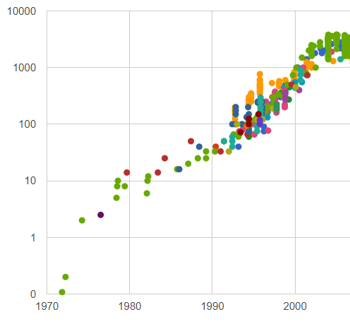
Historical Performance Gains
Clock period
Clock frequency improved quickly between 1985 and 2002:
~10x from faster transistors, and
~10x from pipelining and circuit-level advances.
So overall, ~100X of the total 800X gains came from reduced clock periods.
Clock Frequency (MHz)
Year
A. Danowitz, K. Kelley, J. Mao, J. P. Stevenson, and M. Horowitz. Clock Frequency, Stanford CPU DB. Accessed on Nov. 5, 2019. [Online]. Available: http://cpudb.stanford.edu/visualize/clock_frequency
Notes:
From: http://cpudb.stanford.edu/visualize/clock_frequency

Slide 20
Historical Performance Gains
From 1985 to 2002, performance improved by ~800 times.
Over time, technology scaling provided much greater numbers of faster and lower power transistors.
The “iron law” of processor performance:
Time = instructions executed x clocks per instruction (CPI) x clock period
Clocks per instruction (CPI)
We will also refer to Instructions Per Cycle (IPC), i.e., 1/CPI.
Notes:
Let’s examine how each of these individual factors (instructions executed, CPI, and clock period) improved over time; let’s look at clock period first…

Slide 21
Clocks Per Instruction (CPI)
Early machines were limited by transistor count. As a result, they often required multiple clock cycles to execute each instruction (CPI >> 1).
As transistor budgets improved, we could aim to get closer to a CPI of 1.
This is easy if we don’t care at all about clock frequency.
Designing a high-frequency design with a good CPI is much harder. We need to keep our high-performance processor busy and avoid it stalling, which would increase our CPI. This requires many different techniques and costs transistors (area) and power.
Notes:
CPI = Clocks Per Instruction, i.e., the average number of clock cycles required per instruction or (total clock cycles)/(dynamic instruction count)
Early machines were often implemented using “microcode.“ Each instruction was implemented by effectively running a small “microcode” program that controlled a simple datapath. Using this approach, each instruction would at least take a few clock cycles to execute. Complex instructions are easily supported with microcode.
As transistor counts improved, higher performance microarchitectures were possible and a CPI closer to 1 could be aimed for.
Of course, the aim is to achieve a good CPI and clock frequency, and simply sacrificing one for the other won’t improve performance.
Note, while pipelining improves clock frequency, the cost of pipeline stalls may increase with deeper pipelines. This means, we must try harder to avoid stalling the pipeline, and if we don’t, our CPI will increase and our performance gains will be smaller than expected (ultimately performance will peak and then decrease).

Slide 22
Clocks Per Instruction (CPI)
Eventually, the industry was also able to fetch and execute multiple instructions per clock cycle. This reduced CPI to below 1.
When we fetch and execute multiple instructions together, we often refer to Instructions Per Cycle (IPC), which is 1/CPI.
For instructions to be executed at the same time, they must be independent.
Again, growing transistor budgets were exploited to help find and exploit this Instruction-Level Parallelism (ILP).
Notes:
Can we achieve a CPI < 1 ?
Yes, superscalar processors are able to fetch and execute multiple instructions in a single clock cycle. Think of two car production pipelines placed next to each other to improve throughout.
Obviously, we need to find independent instructions if we are to take advantage of our superscalar processor. For example, we can’t execute two instructions at the same time when the second needs the result of the first.

Slide 23

What Is Pipelining?
Engine
Chassis
Paint
Time
Time
A
A
B
B
C
C
Order of manufacturing
(Car A, B, and then C)
Order of manufacturing
Notes:
Let’s imagine that building a car consists of three major stages:
constructing the chassis
installing the engine
painting.
Each stage or task takes 1 hour to complete.
We could complete each of these steps before starting to build a new car. This approach is illustrated in the left figure. A new car will be produced every 3 hours. Our throughput will be 8 cars per day, assuming our factory runs 24 hours.
Alternatively, if each of these tasks is completed at a different station, we could pipeline the cars construction. Now, the construction of a new car is started as soon as the first task is complete. Once our pipeline is full, a car will be completed every hour. Our throughput is now 24 cars per day.
We will learn more about pipeline and its implementation in future modules.

Slide 24
IPC and Instruction Count
Of the 800x improvement in performance (1985-2002), ~100x is from clock frequency improvements.
The remaining gains (~8x) were from a reduction in instruction count, better compiler optimizations, and improvements in IPC.
The graph to the right shows these improvements. It plots performance (SpecInt2000 benchmark performance per MHz for Intel processors against time).
Year

Slide 25
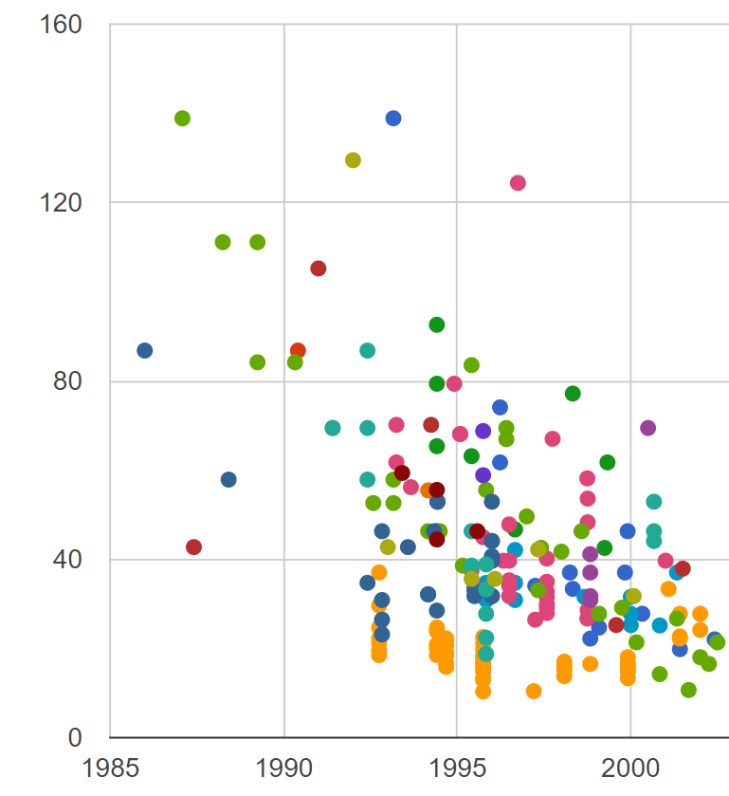
A Shorter Critical Path
We can also try to reduce the number of gates on our critical path.
This can be done by inserting additional registers to break complex logic into different “pipeline” stages.
Advances were also made that improved circuit-level design techniques.
The length of our critical paths reduced by ~10x (1985-2002).
Critical path length (FO4 delays)
Year
A. Danowitz, K. Kelley, J. Mao, J. P. Stevenson, and M. Horowitz. Stanford CPU DB. Accessed on Nov. 5, 2019. [Online]. Available: http://cpudb.stanford.edu
Notes:
Our processor’s clock period is set by its critical path, i.e., the longest logic delay between two registers. In order to improve clock frequency, we can “pipeline” our processor by inserting registers into the combinational logic. This breaks an instruction execution into a number of shorter stages. If it was still the case that only a single instruction could be in our pipeline at any one time, performance would not improve. Luckily, it is possible to overlap the execution of different instructions (think of a car production pipeline). Hence, clock frequency improvements can translate to improvements in instruction throughput.
Extra:
A number of circuit-level techniques were also used to improve logic delays and increase clock frequency. Clock distribution also became a major challenge as clock frequencies increased. The aim is to distribute the clock in a way that ensures it arrives at all registers at the same time. Differences in arrival times, so-called clock skew, can impact the maximum achievable clock frequency and also lead to hold violations. By the late 1990’s, high-performance processors employed active deskewing techniques. A deskewing circuit measures the skew between different parts of the chip and inserts delays into the clock tree to reduce the skew. Intel’s Pentium Pro realized a clock skew of just 15 ps with this technique. The performance of later designs such as Intel’s Pentium 4 benefited by up to 10% due to this sort of skew compensation.
Image from: http://cpudb.stanford.edu

Slide 26
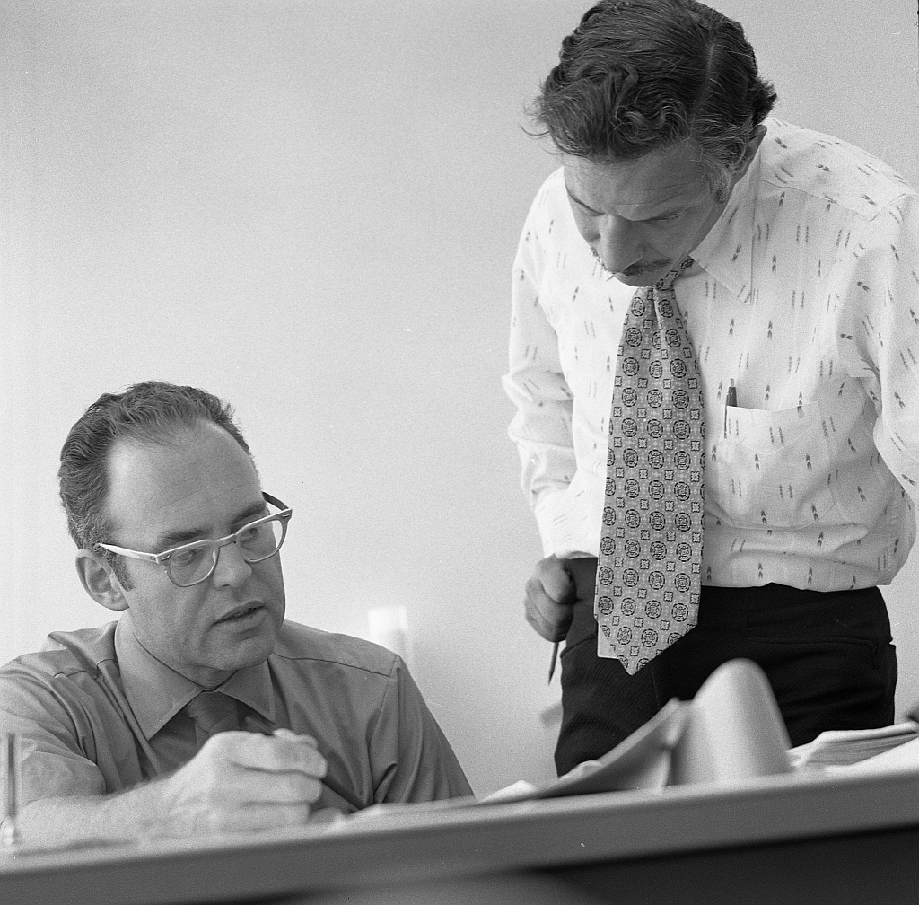
Moore’s Law
Moore’s Law predicts that the number of transistors we can integrate onto a chip, for the same cost, doubles every 2 years.
Gordon Moore and Robert Noyce at Intel in 1970
Source: IntelFreePress, CC BY-SA-2.0
Notes:
In 1965, Intel co-founder Gordon Moore predicted the rapid increase in the number of transistors on a chip.
By 1975, he had refined his prediction to what is now known as Moore’s Law
References:
https://www.economist.com/science-and-technology/2015/05/26/beyond-moores-law

Slide 27
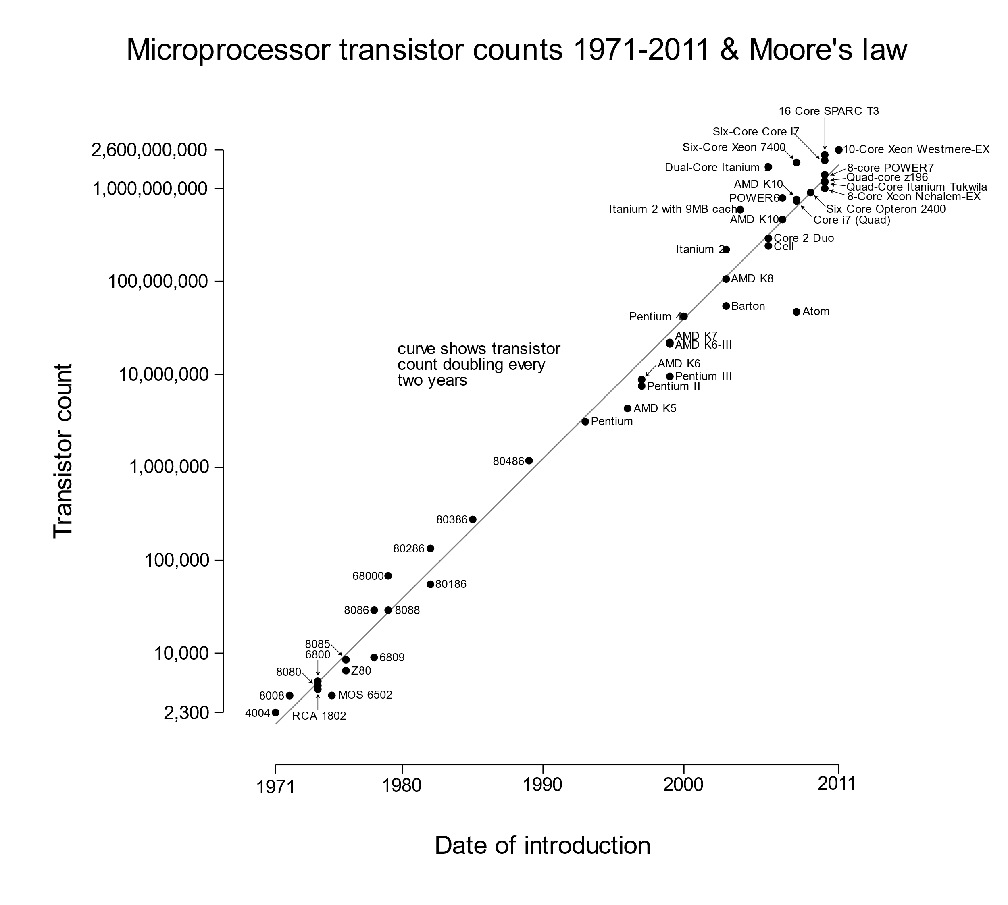
Moore’s Law
Processor transistor budgets grew quickly as microarchitectures became more complex.
1985 – Intel 386 275K transistors, die size = 43 mm²
2002 – Intel Pentium 4 42M transistors, die size = 217 mm²
Source: Wgsimon, Wikipedia, CC BY-SA 3.0
Notes:
Increased performance didn’t come from pipelining and faster transistors alone. Innovation at the microarchitectural level was also necessary. This ensured improvements in clock frequency were accompanied by improvements in CPI (or IPC). Processors became more complex in order to exploit greater levels of instruction-level parallelism requiring greater numbers of transistors (i.e., they contained more logic, registers, and memory).
Transistor counts were able to rise exponentially due to the ability to reduce their size and also increase the size of the die (or chip).

Slide 28
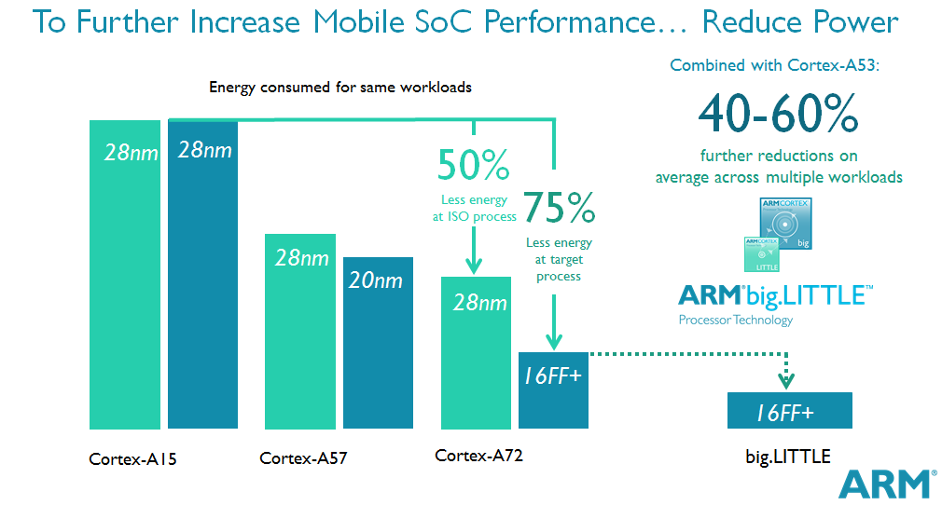
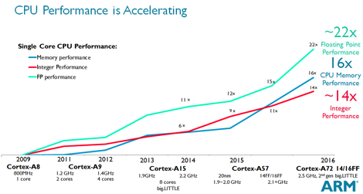
Better Performance and Lower Power
Notes:
As discussed previously, we make a range of trade-offs, and for mobile products, we must be especially careful to balance performance and power consumption.
If we look at recent Arm processors, it has been possible to boost performance significantly and reduce the energy consumed for a particular workload.
The light green column shows how energy consumption reduces even when the fabrication process remains unchanged. The second blue column illustrates gains from both microarchitecture and newer fabrication processes.
Arm big.LITTLE – this is the idea of employing both larger and smaller cores to optimize the power consumed for a particular workload; “low intensity” tasks can be run on the most energy efficient processor while those demanding the highest performance are run on the larger cores. Overall, power is saved. Tasks may be migrated between the big and LITTLE cores as required.

Slide 29
Multicore Processors,
Systems on Chip (SoC), and Beyond

Slide 30
Slowing Single-core Performance Gains
To summarize, sustaining single core performance gains became difficult due to:
The limits of pipelining
The limits of Instruction-Level Parallelism (ILP)
Power consumption
The performance of on-chip wires
As a result performance gains slowed from 52% to 21% per year for the highest performance processors.
Notes:
The graph shows the performance of desktop processors over time. Performance is measured by running particular benchmark programs. In this case, a benchmark suite called “SPEC” has been used. In particular, a suite called “SPECint” focuses on integer processing power (rather than floating-point). The benchmarks are also often chosen to test the performance of the memory system. Their data sets are usually large enough to ensure that they don’t simply fit within on-chip memories (or “caches”).
More information about the SPEC benchmark suite: https://www.spec.org/benchmarks.html
How might we seek further performance gains?

Slide 31
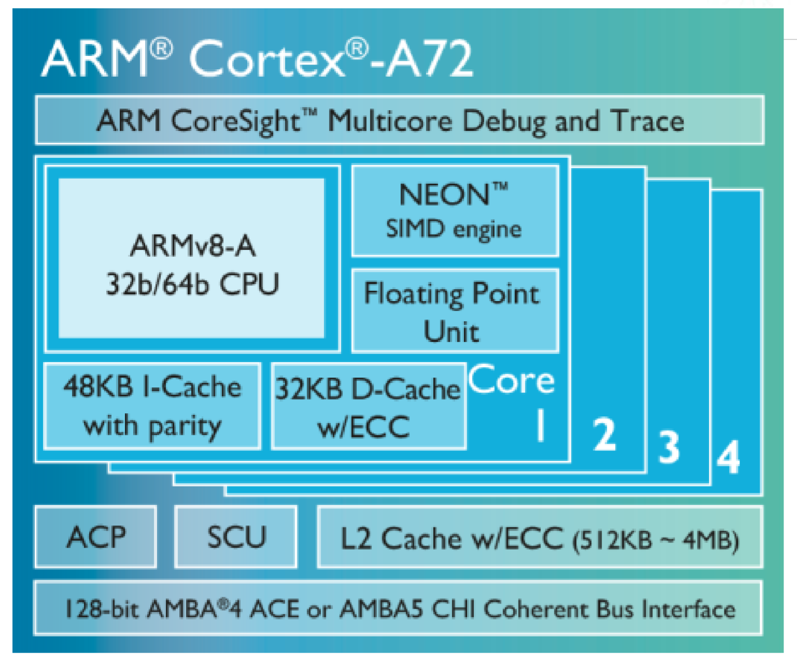
Multicore Processors
Eventually, it made sense to shift from single-core to multicore designs.
From ~2005, multicore designs became mainstream.
The number of cores on a single chip increased over time.
Clock frequencies increased more slowly.
Individual cores were designed to be as power efficient as possible.
e.g., 4 x Arm Cortex-A72 processors, each with their own L1 caches and a shared L2 cache
Notes:
Industry would have preferred to continue to make incremental improvements to their high-performance processors. Such improvements typically improved the performance of all applications and had little implications for their programming. This “free lunch” meant programmers could be confident that the performance of their applications would improve over time, even if performance was only just adequate upon release.
Unfortunately, uniprocessor (single-thread) performance gains could not be sustained. Multicore designs were the answer, but the free “performance” lunch was over. Applications requiring the full power of these new multicore processors would have to be structured in a way that could take advantage of the separate cores (or thread-level parallelism). This requires extra work on the part of the programmer. Unfortunately, writing parallel programs and dealing with concurrency issues is considerably more difficult than writing sequential applications.
Cortex-A72 example
The block diagram illustrates a system with four Cortex-A72 cores
Each of these cores fetches and executes approximately* 4 instructions per clock cycle
This means, in total, we can have up to 16 instructions executing at the same time.
While this sort of system is common today, it would be extremely challenging to build a single core that could sustain 16 instructions per cycle.
----
*why approximately 4?
Each A72 can fetch up to 4 instructions per clock cycle from memory
It can then decode up to 3 per cycle
These instructions are then expanded into a slight (~+20%) number of micro-operations. Up to 5 of these can then be dispatched to the processor’s functional units in a single cycle. Expanding “macro-ops” into “micro-ops” is a common trick to avoid the need to actually implement each instruction directly, rather they can map to a small number of simpler operations that are easier to implement.

Slide 32
Multicore Processors
Exploiting multiple cores comes with its own set of challenges and limitations:
Power consumption may still limit performance.
We need to write scalable and correct parallel programs to exploit them.
We might not be able to find enough parallel threads to take advantage of our cores.
On-chip and off-chip communication will limit performance gains.
Off-chip bandwidth is limited and may throttle our many cores.
Cores also need to communicate to maintain a coherent view of memory.
Notes:
We will explore these ideas in future modules.
Is there something else we can do beyond exploiting multiple cores?

Slide 33
Specialization
Today, we often need to look beyond general-purpose programmable processors to meet our design goals.
We trade flexibility for efficiency.
We remove the ability to run all programs and design for a narrow workload, perhaps even a single algorithm.
These “accelerators” can be 10-1000x better than a general-purpose solution in terms of power and performance.
Notes:
We typically design for the common-case, for a microprocessor what constitutes the common-case is normally determined from a broad range of applications. Of course, such computers are both programmable and universal, in the sense that they can perform any algorithmic process – given enough memory and time.
By narrowing what the common-case is, perhaps even if it is a single algorithm or kernel, we can remove hardware that is required to provide universality (i.e., we may only need a very limited set of operations) and the hardware that exists to enable the hardware to be reprogrammed, i.e., follow a sequence of instructions. Our accelerator may simply not require this level of programmability (although some ability to program or configure may be retained).
Furthermore, we can tune what remains for our particular application. This may also involve adding more memories, building specialized functional units, and duplicating these many times. The compute-intensive applications that often benefit from hardware accelerators also typically have a large amount of parallelism that can be exploited by hardware accelerators.
However, the limitation of specialization is that specialization also reduces flexibility, whereby the logic invested in specialized accelerators is no longer general-purpose. Therefore, algorithm changes may render specialized hardware obsolete.

Slide 34
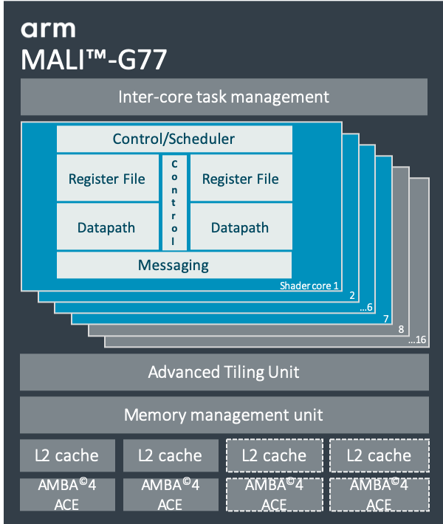
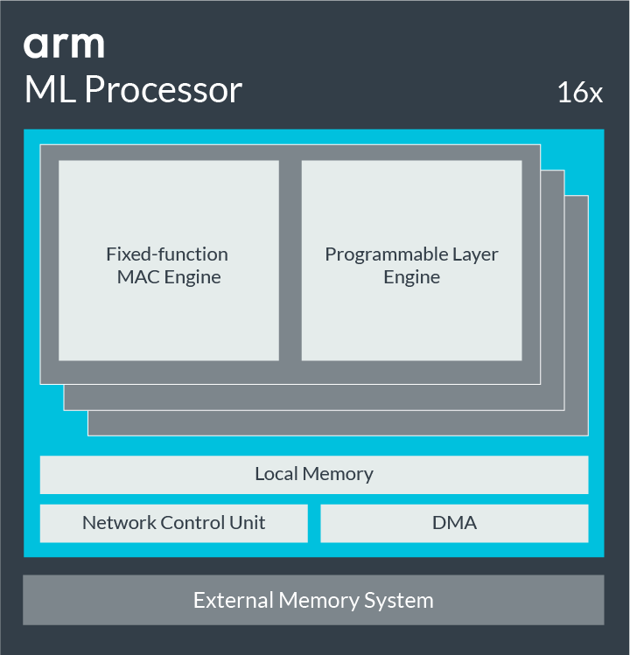
Specialization
Graphics Processing Unit (GPU)
Neural Processor Unit (NPU)
Notes:
Two common examples of specialization today.
GPUs - Graphics Processing Unit
NPUs - Neural Processing Unit, i.e., a neural network accelerator or ML (Machine Learning) Processor
Common to see parallelism exploited. In both the GPU and NPU, we can see that a core processing element is instantiated many times. These parallel hardware units are then used to exploit the parallelism available within the application.
Modern SoCs include many other specialized accelerators too. This is driven by the need to save power – if we can afford billions of transistors but only a small fraction can be active at any one time (dark silicon), specialization makes good sense.
Gains from specialization may be very high, e.g., 10-1000x in the extreme case.
-----
References:
ML processor: https://developer.arm.com/ip-products/processors/machine-learning/arm-ml-processor
G77 GPU: https://developer.arm.com/ip-products/graphics-and-multimedia/mali-gpus/mali-g77-gpu

Slide 35
Today’s SoC Designs
A modern mobile phone SoC (2019) may contain more than 7 billion transistors.
It will integrate:
Multiple processor cores
A GPU
A large number of specialized accelerators
Large amounts of on-chip memory
High bandwidth interfaces to off-chip memory
mem interface
mem interface
GPU
L3 cache memory
Neural
Processor
Unit
(NPU)
4 “big”
cores
4 “small” cores
Other accelerators
mem interface
mem interface
A high-level block diagram of a mobile phone SoC
Notes:
The SoC’s architect will exploit many different types of parallelism, e.g., instruction, data, and thread-level. Its design will involve carefully balancing trade-offs, in terms of power, cost, performance, etc., to meet the design goals.
We’ll look at the design of a complete SoC as part of the last module.

Slide 36
Trends in Computer Architecture
Time
Early computers | Gains from bit-level parallelism
Pipelining and superscalar issue | + Instruction-level parallelism
Multicore/GPUs | + Thread-level parallelism/data-level parallelism
Greater integration (large SoCs), heterogeneity, and specialization | + Accelerator-level parallelism
Note: Memory hierarchy developments have also been significant. The memory hierarchy typically consumes a large fraction of the transistor budget.
Notes:
Reference:
Accelerator-Level Parallelism (ALP), Vijay Janapa Reddi and Mark D. Hill
https://www.sigarch.org/accelerator-level-parallelism/
(accessed on 27th October 2019)

Slide 37
The Future – The End of Moore’s Law?
The end of Moore’s Law has been predicted many times.
Scaling has perhaps slowed in recent years, but transistor density continues to improve.
Eventually, 2D scaling will have to slow down.
We are ultimately limited by the size of atoms!
Where next?
Going 3D - Future designs may take advantage of multiple layers of transistors on a single chip.
Note: the gains are linear rather than exponential.
Better packaging and integration technologies (e.g., chip stacking)
New types of memory
New materials and devices
Notes:
The end of Moore’s law has been predicted many times. Many of today’s predictions point to the period between 2020 and 2025.
There are many challenges to overcome in order to continue to scale transistors:
Lithographic challenges, i.e., how do we “print” tiny transistors. Extreme Ultra Violet (EUV) scanners are very extremely large and complex machines.
Fabrication plant costs continue to rise, a 5 nm fabrication plant (2019/2020) is estimated to cost $15-20 billion
The number of “fab” plants has reduced sharply over time
Industry may also try to look beyond silicon technology, but the investment in silicon semiconductors to date has been very large, and its capabilities are impressive (billions of working devices operating at GHz speeds). Alternative technologies may make sense for particular target markets, e.g., ultra low-cost processors using printable plastic transistors.
We may see numerous one-off advances in the area of packaging and communication (e.g., optical on-chip and off-chip communication), but scaling is likely to be much more complex than it has been in the past. This will no doubt be an interesting challenge for the next generation of computer architects!
Additional material:
N3XT: http://poplab.stanford.edu/pdfs/Aly-N3XT1000-computer15.pdf

Slide 38
Backup Slides

Slide 39
From Sensors and Smartphones to Servers
Notes:
This slide illustrates how different the design of processors can be. Area and power consumption may differ by a factor of 1000x.
Each square represents the area of an Arm Cortex-M0 core.
While a high-performance 32-bit core (Cortex-M7) may only be 13 times larger than an M0,
the server class Cortex-A76 has an area equivalent to 1,380 M0 cores.
Their architectures are very different as we will see as the course develops.

Slide 40
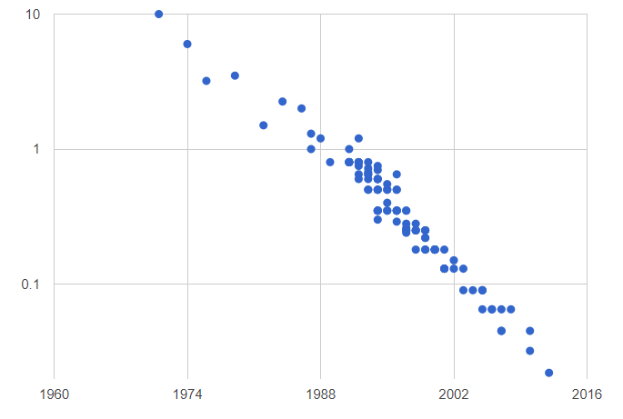
Technology Scaling: Faster Transistors
From 1985 to 2002, we saw ~7 new process generations.
Scaling provides smaller and faster transistors. Performance improves ~1.4x per generation, so for 7 generations, we have ~10x faster logic gates.
Feature Size (um)
Year
A. Danowitz, K. Kelley, J. Mao, J. P. Stevenson, and M. Horowitz. Stanford CPU DB. Accessed on Nov. 5, 2019. [Online]. Available: http://cpudb.stanford.edu
Notes:
Improvements in fabrication technology leads to smaller and faster transistors. As improvements are made in the fabrication process, new “process generations” or “technology nodes” are created. These are names for manufacturing processes that create transistors and wires (or interconnect) with particular sizes and spacing rules. For example, today, we often refer to 10 nm or 7 nm processes.
Unfortunately, main memory access times don’t decrease as quickly. Note that this disparity (or memory “gap” or “wall”) will limit the effectiveness of building faster processors if we don’t address it. In practice, we exploit smaller on-chip memories to hold data and serve the majority of our memory requests, and these memories are called “caches.”

Slide 41
Instruction Count
Increased datapath width (e.g., 16-bit to 32-bit to 64-bit)
Larger register files (fewer load/store instructions)
More complex instructions?
SIMD instructions
Notes:
How might we reduce the number of instructions executed?
Increasing the width of our datapath
Large register file - Ensuring we have a large register file with lots of general-purpose registers that our compiler can use. In this way, we can reduce the number of load/store instructions (i.e., the need to spill registers to memory)
How about adding more complex instructions?
This sounds easy, but naively adding more instructions will increase our clock period and may lead to an overall slowdown. Complex instructions may also require multiple cycles to execute (increasing our CPI) and will add to design complexity (e.g., design time and cost). The golden rule is to always optimize the common-case, more about this later. It is common sense that we don’t want to accelerate rare cases at the expense of the common case.
The challenge is that the terms of our computer performance equation are not independent (optimizing one may disadvantage another)
Another useful idea is:
SIMD = Single Instruction Multiple Data
The idea is that instead of working with scalar values, we can define an instruction that operates on short-vectors, e.g., a 128-bit register that can be broken down into eight 16-bit values. A single instruction can now specify that two of these short vectors should be added together (requiring eight 16-bit add operations). An additional advantage is that the hardware knows that all of these operations can be undertaken in parallel.

Slide 42
Limits to Single Core Performance
Limits to pipelining
Cost of interruptions grow, e.g., impact of cache misses and mispredicted branches.
Ultimately, some components are difficult or expensive to pipeline.
There are also practical limits to distributing very high-frequency clocks, registers represent a finite delay, and we may struggle to balance logic between pipeline stages.
Limits of Instruction-Level Parallelism (ILP)
Large amounts of ILP are very difficult to discover and exploit efficiently.
Our returns on investment quickly diminish, i.e., we must use more power and more transistors to expose and exploit ever smaller amounts of ILP.
Notes:
Diminishing returns from ILP
The theoretical upper limits to Instruction-Level Parallelism (ILP) are high, often ten’s of instructions per cycle, perhaps even above 100 instructions per cycle for some applications. Unfortunately, hardware costs grow quadratically or worse. This means, large investments in hardware typically result in ever smaller gains over time. In practice, we have been limited to building machines that at most can fetch and issue around 4 to 8 instructions per cycle.

Slide 43
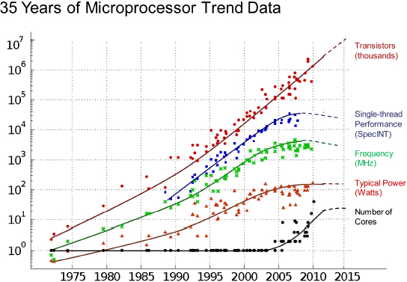
Limits to Single Core Performance
Power consumption
Historical performance gains have been impressive, but power consumption also grew very quickly during the 1980s and 1990s.
This happened even with improvements in fabrication technology and reductions in supply voltage.
Power quickly became, and remains, a first-order design constraint for all significant markets.
Year
Figure source: Original data collected and plotted by M. Horowitz, F. Labonte, O. Shacham, K. Olukotun, L. Hammond, and C. Batten. Dotted-line extrapolations by C. Moore: Chuck Moore, 2011, “Data processing in exascale-class computer systems,” The Salishan Conference on High Speed Computing, April 27, 2011.
Notes:
As technology scales, transistors become more power efficient, both as a result of lower capacitances and a reduction in their supply voltage.
Historically, a move to a new generation of fabrication process would provide twice as many transistors for a given area. Their delay would also reduce by a factor of ~0.7. At the same time, the power dissipated in our logic gates would half. As a result, our power density would remain constant.
As you can see from the graph, in reality, both power consumption and transistor counts grew quickly during the 1980s and 1990s. This was due to the fact that in addition to taking advantage of faster and smaller transistors, die sizes grew and pipelining also boosted clock frequencies.

Slide 44
Limits to Single Core Performance
On-chip wiring
Wire delays scale relatively poorly compared to logic delays.
This limits the amount of state reachable in one clock cycle.
Unfortunately, this limits the performance of large complex processors.
Notes:
In addition to transistors, we need to manufacture small wires (or on-chip interconnect) to connect the transistors together to form a circuit and provide power to them. A chip typically has many (perhaps 13 or more) different metal wiring layers stacked on top of each other.
Wires delay may force us to partition our design. Extra clock cycles of delay are then often required to communicate between these new submodules or clusters of resources.

Slide 45
Specialization
What does specialization allow us to do?
Remove infrequently used parts of the processor.
Tune the instruction set for common operations or replace with hardwired control .
Exploit forms of parallelism abundant in the application(s) – we often see a specialized processing element and local memory reproduced many times.
Instantiate specialized memories and tune their widths and sizes.
Provide specialized interconnect between components.
Optimize data-use patterns.
Notes:
What we lose by specializing is the general-purpose nature of a processor, i.e., the ability to run any program. What is gain is the ability to more directly implement the hardware to solve our problem. Of course, in practice, there is a spectrum of approaches ranging from specialized processors (that may retain the ability to run all programs), highly parallel programmable accelerators to fixed-function accelerators.

Slide 46
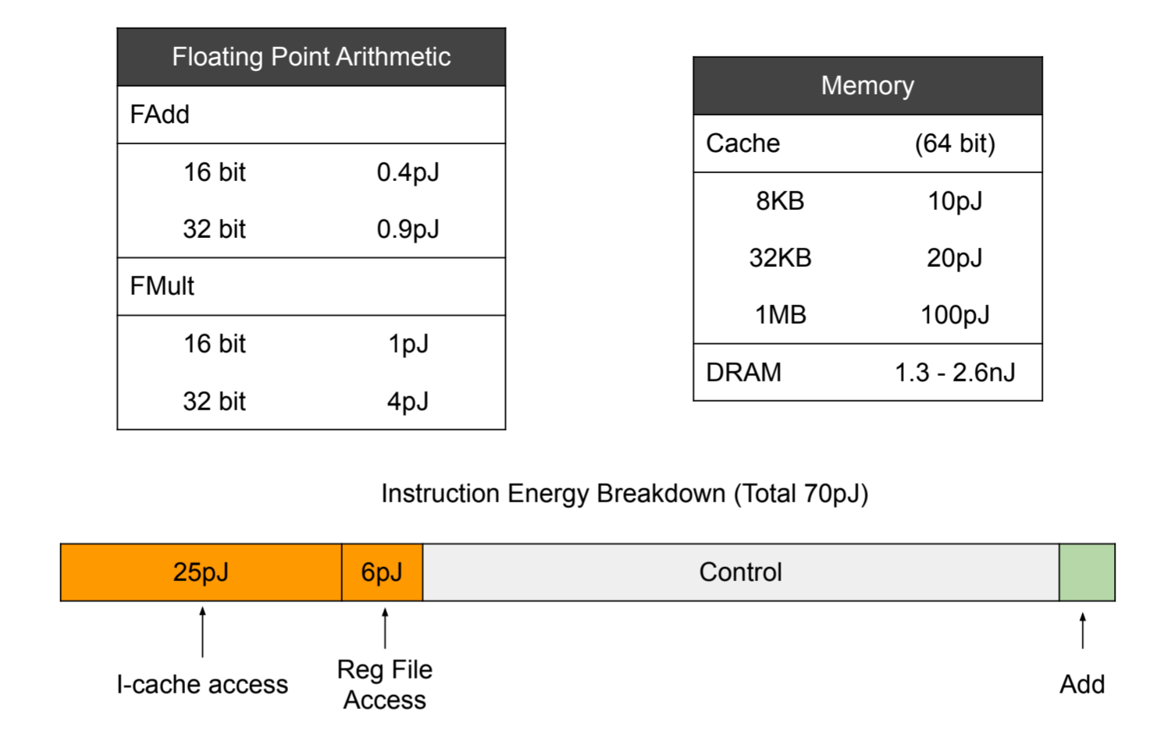
Specialization
Data assume a 45 nm process @0.9 V
M. Horowitz, Computing's energy problem (and what we can do about it), IEEE, March. 6, 2014. [Online]. Available: https://ieeexplore.ieee.org/document/6757323
Notes:
To illustrate the potential of specializing hardware, let’s look at a breakdown of the energy used when executing an instruction.
The breakdown is shown for an “ADD” instruction. It is clear from this that the actual energy expended in performing the ADD is very small compared to the energy required to fetch the instruction, fetch its operands, and control its execution.
In the case of an accelerator, much of this “overhead” can be removed. It may be that we can instantiate many more adders with the transistors saved and potentially further specialize the add itself, e.g., by matching the actual width of the data, say 16 bit.
---
Note that 45 nm process was first introduced in 2007.

Slide 47
Limits to Specialization
There are costs associated with designing each new accelerator.
The chip, or “ASIC,” produced may only be competitive in a smaller target market, reducing profitability.
Specialization reduces flexibility.
The logic invested in specialized accelerators is no longer general-purpose.
Algorithm changes may render specialized hardware obsolete.
Once we’ve specialized, further gains may be difficult to achieve.
Specialization isn’t immune to the concept of diminishing returns.
Notes:
Note: modern fabrication processes continue to provide us with cheaper and smaller transistors. Unfortunately, the one-time or Non-Recurring Engineering (NRE) costs of producing a chip design increases with each new generation. In particular, the costs associated with design, verification, and mask costs (masks are stencil-like patterns used to fabricate chips) increase. This means, complex chips can only be made cheaply in very high volumes so that these NRE costs can be amortized. Transistors are cheap if designs are manufactured in high volumes but can also be very expensive if a smaller number of chips are manufactured.
-----
(ASIC = application-specific integrated circuit)
Specialization introduces a new set of problems and costs. We may be able to mitigate some of these disadvantages by creating accelerators that are programmable or reconfigurable. As with much of computer architecture, the challenge is to balance a large number of trade-offs to meet our design goals. Specialization is concerned with the trade-off between flexibility and efficiency.
Once steps are taken to tune for a particular application, returns from specialization may begin to diminish. This is especially true if Moore’s law slows and increases in transistor budgets stagnate.
Specialization also means we have less flexibility, e.g., to run a different workload or take advantage of a new algorithm or evolution of an algorithm. Domains where there is particularly rapid innovation in terms of algorithms may be problematic, e.g., machine learning.
-----
Another question is how we might partition our transistor (and power) budget for a complete chip, i.e., between processors, accelerators, memory, and interconnect.
The design of accelerators is made even more challenging if the algorithms and techniques used in a particular area are evolving quickly. This is currently true for neural network accelerators where new hardware encourages innovation at a higher level, changing what constitutes the common case.
-----
Makimoto’s wave
In 1987, Tsugio Makimoto noticed a cyclical pattern in the semiconductor industry, one in which the industry shifts between standardization and customization every 10 years. Standardization favours general-purpose processors and regular programmable substrates such as FPGAs. Customization emphasizes application-specific qualities. The swing in each direction was driven by not only new technology and new target market, but also constraints such as cost and time-to-market.
(“Implications of Makimoto’s Wave,” IEEE Computer, December 2013)
-----
References:
“The Accelerator Wall: Limits of Chip Specialization” http://parallel.princeton.edu/papers/wall-hpca19.pdf

