Slide 1
Fundamentals of Computer Design
Module 2

Slide 2
Module Syllabus
Explore a simple processor design.
Introduce the fundamentals of computer design.
Outline the principles of instruction set design.
The Armv8-A Instruction Set Architecture.
Notes:
This module will step through the design of a simple processor. The aim is to outline their basic operation, understand how the basic fetch-execute cycle is implemented and how instructions are encoded in memory. We’ll then explore some fundamental computer design principles and introduce the concept of an Instruction Set Architecture (ISA).

Slide 3
A Simple Processor
We will only need a few simple components:
Memories – to store our program (instructions) and data
A register file – instructions will read their operands from the register file and also write their results to it.
Registers, an ALU and adders
Decode and control logic
Notes:
These components should be familiar from an introductory course on digital electronics.
Memories - To keep things simple, we will use a different memory for instructions and data in this example. This is also the norm for real processors as we often want to access both instructions and data in memory at the same time.
The register file is simply a small multi-ported memory. Adding multiple “ports” allows us to read from, or write to, multiple memory locations in a single clock cycle.
Our register file has two read ports and a single write port - we can read two values and write a result in a single clock cycle.
Our processor can only load data from memory into our register file and store data from the register file to memory using special load and store instructions. Architectures that restrict memory access to a few instructions like this are called load-store architectures
ALU – Arithmetic Logic Unit, a functional unit capable of performing a range of arithmetic and logical operations. The input is typically two operands and the operation to be performed (e.g., add, shift, xor, etc.). The output is the result.

Slide 4
A Simple (32-bit) Processor
Let’s assume all our instructions are encoded in 32-bits/
Our registers and datapath are also 32-bits wide.
Memory is accessed with a 32-bit address and returns 32-bit data.
Our processor has 32 registers, hence we must use 5-bits to identify a particular register (as 2^5 =32).
Notes:
NOTE: We could also build a datapath that is 64-bits wide. This would not require us to increase the width of our instructions, they could still be encoded in 32-bits. The datapath simply processes data, and the instructions in our program control it.
Code density
Using more than 32-bits to encode our instructions would likely lead to poor code density. This could increase costs, e.g., by requiring systems to have more memory, or decrease performance.
Some instruction sets adopt a variable-length instruction encoding. The Intel x86 instruction set, for example, may encode instructions using a single byte (8-bits) up to 15 bytes (120-bits). This may lead to better code density when compared to a fixed-width 32-bit encoding. In practice, modern processors often adopt both 16-bit (compressed) and 32-bit encodings to boost code density.

Slide 5
A Processor Datapath – Encoding Instructions
A simple data processing instruction may have the following format, where Operand2 may be a register or immediate value.
Given 32-bits to encode our instructions, we may invent two simple instruction encoding formats for our processor, e.g.:
Instruction Rd, Rs, Operand2
15
0
31
25
20
10
op | rs1 | rs2 | rd | function
op | rs1 | rs2 / rd | immediate
15
Notes:
An “immediate” is simply a numeric value stored in the instruction itself, e.g., the number 99.
This slide describes the encoding of instructions stored in memory. Here, we assume a simple fixed-length instruction encoding as is adopted in most Reduced Instruction Set Computer (RISC) processors. Complex Instruction Set Computer (CISC) machines often have much more complex variable-length instruction encoding schemes. The idea here is just to introduce the concept and to demystify how instructions are actually stored in memory.
The “op” bits tell us what the instruction is, i.e., the operation code or “opcode.” For instructions that share the same opcode, the “function” field gives us additional information about the operation to be performed, e.g., if an opcode of 0 indicates an ALU operation, the function field would indicate the ALU function (e.g., add, subtract, or multiply, etc.).

Slide 6
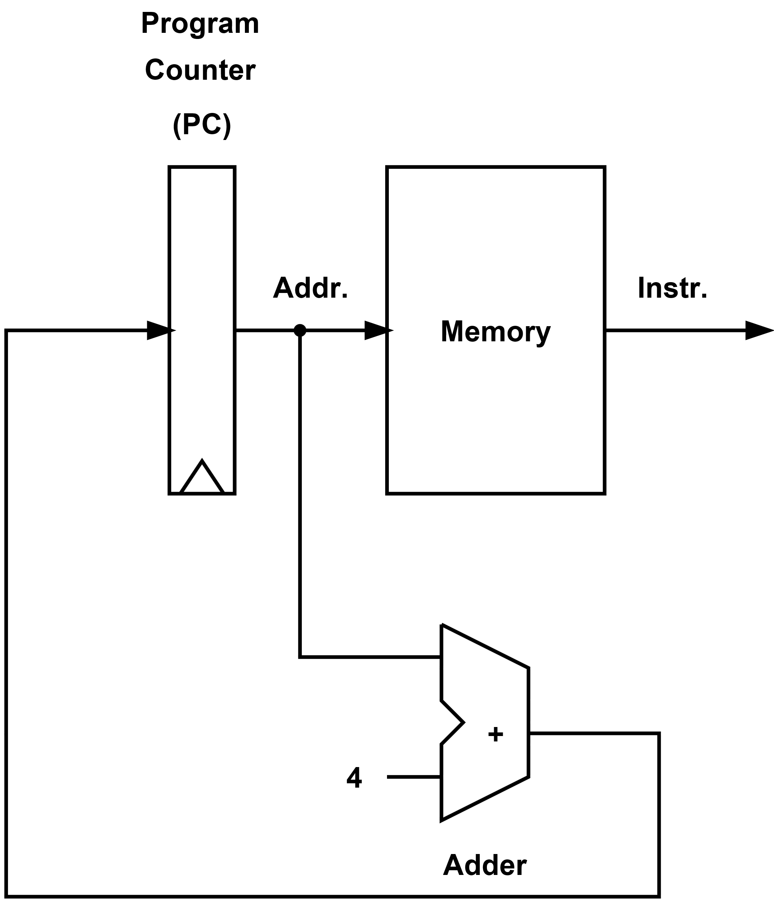
A Processor Datapath – PC and Instruction Memory
Our Program Counter (PC) stores the address of the instruction currently being fetched from memory.
This simple datapath increases the PC by 4 (bytes) on each cycle and only allows us to read each 32-bit instruction in turn.
We need to add more logic to actually compute, handle branches, provide registers, access data memory, etc.
Notes:
A datapath is simply a collection of registers, ALUs, memories, etc. that operate on words of data. Processors are constructed from datapaths and control logic. The control logic provides the select, enable, and other control signals to each of the datapath components necessary to execute each instruction correctly.

Slide 7
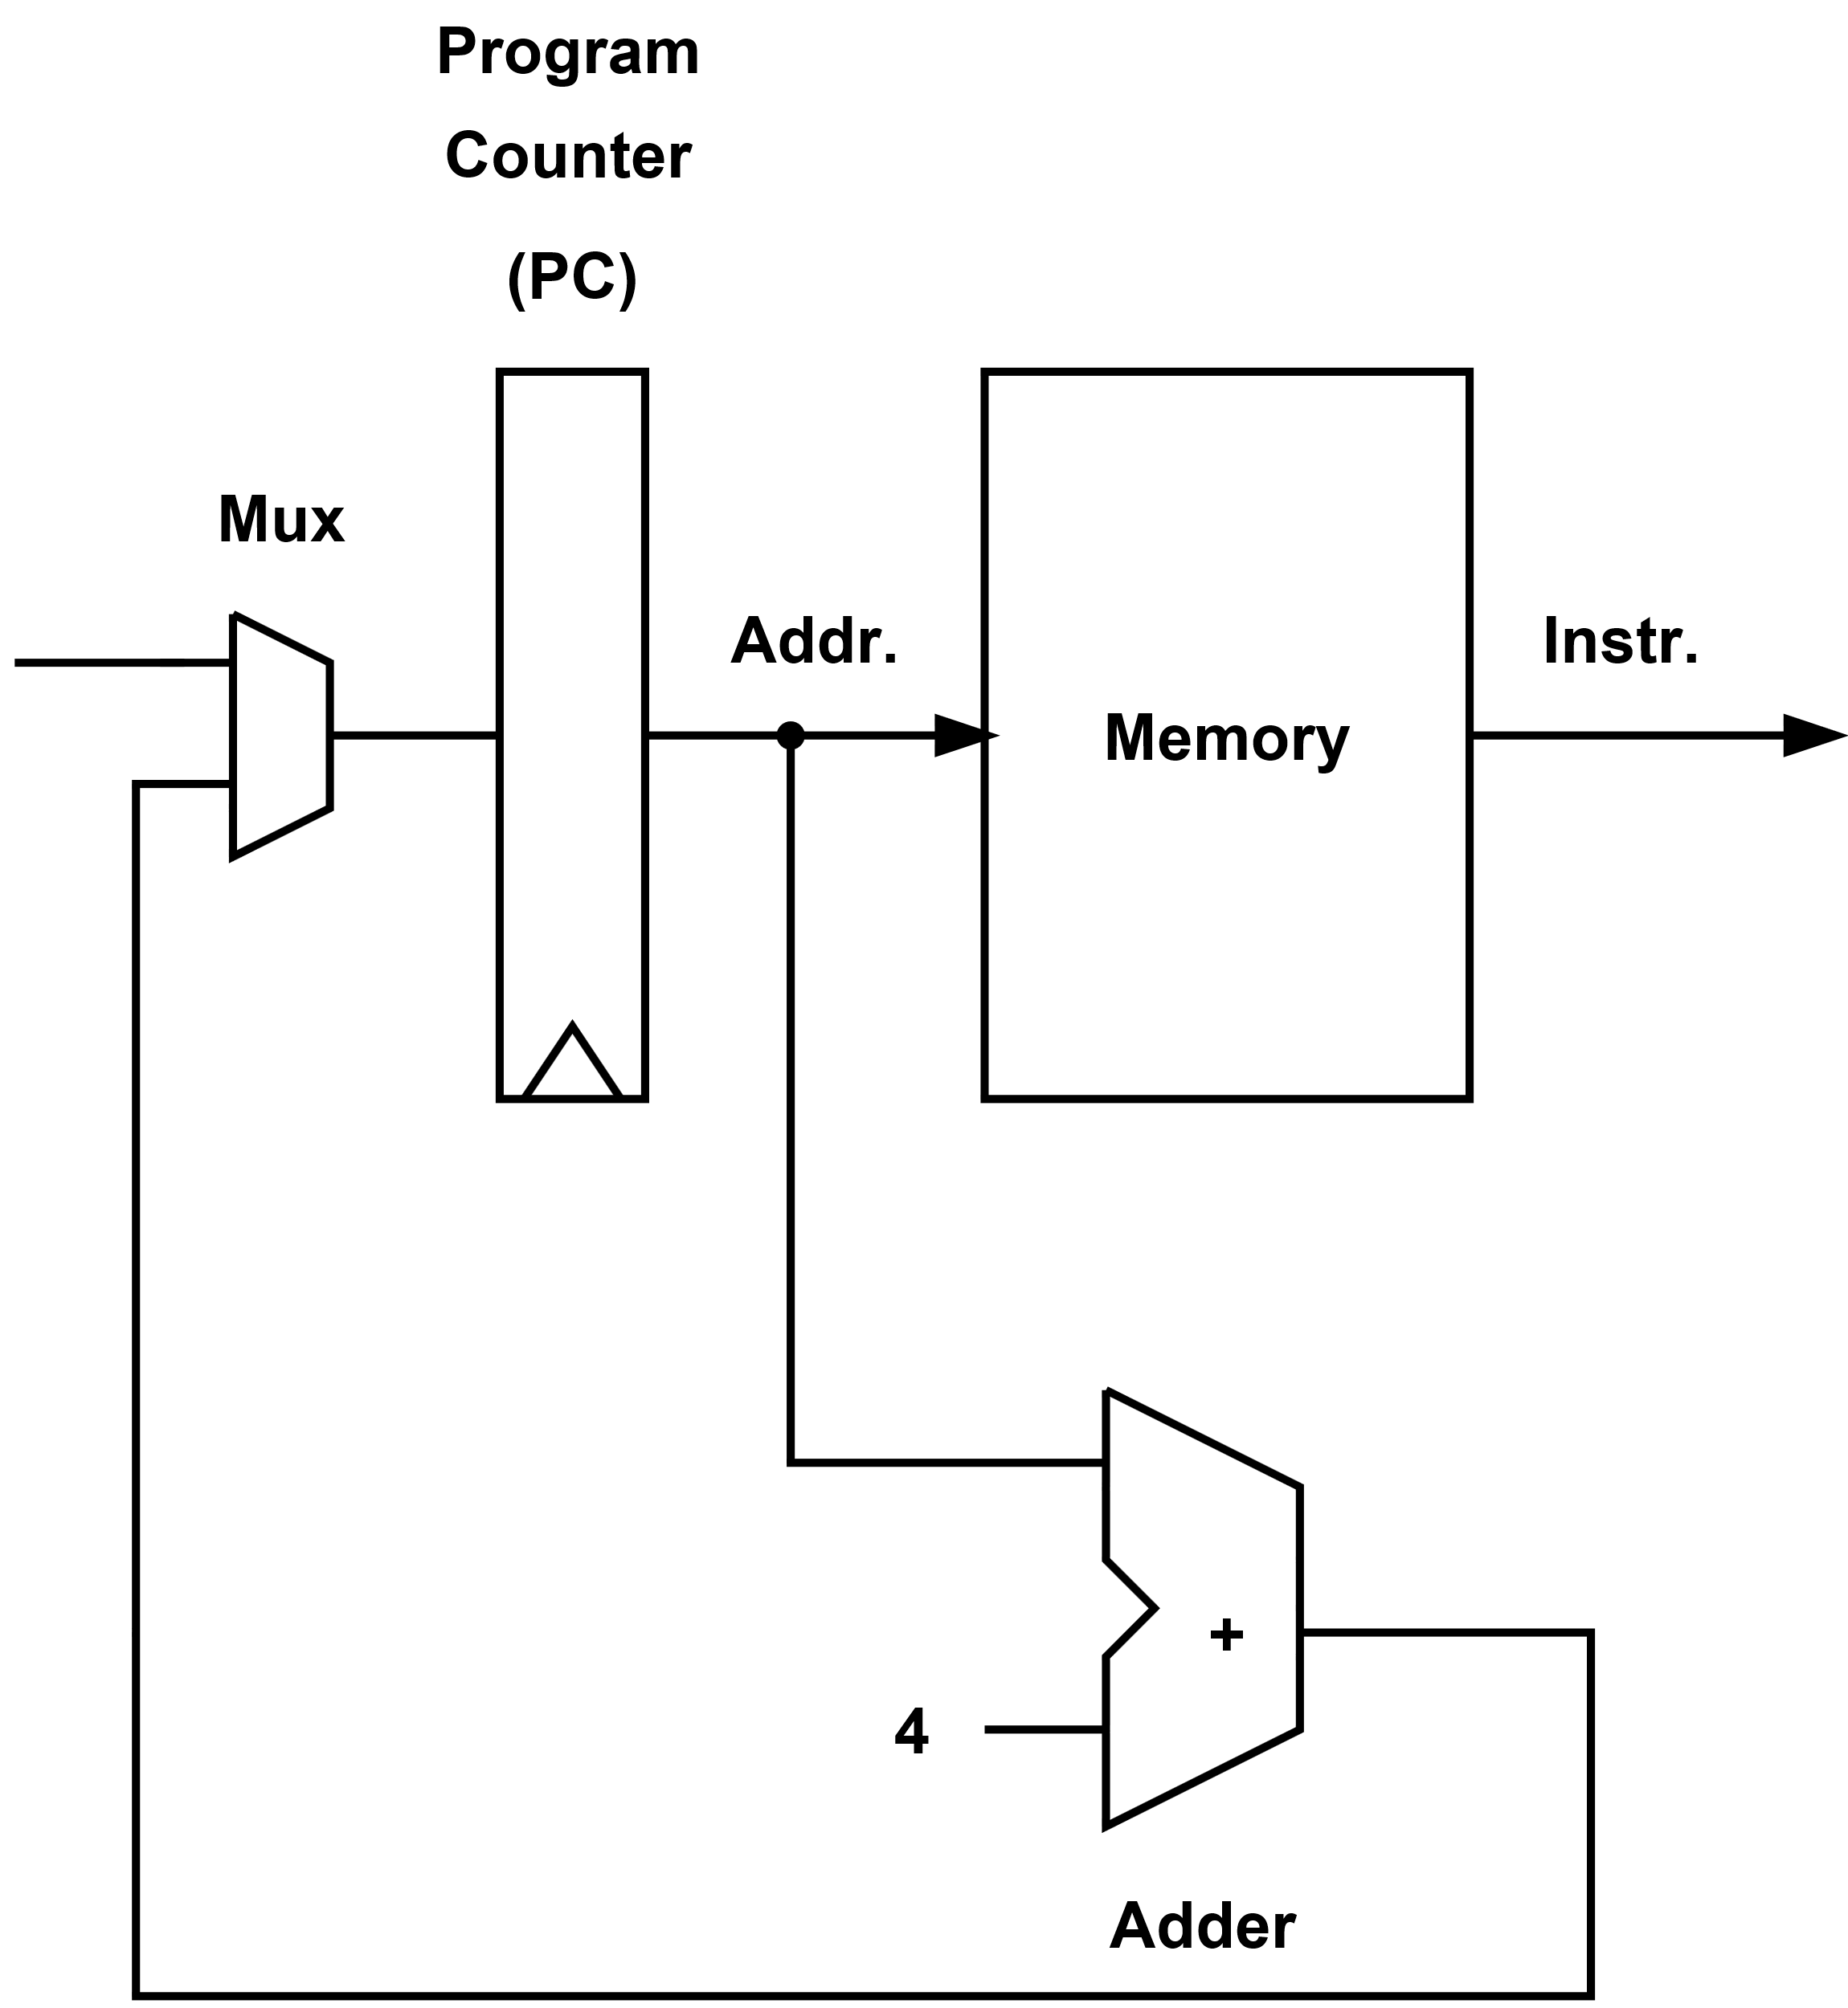
A Processor Datapath – Add mux to Allow Jump/Branch
We add a multiplexor (mux) to allow us to provide a branch target address, i.e., the PC value following a taken branch.

Slide 8
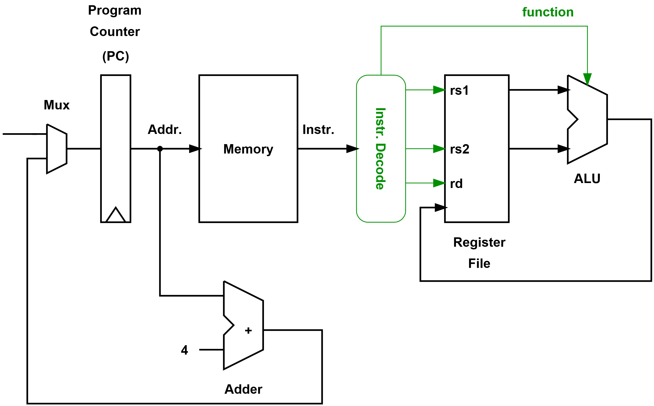
A Processor Datapath – Add a Register File and ALU
We could now execute a simple sequence of ALU operations.
Although, we do not yet have access to data memory and can’t branch!
We also add decode logic that extracts information from our instruction; in this case, the source registers (rs1, rs2), destination register (rd), and the ALU function to be performed.

Slide 9
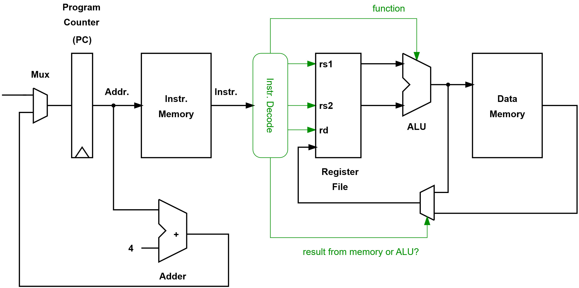
A Processor Datapath – Loading from Data Memory
We extend the datapath so we can implement an instruction that loads from data memory.
The effective address could be the sum of the two source registers.

Slide 10
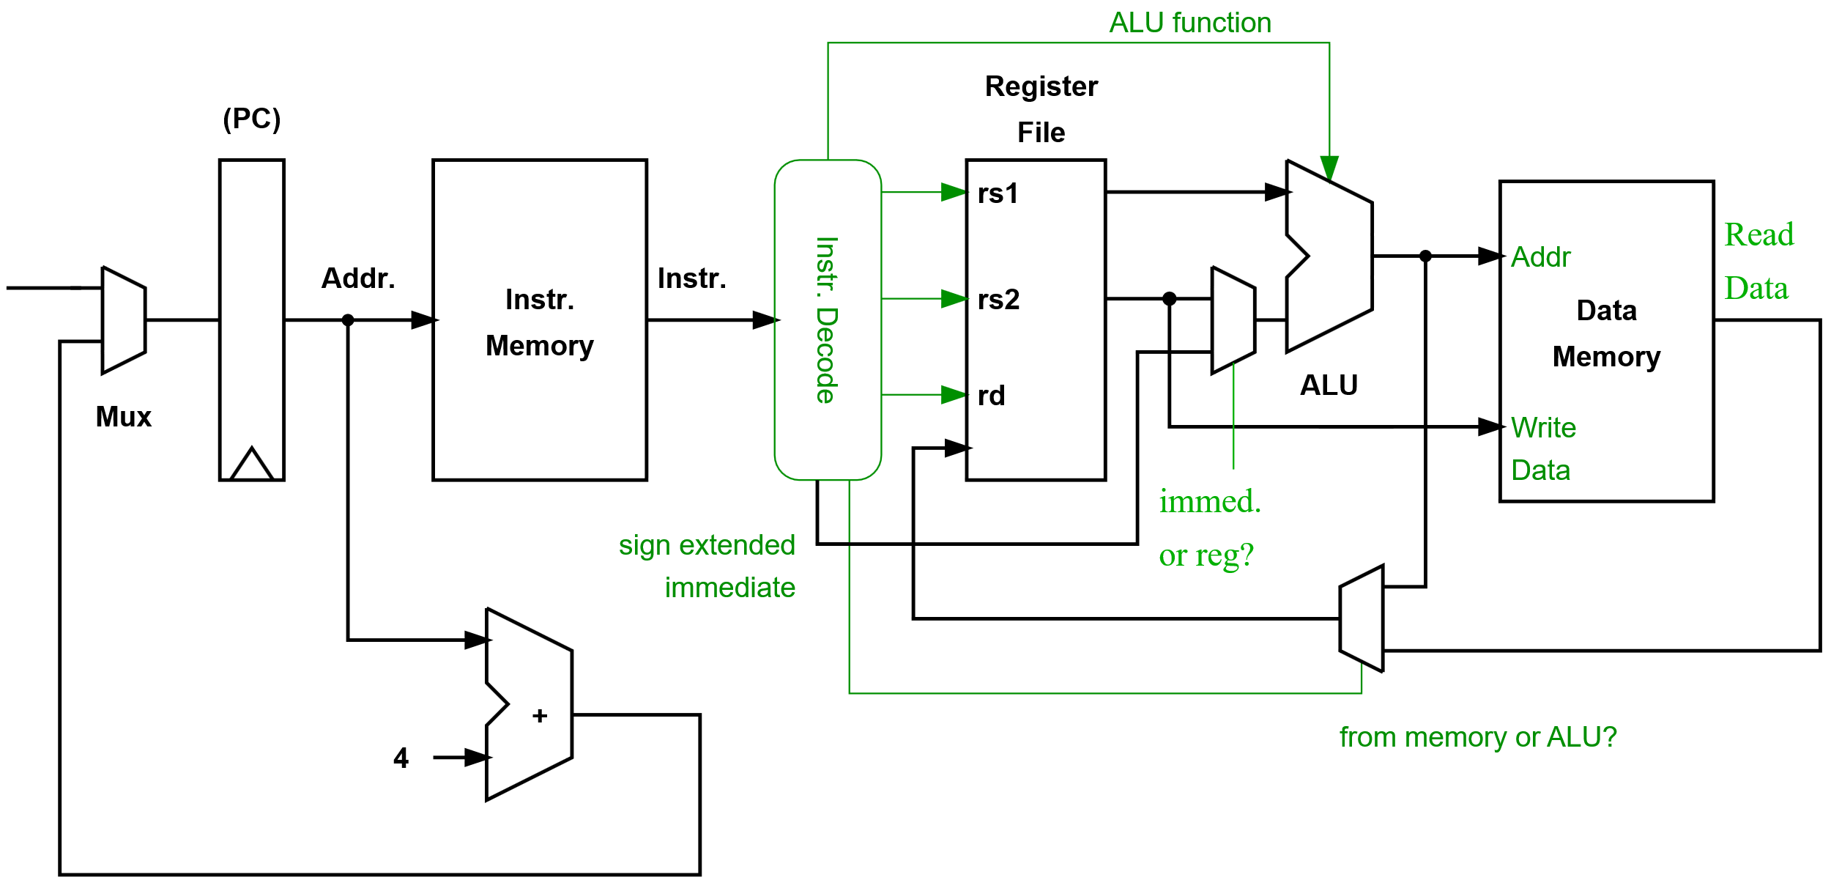
A Processor Datapath – Storing to Data Memory
Storing to memory requires we provide both an address and the data to write.
We have also added the ability to extract immediate values from the instructions and use them in ALU operations or address calculations.
Notes:
Sign extending immediate values
Our immediate values are contained within instructions so will be less than 32-bits (our instructions are a fixed size, and we will need to use some bits to indicate what the instruction is and at least specify a destination register). Before we use these values within our datapath, we must increase their width to 32-bits. This must be done while preserving the number’s sign and value. As the value is stored in two’s complement form, we simply duplicate the most significant bit (MSB) to fill the additional uppermost bits.

Slide 11
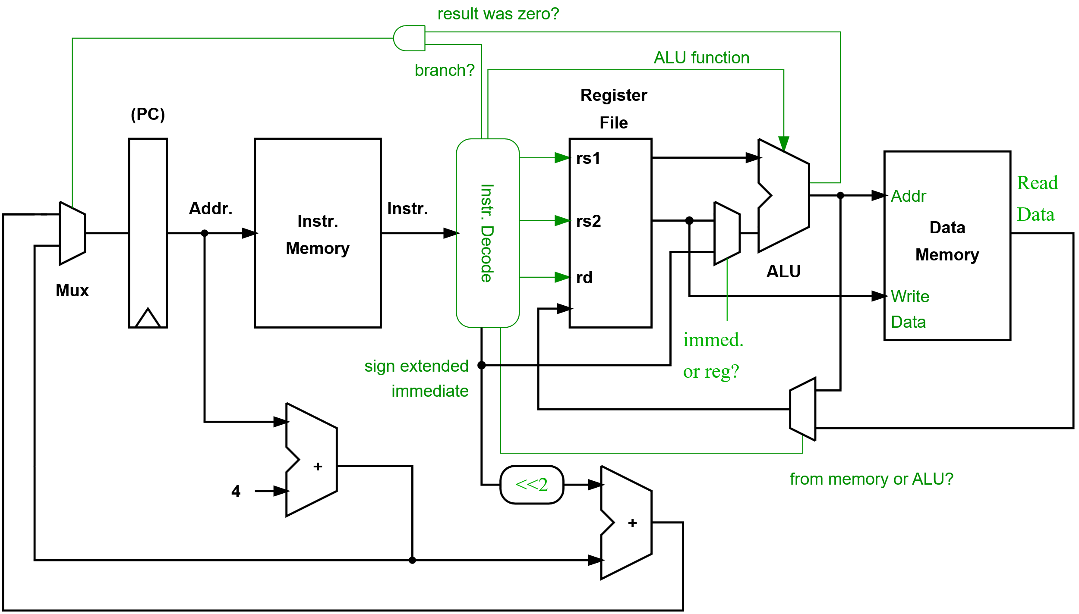
A Processor Datapath – Supporting Branch Instructions
Here, we assume a simple “branch if equal to zero” instruction.
Our branch target address is computed relative to the PC. Our immediate (the offset) is shifted left by two (i.e., multiplied by 4) as all instructions are 32-bits.
Notes:
In our simple processor, all instructions are 32-bits, hence all branch targets will be aligned on 32-bit boundaries. Therefore, the lower two bits of the address are always zero. Hence, we don’t need to store these lower bits in the instruction and can simply shift the immediate value two places to the left when adding to the current PC value (i.e., specify the PC offset in terms of the number of instructions and then multiply by 4 to get the offset in terms of bytes).
------
Other resources:
Here is a link to a visual simulation of the Arm1 processor. It is possible to zoom in (using the mouse wheel) and watch the processor in action. Individual transistors and the interconnect between them is clearly visible.
http://visual6502.org/sim/varm/armgl.html
http://www.righto.com/2015/12/reverse-engineering-arm1-ancestor-of.htmls
The Arm1 was introduced in 1985 using a 3 micron technology (today’s cutting edge technologies are called “10 nm or 7 nm”).
The Arm1’s peak performance was 8 MIPS.
The processor was organized as a three stage pipeline:
Instruction fetch
Instruction decode
Execute: Register read, shift, ALU, register write (and memory accesses)
Some instructions could take up to 5 cycles to complete as they need to be run through the execute stage two or three times given the processors limited resources.

Slide 12
The Fundamentals of Computer Design
Notes:
We have seen that we can design a relatively simple processor.
In practice, we often want to design a processor to meet performance goals under particular constraints of cost, area, power, etc.
This involves making numerous trade-offs and searching a very large space of possible designs. Luckily, we can draw on lessons from history, a toolkit of basic techniques, and some fundamental principles and observations to help us.

Slide 13
The Fundamentals of Computer Design
Architecture
Set of specifications that allows developers to write software and firmware. These include the instruction set.
Microarchitecture
Logical organization of the inner structure of the computer. Sometimes also called the “organization”
Hardware or Implementation
The realization or the physical structure, i.e., logic design and chip packaging
Notes:
It is useful to remember that when designing a processor, we must make design choices and understand the constraints at many different levels.
For example, the design process is complex and involves many interrelated trade-offs. For instance, we cannot simply start by designing an instruction set in isolation.
======
It is useful to identify distinct levels of abstraction when describing the process of design.
Architecture
This defines the instruction set, as well as exception and memory models that are relied upon by the operating system and hypervisor. The Arm architecture also includes definitions of the system registers, debug and trace architectures, and details of the virtual memory system.
Beyond the CPU, it is often helpful to define other components and interfaces that make it easier for hardware and software to interoperate, sometimes called “Systems Architectures” – together CPU and system architectures create platform definitions that operating systems can rely on.
Note: the terms “Architecture” and Instruction Set Architecture or “ISA” are often both used interchangeably.
What we are defining here is the “hardware-software interface.”
Microarchitecture – a specific implementation of the architecture.
What the architecture does not describe is how a processor is built, this we call microarchitecture. An easy way to understand microarchitecture is to imagine having two cars. Both cars can get you to the same destination, but both can be built very differently. In a similar way, you can have two processors implementing the same architecture, but with different microarchitectures. Meaning that they are built in very different ways.
The only constraint here is that we meet the specification so that different microarchitectural designs remain functionality equivalent. Different microarchitectures may aim to make different trade-offs in terms of performance and cost (e.g., area, power consumption, or complexity). Other important aims beyond performance may include security, reliability, or predictable performance.
Implementation
A particular physical realization of the microarchitecture, e.g., the hardware itself. We can select parameters for a given microarchitecture and then implement the design using different circuits, gates, and transistors (i.e., using different fabrication technologies). Different implementations may also target and operate at different clock frequencies. Even for the same technology node (e.g., 28 nm or 10 nm), there will be many choices, e.g., favoring performance or power efficiency.

Slide 14
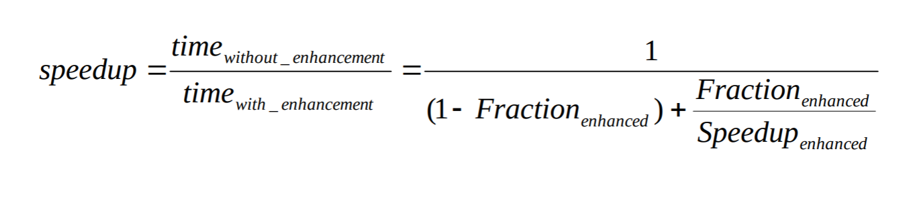
Amdahl’s Law
How do we allocate our resources?
Amdahl’s law
Amdahl’s law provides a simple way of calculating the performance gain that can be obtained by improving an element of a computer system.
Notes:
Amdahl’s law is simple but easy to forget!
It follows from a common-sense observation that performance improvements are limited by the fraction of time they can be employed.

Slide 15
Amdahl’s Law
Diminishing returns
Incremental improvements in speedup gained by enhancing just one portion of our design diminish as improvements are made. Eventually, we reach the limit 1/(1-Fraction_enh).
E.g., If Fraction_enh = 0.5
Speedup_enh = 2, speedup = 1.33
Speedup_enh = 4, speedup = 1.6
Speedup_enh = 10, speedup = 1.8
Speedup_enh = 100, speedup = 1.98
If we focus on a single optimization, we will see diminishing returns from investing more hardware. This suggests we should carefully re-evaluate where to make enhancements (and invest hardware) after each optimization is applied.
Notes:
Example: consider a journey from London to New York. If 50% of the time is spent on the aeroplane, improving the speed of the plane will have a diminishing impact on the speedup obtained. In the limit, we can only obtain a speedup of two even if the plane journey time is reduced to zero.
E.g., if we double the speed of the plane, the overall speedup (the factor by which our journey time improves) is only 1.33
Now, if we double the speed of the plane again (4x in total), the speedup obtained is only 1.6

Slide 16
Complexity
“In engineering, all other things being equal, simpler is always better, and sometimes much better,” Robert P. Colwell, from the book “The Pentium Chronicles”
We normally want to seek simple elegant solutions.
Complexity adds to design and verification costs.
We often want to understand what we have built and predict how it will behave.
Notes:
In addition to seeking good performance and cost trade-offs, it is also important to favor simple solutions.

Slide 17
Making the Common-case Fast
Pitfall: Isn’t every improvement we make worthwhile even if it only provides a small performance improvement?
No! Enhancements consume design, verification, and implementation resources – they are never free.
Adding an enhancement may disadvantage the common case:
Less time can be spent optimizing the common case.
Accelerating complex operations may require the cycle-time to be extended. This will slow all operations.
Resources (transistors, power) are redirected to less important (less often used) features.

Slide 18

Making the Common-case Fast
What tools/techniques do we have at our disposal?
Locality
Speculation
Prediction
Indirection*
Parallelism
Specialization
* “All problems in computer science can be solved by another level of indirection” – David Wheeler (1927-2004), University of Cambridge
Notes:
Interestingly, there is a surprising short list of distinct techniques to draw from.
Locality - spatial and temporal locality (e.g., exploited by caches, Translation Lookaside Buffers(TLBs), Branch Target Predictors(BTBs), etc.)
Speculation – we may go ahead and do something before we know if it is needed or precisely the correct thing to do. The hope is that by performing the operation early, we can improve performance. Speculation differs from prediction as it requires us to provide a mechanism to correct our guess if we are wrong (perhaps change some state that has been modified or at least prevent a state update)
Prediction – In order for speculation to be profitable, we normally try to make the best prediction possible, e.g., branch prediction. In other cases, we might make very simple predictions, e.g., a packet in an on-chip network won’t change direction. Prediction can also be used without speculation, e.g., prefetching (where we predict future memory accesses in an attempt to ensure they are in the cache just before they are required)
Indirection – e.g., virtualization, or directory-based cache coherence protocols
Parallelism – e.g., pipelining, superscalar processors, Single Instruction Multiple Data (SIMD) operations, and Graphic Processing Units (GPUs)
Specialisation – e.g., hardware accelerators. Specialization takes the common-case and ensures that it is implemented efficiently in HW, i.e., with a minimum of superfluous logic – the trade-off here is that we lose flexibility (or the general-purpose nature of a processor). The aim might be to save power or boost performance by exploiting parallelism or both.

Slide 19
Benchmarks
We use benchmarks to determine what the common cases are and to help guide the design process.
The challenge is to always carefully evaluate ideas quantitatively. This is difficult as the actual workload is often unknown and the design space of possible designs is extremely large.
There is also the risk of looking backward:
“Computer architects often err by preparing for yesterday’s computations,”
Prof. Bill Dally, Stanford and Chief Scientist Nvidia.
Notes:
We also need to look forward and try to predict the characteristics of the underlying fabrication and packaging technology as this will also have an impact on our design, e.g., how will memories and interconnect characteristics develop compared to transistors, how will off-chip bandwidth scale, etc.

Slide 20
The Instruction Set Architecture

Slide 21
Instruction Set Architecture (ISA)
ISA is typically seen as the contract between software and hardware.
Instruction Set Architecture (ISA)
The computing abstraction stack
Instruction Set Architecture
instructions
registers
memory addressing
addressing modes
etc.
Problem
Algorithm
Program Language
Runtime System
(OS/VM)
Architecture (ISA)
Microarchitecture
Logic
Transistors
Electrons
Notes:
The ISA is a contract between hardware and software functionality.

Slide 22
The Instruction Set
The instruction set defines what information can be passed from the compiler to the hardware - what hardware details are exposed to software and what is hidden.
This raises a number of questions:
At what level do we draw this HW/SW dividing line or interface?
What other information might it be useful to pass to the hardware to help simplify it?
How do we ensure good code density?
Notes:
Examples of information we may wish to communicate to the hardware:
Explicit information indicating which instructions are dependent or independent of each other?
That we wish to perform the same operation on many elements of data (e.g., vector or SIMD)
Information to help ensure good security, e.g., to restrict pointer accesses or branching
That a group of instructions should be executed atomically in a multi-threaded environment
Communicate other performance hints the compiler is able to collect?
Do we provide the processor with high-level instructions or provide instructions that can control our datapath directly?
If our contract with the hardware is at a very low level, we will perhaps be tied to compiling for a particular microarchitecture, alternatively, if we have very high-level instructions, it may be complex to implement a datapath that can execute them directly.

Slide 23
Instruction Set Architecture
Execute high-level languages directly.
Execute complex instructions (CISC).
Tailor instruction set for pipelined and high-performance implementations. Expose the instruction pipeline to the compiler so it can optimize code and help simplify the hardware (RISC). We will explore this approach.
Provide additional explicit information about the dependencies between instructions. E.g., VLIW or
Specify individual data transfers, e.g., Transport Triggered Architectures (TTA)
High-level interface
Low-level
interface
Notes:
Terminology:
CISC = Complex Instruction Set Computer
RISC = Reduced Instruction Set Computer
VLIW = Very Long Instruction Word
VLIW processors permit the compiler to specify independent instructions that are to be executed in parallel (VLIW). The advantage is that the work of determining whether instructions can be executed together can be done statically (i.e., at compile-time), hence removing the need for the hardware to do this. The disadvantage is that we are compiling for a particular machine and that the decisions we make at compiler time might not be optimal at run-time (due to unpredictable events such as cache misses).
TTA = Transport Triggered Architectures
At the extreme, we could think about specifying our program as a series of communications between different parts of our datapath. These simplified “instructions” or move operations could help us simplify our datapath and optimize execution.

Slide 24
Instruction Set Architecture
The best instruction set is the one that yields the “best” implementation.
Changing the instruction set is difficult and happens infrequently .
The factors that influence instruction set design do change over time, e.g., applications, programming languages, compiler technology, transistor budgets, and the underlying fabrication technology.
We need to take care not to include “features” that will be regretted later.
Notes:
Changing the instruction set is disruptive to the whole HW/SW ecosystem. When hardware is manufactured, it normally supports only a single instruction set. The decode and control logic is hardwired and can’t be reconfigured to support a new instruction set. Similarly, software is often distributed in a binary form and must be recompiled and redistributed when a new instruction set is introduced. As a result, new instructions sets are introduced very infrequently*.
There are many examples of features being including in an instruction set that made sense at a particular point in time, but were later seen as a disadvantage (as transistor budgets increased or compiler technology improved)
E.g., register windows (SPARC ISA), conditional execution (Arm, not Armv8), branch delay slots (MIPS). We’ll look at some of these ideas in more detail later.
-----
* The situation is perhaps different for deeply embedded processors, i.e., processors that typically perform a single function. In this case, it may be much easier to change the processor’s instruction set when designing a new version of the hardware. Compatibility is less of a concern as the processor’s program doesn’t typically change.

Slide 25
The RISC Approach
The RISC approach aims to ensure that we make the common-case fast by carefully selecting the most useful instructions and addressing modes, etc.
Instructions are designed to make good use of the register file.
A RISC ISA is designed to ensure a simple high-performance implementation is possible.
Notes:
The late 1970s and early 1980s saw the development of the Reduced Instruction Set Computer (RISC).
RISC ideas re-evaluated processor design trade-offs given the development of new fabrication technologies, target-markets, applications, and compilers.
They exploited the idea of streamlined hardware that was constructed to support common-case operations efficiently.
RISC architectures don’t simply remove components from a CISC machine, they are built from scratch with different guiding principles and ideas.
They were designed to allow the compiler to make good use of a large number of general-purpose registers. These registers were stored in a small memory (register file). The register file can be accessed in parallel, quickly, and at a relatively low energy cost (compared to main memory). General-purpose registers are favored over specialized ones to ensure the compiler can make best use of them.

Slide 26
Instruction Set Architecture
Common features of RISC instruction sets:
Fixed length instruction encodings (or a small number of easily decoded formats)
Each instruction follows similar steps when being executed.
Access to data memory is restricted to special load/store instructions (a so-called load/store architecture).
Notes:
They aim to create an instruction set that is simple to pipeline (we’ll look at pipelining in detail in the next module)
To make pipelining simple, they:
Only allow special instructions, i.e., load/store instructions, to access memory (the rest operate on registers)
Each instruction’s execution follows similar steps
In contrast, an instruction in a CISC machine may perform a series of complex steps and even access memory for its operands or to store its result. This makes pipelining (think a car production plant) difficult as we cannot easily overlap the different phases of an instruction’s execution.
----
The simpler instruction sets and smaller transistor budgets of early RISC machines also meant that they could fit on a single chip together with fast cache memories. Larger CISC machines had to deal with the overhead of being implemented across multiple chips.
Cache memories were important as these simple pipelined machines ran at a much higher clock frequency than CISC machines. Their clock periods were as a result much shorter that main memory access times. Caches were therefore important in order to prevent the processor constantly stalling waiting for instructions or data
Caches – these are simply small memories holding recently accessed data or instructions, or data/instructions close to recently accessed data. Luckily, we find in practice that being able to “cache” a small amount of our program or data is enough to significantly reduce our average memory access time.
Having separate instruction and data caches is even better as we commonly want to read the next instruction while completing a data memory access.
----
Simplifying the ISA and hardware also has advantages for power consumption, especially for smaller cores.
While RISC ideas and principles are incorporated into the vast majority of today’s microprocessors, many have very large and complex instruction sets with more than 1000 instructions. Their implementations are also very complex. Over time, as with many areas of computer architecture, different ideas have converged and been combined.
----
Stanford MIPS project:
“We also chose to design a load-store architecture, i.e., a machine in which only the load and store
operations access memory and all ALU instructions are register-register format. This structure is very
compatible with a streamlined instruction set. It also simplifies the implementation of page faults, traps, and
interrupts, which can be particularly difficult to implement in a pipelined machine. Lastly, given reasonable
register allocation algorithms, using a register-based machine is a good match for VLSI technology. Since
the cost of off-chip communication is high, getting data onto the chip and operating on it in the register set is
a cost effective strategy. “
The Design of a High Performance VLSI Processor, John Hennessy, Norman Jouppi, Steven Przybylski, Christopher Rowen, Thomas Gross, Technical Report No. 236, February 1983
(Standard MIPS project)

Slide 27


Arm1: The First Arm Processor (1985)
Arm: Advanced RISC Machine (Arm)
The first Arm processor was designed by Sophie Wilson and Prof. Steve Furber. It was inspired by early research papers from Berkeley and Stanford on RISC.
Arm1
25,000 transistors
3-stage pipeline
8 MHz clock
No on-chip cache
Prof. Steve Furber (left)¹ and Sophie Wilson (right)²
1.By Peter Howkins, CC BY-SA 3.0
2.By Chris Monk, CC BY-SA-2.0
Notes:
https://cacm.acm.org/magazines/2011/5/107684-an-interview-with-steve-furber/fulltext
Early RISC projects:
IBM 801 (operational in 1980)
Berkeley RISC 1 and 2,
RISC 1 (1982), Carlo Sequin and David Patterson
RISC 2 (1984), Manolis Katevenis, Robert Sherburne, David Patterson, and Carlo Sequin
Stanford MIPS (1981-1984)
MIPS: John Hennessy, Norman Jouppi, Steven Przybylski, Christopher Rowen, Thomas Gross, and Forest Baskett
Single chip, 32-bit microprocessor
R2000 released in 1985, 110K transistors, clock frequency 12-33 MHz
R3000 released in 1988, 64K L1 cache, 20-40 MHz

Slide 28
CISC
Not all processors use RISC ISAs; some are Complex Instruction Set Computers (CISC).
CISC designs have evolved since the 1970s.
How are modern CISC machines (e.g., x86) implemented?
They first convert the CISC instructions to (possibly numerous) RISC-like micro-ops!
Their microarchitectures are otherwise very similar to other modern high-performance processors.
Notes:
The CISC concept was not necessarily a bad idea when it was first developed. The trade-offs, e.g., transistor budgets, memory access times, compiler technology, etc. were very different, so they encouraged a different solution.
Microcoded datapaths also encouraged the use of more complex instruction sets. Hardwired control and the aim to exploit pipelining encouraged the use of RISC ideas.

Slide 29
The Armv8-A ISA

Slide 30
Case Study: The Armv8 Architecture
Armv1 – 1985
Armv2 – 1989
Armv3 – 1991
Armv4 – 1996
2000
2004
2006
Announced 2011
Notes:
Each evolution of the Arm architecture is capable of supporting binaries compiled for older architectures (i.e., Armv6 can run Armv5).
The Armv8-A architecture is the latest generation Arm architecture targeted at the Applications Profile. The name Armv8 is used to describe the overall architecture, which now includes both 32-bit execution and 64-bit execution. It introduces the ability to perform execution with 64-bit wide registers, while also having the ability to preserve backward compatibility with existing Armv7 software.
-------
Terminology:
VFP – Vector Floating Point, a coprocessor providing hardware floating point acceleration
Thumb-2 – 16 and 32-bit instructions that can be freely intermixed in “Thumb” mode
but not all the functionality of Arm mode
TrustZone – provides system-wide hardware isolation for trusted software
https://developer.arm.com/ip-products/security-ip/trustzone
SIMD – Single Instruction Multiple Data or “short vector” operations
NEON – SIMD architecture extension
https://developer.arm.com/architectures/instruction-sets/simd-isas/neon
Crypto – Hardware acceleration for cryptography. These extensions add new A64, A32, and T32 instructions to Advanced SIMD that accelerate Advanced Encryption Standard (AES) encryption and decryption, and the Secure Hash Algorithm (SHA) functions SHA-1, SHA-224, and SHA-256.
SP floating point – Single Precision (32-bit)
DP floating point – Double Precision (64-bit)
Half-precision floating point – 16-bit
https://developer.arm.com/architectures/instruction-sets/floating-point

Slide 31
A64 Instructions
64-bit pointers and registers
Fixed-length 32-bit instructions
Load/store architecture
Simple addressing modes
32 x 64-bit general-purpose registers (including the R31 the zero/stack register)
The PC cannot be specified as the destination of a data processing instruction or load instruction.
Notes:
“Addressing modes” – this determines how the effective memory address is calculated, e.g., we might hold the address in a register or calculate it as the sum of two registers (offset) or a register + immediate, etc.
Let’s look at a few example instructions (not all of them).
(Note: our instructions are still encoded in 32-bits even though our datapath and registers are 64-bits wide)

Slide 32
AArch64 - Registers
In the AArch64 Execution state, each register (X0-X30) is 64-bits wide. The increased width (vs. 32-bit) helps to reduce register pressure in most applications.
Each 64-bit general-purpose register (X0 - X30) also has a 32-bit form (W0 - W30).
Zero register – X31
63 32 31 0
Wn
Xn
Notes:
The 32-bit W register forms the lower half of the corresponding 64-bit X register. That is, W0 forms the lower word of X0, and W1 forms the lower word of X1.
------
Register 31
Acts as zero register when used as a source register
Acts as stack pointer when used as load/store base register
https://developer.arm.com/docs/100878/latest/registers

Slide 33
AArch64 – Load/Store Instructions
LDR – load data from an address into a register.
STR – store data from a register to an address.
LDR X0, <addr> ; load from <addr> into X0
STR X0, <addr> ; store contents of X0 to <addr>
In these cases, X0 is a 64-bit register, so 64-bits will be loaded or stored from/to memory.

Slide 34
AArch64 – Addressing Modes
Base register only: Address to load/store from is a 64-bit base register.
LDR X0, [X1] ; load from address held in X1
STR X0, [X1] ; store to address held in X1
Base plus offset: We can add an immediate or register offset (register indexed).
LDR X0, [X1, #8] ; load from address [X1 + 8 bytes]
LDR X0, [X1, #-8] ; load from address [X1 – 8 bytes]
LDR X0, [X1, X2] ; load from address [X1 + X2]
LDR X0, [X1, X2, LSL #3] ; left-shift X2 three places before adding to X1
Notes:
Base plus offset: The base register contains a pointer to a memory location. To this, we can add an offset or displacement, this can be either another register or immediate. We can also shift this offset before adding it to the base (see the last example), i.e., to convert an offset specified in terms of words to one in bytes.
64-bit loads allow an index shift of #0 or #3
32-bit loads allow an index shift of #0 or #2

Slide 35
AArch64 – Addressing Modes
Pre-indexed: source register changed before load
LDR W0, [X1, #4]! ; equivalent to:
ADD X1, X1, #4
LDR W0, [X1]
Post-indexed: source register changed after load
LDR W0, [X1], #4 ; equivalent to:
LDR W0, [X1]
ADD X1, X1, #4
Notes:
You may ask if complex addressing modes (see also the register-indexed addressing on the previous slide) have a place in a RISC instruction set.
These addressing modes provide two advantages: the first is better code density and the second is potentially higher performance. Higher performance is possible when these instructions can be performed within a single cycle. At least some processor implementations will be able to do this. Other implementations will need an additional cycle to execute such addressing modes (to reduce implementation costs).
The architects intend that implementations should be free to fine-tune the performance trade-offs
within each implementation, and note that providing an instruction, which in some implementations takes two
cycles, is preferable to requiring the dynamic grouping of two independent instructions in an implementation that can perform this address arithmetic in a single cycle.
(See “Armv8 Instruction Set Overview”)

Slide 36
AArch64 – Data Processing
Values in registers can be processed using many different instructions:
Arithmetic, logic, data moves, bit field manipulations, shifts, conditional comparisons, etc.
These instructions always operate between registers, or between a register and an immediate.
Example loop:
MOV X0, #<loop count>
Loop:
LDR W1, [X2]
ADD W1, W1, W3
STR W1, [X2], #4
SUB X0, X0, #1
CBNZ X0, loop
Notes:
Remember, only load/store instructions access memory, other operations only operate on the contents of registers or immediates.

Slide 37
AArch64 - Branching
B <offset>
PC relative branch (+/- 128MB)
BL <offset>
Similar to B, but also stores return address in LR (link register), likely a function call
BR Xm
Absolute branch to address stored in Xm
BRL Xm
Similar to BR, but also stores return address in LR

Slide 38
AArch64 - Branching
RET Xm or simply RET
- Similar to BR, likely a function return
- Uses LR if register is omitted
Subroutine calls:
The Link Register (LR) stores the return address when a subroutine call is made. This is then used at the end of our subroutine to return back to the instruction following our subroutine call.

Slide 39
AArch64 – Conditional Execution
The A64 instruction set does not include the concept of widespread predicated or conditional execution (as earlier Arm ISAs did).
The NZCV register holds copies of the N, Z, C, and V condition flags.
A small set of conditional data processing instructions are provided that use the condition flags as an additional input. Only the conditional branch is conditionally executed.
Conditional branch
Add/subtract with carry
Conditional select with increment, negate, or invert
Conditional compare (set the condition flags)
Notes:
Earlier Arm ISAs supported the conditional (or “predicated”) execution of most instructions. Here, individual instructions could indicate that they should only be executed if a flag held a particular value. If this condition was not met, the instruction would be treated as a no-op. This mechanism allowed the compiler to remove branches from short sequences of instructions that needed to be conditionally executed (a process called “if-conversion”)
Most instructions could also update the flags (if the “S” suffix was added to the instruction. The flags were preserved until updated).
E.g.,
CMP r0, #100 ; if (x<=100)
MOVLE r1, #0 ; y=0;
MOVGT r1, #1 ; else y =1
Here, the first MOV instruction is only executed if the LE (less than or equal) condition is met (i.e., Z or (N!=V))
The disadvantage of this sort of conditional execution is that it consumes valuable instruction encoding space (i.e., we need to reserve extra bits in our instruction encoding – a 4-bit condition-code selector for every 32-bit instruction). Furthermore, this extra state complicates the implementation of superscalar processors. In practice, the advantages are also reduced when modern branch predictors are used perhaps together with a very small set of conditional instructions.
-------------
The A64 instruction set does not include the concept of predicated or conditional execution. Benchmarking shows that modern branch predictors work well enough that predicated execution of instructions does not offer sufficient benefit to justify its significant use of opcode space and its implementation cost in advanced implementations.
A very small set of “conditional data processing” instructions are provided. These instructions are unconditionally executed but use the condition flags as an extra input to the instruction. This set has been shown to be beneficial in situations where conditional branches predict poorly, or are otherwise inefficient. The conditional instruction types are:
• Conditional branch: the traditional Arm conditional branch, together with compare and branch if register zero/non-zero, and test single bit in register and branch if zero/non-zero – all with increased displacement.
• Add/subtract with carry: the traditional Arm instructions for multi-precision arithmetic, checksums, etc.
• Conditional select with increment, negate, or invert: conditionally select between one source register and a second incremented/negated/inverted/unmodified source register. Benchmarking reveals these to be the highest frequency uses of single conditional instructions, e.g., for counting, absolute value, etc. These instructions also implement:
o Conditional select (move): sets the destination to one of two source registers, selected by the condition flags. Short conditional sequences can be replaced by unconditional instructions followed by a conditional select.
E.g.,
CMP W1, #0 ; compare W1 to 0 and set flags (Z flag will be set to 1 if W1==0),
CSEL W5, W6, W7, EQ ; ; if (EQ), then W5=W6, else W5=W7 (EQ simply tests the Z flag)
o Conditional set: conditionally select between 0 and 1 or -1, for example, to materialize the condition flags as a Boolean value or mask in a general register.
• Conditional compare: sets the condition flags to the result of a comparison if the original condition was true, else to an immediate value. Permits the flattening of nested conditional expressions without using conditional branches or performing Boolean arithmetic within general register
(See Armv8 Instruction Set Overview, Section 3.2)

Slide 40
AArch64 – Conditional Branches
B.cond
Branch to label if condition code evaluates to true, e.g.,
CMP X0, #5
B.EQ label
CBZ/CBNZ – branch to label if operand register is zero (CBZ) or not equal to zero (CBNZ)
TBZ/TBNZ – branch to label if specific bit in operand register is set (TBZ) or clear (TBNZ)
TBZ W0, #20, label ; branch if (W0[20]==#0b0)

Slide 41
AArch64- Conditional Operations
CSEL – select between two registers based on a condition
CSEL X7, X2, X0, EQ ; if (cond==true) X7=X2, else X7=X0
There are also variants of this that cause the second source register to be incremented, inverted, or negated.

Slide 42
Backup Slides

Slide 43
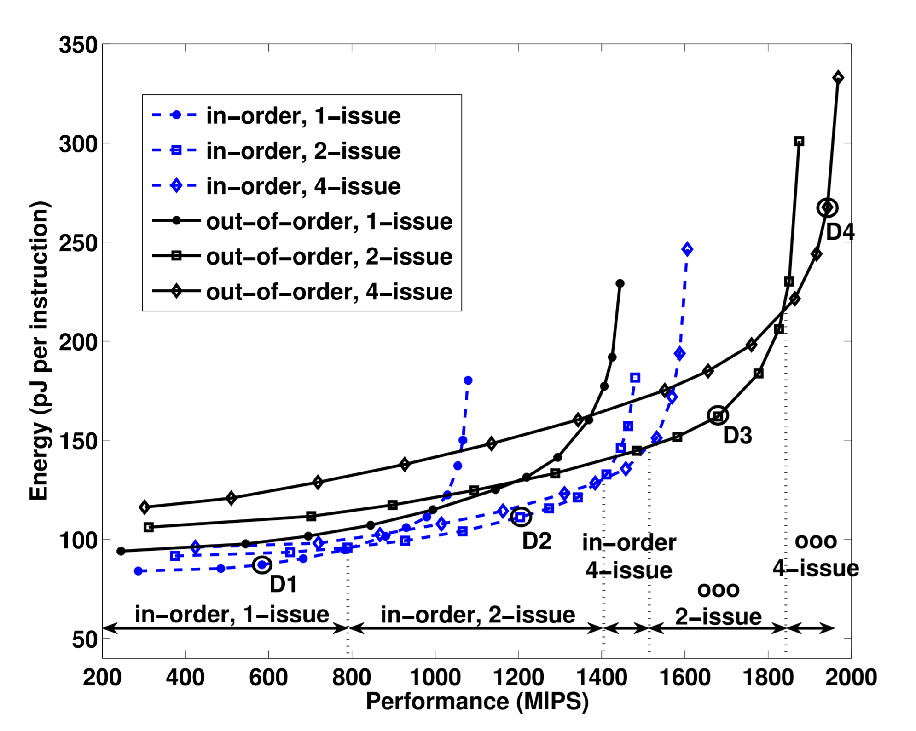
The Fundamentals of Computer Design
Let’s assume our architecture and fabrication technology are fixed.
There are still many different microarchitectural design choices.
If we want to minimize power consumption, the “best” microarchitecture will depend on the required performance.
O. Azizi, A. Omid & A. Mahesri, M. Aqeel & B. Lee, L. Benjamin & S. Patel, P. Sanjay & M. Horowitz. Energy-performance tradeoffs in processor architecture and circuit design: A marginal cost analysis, 2010. ACM SIGARCH Computer Architecture News. 38. 26-36. 10.1145/1815961.1815967.
Notes:
There a number of different processor designs considered here:
In-order single issue (i.e., a simple scalar pipeline)
In-order dual-issue design, fetches and executes up to two instructions per cycle in the original program order
In-order quad-issue design, as above but up to four instructions
Out-of-order 2-issue and 4-issue. Maintains a limited window into the dynamic instruction stream and is able to issue instructions as operands, and functional units become ready – not necessarily in the original program order.
The key point here is that the “best” microarchitecture (what is on the Pareto optimal curve) changes as we increase our performance target.
We’ll explore the design of superscalar processors in detail later in the course.
The same can be seen for the design of a simple adder circuit. At low-performance levels, a simple ripple carry adder will be the most energy efficient design (as the circuit is simple). As performance requirements increase, we can try to boost performance, but the scope to do this will be limited, trying to add logic to improve performance will have a limited effect but will increase energy requirements significantly. A better approach will be to change to a higher-performance adder organization, e.g., carry-select or Kogge-Stone parallel prefix adder.

Slide 44
AArch64 – How Does It Differ from Older Arm ISAs?
Conditional execution mostly dropped
No free shifts in arithmetic instructions
Program counter not a part of integer register set
No load/store multiple instructions
Adopts a more regular instruction encoding
Notes:
An ISA is often designed with particular microarchitectures, programming languages, compilers, applications, and implementation technology in mind. As these change, what constitutes a good ISA also changes.

Slide 45
Compressed Instruction Sets
We could encode instructions using 16-bits to produce much smaller programs.
This improved code density would come at the cost of some performance.
The T32 (Thumb-2) instruction set (part of the Armv8 AArch32 execution state) allows us to mix 16- and some 32-bit instructions (without a mode change).
This allows us to improve code density and maintain performance, e.g., in performance critical loops.
Notes:
Some applications are very cost or power sensitive. Instruction memory may be a large part of the cost (and fetch power may be significant too). There are also applications where the program must fit on limited on-chip memory, perhaps on-chip flash memory, further encouraging techniques to reduce code size. Better code density can also improve the performance of the instruction cache, effectively making it act as a larger cache would.
One early approach, used by Hitachi’s SuperH processors in the 1990s, was to use a fixed 16-bit instruction set together with a 32-bit processor (i.e., 32-bit registers, operations, etc.). Of course, using narrower instructions forces some simplifications as there are fewer bits to encode our instruction set. This typically means we can define fewer operations, address fewer registers, typically use a two-address format rather than a three-address one and must accept shorter immediate values.
The drawback with only providing these simpler 16-bit instructions is that while the static code size may improve, we may need to execute more instructions thus reducing performance. There are two ways in which we can mitigate this problem:
We could allow the compiler to mix 16-bit and 32-bit instructions freely. This would allow performance critical sections of the code, e.g., loops, to use the more expressive 32-bit instructions (and access the whole register file), with minimum impact on code size. Alternatively, we could switch between 16-bit and 32-bit “modes”
A different approach, adopted by some processors from IBM, is to actually compress and decompress instructions between main memory and the instruction cache. This can provide good compression rates and retain the full power of the 32-bit instruction set. The disadvantage here is that the advantages of better code density are not seen in the instruction cache – as it holds uncompressed 32-bit instructions.
The T32 instruction set (part of the Armv8 AArch32 execution state) allows us to mix 16- and some 32-bit instructions (without a mode change). The 32-bit and 16-bit T32 instructions together provide almost exactly the same functionality as the A32 instruction set. The T32 instruction set achieves the high performance of A32 code along with the benefits of better code density.

Slide 46
Specifying More Work in One Instruction
It is often beneficial to specify more work in a single instruction if this simplifies our hardware or enables us to make better use of it.
See earlier comments regarding Armv8 addressing modes.
Going further, we might be able to specify more work and hence fetch fewer instructions, or perform more work per cycle.
We might actually also be able to reduce fetch and control overheads in this way, e.g., SIMD or vector instructions.

Slide 47
Early RISC Ideas: IBM 801 (~1974-1980)
The IBM 801’s architectural aims to:
Make effective use of the registers and ensure registers are general-purpose.
Avoid complex instructions where the same effects can be realized by simple ones. Ensure hard-wired control is possible.
Use separate instruction and data caches
Ensure all instructions are usable by compilers.
Provide an optimizing compiler.
“In some sense, the 801 appears to be rushing in the opposite direction to the conventional wisdom of this field. Namely, everyone else is busily moving software into hardware and we are clearly moving hardware into software. Rather than consuming the projected cheaper, faster hardware, we are engaged in an effort to save circuits, cut path lengths and reduce functions at every level of the normal hierarchy.”
From “The 801 Microcomputer – An Overview”, Internal IBM memo, 1976.
Notes:
John Cocke and his team started working on a design for a controller for a telephone exchange in 1974. This project would go on to develop many of RISC concepts. Cocke recalled in 1987:
"We knew we wanted a computer with a simple architecture and a set of simple instructions that could be executed in a single machine cycle—making the resulting machine significantly more efficient than possible with other more complex computer designs."
In contrast to this goal, typical machines in the 1970s were built on the idea of a CISC or Complex Instruction Set Computer. Here, the so-called “semantic gap” between high-level programming languages and the processor was smaller, e.g., these machines had complex addressing modes. These instructions also produced small compact binaries, which were beneficial given the small size and high cost of memories.
See also: “The evolution of RISC technology at IBM,” Cocke and Markstein, IBM Journal of Research and Development, vol 44, number 1/2, Jan/March 2000
and
https://www.ibm.com/ibm/history/ibm100/us/en/icons/risc/
---
Some attempts were made to pipeline CISC machines directly (e.g., Intel 486), but this proved difficult. Eventually, even CISC machines converted to RISC-like operations internally to enable efficient pipelined implementations.

