Slide 1
Pipelining
Module 3

Slide 2
Module Syllabus
Pipelining and implementation
Pipeline hazards and data dependency
Pipeline and performance
Notes:
In this module, we will learn in further detail about pipelining and how it can be implemented. We will also discuss about the different types of pipeline hazards and various data dependencies and how we can deal with them. Finally, we will learn about the relationship between pipelining and performance.

Slide 3
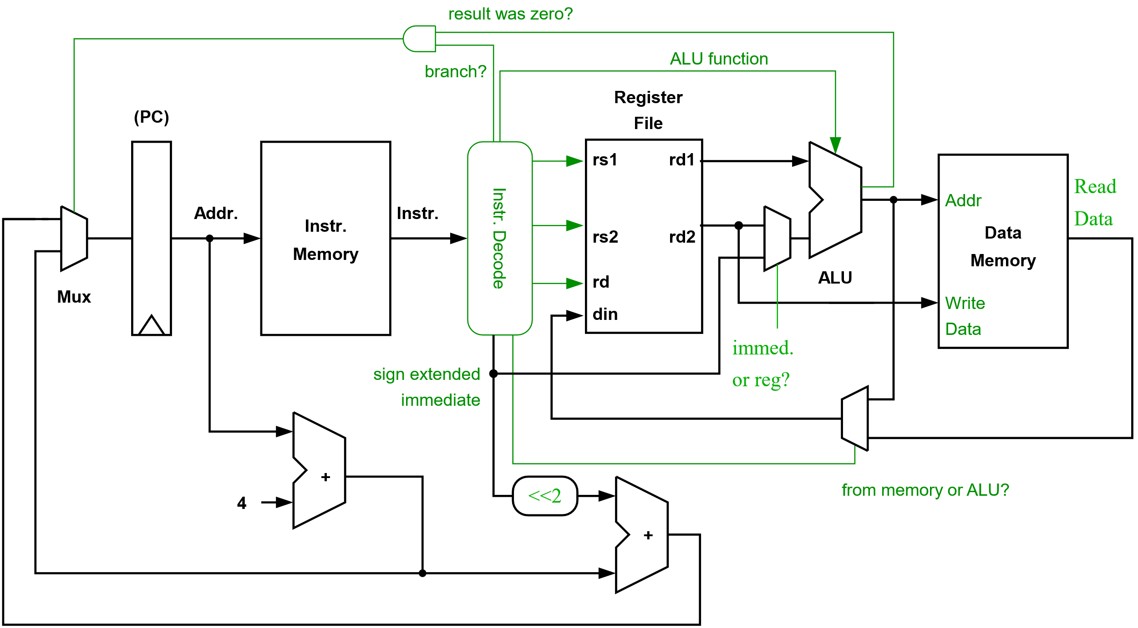
Our Simple Processor
Notes:
In the last module, we built a simple processor step-by-step from a few simple components. The basic fetch execute cycle is relatively simple to implement. In fact, a minimal processor can be constructed from a few thousand transistors.
Let’s start to explore how we can improve the performance of our processor.

Slide 4
A Simple Processor
Our processor executes each instruction in one clock cycle, i.e., it has a Clocks Per Instruction (CPI) of 1.
The minimum clock period will be the worst-case path through all of the logic and memories shown (plus some margin for variations in Process, Voltage, and Temperature, also known as “PVT”).
How might we improve our clock frequency without significantly increasing CPI?

Slide 5

What Is Pipelining?
Engine
Chassis
Paint
Time
Time
A
A
B
B
C
C
Order of manufacturing
(Car A, B, and then C)
Order of manufacturing
Notes:
Let’s imagine that building a car consists of three major stages:
constructing the chassis
installing the engine
painting.
Each stage or task takes 1 hour to complete.
We could complete each of these steps before starting to build a new car. This approach is illustrated in the left figure. A new car will be produced every 3 hours. Our throughput will be 8 cars per day, assuming our factory runs 24 hours.
Alternatively, if each of these tasks is completed at a different station, we could pipeline the cars construction. Now, the construction of a new car is started as soon as the first task is complete. Once our pipeline is full, a car will be completed every hour. Our throughput is now 24 cars per day.

Slide 6
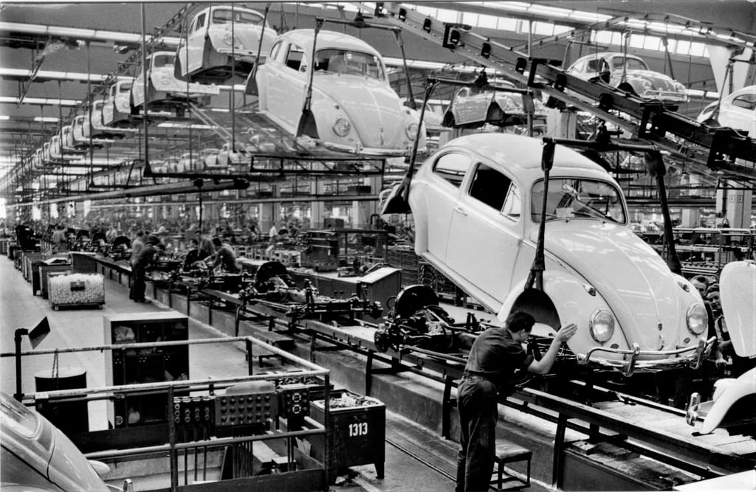
What Is Pipelining?
We arrange for the different phases of execution to be overlapped. We aim to exploit “temporal” parallelism.
How are latency and throughput affected?
Volkswagen Beetle Assembly Line (By Alden Jewell, license: CC BY 2.0)
Notes:
We can often arrange for the different phases of a job to be overlapped, e.g., the construction of a car in assembly line. Each stage performs a particular task that can be performed in parallel with the other stages. We exploit “temporal parallelism”; we’ll see later how we can execute multiple instructions in parallel too (“spatial parallelism”).
Of course, a single car is not produced more quickly, latency may actually increase slightly. Nevertheless, the rate at which cars are produced, our “throughput,” is much higher than if we constructed a single car at a time.

Slide 7
Pipelining and Maintaining Correctness
We can break the execution of instructions into stages and overlap the execution of different instructions.
We need to ensure that the results produced by our new pipelined processor are no different to the unpipelined one.
What sort of situations could cause problems once we pipeline our processor?
Notes:
We must ensure that the process of pipelining of processor has no impact on its functional behavior, i.e., it should produce the same results as in the unpipelined case.
For example, we must ensure that data dependencies between instructions are respected, that is, results produced by one instruction that are needed by a subsequent one are communicated correctly even if they are in the pipeline at the same time. If this was not the case, our programs would obviously not run correctly.

Slide 8
Pipelining
Clock period = T + C
Now, if we create two pipeline stages:
Clock period = T/2 + C
If C is small, our clock frequency has almost doubled.
Hence, our throughput will double, too.
C
T
Combinational
logic
clk
C
C
C
T/2
T/2
clk
Pipelining register
Notes:
T – is the critical path through our combination logic
C – is the delay though our register, the so-called clk->Q delay

Slide 9
Pipelining Our Processor
We can insert pipelining registers into our processor to divide the logic into different pipeline stages.
If added carefully, the worst-case delay between any two registers will be reduced.
We will also need to be careful to pipeline our control signals so that decoded control information accompanies each instruction as they progress down the pipeline.
Notes:
The appropriate control signals need to accompany the instructions as they move down the pipeline, e.g., an instruction’s destination register needs to be carried with it until it reaches the “writeback” pipeline stage and actually writes to the register file.
Remember it is the worst-case delay between two registers that determines our clock period in a synchronous design. Pipelining only makes sense if it is possible to reduce the worst-case delay. If the delay of each pipeline stage is unequal, the gains (speedup) from pipelining will be smaller than expected.
E.g., consider adding an additional pipelining register to subdivide only one of the two pipeline stages in the lower figure on the previous slide. This will have no impact on clock frequency as the worst-case delay will remain T/2.

Slide 10
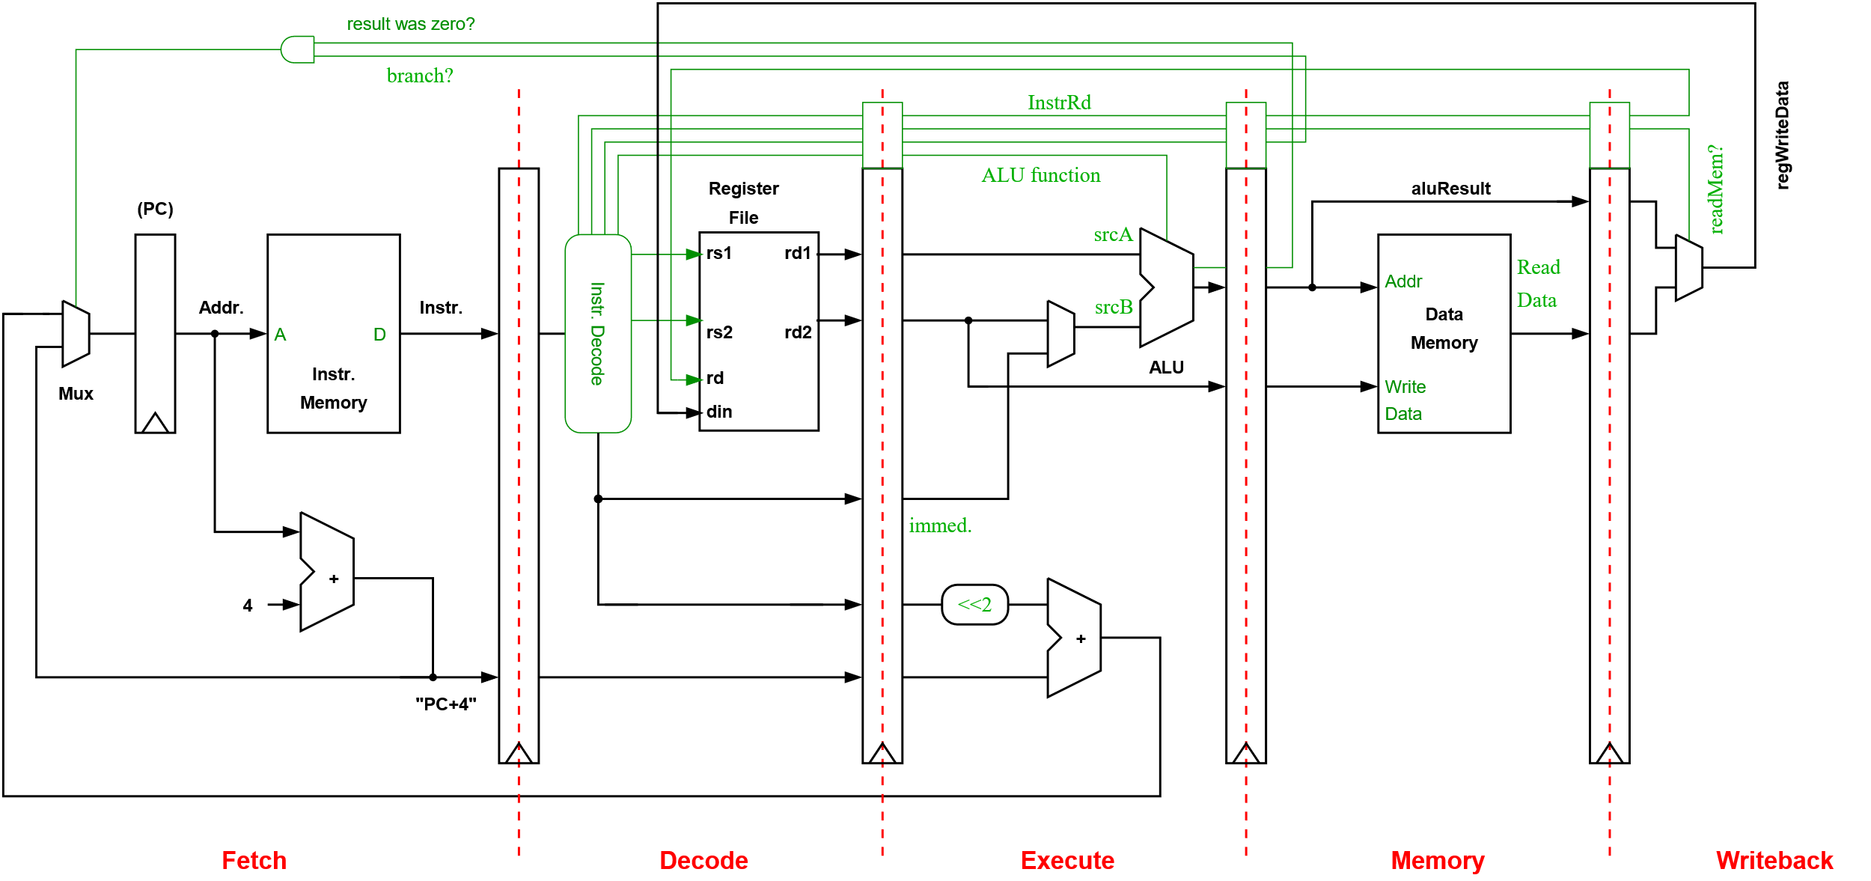
Pipelining Our Processor
FETCH DECODE EXECUTE MEMORY WRITEBACK
Notes:
Let’s start to explore how we might pipeline our simple processor. Here, we have added pipelining registers to create the classic 5-stage pipeline.
The pipelining registers are added at natural boundaries between the different phases of an instruction execution (i.e., after an instruction fetch, after decode and register read, after the ALU, and after the memory is accessed).

Slide 11
Pipelining Our Processor
We’ve simply taken our original datapath and added pipelining registers. (Note: its behavior is now different to our unpipelined processor – we’ll revisit this)
This has created a 5-stage pipeline:
FETCH – access our instruction memory.
DECODE – decode our instruction and read the source registers.
EXECUTE – perform an ALU operation, calculate a memory address, or compute a branch target address.
MEMORY – access our data memory.
WRITEBACK – write to the register file.

Slide 12
The Pipeline in Action
Clock
Cycle 1 2 3 4 5 6 7 8
Instruction
1. LDR X1, [X2]
2. ADD X2, X2, X3
3. STR X4, [X5], #4
4. SUB X0, X0, #1
5. LDW X5, [X3]
FETCH
DEC
EXE
MEM
WB
FETCH
DEC
EXE
MEM
WB
FETCH
DEC
EXE
MEM
WB
FETCH
DEC
EXE
MEM
WB
FETCH
DEC
EXE
MEM
WB
On clock cycle 5, the pipeline contains all the instructions listed in different pipeline stages

Slide 13
An Ideal Pipeline
In the ideal case, when our pipeline never stalls, our CPI will equal 1 (and IPC = 1).
If we need to stall the pipeline, our CPI will increase, e.g.:
If we must stall for 1 cycle for 20% of instructions, and 3 cycles for 5% of instructions, our new CPI would be:
Pipeline CPI = ideal pipeline CPI + pipeline stalls per instruction
= 1 + 1*0.20 + 3*0.05 = 1.35
Note: to make the best use of pipelining, we should avoid stalling as much as possible. (without increasing our clock period!) Remember:
Time = instructions executed×Clocks Per Instruction (CPI)×clock period
Notes:
CPI = Clocks per Instruction
IPC = Instructions Per Cycle

Slide 14

Stalling to Access Memory
Processor pipeline
The latency of accessing off-chip memory (DRAM) is typically 10-100 times higher than our pipelined processor’s clock period .
In order to avoid stalling, we must use on-chip caches.
L1 I-Cache
L1 D-cache
Memory interface
on-chip
Main Memory
off-chip
A single Arm Cortex A35 with 8K L1 instruction and data caches, no L2
For a 28 nm process:
Area: < 0.4 mm^2
Clock: 1 GHz
Power: ~90 mW
Notes:
To exploit our very fast processor, most of our instruction and data accesses must come from small on-chip memories (SRAM). When we allow hardware to manage these memories, they are called caches. Caches work because our memory accesses are not random; they possess significant temporal and spatial locality. That is, we typically access the same memory locations again and again (temporal locality) and also access memory locations nearby (spatial locality).
Of course, not all the data we need will be in our caches, and in those cases, we will need to stall – adding to our CPI.

Slide 15
Pipeline Hazards

Slide 16
Pipeline Hazards
Pipelining allows new instructions to start while others are still in the pipeline, i.e., the execution of instructions is overlapped.
There may be cases where an instruction must wait and not move forward in the pipeline to ensure correctness. These cases are known as pipeline hazards:
Structural hazard – arise from resource conflicts
Data hazard – arise from the need to ensure we always respect inter-instruction data dependencies
Control hazard – are caused by instructions that change the PC, i.e., branches and jumps (details in next module)
Notes:
Data hazards: we need to make sure data values are communicated correctly between instructions. This is trivial if we execute each instruction one-by-one, i.e., without pipelining. In this case, we know that the values in the register file will be correct at the end of each clock cycle.
In our simple pipeline, there is the possibility that an earlier instruction that will provide a result to a later instruction is still in the pipeline but hasn’t yet reached the writeback pipeline stage. If we are not careful, it may be possible to read old values from the register file.
More complex pipelines may introduce additional data hazards.

Slide 17
Structural Hazard
Instructions may need to stall in order to wait for access to a shared resource, e.g.:
A functional unit that is not pipelined
A register file read port or register file write port
A memory
Why permit any structural hazards?
Designing for the worst-case may reduce the average (common) case performance, i.e., the added complexity may reduce our CPI but increase our clock period.
Adding support for the worst-case may be too costly (e.g., in terms of power and area). We may have strict budgets or may want to use these limited resources elsewhere.
Notes:
Instructions in our pipeline may not always be able to move forward on each clock cycle if the appropriate resources are not free. They may need to wait and stall. In a simple in-order pipeline, this will, of course, force earlier instructions to stall too.
Perhaps an obvious question is why we permit any structural hazards, why can’t we provide enough resources to prevent such stalls? (e.g., provide copies of resources or ensure they are fully pipelined). The problem here is that performance may actually be lower as these might not be the optimal place to invest our limited resources (e.g., transistor and power budget), the additional complexity may also force us to extend our clock period – slowing the whole processor.
We can begin to see that the process of designing a real processor involves many different trade-offs and constraints.
-----
A structural hazard due to a shared memory, e.g., two parts of our pipeline are trying to access the same single-ported memory, e.g., if we tried to supply instructions and data to our pipeline from the same memory.
We will also need to stall the pipeline if we access a cache and the data are not present. Additional time will be required to acquire the missing cache line from a different cache or main memory.
Register file ports – if we have 4 read-ports and 2 write-ports, it simply means we can read 4 different registers and store 2 results simultaneously (in the same clock cycle). Adding additional read or write ports to memories is typically very expensive. Fortunately, the small size of register files allows us to have a relatively large number of ports.

Slide 18
Data Dependencies – True Data Dependencies
True data dependence (green arrow). Also known as a Read-After-Write (RAW) dependence.
If we imagine two instructions, i followed by j
If j uses the result of i, we say that j is data dependent on i. This is an example of a true data dependence (a read after a write).
LDR X1, [X2]
ADD X1, X1, X3
LDR X3, [X2], #4
SUB X2, X3, #1
Notes:
Let’s now look at several examples of data dependencies so that we can understand, in the later slides, its relation to data hazards.
The green arrows represent true data dependencies. We must ensure the result of the first instruction is communicated correctly to the second (i.e., we don’t read an old version or change the value before it is read).

Slide 19
Data Dependencies – Name Dependencies
Name dependencies may also exist when two instructions refer to the same register. Unlike true data dependencies, no data are communicated:
Output dependencies (red arrow)
Anti-dependence (gold arrow)
LDR X1, [X2]
ADD X1, X1, X3
LDR X3, [X2], #4
SUB X2, X3, #1
Notes:
Name dependencies may restrict the order instructions are executed (or writebacks occur) even though they don’t represent true data dependencies – i.e., no data are communicated between the instructions.
Name dependencies are unavoidable as the compiler only has a limited number of registers to allocate, forcing registers to be reused.
In a simple pipeline, where instructions pass through each stage in program order, name dependencies cannot create pipeline hazards.
There are different types of name dependence, which are ‘output dependence’, and ‘antidependence’, which will be explained in the next slides.

Slide 20
Data Dependencies – Name Dependencies
Output dependence (red arrow). Also known as a Write-After-Write (WAW) dependence
We need to ensure we don’t reorder writes to the same register. This would mean subsequent instructions could receive the wrong data value.
LDR X1, [X2]
ADD X1, X1, X3
LDR X3, [X2], #4
SUB X2, X3, #1
Notes:
Name dependencies may restrict the order instructions are executed (or writebacks occur) even though they don’t represent true data dependencies – i.e., no data are communicated between the instructions.
We’ll come back to these name dependencies when we discuss complex superscalar processors that execute their instructions out-of-order. They actually remove this false or name dependencies by renaming registers at run-time. The physical register file in these processors contains many more registers than the number available to the compiler (the number of “architectural” registers)

Slide 21
Data Dependencies – Name Dependencies
Anti-dependence (gold arrows). Also known as a Write-After-Read (WAR) dependence
Again, we need to be careful not to overwrite a register whose current value is still required by an earlier instruction.
E.g., we can’t schedule the STR instruction before the ADD instruction.
LDR X1, [X2]
ADD X1, X1, X3
LDR X3, [X2], #4
SUB X2, X3, #1
Notes:
Here the LDR is anti-dependent on the ADD instruction as it writes X3 and the ADD reads X3.
Name dependencies may restrict the order instructions are executed (or writebacks occur) even though they don’t represent true data dependencies – i.e., no data is communicated between the instructions.
We’ll come back to these name dependencies when we discuss complex superscalar processors that execute their instructions out-of-order. They actually remove this false or name dependencies by renaming registers at run-time. The physical register file in these processors contains many more registers than the number available to the compiler (the number of “architectural” registers).
If additional registers were available a compiler could also use a different register for the result of the LDR instruction to remove the dependence, e.g.:
LDR X1, [X2]
ADD X1, X1, X3
LDR X4, [X2], #4
SUB X2, X4, #1

Slide 22
Data Hazards
A data hazard is created whenever the parallel execution of instructions makes it possible for a dependency to be violated.
Read After Write (RAW) hazards – produced by true data dependencies, i.e., j attempts to read a source register before i writes to it.
Write After Write (WAW) hazards – produced by output dependencies, i.e., j tries to write to a destination register before it is written by i.
Write After Read (WAR) hazards – produced by anti-dependencies, i.e., j tries to write to a destination before it is read by i.
Notes:
Pipelining overlaps the execution of multiple instructions. We must ensure that this doesn’t change the outcome of the program and that all data dependencies are respected.
Note: Hazards are named after what should happen, i.e., they specify the required order of read and writes.

Slide 23
RAW Hazards
The result of the ADD has been produced by the end of cycle 4
Cycle 1 2 3 4 5 6 7 8
Instruction
1. LDR X1, [X2]
2. ADD X2, X2, X3
3. STR X4, [X2], #4
4. SUB X0, X0, #1
5. LDW X5, [X3]
Cycle 6:
ADD writes X2 and STR reads X2
FETCH
DEC
EXE
MEM
WB
FETCH
DEC
EXE
MEM
WB
Cycle 7: perform
Address calculation
FETCH
DEC
STALL
STALL
EXE
MEM
…..
FETCH
STALL
STALL
DEC
EXE
…..
FETCH
DEC
…..
Notes:
The register file can be written and read on the same clock cycle. This can either be implemented by writing in the first half of the clock cycle and read in the later half. Alternatively, there may be bypass logic to provide the value currently being written as an output on a read port. Because of this, we can assume there is never a RAW hazard between the WB and DEC stages.
If all data values must be communicated via the register file, we have no choice but to stall until the ADD instruction reaches the WB stage
Of course, we’ve calculated the result of the ADD by the end of cycle 4.

Slide 24
Data Forwarding
Cycle 1 2 3 4 5 6 7 8
Instruction
1. LDR X1, [X2]
2. ADD X2, X2, X3
3. STR X4, [X2], #4
4. SUB X0, X0, #1
5. LDW X5, [X3]
FETCH
DEC
EXE
MEM
WB
FETCH
DEC
EXE
MEM
WB
FETCH
DEC
EXE
MEM
WB
FETCH
DEC
EXE
MEM
WB
FETCH
DEC
EXE
MEM
WB
To avoid stalling due to RAW hazards, we must “forward” the result from the execute stage’s pipeline register to the input of the ALU (rather than communicating via the register file).
Notes:
This problem can be solved by making the result of the add available to the store earlier. We don’t need to communicate only via the register file. We can select a result held in one of our pipelining registers and select that as the input to a previous stage (e.g., the execute stage)

Slide 25
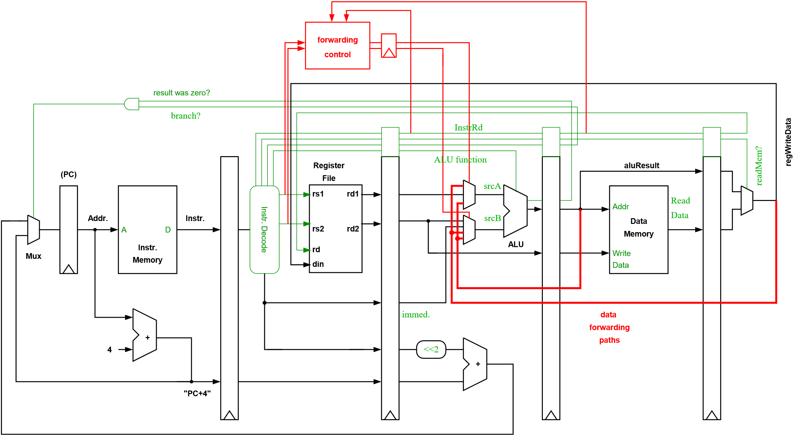
Data Forwarding
Notes:
Here, we extend our pipelined datapath with data forwarding paths. We now have the ability to select a result from an earlier instruction (that is still in the pipeline and not yet written to the register file) as the operand of a later instruction. This completely avoids the problem of RAW hazards in our simple pipeline.
What does the forwarding control logic actually do?
It compares the source register identifiers of the instruction in the decode stage with the destination register identifier of the instructions currently in the execute and memory stage to see if forwarding is necessary.

Slide 26
Load-use delay
Cycle 1 2 3 4 5 6 7 8
Instruction
1. LDR X1, [X2]
2. ADD X2, X1, X3
FETCH
DEC
EXE
MEM
WB
FETCH
DEC
STALL
EXE
MEM
WB
The LDR instruction loads data from memory in the “MEM” pipeline stage.
Even with data forwarding it is not possible to execute the LDR and ADD instructions at the same time. The ADD must be stalled.
Notes:
Hardware interlocks
The hardware to check for this type of hazard is called a hardware interlock. In the example above it will determine when it is necessary to stall instructions until the result of a load is available.
An alternative is to avoid the need for this extra stall, or interlock, logic. Instead we ensure that the compiler schedules instructions in such a way that this hazard never occurs, i.e. schedules instructions after the load that do not require its result. If necessary these could be NOPs. The number of such instructions we need will depend on the load-use delay. For our design it is 1-cycle. The instruction after the load is said to be in the load delay slot.
Obviously the compiler needs to find an independent instruction that it is free to move into this slot, i.e. ensure the behaviour of our program is not changed. This will require some instruction-level parallelism to be present.
The MIPS processor was originally designed without interlocked pipeline stages, in fact this is where the name “MIPS” comes from: Microprocessor without Interlocked Pipeline Stages”.

Slide 27
Control Hazards
FETCH DECODE EXECUTE MEMORY WRITEBACK
Notes:
In our simple pipeline, the branch is evaluated in the “Execute” stage, and the decision to branch or not is then made on the next cycle. To cope with the fact that the “Fetch” stage doesn’t know what to fetch after the branch, we could simply stall for 3 cycles.

Slide 28
Control Hazard
Cycle 1 2 3 4 5 6 7 8
Instruction
1. CBZ X3, label
2. ADD X2, X2, X3
3. STR X4, [X2], #4
4. label: SUB X0, X0, #1
A new PC, the branch target, is communicated to the fetch stage
FETCH
DEC
EXE
MEM
WB
FETCH
DEC
EXE
MEM
WB
becomes a NOP
FETCH
DEC
EXE
MEM
WB
becomes a NOP
FETCH
DEC
EXE
MEM
WB
(CBZ – branches if the operand is equal to zero)
If the branch is evaluated in the execute stage, and it is taken, we must convert the two instructions that follow it into NOPs (we waste two cycles).
Notes:
Branches are relatively common and may occur every 5 or 6 instructions. It is therefore important that we can handle them as efficiently as possible. This is especially true as pipeline depth increases.

Slide 29
Control Hazards – Evaluate Branch in Decode Stage
To reduce the cost of branches, we could evaluate the branch in the decode stage.
Now, a taken branch only involves a single “dead” cycle.
Potential data hazards
If the instruction immediately before the branch writes to the register than the branch tests, we must stall for one cycle (i.e., until this instruction generates its result).
We will also need forwarding paths from the EXE and MEM pipeline stages to the decode stage.
Notes:
To reduce the cost of branches, we could evaluate the branch as early as possible, e.g., in the decode stage.
Now, we only need a single “dead” cycle in the case of a taken branch.
We’ll look at branches in much more detail in the next module. It is particularly important that we handle them efficiently especially in deeper pipelines (or superscalar ones)

Slide 30
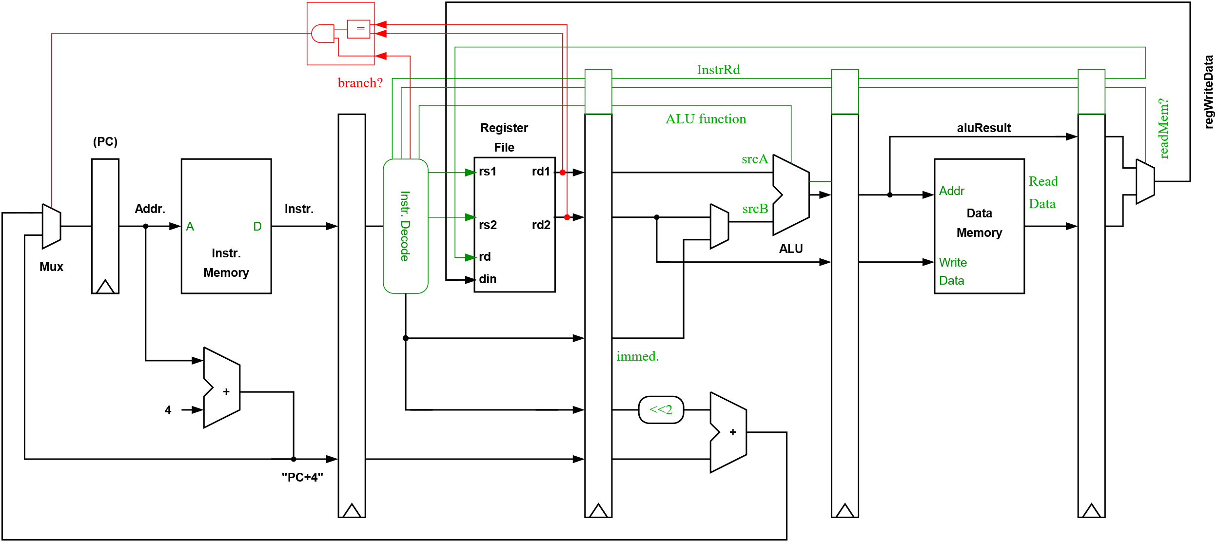
Control Hazards – Evaluate Branch in Decode Stage

Slide 31
Pipeline and Performance

Slide 32
Pipeline CPI
Pipeline CPI = ideal pipeline CPI + Structural stalls + Data hazard stalls + Control stalls
Stalls can be reduced by using a combination of compiler (e.g., scheduling) and hardware techniques.
Hardware techniques typically increase the area and complexity of our processor. Consequently, power consumption typically grows quickly (not just linearly) as we try to boost the performance of our processor.

Slide 33
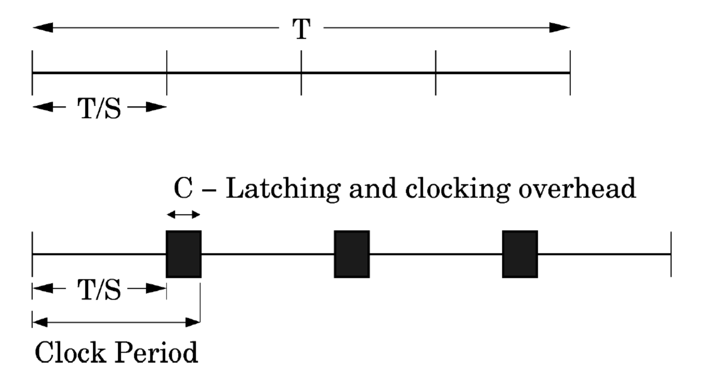
An Analytical Model of Performance
Let’s construct a simple analytical model of pipeline performance.
We start with a critical path of delay T.
Divide it into S stages of delay T/S.
We then add a clocking overhead C to our clock period, to give T/S+C.
Notes:
(See also slide 7 of this module.)
Remember, if we start with a clock period of T, by pipelining, we can reduce our clock period to T/S (where S is the number of pipeline stages).
We also add some clocking overhead, C, to account for the delay of our register and clock distribution overheads due to clock skew and jitter – i.e., the inability to deliver a perfect clock signal to all registers in a perfectly synchronized fashion.

Slide 34
An Analytical Model of Performance
We can now create a simple analytical model of pipeline performance.
Pipeline CPI = ideal pipeline CPI + pipeline stalls per instruction
Freq = 1 / (clock period) = 1 / (T/S + C)
Throughput = Freq / CPI
Let’s assume stalls occur at frequency b, and their cost is proportional to pipeline depth, say (S-1), now:
Throughput = 1 / (1+(S-1)b) x 1 / (T/S+C)
Notes:
Note: simple analytical models like this are an excellent way to understand problems and perform a sanity check on ideas, limit studies, etc.

Slide 35
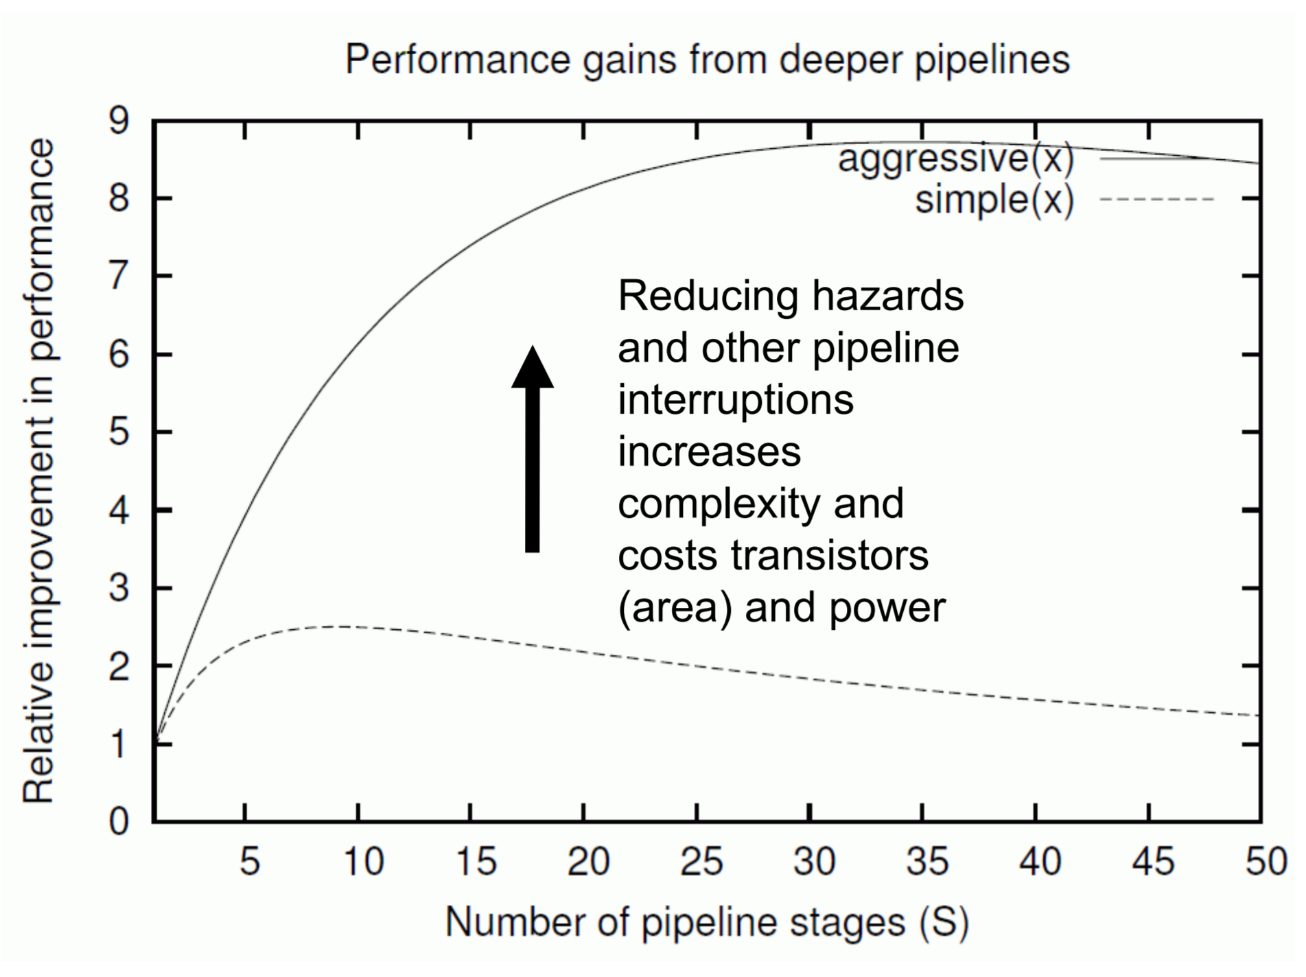
Optimal Pipeline Depth
T = 5 ns, penalty of interruption is (S-1)
Simple pipeline design
C= 300 ps
Pipeline interruption every 6 instructions
Aggressive pipeline design
C = 100 ps
Pipeline interruption every 25 instructions
Source: Robert Mullins, University of Cambridge

Slide 36
Typical Pipeline Lengths
Area optimized cores may have 2-3 stages.
Simple, efficient scalar pipelines are normally implemented with 5-7 stages.
Higher performance cores, which fetch and issue multiple instructions in a single cycle, may have 8-16 stages.
Pipeline lengths for general-purpose processors peaked at 31 stages with Intel’s Pentium 4 in 2004. Why have they reduced since 2004 instead of increasing?
Notes:
Answer: The industry has shifted to producing multicore designs, and power consumption has become a first-order design constraint.

Slide 37
Summary
Pipelining is often an effective and efficient way to improve performance. Of course, we must be careful that gains from a faster clock are not lost due to the cost of stalling the pipeline.
We must take care to:
1. Supply instructions without stalling:
Ensure branches are handled efficiently in our pipeline.
Try to minimize our instruction cache miss rate.
2. Supply data – minimizing our data cache miss rate.
3. Minimize pipeline stalls due to structural hazards and data hazards.

Slide 38
Backup Slides:
Diversified Pipelines &
Arm10 Pipeline Case Study

Slide 39
Diversified Pipelines
It is impractical to require that all instructions execute in a single cycle.
We also want to avoid sending all instructions down a single long pipeline.
We can instead introduce multiple (or “diversified”) execution pipelines.
Could this introduce new hazards?
Notes:
For some more complex operations, we will require specialized functional units. In some cases, these functional units will take longer to produce a result. They may or may not be pipelined as adding many pipeline stages may be too expensive.
Now, rather than arranging all these functional units as a single long pipeline that all instructions must traverse, we arrange them in parallel. This reduces the cost of forwarding paths and pipeline registers. It also provides opportunities for instructions to bypass or overtake longer latency instructions.
This introduces the potential for WAW hazards. WAR hazards are still impossible as instructions are still issued in program order (i.e., their registers are read in program order)

Slide 40
Diversified Pipelines
EX
Integer
Fetch
Decode
F1
F2
F3
F4
Mem
WB
Floating point and integer multiplier
FD (unpipelined
Latency = 20 cycles)
Floating point and integer divider
Notes:
Here is an example of a processor with a number of parallel execution pipelines that perform different operations. The integer ALU has a latency of 1 cycle, floating point operations are executed using a 4-stage pipeline, and divide operations take 20 cycles and are not pipelined.

Slide 41
Example: Arm10 Pipeline (1999)
Shifter/ALU
Branch Predictor,
Instruction Buffer,
Address Generator
Arm and Thumb Instruction Decode
Register File Read and
Result Forward Scoreboard
Register File
Write
Multiplier
Multiply adder
Data address calc
Data Cache
Fetch Issue Decode Execute Memory Write
Buffers up to 3 instructions
We can have numerous instructions executing in parallel in these stages
Notes:
This pipeline issues a single instruction each clock cycle, but has multiple execution units that can operate concurrently.
Multicycle instructions can be issued to one execution unit, and while they are executing, subsequent instructions can be issued and executed by other execution units.
Perhaps most interesting here is the ability to overlap the execution of memory operations (including load/store multiple) with ALU operations.

Slide 42
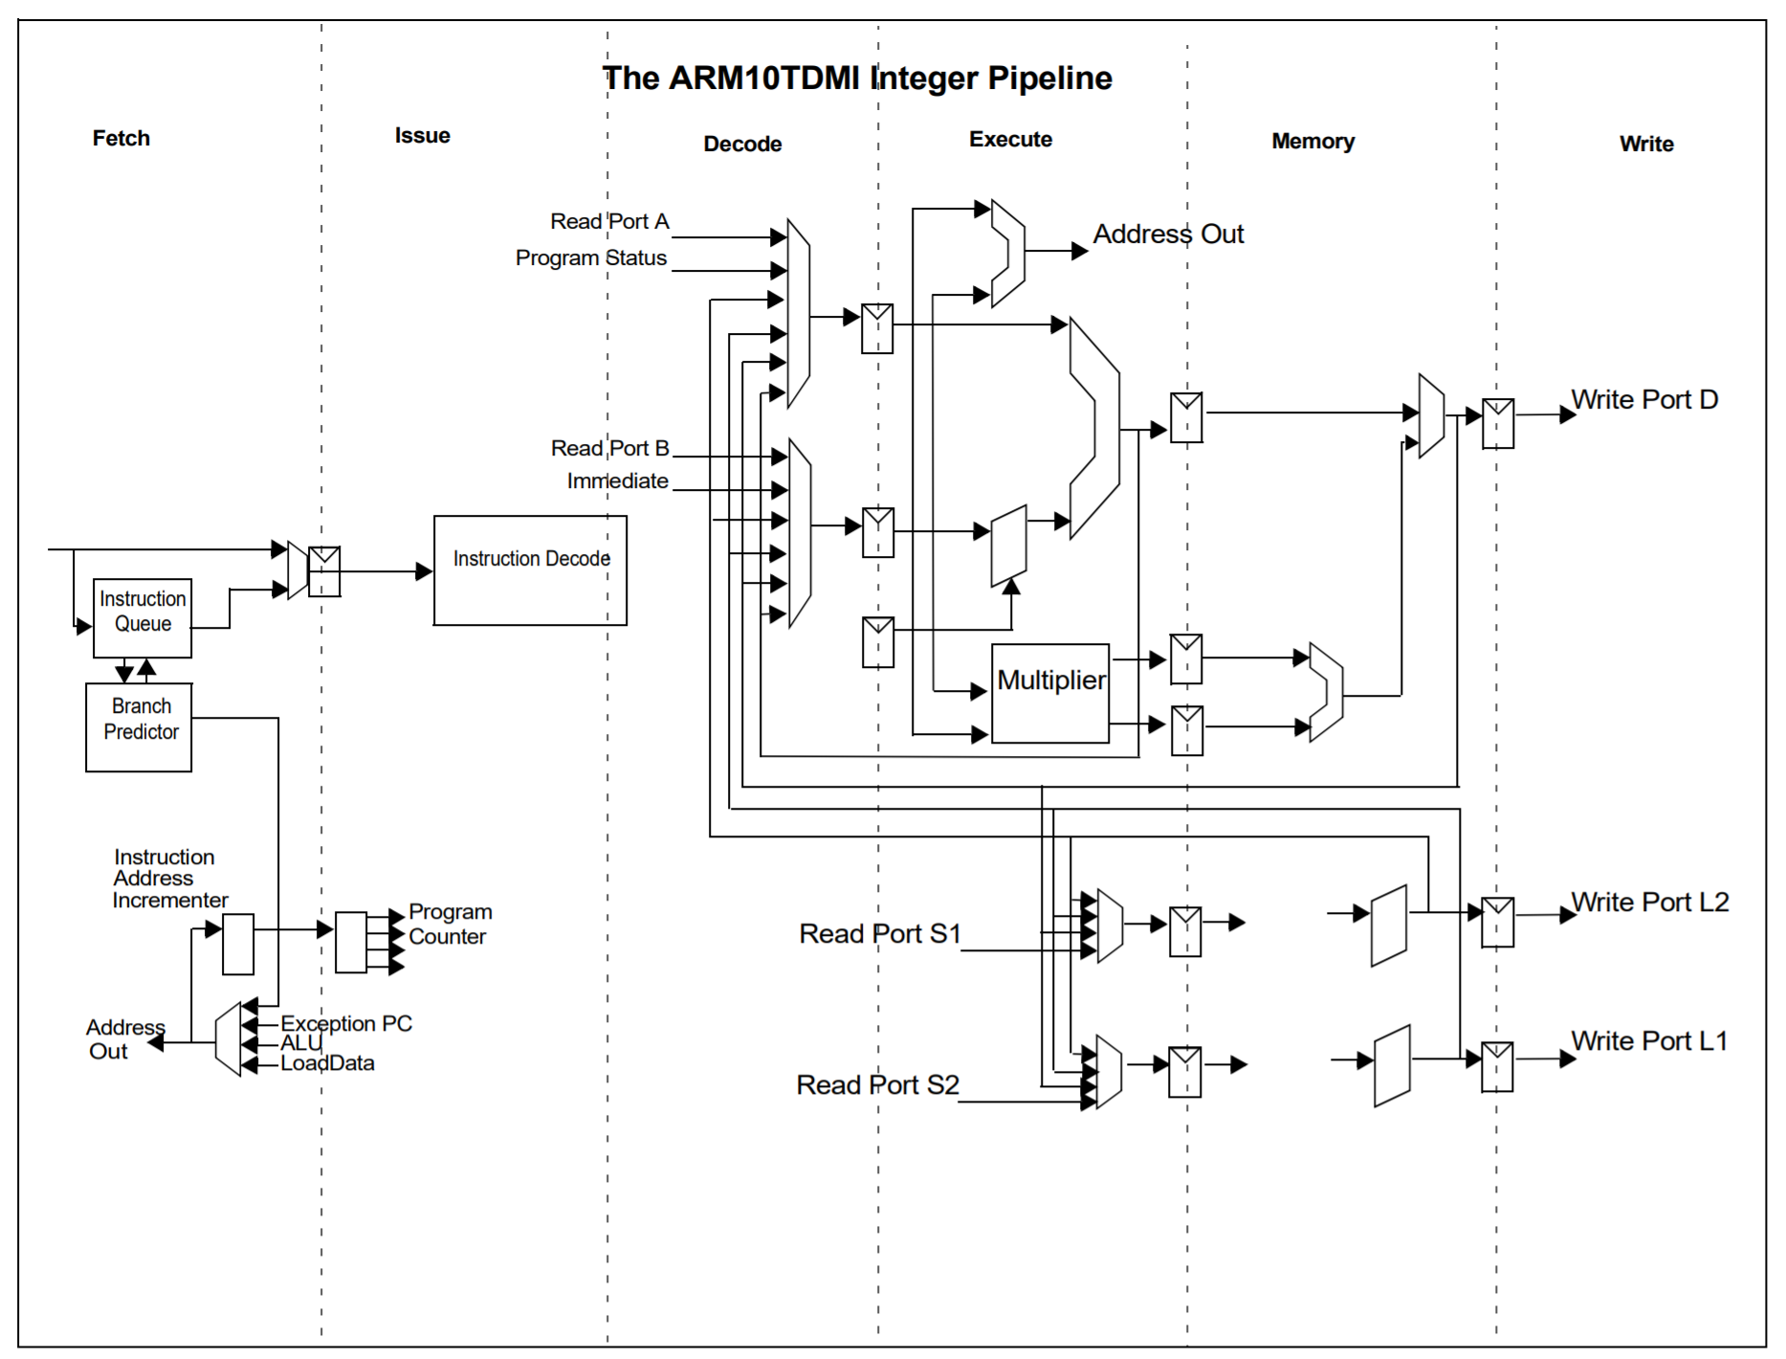
Arm10 Pipeline
Notes:
Notes:
The forwarding multiplexors are placed in the decode stage
The processor had 64-bit instruction and data interfaces (i.e., there is a 64-bit data bus between the processor unit and instruction and data caches)
Hence, there is a need for two register file read ports, S1, S2, to provide data when performing a store
The processor featured a non-blocking data cache (i.e., hit-under-miss support)
This scheme allows a single outstanding miss. Subsequent memory operations can be serviced if they hit in the cache. We only need to stall when an instruction attempts to consume the result of a load (or due to WAW hazards). This sort of Hit-Under-Miss (MUM) scheme reduces the effective miss penalty (by ~20-30% even when only a single outstanding miss is permitted).
The Arm1020E had a CPI of around 1.3. It was a 6-stage pipeline with static branch prediction.
Source of image diagram: Arm10200 Reference Device Product Overview

Slide 43
Arm10 Pipeline Hazards
ALU instructions need not necessarily wait for load/store operations in the load/store pipeline to complete, i.e., they may bypass or overtake them if they are independent.
Data Hazards
We cannot allow all ALU instructions to bypass memory instructions. We must respect dependencies.
RAW (i.e., the ALU operation requires the result from a load) or a WAW hazard
Structural Hazards
Load/store or multiply pipeline is occupied.
Check for hazards late.
The use of interlocks is minimized by checking for hazards late, not simply in the decode stage.
Notes:
Load/store operations complete by using the load/store pipeline. Other instructions can use the ALU pipeline at the same time – although we must always take care to respect any data dependencies.
The 32-bit Arm ISA (not the more recent A64) includes a feature whereby a single instruction can specify many load or store operations (load and store multiple: LDM and STM). The execution of one of these multicycle operations didn’t prevent independent ALU instructions from using the ALU pipeline.
Similarly, a normal load instruction could miss, but ALU operations (or even independent loads) could execute while it was serviced (as outlined on the previous slide).

