Slide 1
Advanced Pipelining: Branch Prediction, Exceptions, and Limits to Pipelining
Module 4

Slide 2
Module Syllabus
Minimizing the impact of branches (control hazards)
Handling exceptions
The limits to pipelining
Notes:
In this module, we will first learn about the various methods of handling branches and how we can minimize the impact of branches (control hazards). We will also learn about handling exceptions. Finally, we will conclude this module with a discussion about the limitations of pipelining.

Slide 3
Control Hazards
What happens immediately after we fetch a conditional branch instruction?
We must determine if the branch is taken or not.
If the branch is taken, we must compute and branch to the target address.

Slide 4
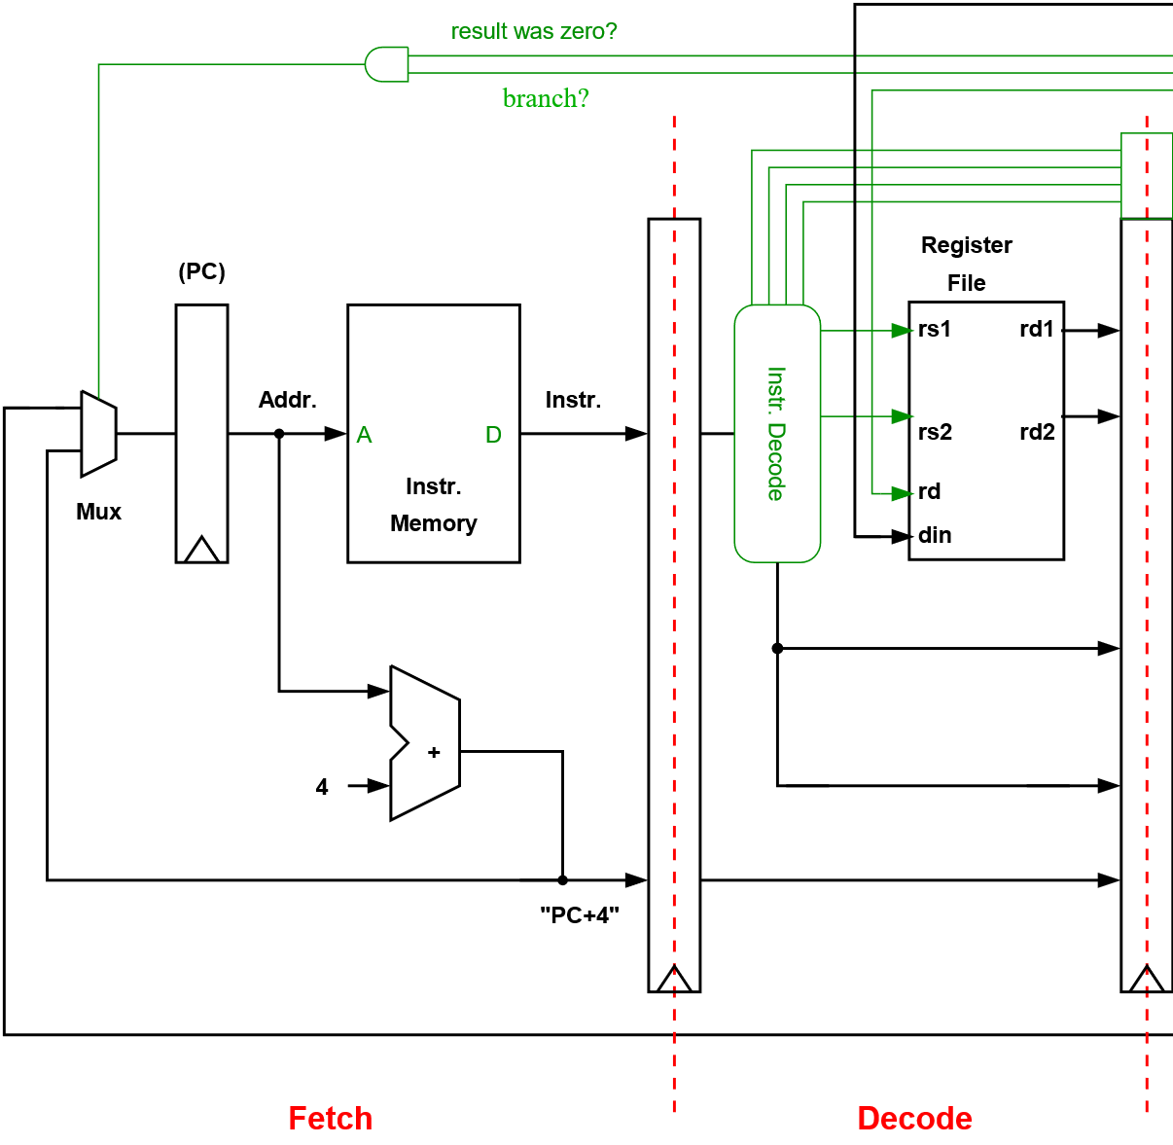
How Would We Like to Handle Branches?
In a pipelined processor, we would like to calculate the next value of the program counter (PC) in parallel with reading our instruction memory.
In practice, this is non-trivial to support as branches may not be decoded and evaluated until later in the pipeline.
FETCH DECODE
Notes:
The problem here is that we must evaluate the branch and calculate the branch target address (if taken) before we can update the PC.
This may take a few cycles in a pipelined processor. The result of the branch returning from a later pipeline stage is illustrated by the thick green line.
Due to this delay, in the case of a taken branch, the processor will continue to fetch instructions sequentially when it should have branched to the branch target address. In this case, we will need to squash the instructions fetched after the branch (i.e., turn them into No Operations (NOPs)). These dead cycles will degrade the performance of our pipeline.
In practice, modern processors are often able to accurately predict branches (and their target addresses) to help minimize their impact on performance.
Note: branch prediction alone is not enough if we want to avoid any dead cycles due to branches. In addition, we must also know when the instruction we are currently fetching is a branch (before we have actually fetched it from our instruction memory). We must also be able to calculate (or recall) the branch target address by the end of the cycle we fetch the branch.

Slide 5
How Would We Like to Handle Branches?
Option 1: Assume a branch is not taken
Option 2: Evaluate the branch earlier in the pipeline
Option 3: Delayed branch
Option 4: Branch prediction
Notes:
In this module, we will discuss the various methods of handling branches.

Slide 6
Option 1: Assume the Branch Is Not Taken
Cycle 1 2 3 4 5 6 7 8
Instruction
1. CBZ X3, label
2. ADD X2, X2, X3
3. STR X4, [X2], #4
4. label: SUB X0, X0, #1
A new PC, the branch target, is communicated to the fetch stage
FETCH
DEC
EXE
MEM
WB
FETCH
DEC
EXE
MEM
WB
becomes a NOP
FETCH
DEC
EXE
MEM
WB
becomes a NOP
FETCH
DEC
EXE
MEM
WB
(CBZ – branches if the operand is equal to zero)
If the branch is evaluated in the execute stage, and it is taken, we must convert the two instructions that follow it into NOPs (we waste two cycles).
Notes:
Stalling for 3 cycles on every branch would obviously have a big impact on our CPI, given that branches are comment; perhaps 1 in every 5 or 6 instructions.

Slide 7
Option 1: Assume a Branch Is Not Taken
If we evaluate the branch in the execute stage, we would lose two cycles every time we encountered a taken branch.
If we assume 20% of instructions are branches, and 60% are taken, and an otherwise perfect CPI of 1:
CPI contribution from taken branches = 0.2*2 * 0.6 = 0.24
Our new CPI = 1.0 + branch stalls = 1.24
Notes:
(Here, we assume a 5-stage pipeline)
We can see why increases in clock frequency gained through pipelining may not translate directly into performance. Our clock period is reduced, but our CPI is increased.
If we start with a perfect CPI of 1, it will now be 1.24
We’ll also need to add to this due to stalls from instruction and data memory accesses
(Note: A “predict taken” scheme is more complex to implement, we’ll consider this later)

Slide 8
Option 2: Evaluate the Branch Earlier in the Pipeline
Move the branch test and branch target address calculation to the decode stage.
This would reduce the branch penalty to a single cycle in the case of a taken branch.
i.e., in the case of a taken branch, we would need to discard the instruction after the branch.

Slide 9
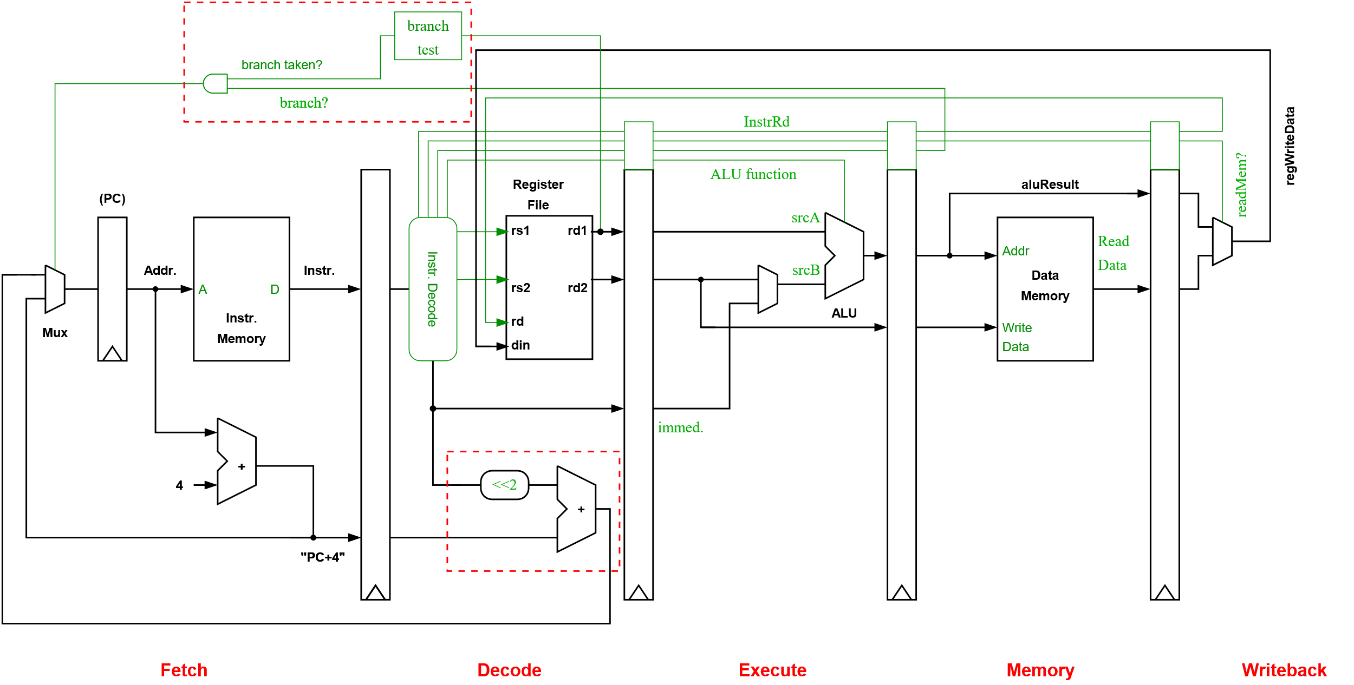
Option 2: Evaluate the Branch Earlier in the Pipeline
Note: Data forwarding logic omitted for simplicity

Slide 10
Option 2: Evaluate the Branch Earlier in the Pipeline
For this technique to work:
The branch condition must be simple to evaluate.
Test for zero is simple .
Tests requiring an ALU operation are probably too complex.
We don’t want to the branch test to extend the clock cycle time.
We must take care of potential data hazards.
If the instruction immediately before the branch writes to the register than the branch tests, we must stall for one cycle (i.e., until this instruction generates its result).
We will also need forwarding paths from the EXE and MEM pipeline stages to the decode stage.
Notes:
Testing for zero is simple. We could even append a zero flag to each register. This would be set if a zero is written to the register (and otherwise unset). This would mean we could quickly check for zero (i.e., avoiding the need to check all bits in the register are zero).

Slide 11
Option 3: A Delayed Branch
We could decide to always execute the instruction after the branch, regardless of whether the branch is taken or not.
This instruction after the branch is now called the “branch delay slot.”
loop: ……
SUB X3, X3, 1
CBZ X3, loop
ADD X2, X1, X5
….
The branch
The branch delay slot
Notes:
Idea: always execute instruction after branch. Provide opportunity for compiler to fill this “delay slot”
Example ISAs with branch delay slots: MIPS, SPARC, PA-RISC (all early RISC ISAs)
Drawbacks: beneficial for simple processors but difficult to justify for even moderately complex designs – the argument is that we are exposing too much of the microarchitecture to the compiler unnecessarily
Branch prediction and branch target prediction typically work well, normally the best choice for a pipelined processor. If so, we don’t want extra complexity of dealing with a branch delay slot and potential code size and performance hit when it can’t be filled

Slide 12
Option 3: A Delayed Branch
A compiler can usually fill a single branch delay slot around 60-70% of the time.
If we had a longer pipeline, we could introduce multiple branch delay slots, but they are typically hard to fill.
Question: where can we find an instruction to move to the branch delay slot?
If we can’t find an instruction to fill the slot, we have to fill it with a NOP.
Notes:
We could find an instruction in the current basic block that is free to move into the branch delay slot or even from the branch target.
Obviously, only some instructions will be free to move, the scheduling of others will be restricted because of the data dependencies to other instructions.
In practice, we will see that branch prediction is usually a better option. This also prevents the need to make changes to the ISA (hence forcing us to support delay-slots in all processors that support the instruction set).

Slide 13
Example
Fetch 1
Fetch 2
Decode
ALU
Mem 1
Mem 2
Mem 3
Writeback
This pipeline has 8 pipeline stages.
The basic branch delay is 3 cycles.
The branch condition and target address are evaluated in the ALU stage.
All branches are predicted as not taken.

Slide 14
Example
Impact on CPI:
Let’s make some reasonable assumptions:
15% of instructions are unconditional or taken branches; the penalty here is 3 cycles.
5% of instructions are untaken conditional branches; no penalty here, as we are predicting these not-taken.
CPI contribution from branch stalls = 0.15 * 3 + 0.05 * 0 = 0.45
Notes:
Let’s look at the cost of different types of branches and the impact on CPI.

Slide 15
Option 4: Branch Prediction
For high-performance processors, with deep pipelines, the techniques described so far are inadequate.
E.g., Arm Cortex-A15
15-stage pipeline
Branches are evaluated late in the pipeline.
Branch misprediction penalty ~14 cycles
It also fetches 4 instructions per cycle and decodes 3 at a time (i.e., there are multiple instructions in a single pipeline stage).
We may discard>40 instructions if we must flush the pipeline due to a mispredicted branch.
Notes:
For many high-performance pipelines, the techniques outlined so far are inadequate as the impact of branches on CPI would be too high.
This is particularly true if the pipeline is deep and/or we are fetching and executing multiple instructions per clock cycle (i.e., superscalar processors, see next module).
https://www.arm.com/files/pdf/AT-Exploring_the_Design_of_the_Cortex-A15.pdf

Slide 16
Static Branch Prediction (Mostly Historic)
Static prediction methods exploit the observation that a given branch instruction is likely to be highly biased in one direction.
Schemes are often based on whether the branch is branching forward or backward in the code or alternatively depend on the op-code of the branch instruction.
Displacement-based prediction
We can exploit a simple observation that backward branches are usually loop branches and are likely to be taken.
Now, if the branch’s target address < PC, we predict the branch taken.
The accuracy of this sort of scheme is around 65% (or 80-95% with aid of profiling).
Notes:
Static branch prediction schemes can be improved through the use of profiling. The compiler can then set prediction bits within the branch instructions that reverse op-code or displacement-based predictions, if necessary. Accuracy is usually in 80-95% range.

Slide 17
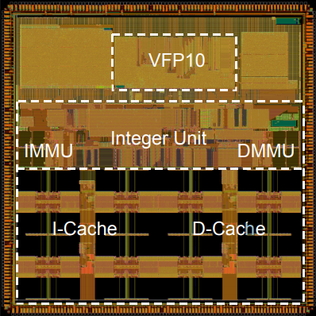
Example: Arm10 Processor
The integer pipeline had 6 stages.
The Arm10 employed a static displacement-based branch prediction scheme.
The Arm10’s Branch Prediction Unit also worked ahead of the fetch stage (prefetching instructions) in order to reduce the costs of branches.
Arm10 (Circa 2000)
Transistor count: ~250,000
Clock frequency: 400 MHz
Technology: 0.18-micron
Applications: modems, cellular phones, automotive, etc.
Notes:
“The Branch Prediction Unit worked by prefetching instructions beyond the fetch stage, decoding branch instructions, calculating branch target addresses, and fetching the target instruction.”
“Under normal operation, branch prediction can be completed before the fetch stage requests the branch instruction so that the instruction at the target of the branch can be speculatively given to the integer unit instead of the branch. This reduces the execution time impact of the branch to zero. The branch prediction scheme is static. Backward branches are assumed taken as these are usually loops. Forward branches are assumed untaken. If the prediction is wrong (a branch mis-predict), the integer unit takes three cycles to resume execution. On average, this scheme correctly predicts 80% of branch destinations.”
See also slide on branch folding later.
Notes:
Displacement-based prediction was also used in the Alpha 21064, Power PC 601, MicroSparc-2, PA-7x00, …. processors.
The Power PC 601/602 predict bit reversed the “op-code” or “displacement”-based static prediction. This bit could be set by the compiler after a profiling run.
Sources:
Details of Arm10 static branch predictor from p12. “Arm10200 Reference Device Product Overview”
#### Chip plot source, Arm slides:
https://www.hotchips.org/wp-content/uploads/hc_archives/hc13/2_Mon/02arm.pdf

Slide 18
A Simple One-level Dynamic Branch Predictor
A simple dynamic branch prediction algorithm is to predict a branch taken only if it was the latest time we executed it. We can use a simple table of 1-bit entries to store our predictions
The drawback of these 1-bit table entries is that a single event can flip the prediction. We probably want some hysteresis, e.g., in the case of loops to avoid two mis-predictions per loop (upon entry and exit).
Branch Prediction Buffer
Branch Address
Prediction
Update with actual branch outcome (once known)
Notes:
We could add hardware to track the behavior of branches in order to help make better predictions. The simplest dynamic prediction algorithm is to predict that a branch will behave in the same way as it did on its last execution. In this scheme, we simply remember the last outcome of each branch and use this as a prediction of how it will behave when encountered again.
Practically, we will only be able to track a limited number of branches (we can only afford to dedicate a certain amount of memory and area to this). In the figure shown, our table is only indexed by a few bits of the PC, so there will be some aliasing (i.e., different branch instructions mapping to the same entry in the table).
We could use tags to prevent this, but these will consume area we could use to store more predictions. Early schemes just stored the PCs of recent branches that are not-taken. A branch is predicted taken unless its PC matches one stored in the table [for an early reference in this area see “A Study of Branch Prediction Strategies,” James E. Smith, 1981].

Slide 19
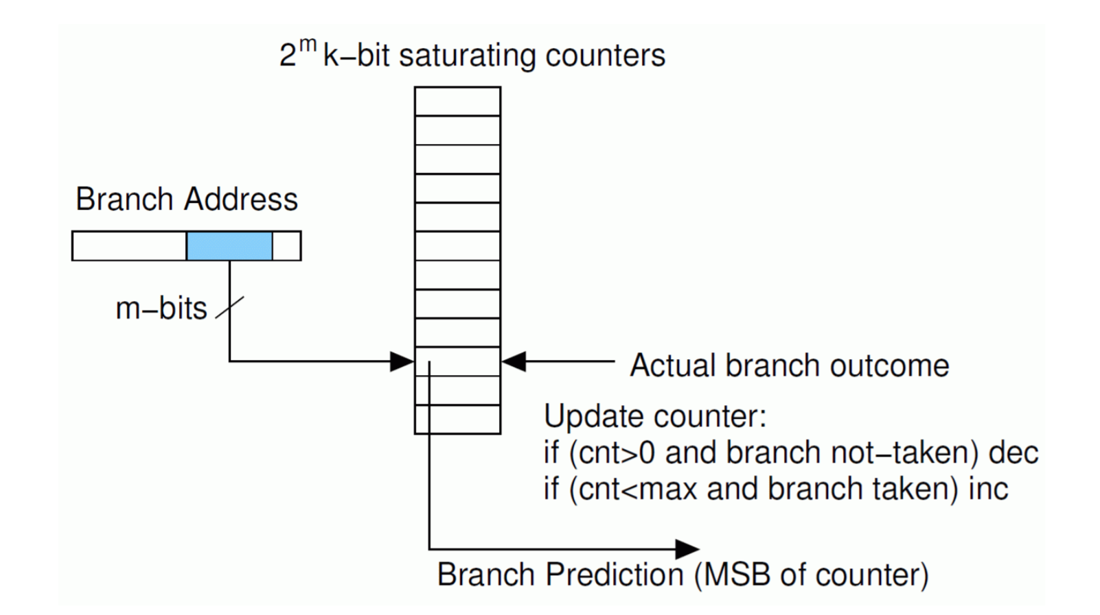
One-level Branch Predictors
In practice, 2-bit saturating counters are a good choice. Why is there no need to consider k>2.
Notes:
We can add hysteresis by changing our single-bit entries (memories) into 2-bit saturating counters.
00: predict not taken
01: predict not taken
10: predict taken
11: predict taken
Now when we exit our loop, the counter will be decremented from “11” to “10,” but we will still make a “branch taken” prediction the next time we encounter the branch (i.e., when the loop is next executed) – as we hope to do.
These one-level predictors (i.e., with 1-bit or 2-bit entries) are also called bimodal predictors.

Slide 20
Correlating Predictors
How can we improve on simple bimodal predictors?
We can take advantage of the fact that the outcome of many branches is correlated either with the past outcomes of the same branch (the local history) or with other recent branches (the global history).
Now instead of simply hashing the PC to select a counter, we can include local or global branch history to improve our prediction.

Slide 21
Correlating Predictors (Local History)
If a particular branch’s outcome has a repetitive pattern, its local history can be used to improve prediction accuracy.
E.g., a particular branch instruction may be predictable if we look at its local history:
….010110101101011010110101101011
History Next
0101 1
1011 0
0110 1
…
Notes:
Now we could expand our 2-bit single-level predictor with a unique 2-bit counter for each local branch history.
This isn’t very flexible though, and we probably want to exploit the fact that many branches will share the same local histories and predictions to make better use of a limited number of counters.

Slide 22
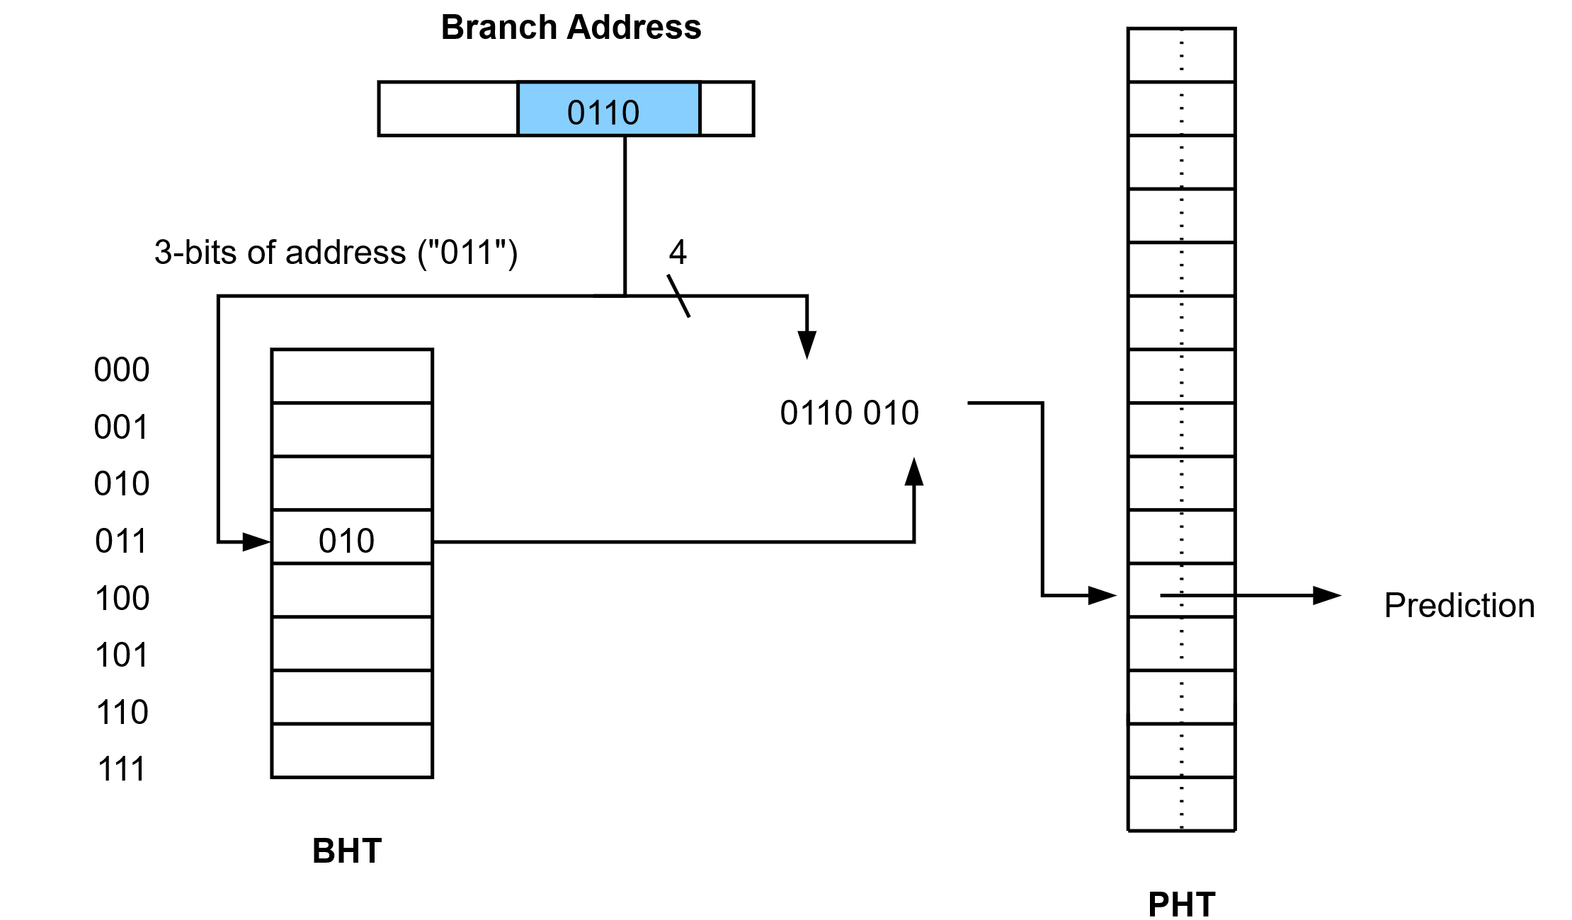
Local-history Two-level Predictor
We now have two memories or tables:
The Branch History Table (BHT)
The Pattern History Table (PHT)
Notes:
In practice, there are various design parameters, such as the size of the BHT and PHT and how the BHT output is combined with bits from the branch address. When designing a real branch predictor, we would evaluate many different options to see which works best. Overall, the total area (or power consumption) of the branch predictor will be limited. It is always important when performing this sort of design space exploration to remember to compare designs of equal cost.
Some schemes index the PHT directly with only the output of the BHT.
E.g., The Alpha 21264 processor (from 1996)
It’s local history predictor used 10-bits of the PC to index a local history table (1024 entries each holding a 10-bit history of the selected branch’s last 10 executions). These 10-bits are then used to index a 1K-entry table of 3-bit saturating counters.
Reference: “The Alpha 21264 Microprocessor,” Kessler, IEEE Micro, 19(2), Mar/Apr 1999.
https://ieeexplore.ieee.org/document/755465

Slide 23
Exploiting Global Branch History
In addition to exploiting the local history of a particular branch, we can also note that the behavior of a branch is often correlated with the behavior of other recent branches (the global history):
If (cond1) { .... }
If (cond2) { .... }
If (cond1 && cond2) { .... } // dependent on outcome of
// previous branches

Slide 24
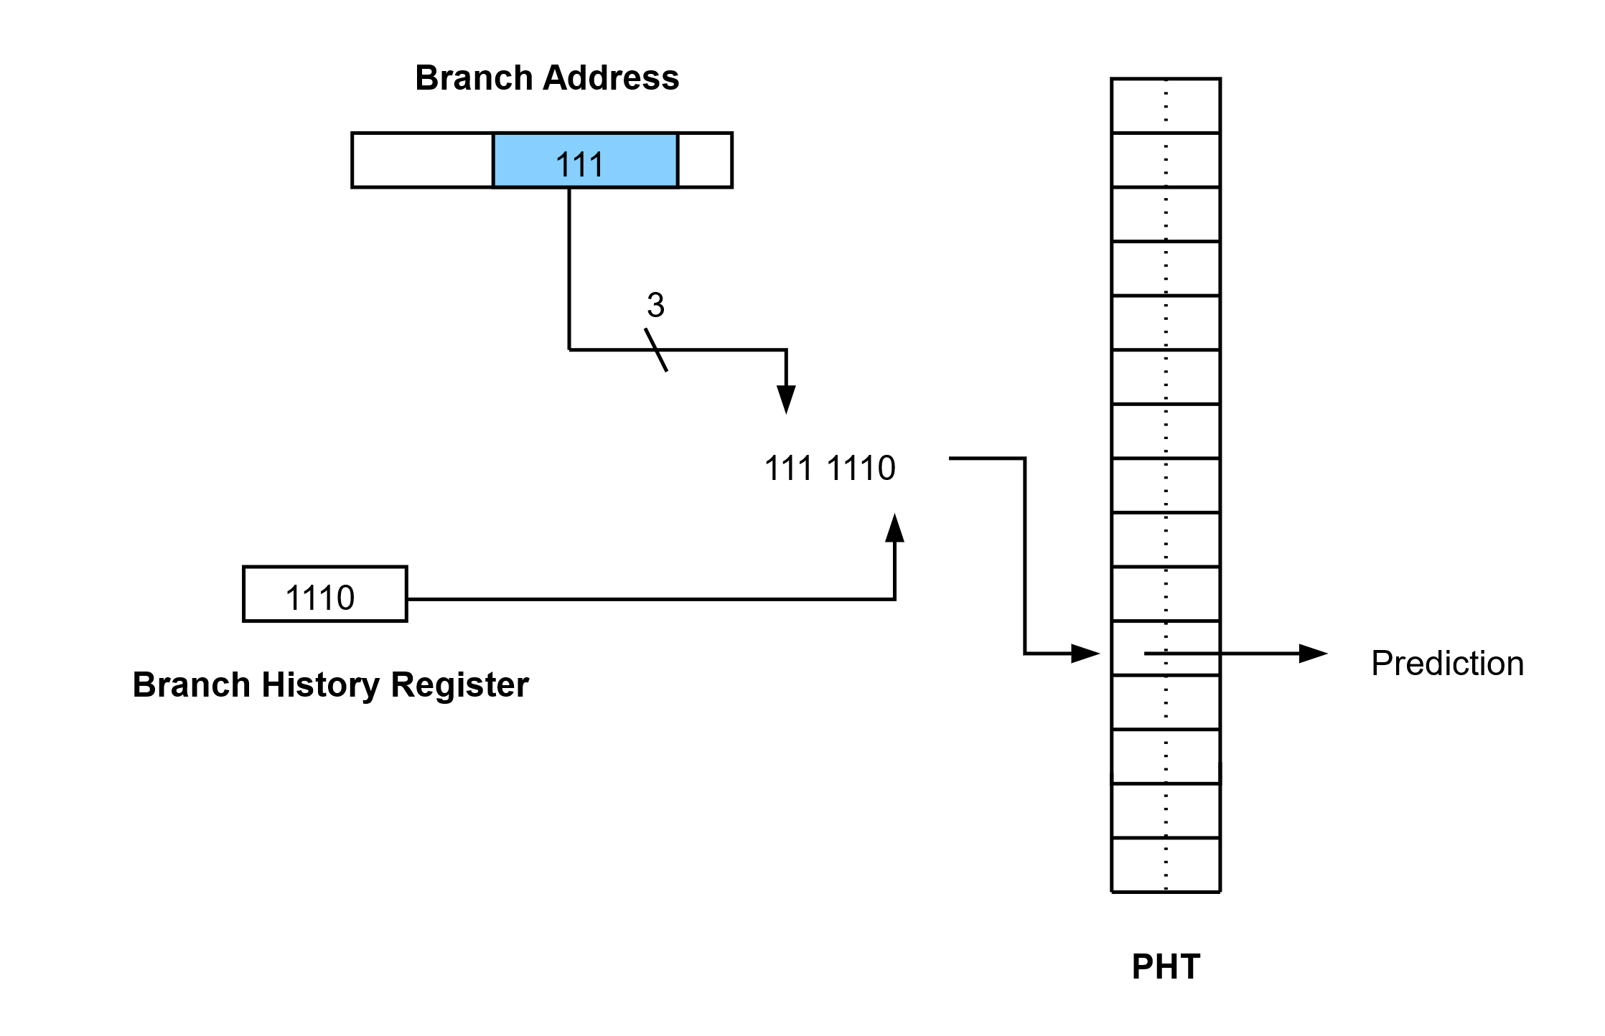
Global History Two-level Predictor
Notes:
The entry in the PHT that is accessed is dependent on both value of the PC and the recent (global) history of branches.

Slide 25
Optimizations
Tournament Predictors
More advanced schemes employ both local and global history predictors
These so-called “tournament predictors” also employ a third predictor (another table of 2-bit counters) to select which predictor’s output (local or global) to use.
Aliasing problems
Performance may be limited by negative interference, i.e., when two branches map to same entry in PHT but are biased in opposite directions. Numerous schemes try to deal with this, e.g., by using multiple PHTs or using a small tagged “cache” to hold branches that experience interference.
Notes:
Addressing limitations due to aliasing
Agree predictor (“The Agree Predictor: A Mechanism for Reducing Negative Branch History Interference,” Sprangle et al., ISCA 1997) – simple scheme, here we store the natural bias of the branch in the BTB (see later). Now instead of the PHT predicting branch taken or not-taken, it predicts where the branch agrees with the “bias” bit or not (i.e., goes in the common direction for that branch). The bias bit can be set to the direction the branch goes the first time it is executed.
See also Gshare, Gskew predictor, bi-mode predictor (see Cortex A15 example later), YAGS predictor, etc.

Slide 26
Limits to Dynamic Branch Prediction
Some branches are unpredictable (dependent on input data).
Need to “train” predictor for some period before predictions are accurate
Predictor accuracy will be limited by the area (cost), cycle time, or power of the hardware.
Aliasing and interference

Slide 27
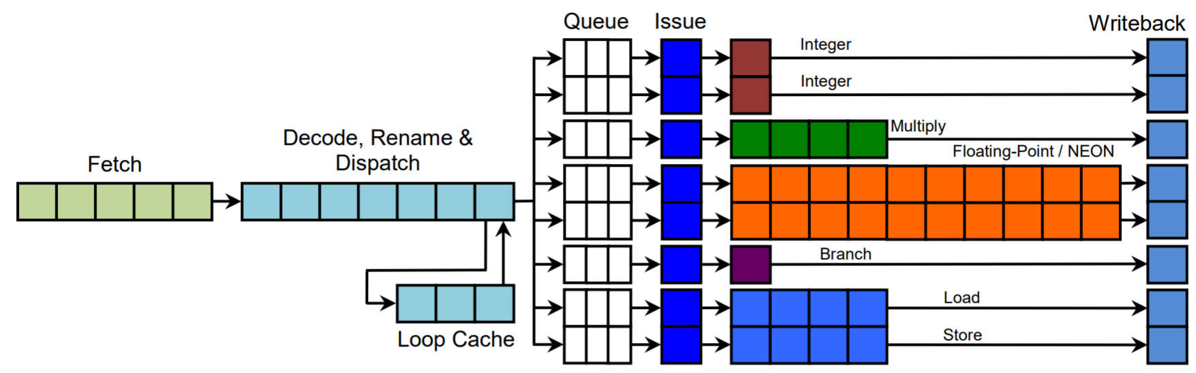
Example: Arm Cortex-A15
Arm Cortex-A15 pipeline
Notes:
The Arm Cortex-A15 has a 15-stage pipeline. Branches are evaluated late in the pipeline (see highlighted unit).
This processor also fetches up to 4 instructions per cycle, decodes up to 3, and issues to 8 different execution pipelines.
The branch mispredict penalty is ~14 cycles so many instructions many need to flushed in the case of a mispredicted branch (>40).

Slide 28
Example: Arm Cortex-A15
The Cortex A-15 uses a “bi-mode” predictor, an extension of the global history two-level predictor to reduce limitations due to destructive aliasing.
There are now two PHTs, each with 8192 entries and an additional “choice” predictor to choose between the two PHTs.
Overall, the branch predictor is relatively large and consumes ~15% of the core’s power.
Notes:
A bi-mode predictor is a global-history two-level predictor with the following modifications:
The second-level table (PHT) is split into two arrays, called the “direction predictors” or taken and not-taken arrays. Direction predictors are indexed by the XOR of bits from the global history and PC. A choice predictor (a simple 2-bit counter indexed by PC bits only, ~80%+ accuracy) chooses which direction predictor to use. The choice predictor helps to separate destructive aliases into different direction predictors to improve overall prediction accuracy.

Slide 29
Branching Without Stalls
What do we need to know to completely avoid stalling on a branch?
Need to know the instruction we are “currently” fetching is a branch (remember, it hasn’t returned from memory yet, so how can we know?)
We need to predict the branch taken or not-taken.
If the branch is predicted as taken, we will need to know the branch’s target address.
To provide the information to solve issues 1 and 3, we store recent branches together with their target addresses in a Branch Target Buffer (BTB).

Slide 30
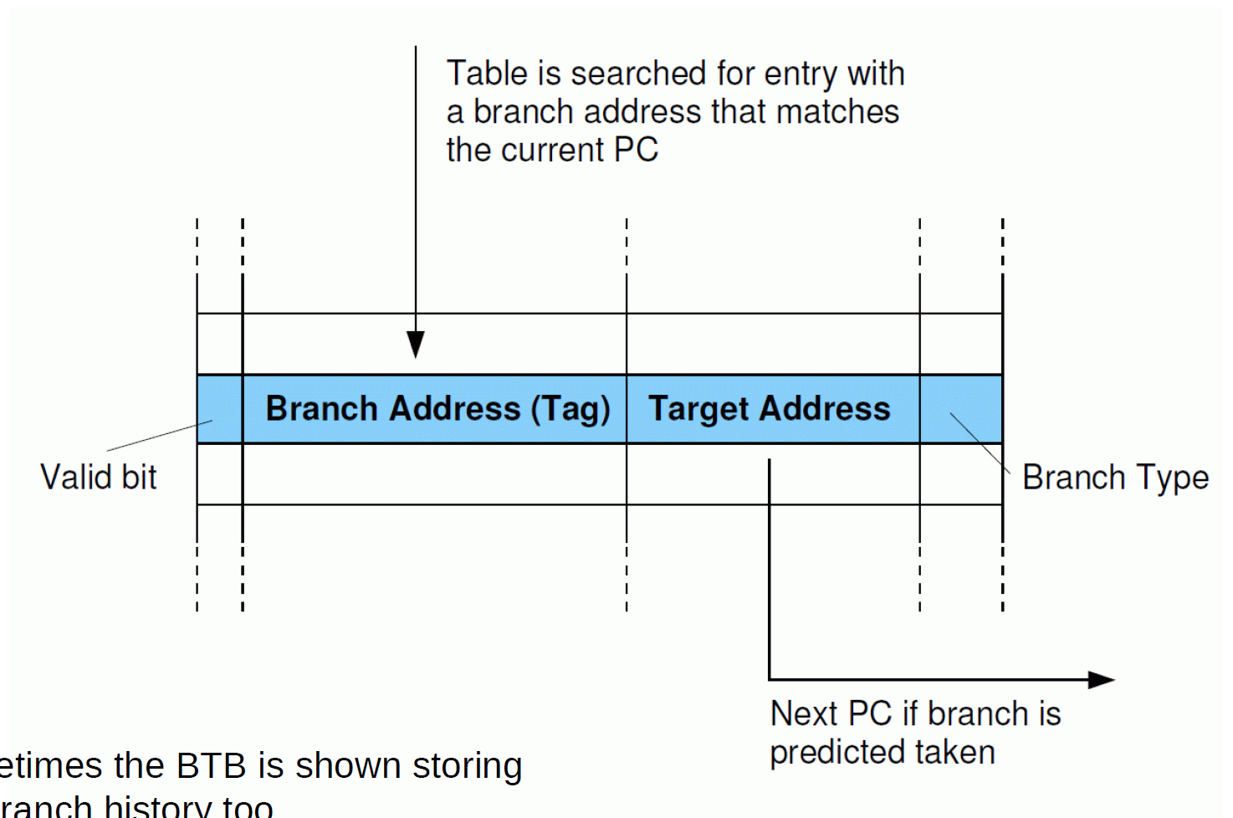
The Branch Target Buffer (BTB)
Notes:
A simple BTB where each entry stores the branch address and the target address.
The current PC value is used to index into the buffer. If the BTB is fully-associative we compare the PC to all branch addresses stored in every entry. Alternatively, the BTB may be set-associative or direct-mapped (see Module 7 Caches, for more information).
Predicting the target addresses of indirect branches
e.g. BR <Xn>, an unconditional branch to the address specified in Xn
In the case of indirect branches, we may have to repeatedly update the BTB entry for a particular branch as the target address may change each time the branch is encountered. We may decide to add a counter and only update the BTB entry after two consecutive mispredictions. This provides better prediction accuracy if indirect branches favour one common target, which is often the case. Even with this scheme a simple BTB will predict the target addresses of indirect branches poorly.
One technique to achieve better target address accuracy in such cases is to employ a two-level predictor. Now a table of target addresses will be indexed by both the branch address and some additional history bits (or history pattern). This history may consist of parts of the target addresses of recently executed branches. In this way, we can associate multiple target addresses with a single indirect branch and improve the accuracy of our target address prediction. We may use two different BTB-like structures to hold the targets address of direct and indirect branches. In the case of indirect branches this is sometimes called the “indirect predictor”.

Slide 31
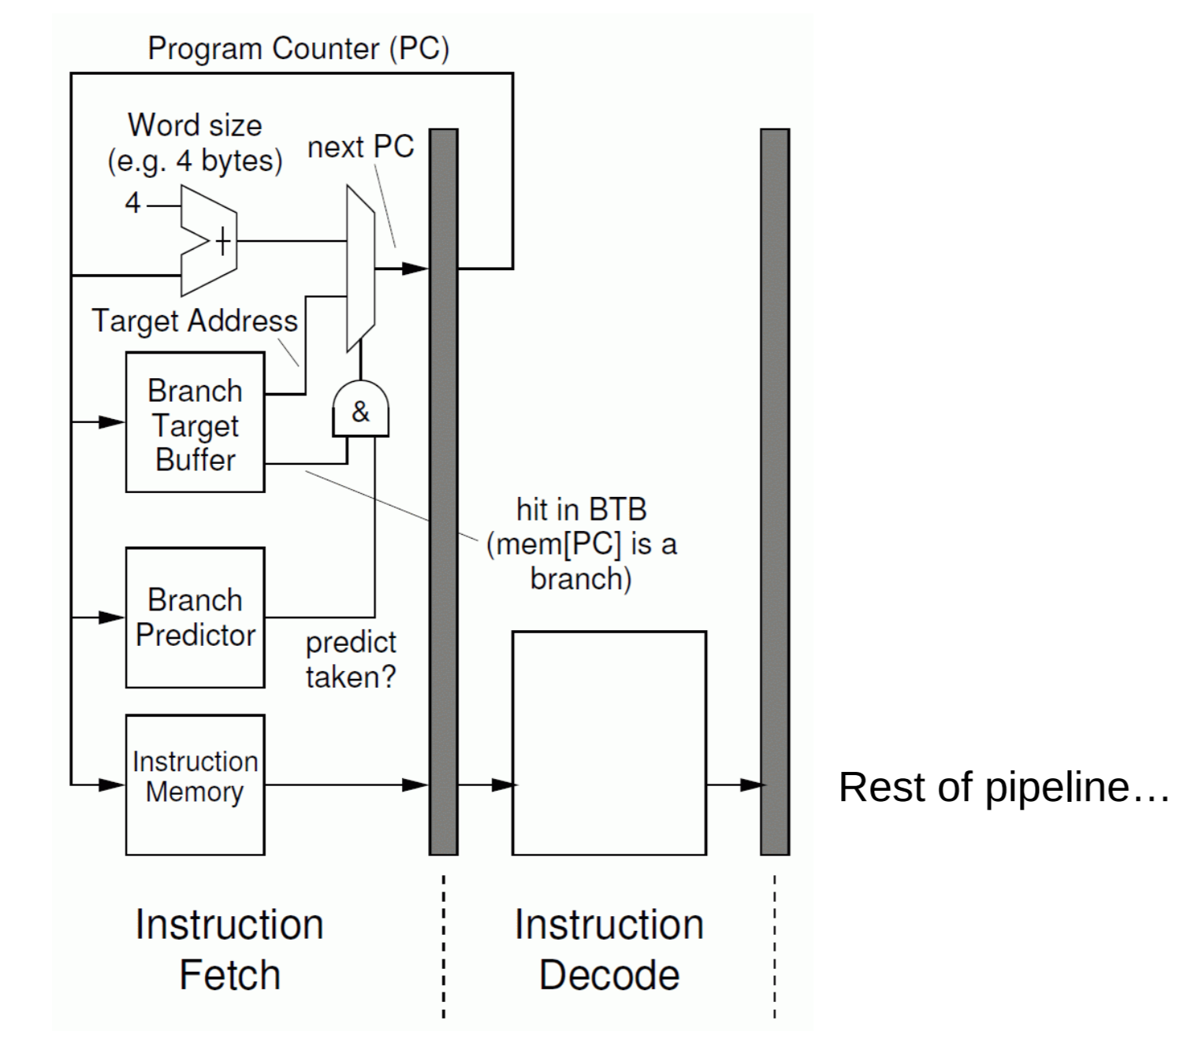
Putting It All Together

Slide 32
Other BTB Tricks: Branch Folding
In addition to storing the branch target address, we could store the target instruction in the BTB.
No need to fetch the next instruction; CPI for branch is effectively zero now.
Could also allow us to take longer to access (a larger) BTB
The branch has now been removed from the instruction stream that is presented to the execution pipeline – instead, the branch is substituted for the branch target instruction
We may also create a separate structure to cache instructions at the branch target (i.e. the Branch Target Instruction Cache or BTIC)
Notes:
High-performance processors may contain two-level BTBs, i.e. a small “Level 1” L1-BTB and a larger (slower to access Level-2 or “main” BTB).
The Cortex-A77 has a 64-entry L1-BTB and a main BTB with 8K entries.

Slide 33
Return Address Predictors
Functions may be called from multiple places in the program.
The accuracy of the branch target (return address) stored in the BTB may be very low.
Solution: use a small hardware stack to store these addresses (the return-address stack).
What if this stack overflows?
Notes:
Doesn’t matter if we overflow, just a prediction, we can easily deal with mispredicted return addresses

Slide 34
Exceptions

Slide 35
Exceptions
In some situations, we are required to interrupt a program’s execution and take some action. These conditions or system events are called exceptions. The necessary action is taken by privileged software, i.e., the exception handler.
Exceptions may occur for many different reasons, e.g.,
A page fault, breakpoint, I/O device request, floating-point errors, memory protection violation, etc.

Slide 36
Exceptions
Types of exceptions (for Arm):
Interrupts
Aborts
Reset
Exception generating instructions
Notes:
Interrupts
IRQ (normal priority interrupt) and FIQ (fast interrupt). These are associated with events generated by external hardware. FIQ and IRQ are physical signals connected to the processor core. FIQ has higher priority than IRQ
Aborts can be generated either on failed instruction fetches (instruction aborts) or failed data accesses (Data Aborts). They can come from the external memory system giving an error response on a memory access
E.g., a page fault or memory protection violation
Reset
All cores have a reset input and take the reset exception immediately after they have been reset. It is the highest priority exception and cannot be masked.
Exception generating instructions
Execution of certain instructions can generate exceptions. Such instructions are typically executed to request a service from software that runs at a higher privilege level, e.g., supervisor, hypervisor, or secure monitor call instructions (SVC, HVC, SMC).

Slide 37
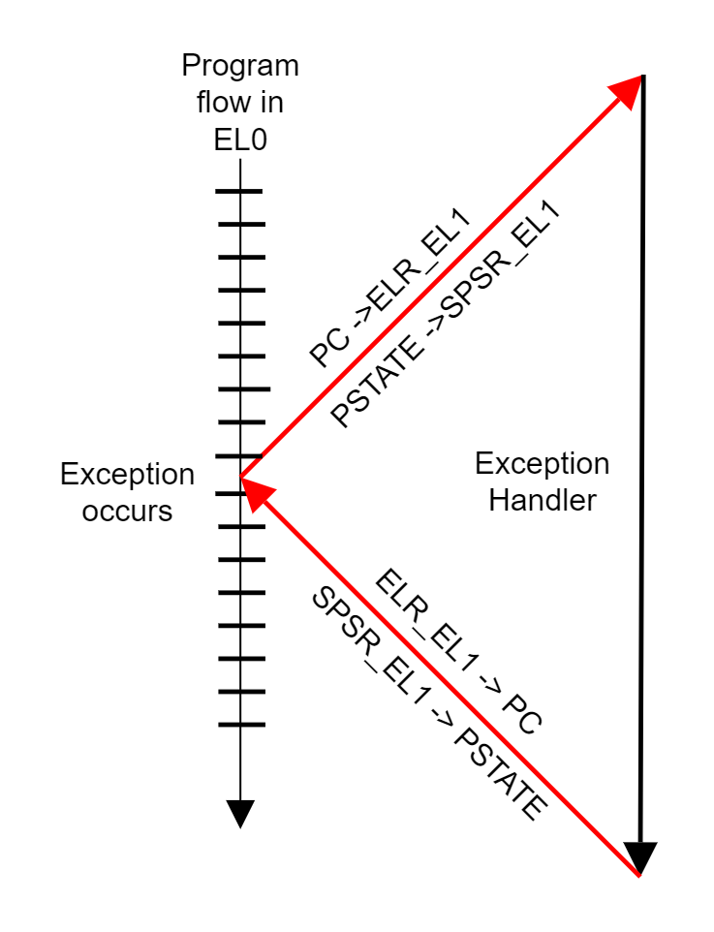
Exceptions
An exception will cause the processor to perform the following:
Save the Processor State (PSTATE), e.g., processor flags, interrupt mask bits, exception level, etc.
Save the return address (current PC).
Branch to handler specified in vector table
Save registers, execute handler code, restore registers.
Return from exception (ERET instruction).
Notes:
Diagram source: https://developer.arm.com/docs/den0024/latest/aarch64-exception-handling/exception-handling-registers

Slide 38
Exceptions
The intention is to temporarily interrupt program execution, deal with the exception, and then to resume execution.
A good way to ensure we can easily resume is to ensure that the architectural state is consistent with the sequential model of program execution before the exception is taken, i.e., if the instruction that causes the exception is instruction E:
All instructions prior to E should have completed and updated their destination registers. All exceptions caused by these instructions should have been handled.
Any instructions after E in program order should not have completed and not have modified any processor state.
Whether E should complete or not will depend on the exception.
These are called “precise exceptions.”
Notes:
Point (3):
If E is a floating-point operation, we will let the instruction write its result to the register file before taking the exception. For a page-fault, we need to handle the exception and then re-execute the memory operation.
Interesting early reference:
“Implementation of Precise Interrupts in Pipelined Processors,” J. E. Smith and A. R. Pleszkun
Proc. Computer Architecture, 1995.
https://lagunita.stanford.edu/c4x/Engineering/CS316/asset/smith.precise_exceptions.pdf

Slide 39
Precise Exceptions and Pipelining
The requirements on the previous slide are trivial in the case of an unpipelined processor, but more complex for a pipelined processor.
V, U, T, S, R, Q, P, O, N, M, L, K, J, I, ….
V, U, T, S, R, Q, P, O, N, M, L, K, J, I, ….
Unpipelined
Pipelined
Notes:
Why does pipelining make implementing precise exceptions more complex?
In an unpipelined processor, we know all previous instructions have completed and no instruction other than the currently executing instruction has started to execute. This makes implementing precise exceptions simple.
For a pipelined processor, things are more complex for two reasons:
There may be partially executed instructions after the instruction that raised the exception (“O” in this example) and instructions before “O” that haven’t yet finished.
Exceptions may occur in different pipeline stages. This leads to the possibility that exceptions may not necessarily occur in program order – but we do need to take exceptions in program order.
This issue will be even more significant when we explore architectures that actually execute instructions out-of-order (see Module 5)

Slide 40
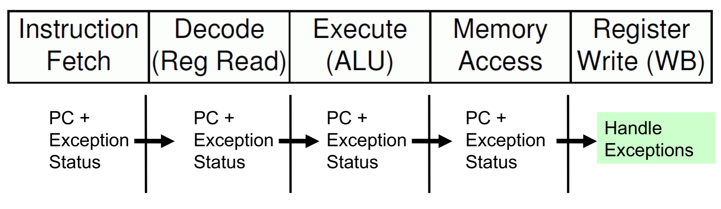
Precise Exceptions
Notes:
To ensure we take exceptions in program order, we note the PC of each instruction and its exception status (i.e., does it need to generate an exception or not). This information is appended to each instruction and carried with it as it progresses down the pipeline. An instruction’s exception status is only examined, and an exception taken, if necessary, when the instruction reaches the Writeback stage. This ensures exceptions are handled in program order (even though they may actually occur in a different order due to pipelining). We can simply flush the pipeline when we take an exception to ensure no later instructions complete (i.e., change the state of the processor).

Slide 41
The Limits of Pipelining

Slide 42
Limits to Pipelining
As we saw in the last module, a deeper pipeline doesn’t necessarily lead to better performance.
We need to work hard to feed the pipeline with instructions and data and to minimize pipeline stalls.
If we pipeline our execute stage, we will also need to find successive independent instructions to keep our pipeline from stalling.
Notes:
Point 2: Minimizing pipeline stalls increases costs (i.e., area, power, and complexity), e.g., we need to add more bypass paths, complex branch predictors, larger caches, etc. Of course, complex/large components will themselves need to be pipelined also limiting gains.
Point 3: Even with the help of data-forwarding, data-dependent instructions can’t execute in a pipelined fashion within a single ALU. More on this in the next module

Slide 43
Limits to Pipelining
Pipelining is also ultimately limited by lower-level concerns:
Register and clocking overheads are non-zero. If we have very little logic per pipeline stage, these may represent a significant fraction of our critical path delay.
Need to balance logic between pipeline stages. Clock period is determined by worst-case delay.
Limits on number of pipelining registers
Notes:
Register and clocking overheads are non-zero. If we have very little logic per pipeline stage, these may represent a significant fraction of our critical path delay.
Distributing very high-frequency clocks with a low skew is also complex and requires more power.
Our clock period is determined by the worst-case delay between two registers, so there is a need to balance logic between pipeline stages (we don’t want many stages with almost no logic either)
Pipelining registers are relatively narrow in shallow pipelines. Deeper pipelines may require many more registers as we need to pipeline at less natural points in the datapath.

Slide 44
Limits to Pipelining
Ultimately, we will be unable to increase the performance of a processor that only attempts to issue a single instruction per clock cycle.
Even before this point is reached, it is preferable to use multiple-issue techniques, i.e., do more work in each pipeline stage: fetch and execute multiple instructions per clock cycle.
Details in the next module

