Slide 1
Memory
Module 6

Slide 2
Module Syllabus
Types of memory
Memory hierarchy
Static RAM (SRAM)
Dynamic RAM (DRAM)
Memory management
Translation lookaside buffers (TLBs)
Direct memory access (DMA)
Notes:
In this module, we’re going to look at the different types of memory available in computer systems, focusing primarily on volatile memories, since these are found closest to the cores in the form of SRAM (used for caches) and DRAM (used for main memory). We’ll then consider how main memory is managed by the OS and hardware support for it. Finally, we’ll look at direct memory access, or DMA, which is a technique to avoid using the core in transferring data between a peripheral and main memory (in either direction).

Slide 3
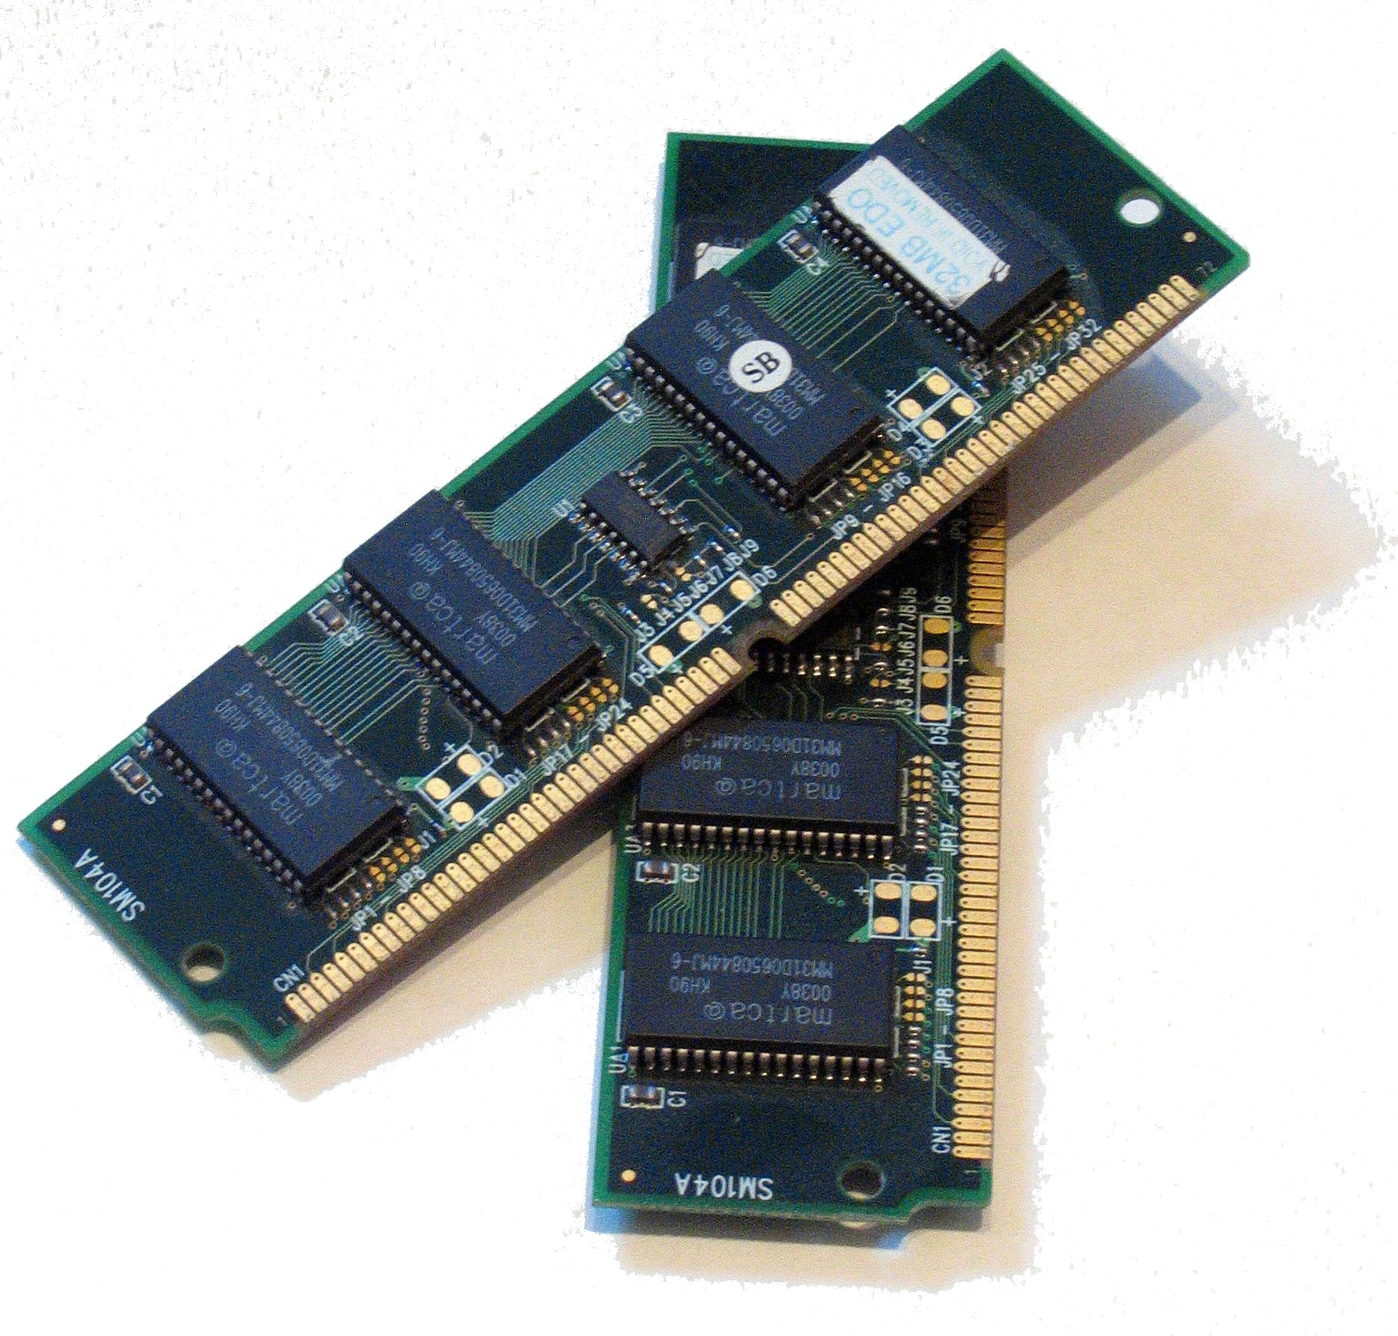

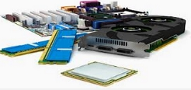
Motivation
When a processor runs an application, it needs access to its instructions and data.
These have to be placed in physical storage locations for the processor to easily access.
Instructions and data for one program also need isolating from other programs.
Understanding their designs gives insight into their trade-offs.
Understanding how they are used gives insight into how hardware can help.
Pair of DRAM modules¹
DRAM²
Computer parts³
By Douglas Whitaker at English Wikipedia, CC BY-SA 2.5
By Petr Kratochvil, CC BY-0
By Clipartwiki.com
Notes:
So far throughout this course, we’ve looked at computer architecture from the processor’s point of view, assuming that memory is some abstract concept that is somehow connected to our systems. However, in order to build full systems and to make them fast, energy efficient, reliable, and secure, we need to understand the different types of memory and how they can be used to improve the system.
The fundamental job of memory is as a store for the instructions that execute on the processor and the data that it operates on. The processor needs fast access to these so that it can execute applications as quickly as it was designed to do. If access to instructions or data is slow, there is no point designing a high-performance processor with the advanced ILP extraction techniques seen in previous modules because they simply won’t be effective; memory access will be the limiting factor.
When thinking about providing access to a program’s instructions and data, we need to consider that the application, in most cases, will not have sole access to the processor. There is usually an operating system to arbitrate between programs wanting to run on the processor to ensure a fair amount of time is given to each. The operating system provides isolation between different processes that it manages; we can provide hardware to help with this and ensure that we don’t inadvertently create systems where this is impossible to achieve.
Since the majority of systems are von Neumann architectures (meaning that the memory contains both instructions and data), in future slides, unless explicitly stated, data refer to both instructions and data.

Slide 4
Volatile vs Non-volatile Memory
Volatile memory
Requires power to retain the data information
Usually, faster access speed and less costly
Used for temporary data storage, such as CPU cache, internal memory
Also known as Random Access Memory (RAM)
Non-volatile memory
No power is required to retain the data information
Usually, slower access speed and more costly
Used for secondary storage, or long-term persistent storage
Notes:
Types of memory can essentially be broken down into two categories: volatile and non-volatile. In the former, data are lost once power has been removed, but they tend to have faster access times and are relatively cheap. These are therefore used for temporary data storage close to the processor. The latter, which are slower and more expensive, are usually used to provide persistent storage for data.

Slide 5
Types of Memory
Memory
Volatile memory
Static RAM (SRAM)
Dynamic RAM (DRAM)
Non-volatile Memory
Read Only Memory (ROM)
Erasable Programmable ROM (EPROM)
Electrically Erasable Programmable ROM (EEPROM)
Mechanical Storage
Hard Drive
Random-Access
Magnetic Tape
Optical Disc
Flash Memory
New Technologies, e.g. PCM, ReRAM, STT-MRAM
Volatile memory
Static RAM (SRAM)
Dynamic RAM (DRAM)
Non-volatile memory
Read only memory (ROM)
Erasable programmable ROM (EPROM)
Electrically erasable programmable ROM (EEPROM)
Non-volatile random-access memory (NVRAM)
Flash memory
Mechanical storage
Hard drive, magnetic tape
Notes:
A detailed list of different types of memory blocks are listed here.
Volatile memory include: Static RAM (SRAM) and Dynamic RAM (DRAM), which will be discussed in more detail later on.
“Non-volatile data storage can be categorized in electrically addressed systems (read-only memory), mechanically addressed systems (hard disks, optical disk, magnetic tape, holographic memory, and such), and newer random-access systems. Electrically addressed systems are expensive, but fast, whereas mechanically addressed systems have a low price per bit, but are slow.”
From: http://www.bioscience.ws/encyclopedia/?title=Non-volatile_memory
In former times, ROM was manufactured with the desired information inside, which cannot be later changed. Later types of ROM allowed data to be reprogramed but with a degree of effort. Examples include Erasable Programmable ROM (EPROM) and Electrically Erasable Programmable ROM (EEPROM).
“The flash memory chip is a close relative to the EEPROM; it differs in that it can only erase one block or "page" at a time. In addition, its capacity is substantially larger than that of an EEPROM, making these chips a popular choice for digital cameras and desktop PC BIOS chips.”
From: http://www.bioscience.ws/encyclopedia/?title=Non-volatile_memory
There are also new emerging memory types including Ferroelectric RAM (F-RAM) and Magnetoresistive RAM (M-RAM), which have very promising properties such as non-volatility, infinite endurance, high-speed reading/writing, and low cost.

Slide 6
Memory Hierarchy
Memory Types
Functional/Organizational View
Register
Caches (Multilevel)
Main Memory
Secondary Memory
Tertiary Memory
Register: usually one CPU cycle to access
Cache: CPU cache, translation lookaside buffer (TLB)
SRAM
Main memory
DRAM
Secondary memory: hard disk, solid-state drive
Tertiary memory: tape libraries, cloud
Larger Size
Lower Cost
Lower Speed
Notes:
Memory systems are organized as a hierarchy of storage units with increasing capacities, costs, and access times. At the top, frequently used data (but not instructions) reside in CPU registers. Depending on the ISA, there may be a few tens of registers for each data type. Going down, there are usually several levels of cache memory, which stores larger amounts of data and instructions. Caches are usually implemented as SRAM, although SRAM is also used to implement other memory structures within the processor. A level 1 cache may be 32 Kb or 64 Kb in size, whereas a level 3 cache can contain several megabytes of data. Main memory, often implemented in DRAM, holds gigabytes of data. Secondary memory and tertiary memory consist of solid-state drives, hard disks, floppy disks, tapes, and high-capacity sequential storage devices.

Slide 7
Volatile Memory
Although the system contains many types of memory, we’ll focus on volatile memory.
SRAM, for caches
DRAM, for main memory
These are the types of memory most commonly found in microprocessors.
And since they are close to the CPU, their interactions most commonly need to be considered by microarchitects.
Notes:
All the different memory technologies are interesting, but for this course, we’ll focus only on volatile memory, SRAM and DRAM. These are the types most commonly found in or near microprocessors, and therefore whose operation is critical for performance. Typical uses for these types of memory are caches for SRAM (see the next module) and main memory for DRAM.
RAM stands for random-access memory. It means that data can be accessed (read or written) in any order without significant penalty; compare this to a hard drive or CD, where data are accessed sequentially, and to move to a totally different part of the medium incurs a significant time penalty.

Slide 8
Memory Technology Basics
SRAM vs DRAM
SRAM – Static Random Access Memory
DRAM – Dynamic Random Access Memory
Static – holds data as long as power is maintained
Requires multiple transistors to retain one bit and has low density compared to DRAM, thus more expensive
Faster than DRAM
Used for caches (next module)
Dynamic – must be refreshed periodically to hold data
Requires only one transistor (and one capacitor) to retain one bit of data
High density, thus cheaper than SRAM
Used for main memory and sometimes for larger caches
Notes:
Although both types of memory are volatile, they have quite different characteristics. We’ll see why that is in the next few slides. For now, here’s a comparison between them.
SRAM will hold its data as long as power is connected to it. DRAM, in contrast, slowly loses the charge that it stores (that represents the data) meaning that it needs to be refreshed every so often; otherwise, the data will be lost. Hence, the word ”dynamic,” which refers to this periodic refreshing of reading out the data and writing it back again.
However, a DRAM cell is much smaller than an SRAM cell, needing only one transistor and one capacitor to store a bit of data, compared to SRAM’s typical six-transistor (6T) design (although others exist using fewer or more transistors). Because of this, DRAM is much more dense, and DRAM chips are optimized for capacity rather than access speed. They are also cheaper than SRAM.

Slide 9
SRAM

Slide 10
SRAM cell
An SRAM cell is typically made up of six transistors (MOSFETs).
A single bit is stored on 4 transistors (M1-M4), which form two inverters that are cross-coupled.
Access to the bit is controlled by two access transistors (M5 and M6), which are gated by the word line (select).
Data are read in and out through the bit lines.
select
V_{DD}
M₅
M₂
M₄
M₆
M₁
M₃
bit
bit'
Notes:
This slide shows the structure of a typical SRAM cell, made up from six metal-oxide-semiconductor, field-effect transistors (MOSFETs). The data (one bit) in the cell are stored on four transistors (M1, M2, M3, M4) that form two cross-coupled inverters. This storage cell has two stable states that are used to denote 0 and 1. There are two additional access transistors (M5 and M6) – these transistors control the access to a storage cell during read and write operations.
In general, if there are fewer transistors needed per cell, then the smaller each cell can be.
Note that the cost of processing a silicon wafer is relatively fixed. Therefore, if smaller cells are used, then more bits are packed into the wafer, which reduces the cost per bit of memory.
Compared to a 6T or bigger cell SRAM, the principal drawbacks of using 4T SRAM are to do with its high static power and speed:
(1) High static power – this is due to the constant current flow through one of the pull-down transistors
(2) Speed - it is not as fast as, for example, a 6T cell with CMOS flip-flops.

Slide 11
Accessing SRAM
Read operation
The address is decoded and the desired cell is then selected, in which case the select line is set to one.
Depending on the value of the 4 transistors (M1-M4), one of the bit lines (bit or bit’) will be charged to 1 and the other will be drained to 0.
The states of the two bit lines are then read out as 1-bit data.
1
select
V_{DD}
M₅
M₂
M₄
M₆
M₁
2
2
M₃
bit
bit'
3
3
Notes:
To read data, the select line is enabled, which turns on M5 and M6. The data stored in the cell are written onto the bit lines (bit and its complement, bit’) through the inverters driving the bit lines. The states of the two bit lines are then read out as 1-bit data. Although it is not strictly necessary to have two bit lines, both the signal and its inverse are typically provided in order to improve the noise margin.

Slide 12
Accessing SRAM
Write operation
The two bit lines are pre-charged to the desired value (e.g., bit = VDD, bit’ = VSS).
The address is decoded and the desired cell is then selected, in which case the select line is set to one.
The 4 transistors (M1-M4) are then forced to flip their states (either charged or discharged) since the bit lines normally have much higher capacitance than the 4 transistors.
2
1
1
select
V_{DD}
M₅
M₂
M₄
M₆
M₁
3
3
M₃
bit
bit'
Notes:
To write data, the value is placed onto bit and its inverse onto bit’. Then, the select line is enabled that causes the value to be written into the cell.
“Because the bit line input-drivers are designed to be much stronger than the relatively weak transistors in the cell itself, they can easily override the previous state of the cross-coupled inverters. In practice, access NMOS transistors M5 and M6 have to be stronger than either bottom NMOS (M1, M3) or top PMOS (M2, M4) transistors. This is easily obtained as PMOS transistors are much weaker than NMOS when they are the same size. Consequently, when one transistor pair (e.g., M3 and M4) is only slightly overridden by the write process, the opposite transistor pair’s (M1 and M2) gate voltage is also changed. This means that M1 and M2 transistors can be easier overridden, and so on. Thus, cross-coupled inverters magnify the writing process.”
From: https://en.wikipedia.org/wiki/Static_random-access_memory

Slide 13
Accessing SRAM
The SRAM cells are organized into rows, with a whole row accessed at once.
For example, a memory architecture with an 8-bit address and 32-bit data is shown below.
The address decoder uses the address to select a single row, and all its data are read out.
One word
Address decoder
Address bus
.
.
Address [7:0]
.
.
.
.
.
Memory cells
.
.
Data in [31:0]
Bit line amplifier
Data out [31:0]
Notes:
To allow access to more than a single bit at a time, the SRAM cells are organized into rows, then multiple rows formed into columns, with the bit lines running vertically past each cell. The select line from the single cell diagram on the previous slides is joined with its neighbors’ to run horizontally along the row and is usually called a word line.
Data from a whole row can be accessed at once, so to do this, we need to select the word line corresponding to that row. This is achieved by giving each row a unique address. In the example above, we show a 1,024 byte memory with 32 bits (4 bytes) in each row (i.e., 32 columns). We therefore have a 256 rows in total and need 8 bits to represent each address (2⁸ = 256).
To read, the required 8-bit address is presented to the address decoder through the address bus. The decoder selects the corresponding word line. All cells in that row drive the bit lines whose values are detected and amplified by the bit line amplifier.

Slide 14
DRAM

Slide 15
DRAM
A DRAM cell is typically made up of three or even one transistor.
A single bit is stored in one capacitor.
Access to the bit is controlled by a single access transistor, which is gated by the word line (select).
As in SRAM, data are read in and out through the bit line.
select
bit
Notes:
A simple DRAM cell is made up from a single transistor and capacitor, where the status of the capacitor (charged or uncharged) indicates the bit state (1 or 0) and the transistor is used to select the cell.

Slide 16
DRAM
The status of the capacitor (charged or uncharged) indicates the bit state (1 or 0).
Access is similar to SRAM but.
The capacitor is drained on a read and charged (if storing 1) on a write.
The cell needs to be refreshed (or recharged) periodically since the capacitor leaks its charge.
For example, every 7.8 ms
DRAM is higher density than SRAM.
Therefore less expensive
DRAM can be categorized according to its synchronization and data rate.
Most DRAM is now synchronous (SDRAM), so it has a clock, rather than asynchronous.
Double data rate (DDR) DRAM transfers data on both the rising and falling clock edges.
Notes:
DRAM is dynamic RAM. Because "non-conducting transistors” will always leak a small current, this causes the capacitors to slowly discharge. When this happens, the data eventually disappear unless the capacitor charge is refreshed periodically. Due to this refresh requirement, it is a “dynamic” memory, as opposed to “static” memory (SRAM).
One of the main advantages of DRAM is its structural simplicity since typically only one transistor and one capacitor are required per bit. Compared to four or six transistors in SRAM, this allows DRAM to reach very high densities and comparatively smaller block sizes.
Most DRAM has a clock, meaning that access is synchronous, leading to the acronym SDRAM. In addition, the interface can use double pumping (transferring data on both the rising and falling edges of the clock signal) to lower the clock frequency and reduce signal integrity requirements. The term "double data rate" comes from the fact that a DDR SDRAM with a certain clock frequency achieves nearly twice the bandwidth of a single data rate (SDR) SDRAM running at the same clock frequency, due to this double pumping.
It’s important to note that DRAM process technologies differ from logic processes, so you rarely find the two on the same silicon die. This fundamentally comes down to the need for DRAM to be extremely low leakage, but the techniques necessary for this make any logic slow.

Slide 17
DRAM Organization
DRAM cells are organized into arrays.
A whole row is accessed at once.
But only one bit is read out of the row.
Multiple arrays are grouped into banks.
All arrays in a bank are accessed simultaneously.
A bank with N arrays provides N bits per access.
One array
Bank
Row decoder
Address bus
.
.
.
.
Address [7:3]
.
.
Sense amps
Data in [3:0]
Column decoder
Address [2:0]
Data out [3:0]
17
Notes:
DRAM cells, like SRAM, are organized into rows and columns. One set of rows and columns is called an array, and multiple arrays form a bank. On each access, each array provides one bit of data, and the whole bank provides as many bits as it has arrays.
When data are read, for example, the upper bits from the address are sent to the row decoder. All arrays in the bank are accessed, and the data from the corresponding row drive the bit lines in each array. The values are detected by the sense amps at the bottom of each array. However, the lower bits from the address are used as input to the column decoder, which selects a single bit (from the same column) from each array, which is sent out of the bank.
In the example shown, there are four arrays, so the bank provides 4-bit data. Each array has 32 rows (using 5 bits as an address to the row decoder) and 8 columns (using 3 bits to the address decoder). Therefore, each array stores 256 bits of data, and the whole bank stores 1,024 bits.

Slide 18
DRAM Organization
DRAM banks are grouped into devices.
Each device bank operates independently.
This allows multiple accesses to occur concurrently.
Devices may be grouped into ranks.
All devices in a rank are accessed together.
This provides bandwidth.
Rank
Rank
Device
Device
Bank
Bank
Bank
Bank
Rank
Rank
Notes:
DRAM has a hierarchical organization that alternates between components at the different levels operating independently or together. As we saw in the previous slide, cells are organized into arrays, and multiple arrays form a bank. All arrays are accessed together. Banks are grouped into devices, with each bank capable of being accessed independently of the others. Devices are then grouped into ranks, with all devices in a rank accessed together.
Having components operating independently means that multiple accesses can occur concurrently (i.e., to different addresses). Components operating together provide the bandwidth necessary to access all bits from the requested address.

Slide 19
Techniques for Improving DRAM Performance
Row buffer
Double data rate
DRAM banking
To buffer recently accessed data without having to make another access
Read and refresh several words and in parallel.
The row buffer is essentially the sense amps at the bottom of each array.
Transfer data on the rising and falling clock edges to double the bandwidth.
Increase the number of parallel banks to improve bandwidth with simultaneous accesses.

Slide 20
Memory Management

Slide 21
Motivation – Why Manage Memory?
Applications’ instructions and data are stored in main memory.
And cached when required (see the next module)
While this is fine for a single application, it poses a security risk with multiple programs.
An untrusted program could read sensitive data.
Or corrupt the state of another application, including taking control of it
We provide an operating system to prevent this happening.
What hardware support can we provide to improve the performance of the OS?
Notes:
One of the principal responsibilities of the operating system is to provide isolation between processes so that one application cannot interfere with another or read its data. It can do this by providing a virtual address space to each application and mapping this down to the physical address space that identifies the actual locations in main memory where data are stored. This translation from virtual address to physical address has to occur on every memory access, so can be costly. However, we can provide hardware to help, with no performance impact in the common case.
Note, we’ll use the terms “application” and “process” interchangeably within this module.

Slide 22
Paging
The OS forbids direct access to memory.
Instead, it introduces a layer of indirection.
Applications see memory as a range of virtual addresses.
The OS maps these to physical addresses.
Paging is one method to achieve this.
Physical memory is split into fixed-sized frames.
Virtual memory is split into same-sized pages.
Each page is mapped to one frame.
Using the high-order bits from the address
This information is kept in the page table.
Frame 0
Page 0
Frame 1
3
Frame 2
Page 1
5
Page 2
1
Frame 3
7
Page 3
Frame 4
Frame 5
Frame 6
Frame 7
Virtual
address space
Page table
Physical
address space
Notes:
The operating system presents a virtual address space to each of its applications. This means, for example, that each application sees the addresses 0x0 to 0xFFFFFFFF as belonging to it alone (for a 32-bit address space). Each virtual address corresponds to a physical address in the main memory, which is where the data are actually stored.
One common method to achieve this is paging. The virtual address space is split into fixed-sized chunks, called pages, often of 4KiB in size. Physical memory is also split into equally sized chunks called frames. A page table provides the mapping from virtual page to physical frame. So all addresses in page 0 look into the page table at entry 0 to find the frame number that they correspond to. There is one page table for every process.
To translate an address, the high-order bits of the address (e.g., the top 20 bits with a 32-bit address space and 4KiB pages) are used to index into the page table. This provides the frame number in the main memory to access, which is then joined with the low-order bits (e.g., the remaining 12 bits) and presented to memory to provide the required data. These low-order bits represent the offset into the frame where the required data can be found.
The benefits of paging are that its provides isolation between processes, the impression that each application has access to the whole of memory and the ability to support virtual memory (using a secondary storage device, such as hard disk, as an extended main memory).

Slide 23
Page Address Translation
The CPU works on virtual addresses.
To access physical memory, the virtual address has to be converted to a physical address by indexing into the page table.
However, this makes the page table extremely large.
CPU
Memory
Page table
Page number
Offset
.
Frame number
Offset
Virtual address
.
Physical address
.
Notes:
As explained on the previous slide, the high-order bits of the virtual address index into the page table to obtain the frame number, which, combined with the low-order bits from the virtual address, give the physical address. However, this requires a very large page table (2²⁰ entries for a 32-bit address space and 4KiB pages), so operating systems instead implement multi-level page tables. In addition, multi-level page tables allow some translations to be shared across processes whilst others aren’t.

Slide 24
Multi-level Page Tables
To prevent the need for a large page table, we can create a tree of page tables.
Paging the page table
First-level entries point to second-level tables.
Second-level entries point to third-level tables, etc.
Final-level entries point to memory frames.
To access a frame, we must walk through the page tables using the virtual address.
This is extremely costly.
Can we provide hardware to help?
Level 1 page table
Level 2 page table
Physical memory
Base
.
.
.
Index 0
Index 1
Offset
Page number
Virtual address
Notes:
This example shows a two-level page table, but there can be many more levels. Whilst the virtual address is split into the page number and offset as before, the page number is then further split into indices into the different levels of page table. The first index is combined with the value in the page table base register (which contains the address of the level 1 page table) to find the correct entry. This gives the base of the level 2 page table. Index 1 is then used to index into this page table, and so on. Finally, the last-level page table contains physical frame addresses for the program’s data.
However, this makes accessing memory extremely costly. Each memory access is turned into three, in the example above (accessing the level 1 page table, accessing the level 2 page table, and accessing the data in memory). More generally, this is 1 + number_of_page_tables and is known as a page-table walk. To alleviate these costs, we can provide hardware to perform the walks and cache the results.

Slide 25
Memory-management Unit (MMU)
Handles translation of virtual addresses to physical addresses
The MMU provides hardware to read translation tables in memory.
The translation lookaside buffers (TLBs) cache recent translations.
Virtual address space
Physical address space
MMU
Memory
CPU
Caches
TLBs
Translation tables
Notes:
Hardware support comes in the form of a memory-management unit. All memory accesses then goes through the MMU to translate the virtual address, used by the CPU, to a physical address, used by the caches and memory. Inside, the translation lookaside buffer (TLB) provides a cache of recent translations (for the page number to frame only, not the whole address). It also caches page permission bits set by the operating system, such as read, write, and execute permissions for this process. Should there not be a cached translation, the MMU can contain a hardware page-table walker to perform the translation automatically without need to execute operating system code.

Slide 26
Overview of Memory Access Using an MMU
Physical address
Yes
CPU
Cache
Memory
Check if TLB contains the virtual address
No
Virtual address space
Page-table walk
Physical address space
Update TLB
Physical address
MMU
Notes:
This slide shows the translation process within the MMU, which is transparent to application code running on the processor.
Using an MMU is only necessary when there is an operating system present and a need for virtual memory support. In addition, accessing the MMU incurs a variable latency, depending on whether the required translation is cached or not. Therefore, in situations where deterministic latency is required or when there is no operating system, such as in some embedded and real-time systems, the MMU may not be used.

Slide 27
TLB
Translation lookaside buffer
CPU
Physical memory
The TLB is a cache of page translations.
Provides access to recent virtual to physical address mappings quickly
Each block is one or two page-table entries.
TLBs are usually fully associative.
On a hit, forward the physical address to the L1 cache.
On a miss, the MMU will walk the page tables to find the translation.
Page number
Offset
Page
number
Frame
number
.
.
.
Hit
TLB
Miss
Walk page tables
Notes:
The TLB caches page translations and is usually fully associative (see later module on caches). The page number required is compared to each row and, on a match, which is called a hit, the corresponding frame number is read out, along with page permission bits. On a miss, the MMU has to initiate a page-table walk (not shown).

Slide 28
DMA

Slide 29
DMA
Direct memory access
When an application wants to access IO, it does so through the OS.
Using a system call to read from or write to the device
This requires the CPU to be involved in transferring data between the device and memory.
On a read, data are then available to the program in memory.
This data transfer is costly and wasteful.
CPU can’t do any useful work whilst waiting.
Data travel further and take longer to transmit.
Memory
Bus
Path taken by data
IO device
CPU
IO device
Notes:
When an application wants to access an IO device (e.g., reading a file from a disk), it must do so by performing a system call and requesting the operating system do the transfer. Once data are ready on the device, the operating system’s device driver will copy the data to memory, but to do this, it must pass through the CPU. This is wasteful of CPU time (because it can’t be doing anything more useful during this period) and means that data travel much further than needed. Direct memory access solves this problem.

Slide 30
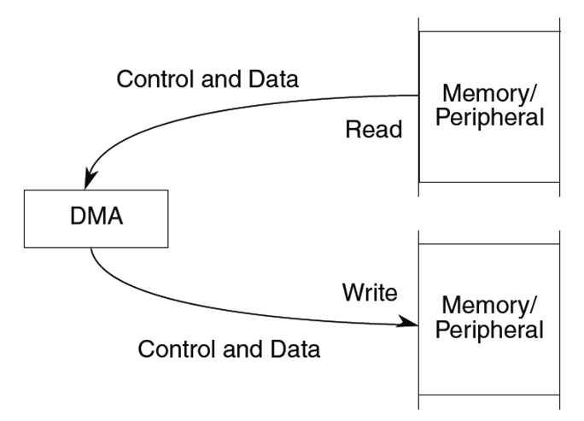
DMA
Instead of involving the CPU, provide dedicated hardware to control the transfer.
A controller for direct memory access, or DMA.
CPU now just required to configure this DMA controller correctly.
Typically supports multiple configurable options:
Number of data items to copy
Source and destination addresses
Fixed or changeable (e.g., increment and decrement)
Size of data item
Timing of transfer start
A DMA controller can also work with interrupts, e.g., interrupt CPU at the end of a transfer.
The main idea is to exempt the CPU from busy-waiting and frequent interruptions.
Notes:
Instead of the CPU having to be involved in data transfers, the IO device can be given direct access to memory to make the transfer. The CPU can run other applications during this time. This makes better use of the CPU’s time and avoids having to bring data into the CPU only to write it back out to memory. The CPU is informed of the transfer finishing because the DMA controller will interrupt the CPU at the end. The CPU then runs the appropriate interrupt handler to acknowledge the transfer and potentially start another (and potentially makes any waiting processes runnable again).

Slide 31
DMA Architecture
CPU
Address bus
Memory
Data bus
Control bus
Bus grant
DMA
Controller
I/O
Device
Bus request
Notes:
This shows an overview of an old-style DMA architecture. The DAM controller is responsible for transferring data to memory from the IO device or vice versa, and thus is attached to the relevant buses to facilitate that. Nowadays, devices themselves come with integrated DMA engines without the need for a separate controller.

Slide 32
DMA Transfer Modes
Burst
An entire block of data is transferred in one contiguous sequence.
The CPU remains inactive for relatively long periods of time (until the whole transfer is completed).
Cycle stealing
DMA transfers one byte of data and then releases the bus returning control to the CPU.
Continually issues requests, transferring one byte per request, until it has transferred the entire block of data
It takes longer to transfer data/the CPU is blocked for less time.
Transparent
DMA transfers data when the CPU is performing operations that do not use the system buses.
Notes:
DMA can operate in different modes trading off how quickly the transfer must complete against how intrusive it is to the system and the impact on the CPU. A burst-mode transfer operates on an entire block of data at once, so the CPU is unable to access memory during this time. That’s fine if the CPU only accesses data in caches, but otherwise, it will be blocked. Cycle-stealing mode deals with this by transferring one byte at a time, so the CPU also has a chance to access memory. The CPU might still get blocked, but it will quickly become unblocked. The downside is that transfers take longer and there is more bus arbitration required. Finally, in transparent mode, the CPU is never blocked, but data take even longer to be transferred since the DMA controller only does this when the CPU does not require the bus.

Slide 33
Case Study: Cortex-A9 MMU
The MMU in the Cortex-A9
Works with the L1 and L2 caches for virtual-to-physical address translation
Controls access to and from external memory
Is based on the Virtual Memory System Architecture from the Armv7-A architecture
Checks access permissions and memory attributes
Checks the virtual address (VA) and address space identifier (ASID)
Notes:
The Cortex-A9 has an MMU that works with the L1 and L2 caches for virtual-to-physical address translation. The MMU also controls access to and from external memory – it is in charge of the mapping of accesses to cache or external memory. The MMU in the Cortex-A9 is based on the Virtual Memory System Architecture (VMSA) specified in the Armv7-A architecture.
On each memory access, the MMU checks the virtual addresses and address space identifiers (ASIDs). An ASID is a number assigned by the OS to each individual task. This value is in the range 0-255, and the value for the current task is written in an ASID register (accessed using CP15). When the TLB is updated and the entry is marked as non-global, the ASID value will be stored in the TLB entry in addition to the normal translation information. Subsequent TLB look-ups will only match on that entry if the current ASID matches with the ASID that is stored in the entry. You can therefore have multiple valid TLB entries for a particular page (marked as non-global), but with different ASID values (i.e., you can have the same virtual pages from different processes mapped to their physical frames in the TLB at the same time). This significantly reduces the software overhead of context switches, as it avoids the requirement to flush the on-chip TLBs.
The Cortex-A9 supports up to 16 access domains, which are a now-deprecated feature to provide further access permissions for ranges of memory. The MMU checks domain access permissions and memory attributes. For more information on domains, please see the Cortex-A Series Programmer’s Guide version 4.0 http://infocenter.arm.com/help/index.jsp?topic=/com.arm.doc.den0013d/index.html.

Slide 34
Case Study: Cortex-A9 MMU
Main TLB along with separate micro-TLBs for instructions and data for quick access
Page-table walks can be configured to go through the L1 data cache.
Allows page tables to be cached
Main TLB
D µTLB
MMU Control logic
I µTLB
Data
Cache
cp15
Instruction Cache
Cortex-A9
Core
AXI Manager 0
AXI Manager 1
Notes:
The Cortex-A9 implements a 2-level TLB structure consisting of the main and micro-TLBs. As shown in the diagram in this slide, the Cortex-A9 contains a single main TLB and separate micro-TLBs for instructions and data. The latter are faster to access than the main TLB, allowing single-cycle translations of cached entries.

Slide 35
Case Study: Cortex-A9 MMU
Memory access sequence
MMU performs a lookup for the requested VA and current ASID in the relevant micro-TLB.
If there is a miss in the micro-TLB, look in the main TLB.
If there is a miss in the main TLB, the MMU performs a hardware page-table walk.
If the MMU finds a matching TLB entry, the MMU
Does permission checks; if these fail, the MMU signals a memory abort
Determines if the access is secure/non-secure, shared/non-shareable, and memory attributes
Performs translation for the memory access
Notes:
When the CPU generates a memory access, the MMU performs a lookup for the requested virtual address and current ASID and security state in the relevant instruction or data micro-TLB. If there is a miss in the micro-TLB, the MMU performs a lookup for the requested virtual address and current ASID and security state in the main TLB. If there is a miss in the main TLB, the MMU performs a hardware page-table walk.
On the other hand, if the MMU finds a matching TLB entry, then it uses the information in the entry to perform permission checks. If it does not pass the permission checks, then the MMU will signal a memory abort. The MMU will also determine if the access is secure/non-secure, shared or not, and whether it is to normal memory, device memory, or strongly ordered memory based on the TLB entry and CP15 c10 remap registers. Then finally, it performs the translation for the memory access and forwards the value to the cache system.
Additional info:
The MMU can be enabled or disabled. If the MMU is disabled, the virtual addresses map directly to corresponding physical addresses. This is known as flat mapping. Before the MMU is enabled, the translation tables must be written to memory. There is a register in the Cortex-A9 called the translation-table base register (TTBR), which must be set to point to the tables. The TTBR basically holds the base address of the translation table and information about the memory it occupies.

Slide 36
Conclusions
SRAM is expensive but fast and typically used for on-chip caches.
DRAM is slower but denser and cheaper, typically used for main memory.
DRAM cells grouped into arrays, banks, devices, and ranks.
Mixture of synchronized operation and concurrency at different levels gives bandwidth and parallel access.
Translating from the application’s view of memory to physical addresses is costly.
The memory-management unit, in particular the TLB, helps.
As do hardware page-table walkers
DMA controllers free up the CPU from dealing with transfers between IO and memory.

