Slide 1
Multicore Processors
Module 8

Slide 2
Module Syllabus
Multicore
Communication
Message passing
Shared memory
Cache-coherence protocol
MESI protocol states
MESI protocol transitions
Visualizing the protocol
MESI state transition diagram
Memory consistency

Slide 3
Motivation
Moore’s law meant that the number of transistors available to an architect kept increasing.
Historically, these were used to improve the performance of a single core processor.
Usually through increased speculation support, but this gives sublinear performance improvement
However, the breakdown of Dennard scaling meant these schemes were no longer viable.
If they consumed large amounts of power without giving commensurate performance improvements.
Multicore architectures are an efficient way of using these transistors instead.
Performance comes from parallelism, specifically thread-level or process-level parallelism.
Note that we had multi-processor systems long before Dennard scaling failed; this just pushed them to mainstream.
What are the challenges in providing multiple cores and how do they communicate?
Notes:
Gordon Moore’s observation about the rate that the number of transistors on an integrated circuit could be doubled, known as Moore’s law, still roughly holds true. Historically, the additional transistors available at each scaling of the technology node would be made available to computer architects to improve the performance of the processors. Often, these went into increased speculation support through, for example, wider and deeper out-of-order superscalar pipelines. This was enabled through Dennard scaling, whereby transistors could be made smaller, faster, and more power efficient at the same time. However, when this broke down, the increasing power consumed by these transistors couldn’t be effectively used for speculation. Instead, industry turned to multicore as a technique to get performance through parallelism by running multiple threads simultaneously in a MIMD style. This module looks at multicore, specifically communication between cores and cache coherence, which ensures that shared-memory semantics can be maintained despite cores keeping local copies (or more up-to-date versions) of data in their private caches.

Slide 4
Multicore
Overview
An example of multicore system
In a multicore processor, multiple CPU cores are provided within the chip.
Cores are connected together through some form of interconnect.
Cores share some components on chip.
For example, memory interface, or a cache level
CPU core
CPU core
CPU core
CPU core
Interconnect
I/O
RAM
Peripheral
Timer
Notes:
This diagram shows one example of a multicore processor and hides detail surrounding the caches.

Slide 5
Multicore
Cores in a multicore processor are connected together and can collaborate.
There are a number of challenges to consider when creating a system like this.
How do cores communicate with each other?
How is data synchronized?
How do we ensure that cores don’t get stale data when it’s been modified by other cores?
How do cores see the ordering of events coming from different cores?
We’ll explore each of these by considering the concepts of
Shared memory and message passing
Cache coherence
Memory consistency
Notes:
There are several challenges to consider when designing a multicore processor. In particular, the three that we’ll consider in this module are:
How does communication between cores occur? We’ll look at a shared-memory model.
How are data synchronized so that values in memory are consistent? We won’t consider this issue, but briefly mention how it can be achieved.
Given that we have shared memory, how do we ensure that when one core writes to a particular address, other cores see the updated value when they want to read, especially in the presence of write-back caches? For this, we’ll look at a well-known cache-coherence protocol.
Reads and writes made by one core are externally visible to other cores, but how do we know whether the order that another core sees them is actually the order that they occurred in? The memory-consistency model tells us how much reordering of operations is allowed.

Slide 6
Communication

Slide 7
Communication
Message Passing
Shared Memory
In this paradigm, applications running on each core wrap up the data they want to communicate into messages sent to other cores.
Explicit communication via send and receive operations
Synchronization is implicit via blocks of messages.
In this paradigm, there is a shared memory address space accessible to all cores, where they can read and write data.
Implicit communication via memory accesses
Synchronization is performed using atomic memory operations.
Notes:
The two main paradigms for communication are message passing and shared memory. The former makes communication explicit since cores have to pass messages between themselves to exchange data. The latter has implicit communication because cores share an address space whereby a write into it can then be seen by all. Here, synchronization is performed using atomic operations, which means that the whole operation is seen as one uninterrupted process. For example, a test-and-set operation tests the value and sets it to something else if it passes the test, and nothing can interfere (by changing the value after the test but before the set).

Slide 8
Message Passing
Cores do not rely on a shared memory space.
Each processing element (PE) has its core, data, I/O.
Explicit I/O to communicate with other cores
Synchronization via sending and receiving messages
Advantages
Less hardware, easier to design
Focuses attention on costly non-local operations
Core
Core
Core
Cache
Cache
. . .
Cache
Memory
Memory
Memory
Interconnection network
Notes:
With message passing, each core has its own private memory and must explicitly send messages to communicate with others.

Slide 9
Shared Memory
Cores share a memory that they see as a single address space.
Cores may have caches holding data.
Communication involves reading and writing to locations in memory.
Synchronization via atomic operations to modify memory
Specific instructions provided in the ISA
The hardware guarantees correct operation
Advantages
Matches the programmer’s view of the system
Hardware handles communication implicitly
Core
Core
Core
Cache
Cache
. . .
Cache
Interconnection network
Memory
Notes:
The second paradigm is shared memory. Here, cores share a memory seen as a single address space. This means that when one core writes to an address, all other cores can see that write at the same address. Hence, communication can occur simply by reading and writing to addresses in memory.

Slide 10
Shared Memory with Caches
Caching shared-memory data has to be handled carefully.
The cache stores a copy of some of the data in memory.
In particular, writes to the data must be dealt with correctly.
A core may write to data in its own cache.
This makes copies in other caches become stale.
The version in memory won’t get updated immediately either, if it’s a write-back cache.
In these situations, there is a danger of one core subsequently reading a stale (old) value.
Core
Core
Cache coherence applies to this level of the cache hierarchy.
Cache
Cache
Interconnection network
Shared cache
Memory
Notes:
For all the reasons explored in the previous module, we want to allow caching of data in a shared-memory system. However, we have to implement caches carefully to enable cores to read the most up-to-date value at any address whenever they want. Write-back caches, in particular, must be carefully architected because they may store a more recent version of a value than the one in memory. When another core wants to read that value, it must be able to get it from the other core’s cache; otherwise, it will read the wrong value. We can deal with this by implementing a cache-coherence protocol.

Slide 11
Cache Coherence

Slide 12
Cache-coherence Protocol
The cache-coherence protocol ensures that cores always read the most up-to-date values.
This means a core can always find the most recent value for some data, no matter where it is.
It describes the actions to take on seeing certain events from other cores.
Cache coherence is required when caches share some memory.
The protocols rely on caches seeing events from other cores.
In particular, reads and writes to the shared memory
Often this is realized through snooping operations on the interconnect.
The protocol runs on each block in the cache independently.
This is the granularity commercial implementations track the state information.
It runs in the private caches that have a shared ancestor.
The orange caches in the diagram
Core
Core
Cache
Cache
Interconnection network
Cache or memory
Notes:
The cache-coherence protocol is responsible for propagating the correct value for any piece of data (address) in memory when a core wants to read it. We’re going to consider a protocol based around caches being able to snoop (i.e., see) transactions on a shared interconnection network. This means that they can observe the messages sent by other caches in the system and take appropriate actions where necessary.

Slide 13
MESI Cache-coherence Protocol
The MESI protocol is a write-invalidate cache-coherence protocol.
When writing to a shared location, the related cache block is invalidated in the caches of all other cores.
This protocol can manage cache coherence for a specified memory area.
In general, uses an allocate-on-write cache policy
New data are loaded into the cache on both read and write misses.
In general, uses a write-back cache
So caches can store data that are more recent than the value in memory.
The MESI protocol defines states for each cache block and transitions between them.
Four states, corresponding to M, E, S, and I
Notes:
We’re going to consider the MESI protocol. The protocol is run on each cache block independently, so we’ll consider just a single block. Cache-coherence protocols are often known by an acronym of their states. MESI, therefore, has four that correspond to the state that the cache block can be in for a particular piece of data, or address.

Slide 14
Modified State (M)
The local cache holds the only copy of the block, which is also the most recent version of the data; memory holds old (stale) data.
Note that memory may actually be a shared cache between the core’s caches and main memory.
Local core cache
Remote core cache
M
Current value
Not coherent
Not current value
Memory
Notes:
A cache block is in the modified state when the data it contains are more up-to-date than the version in main memory. Essentially, the core that is connected to this cache has written to the data, and the version in main memory is stale. No other caches in the system can hold a copy of this data, and any core that wants to read it has to obtain a copy from this cache.

Slide 15
Exclusive State (E)
The local cache holds the only copy of the block, which is identical to memory’s version.
Local core cache
Remote core cache
E
Current value
Coherent
Current value
Memory
Notes:
The exclusive state corresponds to a cache block that has a copy of the data that is exactly the same as the version in memory and no other cache has a copy. In other words, this core has exclusive access to this piece of data.

Slide 16
Shared State (S)
The local cache holds a copy of the block, which is identical to memory’s version; other caches may also hold the block in shared state.
Local core cache
Remote core cache
S
Coherent
S
Current value
Current value
Coherent
Coherent
Current value
Memory
Notes:
A cache block in the shared state holds a copy of data that is exactly the same as the version in memory. In addition, other caches in the system may also have a copy that is the same as in memory too (although, equally, they may not have a copy).

Slide 17
Invalid State (I)
The local cache does not hold a copy of the block.
This state may not be marked in the cache for each block; it could be inferred by a cache miss on that block.
Local core cache
Remote core cache
Memory
Notes:
A cache never really holds a cache block in the invalid state; this actually corresponds to a miss in the cache. The absence of a hit for a particular address means that the data are not in the cache, so its state is invalid.
Having looked at what each of the states means, the following slides show the conditions under which cache blocks transition from one state to another. Recall that the cache can observe the messages sent by other caches and can therefore take actions according to operations from the core it is attached to and after observing messages on the interconnection medium.

Slide 18
Invalid to Modified
Occurs when the local core attempts to write some data to an address not already in the cache
Read-exclusive request
Data response
Local core cache
Remote core cache
Local core cache
Remote core cache
M
2
1
Memory
Memory
Before
After
Notes:
We will consider the state transitions from core 1’s cache’s point of view. The diagrams show the state of the data in each cache and memory before and after the state transitions. In addition to this, the order of the main operations is shown, too.
When the data are invalid in core 1’s cache (recall, a miss) but core 1 attempts to write to it, the data must be obtained from elsewhere in the system. The diagram shows it coming from main memory (it can come from elsewhere, but we’ll look at that case in a later slide). The order of operations after the core has attempted to write are:
Given that the access has been a miss, request exclusive access to the data from memory.
Read from memory and write into the cache (i.e., write-allocate).
The write can then be performed by core 1. Although it might seem odd to read the data into the cache first, note that the core is probably only writing to a part of the cache block, so needs to get the rest from memory anyway. After the access, the cache block is in M (modified) state in core 1’s cache.

Slide 19
Invalid to Exclusive
Occurs when the core attempts to read data from an address that is not already in the cache and no other cache has it
Read request
Data response
Local core cache
Remote core cache
Local core cache
Remote core cache
E
2
1
Memory
Memory
Before
After
Notes:
When the data are invalid in all caches in the system but core 1 attempts to read from it, the value must be obtained from memory.
Request the data from memory.
Read from memory and write into the cache.
Since no other cache has a copy of the data, the cache block ends in E (exclusive) state in core 1’s cache.

Slide 20
Invalid to Shared
Occurs when the local core attempts to read data from an address that is not already in the cache, but other caches have a copy
Data is supplied by another cache.
Read request
Data response
Local core cache
Remote core cache
Local core cache
Remote core cache
E
S
S
2
1
Memory
Memory
Before
After
Notes:
When the data are invalid in core 1’s cache but another cache in the system has a copy, the data can be obtained from there.
Request the data from memory.
Read the data from the other cache, which responds with it after snooping the read request on the interconnect. That other cache may be in M, E, or S state depending on whether the other cache has written to the data, is the only cache with a copy, or otherwise.
Afterward, all caches in the system that previously had a copy now have the cache block in S (shared) state.

Slide 21
Shared to Modified
Occurs when the local core attempts to write some data to an address that is already in the cache, and other caches may have a copy
Needs to invalidate other copies
Read-exclusive request
Invalidate
Local core cache
Remote core cache
Local core cache
Remote core cache
S
S
X
2
M
1
Memory
Memory
Before
After
Notes:
When the data are in S (shared) state in core 1’s cache and core 1 attempts to read it, then it has to ensure that it invalidates all other copies in the system. If this doesn’t occur, then there could be old versions in other caches, and other cores that want to read the data may read the wrong values. Data in memory cannot be invalidated, but the cache-coherence protocol will take care of updating that when necessary.
Send a message out on the interconnect to indicate the desire to write. This may be called different things – here a read-exclusive request – but it could also be an upgrade or another name.
Any other caches holding copies of the data will invalidate them.
Afterward, the only cache in the system to hold a copy of the data is core 1’s cache, which puts it into M (modified) state, and it can perform a write.

Slide 22
Shared to Invalid
Occurs when another core attempts to write some data to an address that is already in the cache
The local cache snoops the exclusive read request.
Read-exclusive request
Invalidate
Local core cache
Remote core cache
Local core cache
Remote core cache
S
S
M
X
2
1
Memory
Memory
Before
After
Notes:
This is the opposite of the previous slide, where we start with a copy shared by multiple caches, but another core attempts to write to the data.
Core 1’s cache snoops a read-exclusive request on the interconnect from another cache.
Core 1’s cache invalidates its copy.
Afterward, the other core can perform its write, and core 1’s cache does not hold a copy.

Slide 23
Exclusive to Modified
Occurs when the local core attempts to write some data to an address that is already in the cache, and that’s the only copy
No need to invalidate other caches because we know they don’t have a copy
Local core cache
Remote core cache
Local core cache
Remote core cache
E
M
Memory
Memory
Before
After
Notes:
When data are in the E (exclusive) state in core 1’s cache and core 1 attempts to write to it, no actions need to occur apart from a silent upgrade to M (modified) state. This is because the data being in E state guarantees that no other caches have a copy. Therefore, there is no need to send any upgrade requests. This ability to silently transition from E state to M state is an optimization of the MESI protocol over more simple protocols (e.g., MSI) and reduces interconnect traffic for thread-private data.

Slide 24
Exclusive to Shared
Occurs when another core attempts to read data from an address that this cache has, and it’s the only copy
Data are supplied by the cache after snooping the read request.
Read request
Data response
Local core cache
Remote core cache
Local core cache
Remote core cache
E
S
S
2
1
Memory
Memory
Before
After
Notes:
When core 1’s cache holds the data in E (exclusive) state and another core attempts to read it, then core 1’s cache needs to change the state of the data internally so that it recognizes that there may be other copies of the data in other caches.
The other core’s cache requests the data from memory.
Core 1’s cache snoops this request, supplies the data to the other core, and transitions to S state. Providing the data to the other cache is an optimization (the protocol could allow memory to respond with it) that means the other cache gets the data faster (because a memory response is much slower).
Afterward, both caches have the cache block in S (shared) state.

Slide 25
Exclusive to Invalid
Occurs when another core attempts to write some data to an address that this cache has the only copy of
The local cache snoops the exclusive read request.
Read-exclusive request
Data response
Invalidate
Local core cache
Remote core cache
Local core cache
Remote core cache
E
M
X
3
2
1
Memory
Memory
Before
After
Notes:
When core 1’s cache holds the data in E (exclusive) state and another core attempts to write to it, then core 1’s cache needs to invalidate its own copy.
The other core’s cache requests the data for exclusive access from memory.
Core 1’s cache snoops the request and responds with the data (this step is an optimization).
Core 1’s cache invalidates the data internally.
Afterward, the data will be in modified state in the other core’s cache and that other core can perform its write.

Slide 26
Modified to Shared
Occurs when another core attempts to read data from an address that this cache has written to
Must flush the data back to memory and the requesting cache
Read request
Data response
Local core cache
Remote core cache
Local core cache
Remote core cache
M
S
S
2
1
Memory
Memory
Before
After
Notes:
When core 1’s cache holds the data in modified but another core attempts to read it, core 1’s cache must provide this data to the other cache to enable them to read the correct value. At the same time, memory is updated.
The other core’s cache requests the data from memory;
Core 1’s cache snoops this request, supplies the data to the other core, and flushes it back to memory too so that data in the cores are coherent with that in memory.
Afterward, both caches have the cache block in S (shared) state.

Slide 27
Modified to Invalid
Occurs when another core attempts to write some data to an address that this cache has altered
Must flush the data back to memory and the requesting cache
Read-exclusive request
Data response
Invalidate
Local core cache
Remote core cache
Local core cache
Remote core cache
M
X
3
M
2
1
Memory
Memory
Before
After
Notes:
When core 1’s cache holds the data in modified but another core attempts to write to it, core 1’s cache must provide this data to the other cache to enable them to write to it (recall the write will generally be to only part of the cache block). At the same time, memory is updated.
The other core’s cache requests the data for exclusive access from memory;
Core 1’s cache snoops this request, supplies the data to the other core, and flushes it back to memory too;
Core 1’s cache invalidates the data internally.
Afterward, the other core’s cache has the data in M (modified) state and can perform its write. Although memory was updated by the flush from core 1’s cache, the subsequent write from the other core means that memory contains stale data once more.

Slide 28
Visualizing the Protocol
We can visualize the protocol in two ways.
First, a table showing the valid combinations of states that two caches can have for the same block
For example, two caches can have it in shared.
But if any cache has it in exclusive or modified, then all other caches are invalid.
Second, we can draw a state transition diagram to show all events and actions.
 | M | E | S | I
M | ⨯ | ⨯ | ⨯ | ✓
E | ⨯ | ⨯ | ⨯ | ✓
S | ⨯ | ⨯ | ✓ | ✓
I | ✓ | ✓ | ✓ | ✓
Notes:
It is often useful to visualize the protocol. The first way of doing this is through a table that shows the state of data in any two caches in the system. The rows correspond to states for one cache; the columns correspond to states for another cache. The ticks show valid combinations of states (note that the table is symmetric). It shows, for example, that if one cache has the data in M state, then other caches must have it in I state. If one cache has it in S state, then others may have it in S state or I state.

Slide 29
MESI State-transition Diagram
Remote core write
Remote core read
Remote core write
Remote core read
Remote core write
M
E
S
I
Local core read/write
Local core read
Local/remote core read
Remote core read/write
Local core read, remote core has a copy
Local core write
Local core write
Local core read, no other copies
Local core write
Notes:
The second visualization is a state-transition diagram. Here, the transitions between states (shown with arrows) have been annotated with descriptions of the events that cause that transition. In essence, there are only four different events that occur:
Observation of another core (the remote core) wanting to read.
Observation of another core wanting to write.
The core attached to this cache (the local core) wanting to write.
The core attached to this cache wanting to read, which gets broken down into two events only if the block is invalid:
No other caches in the system have a copy.
At least one other cache has a copy.
Sometimes these diagrams are shown with the transitions annotated with pairs corresponding to event seen, action taken.

Slide 30
Memory Consistency

Slide 31
Memory Consistency
The purpose of cache coherence is to ensure data propagation and coherence.
So when data are written by one core, all other cores can later read the correct value.
When a core attempts to write, others know that their copies are stale.
When a core attempts to read, others know they must provide their data, if modified.
The cache-coherence protocol is run independently on each block of data.
There is no direct interaction between different blocks, as far as the protocol is concerned.
So what about the order in which data accesses by one core are seen by others?
If a core performs certain reads and writes to different data, in what order do other cores see them?
It is the purpose of the memory-consistency model to define this.
And the job of the memory hierarchy (and core) to implement it
Notes:
Whilst the cache-coherence protocol ensures that the most up-to-date version of each particular data item (on the granularity of a cache block) is read by any core that attempts to do so, it says nothing about the order that reads and writes to different locations in memory from one core is seen by others. That is what the memory-consistency model defines, and the memory hierarchy has to be implemented in such as way as to implement this model correctly (by, for example, preventing loads executing before older stores in the load-store queue).

Slide 32
Memory Consistency
Modern processors may reorder memory operations.
Out-of-order processing can allow loads to access the cache ahead of older stores.
Either because the addresses they access don’t match
Or because the load has been speculatively executed and will be replayed later if a dependence is found
This avoids stalling loads unnecessarily, even though their effects can be seen externally.
By other cores in the system
Recall module 5 where this was introduced.

Slide 33
Memory Consistency vs Cache Coherence
Cache coherence
Memory consistency
Core 1
Core 2
Core 1
Core 2
Accesses issued
Accesses issued
Accesses issued
Core 1’s accesses seen
Store B
Load A
Store C
Store A
Load C
Load D
Store C
Load A
Load B
Load C
Store D
Load A
Store B
Load A
Store C
Store A
Load C
Load D
Load A
Load D
Store B
Store C
Load C
Store A
Reordered
Data propagation
Notes:
A visual representation of cache coherence compared to memory consistency is shown in this slide. On the left is cache coherence. Each of the two cores issues a series of memory accesses (reads and writes, or loads and stores) to different locations. When one core reads a value that the other core has written to, an arrow connects them showing the data propagation between them. Data only propagates when reading the same location as has been written – e.g., an arrow connects Store B to Load B but not Store C to Load A. The cache-coherence protocol defines how the data get propagated.
On the right-hand side is memory consistency. Core 1 issues a series of memory accesses to different locations. Under core 2 is shown the order that these accesses are seen by core 2. They have been reordered so that, for example, the first access seen is Load A, but that was the second access actually issued by core 1. The memory-consistency model defines how much reordering is allowed in the system.

Slide 34
Memory Consistency
The memory consistency model defines valid outcomes of sequences of accesses of the different cores.
Sequential consistency (SC) is the strongest and most intuitive model.
The operations of each core occur in program order, and these are interleaved (at some granularity) across all cores.
This means that no loads or stores can bypass other loads or stores.
SC is overly strong because it prevents many useful optimizations without being needed by most programs.
Total store order (TSO) is widely implemented (e.g., x86 architectures).
The same as sequential consistency but allows a younger load to observe a state of memory in which the effects of an older store have not yet become observable
Forms of relaxed consistency have been adopted (e.g., Arm and PowerPC architectures).
In more relaxed consistency models, other constraints in SC are removed, such as a younger load observing a state of memory before an older load does.
Notes:
The most intuitive model is sequential consistency. Here, operations from each core are seen in program order, interleaved with those from other cores. We call this a strong memory-consistency model. More relaxed models allow operations to be seen out of program order, such as allowing younger loads to observe a state of memory in which the effects of older stores have not yet become observable (in the total store order model), or allowing younger loads to observe a state of memory before older loads, and the effects of younger stores to become observable before those of older stores. Both of these optimizations allow the extraction of more instruction-level parallelism within the core.

Slide 35
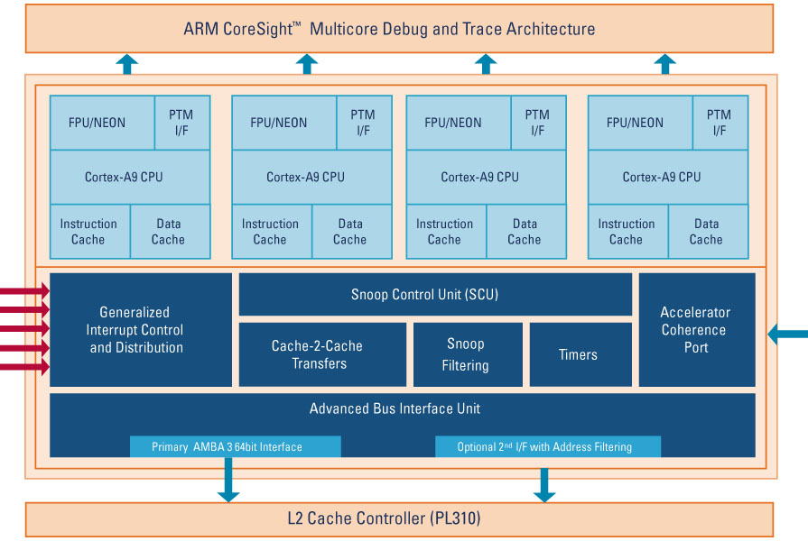
Case Study: Cortex-A9 MPCore
Contains up to four Cortex-A9 processors
Snoop Control Unit
Maintains L1 data cache coherency across processors
Arbitrates accesses to the L2 memory system, through one or two external 64-bit AXI manager interfaces
Notes:
As an example of multicore system, we consider the Cortex-A9 MPCore processor, which contains from one to four Cortex-A9 processors in a cluster, and a Snoop Control Unit (SCU) that can be used to ensure coherency within the cluster.
The Cortex-A9 MPCore also contains a set of private memory-mapped peripherals, including a global timer, and a watchdog and private timer for each Cortex-A9 processor present in the cluster.
It provides an integrated interrupt controller that is an implementation of the Arm Generic Interrupt Controller architecture. The integrated interrupt controller registers sit beside the timers and watchdog control registers in the private memory region of the Cortex-A9 MPCore.
The Cortex-A9 MPCore has configuration options that impact system integration. These configuration options include whether there are one or two AXI manager port interfaces, with address-filtering capabilities, an optional Accelerator Coherency Port (ACP) suitable for coherent memory transfer. The Cortex-A9 MPCore also has a configurable number of interrupt lines.

Slide 36
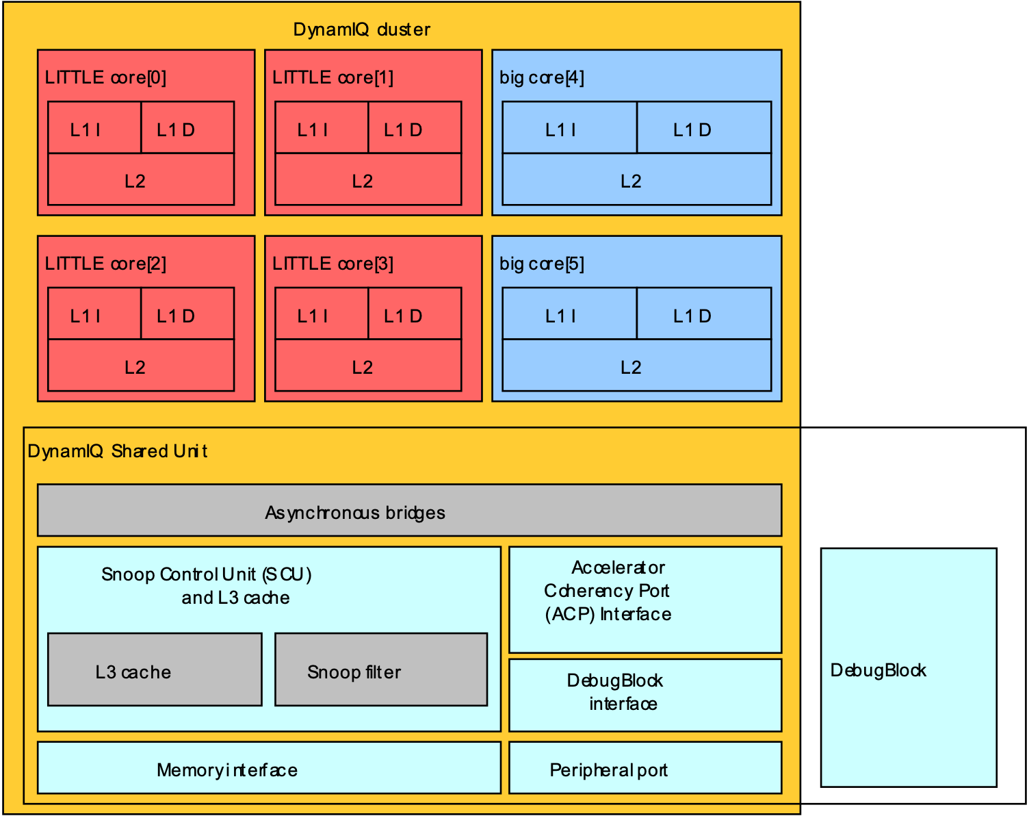
Case Study: Heterogeneous Multicore
big.LITTLE is a heterogeneous processing architecture with two types of cores.
“big” cores for high compute performance
“LITTLE” cores for power efficiency
L1 and L2 memory system in cores
A DynamIQ system contains big and LITTLE cores and a shared unit containing.
L3 memory system
Control logic
External interfaces
Notes:
Arm introduced big.LITTLE technology in 2011 to enable mobile systems to capitalize on the benefits of heterogeneous compute. In this system, there are two types of core. The “big” cores are designed to provide high compute performance, and in a modern system may be a core such as the Cortex-A75 or Cortex-A77. The “LITTLE” cores are designed for power efficiency and battery saving – they are not as powerful as the “big” cores in terms of compute performance. An example of a modern LITTLE core is the Cortex-A55. Each “big” or “LITTLE” core has its own L1 instruction and data cache, and unified L2 cache. big.LITTLE technology allows the system to adjust to the dynamic usage patterns seen in smartphones, tablets, and so on, whereby processes that require computational power can utilize the “big” cores and tasks that are not critical or do not need high compute performance can use the “LITTLE” cores.
Arm has also recently introduced DynamIQ technology that builds on big.LITTLE, with the diagram showing a DynamIQ cluster. This comprises big and LITTLE cores and a DynamIQ shared unit (DSU) for hardware shared across all cores. Within the DSU, there is the L3 cache, the snoop control unit (SCU), internal interfaces to the cores, and external interfaces to the system-on-chip (SoC). The L3 cache is shared by the cores in the cluster, which simplifies process migration between the cores. The SCU maintains coherency between caches in the cores and the L3 and includes a snoop filter to optimize coherency-maintenance operations.

Slide 37
Case Study: Cortex-A55
The Cortex-A55 is a LITTLE core.
Optionally contains an L2 cache
Uses the MESI protocol for coherence
M: Modified/UniqueDirty (UD) – the line is in only this cache and is dirty.
E: Exclusive/UniqueClean (UC) – the line is in only this cache and is clean.
S: Shared/SharedClean (SC) – the line is possibly in other caches and is clean.
I: Invalid/Invalid (I) – the line is not in this cache.
The data-cache unit (DCU) stores the MESI state of each cache line.
Notes:
The Cortex-A55 is a LITTLE core. It needs to be used with the DynamIQ shared unit (DSU) to form a DynamIQ cluster. It has an optional L2 cache and uses the MESI protocol to maintain data coherency between multiple cores. The data-cache unit (DCU) stores the MESI state of each cache line in the tag and dirty RAMs. These are the memory arrays within the DCU that contain the tags for each cache line and information about whether each line is clean or dirty.

Slide 38
Conclusions
Multicore processors provide performance from increasing numbers of transistors.
Performance comes through thread-level parallelism.
Shared-memory systems are the most common paradigm.
Cores share a memory and common address space.
Data written by one core are read by others when accessing the same location.
Dealing with shared memory in the presence of caches poses a challenge.
This is where the cache-coherence protocol comes into play.
We looked at the MESI protocol, but there are other more simple and more complex protocols around.
Memory consistency defines the order that reads/writes to different addresses are seen by the different cores in the system.

