Slide 1

PETS’
ADVERTISING
WEBSITE

Slide 2
CONTENT
01
INTRODUCTION
02
USER LEVELS
03
FUNCTIONAL REQUIREMENTS
04
SYSTEM ANALYSIS & DESIGN
05
SOFTWARE TESTING
06
DEMONSTRATION
07
TEAM MEMBERS

Slide 3
INTRODUCTION
1

Slide 4
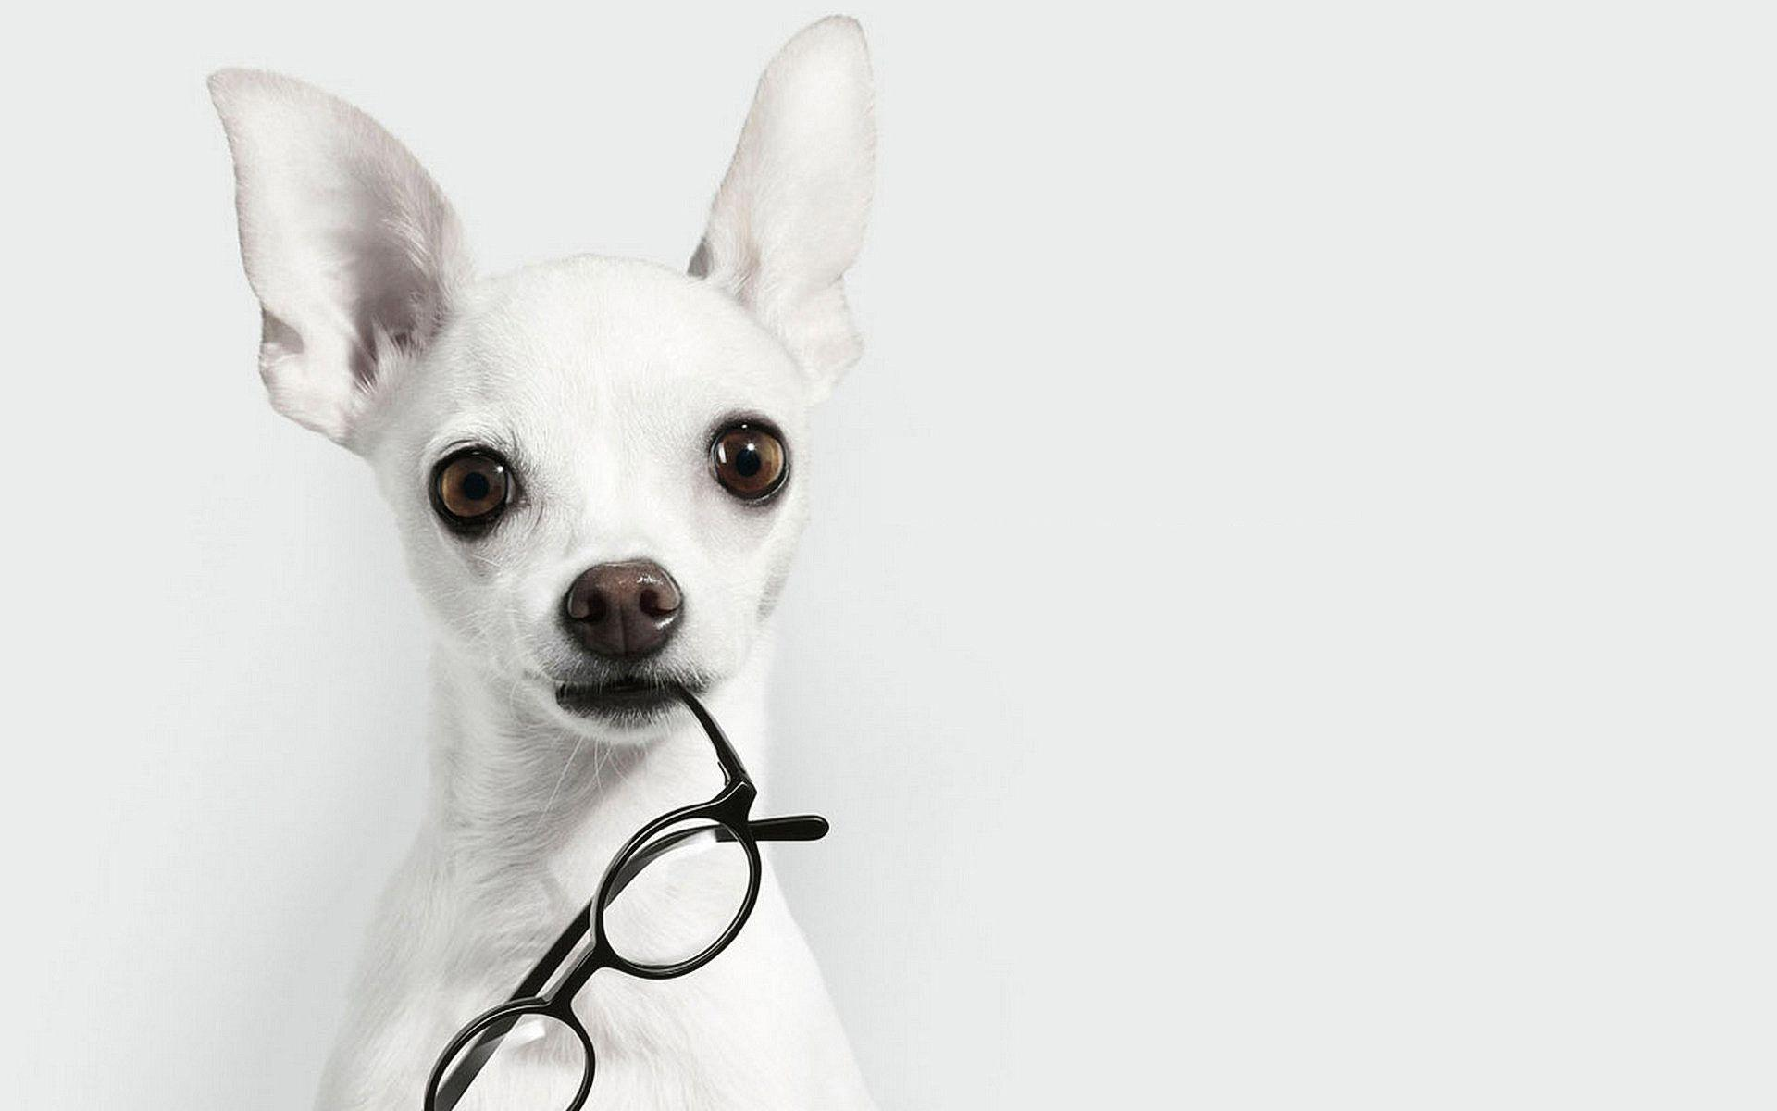
We developed an online advertising web site for pets called “paw.lk”.
Our Project is a Web Based Application in which Users can post ads of pets or pet related products which they want to sell after being registered on the site.
This system provides the services for advertiser to introduce their pets and services into online market.
The overall aim of our system is to provide a platform for customers who want to advertise their pets on online website and provide an effective and efficient services to the customer.
Our website will eliminate the disadvantages caused by current system.
Our system ensures that everyone can use this system more easily, we focused everyone, and interface is more user friendly for all.

Slide 5
User Levels
2

Slide 6

There are three (3) user levels in this advertising system.
Admin (High level user)
Seller (Registered member)
Visitor (Normal user)

Slide 7
FUNCTIONAL REQUIREMENTS
3

Slide 8
User registration & Login System
User Profile Management
Admin Profile Management
View Categories and Items
Search and Filter
Online Payments
Check History

Slide 9
System Analysis & Design
4

Slide 10
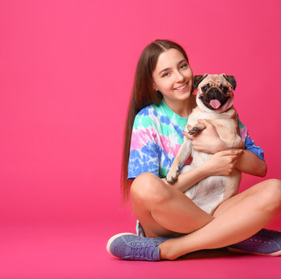
In order to improve the web's overall quality and to identify problem areas we used major 3 UML diagrams and ER Diagram as a blue print to design our databases.
Use Case Diagram
Activity Diagram
Class Diagram
ER Diagram

Slide 11
SOFTWARE Testing
5

Slide 12

Testing Methodologies
Unit Testing
Integration Testing
System Testing
Acceptance Testing

Slide 13
DEMONSTRATION
6

Slide 14
TEAM MEMBERS
7

Slide 15




UWU/CST/18/049
Sewwandi M.G.S.I
UWU/CST/18/054
Kumara R.M.R.S.C
UWU/CST/18/012
Dilshan K.Y.T
UWU/CST/18/035
Bandara C.J.M.H
UWU/CST/18/049
Sewwandi M.G.S.I

Slide 16
Q & A

Slide 17
Thank You

