Slide 1

Project Review - 1
Forex Prediction Based on Technical Analysis using Genetic Algorithm
By: (Pid-15)
160120733050
Supervisor :
Smt. Ms. Sahithi Chennamadhavuni,
Assistant Professor
Notes:
1
1

Slide 2
Introduction
Forex (Foreign Exchange) is the marketplace for trading currencies against one another. It is a decentralized network of financial institutions and traders. As forex market is the largest and most liquid financial market globally, enabling currency conversion, it come with opportunities as well as great risks.
Being correctly able to predict forex can help you avoid risks and gaining substantial profits.
In this presentation, we will explore forex market and discuss how Genetic algorithm can be used for better results.

Slide 3
Existing System
Traditional System are mainly Statistical models.
For Intraday trading ARIMA (Autoregressive integrated moving average), it works best for short durations of Time Series Analysis. But not recommended for Long-term prediction.
For Long-term trading Long Short-Term Memory (LSTM) networks and Sentiment Analysis is widely used. LSTMs is best in capturing time series patterns of historical Forex data.
Long-term trading Focus more on fundamental analysis and hence Sentiment analysis in important for it.

Slide 4
Proposed System
Our proposed "Forex prediction based on Technical Analysis using genetic algorithms" aims to enhance accuracy in currency price forecasting. We leverage genetic algorithms to generate iterative model generations, featuring mutations to enhance accuracy.
Key parameters include Bollinger Bands, relative strength index (RSI), and the Moving Average Convergence Divergence (MACD). The dynamic model adaptation, informed by these indicators, equips traders with insightful, real-time information, optimizing decision-making in the dynamic forex market, expecting continuous accuracy improvement through evolving model generations.

Slide 5
What is GENETIC ALGORITHM
A genetic algorithm is a problem-solving technique inspired by the process of natural selection. It uses populations of potential solutions, mimics genetic processes like selection, crossover (recombination), and mutation to evolve and optimize solutions over successive generations. This approach is particularly effective for complex optimization problems where finding the best solution is challenging.

Slide 6
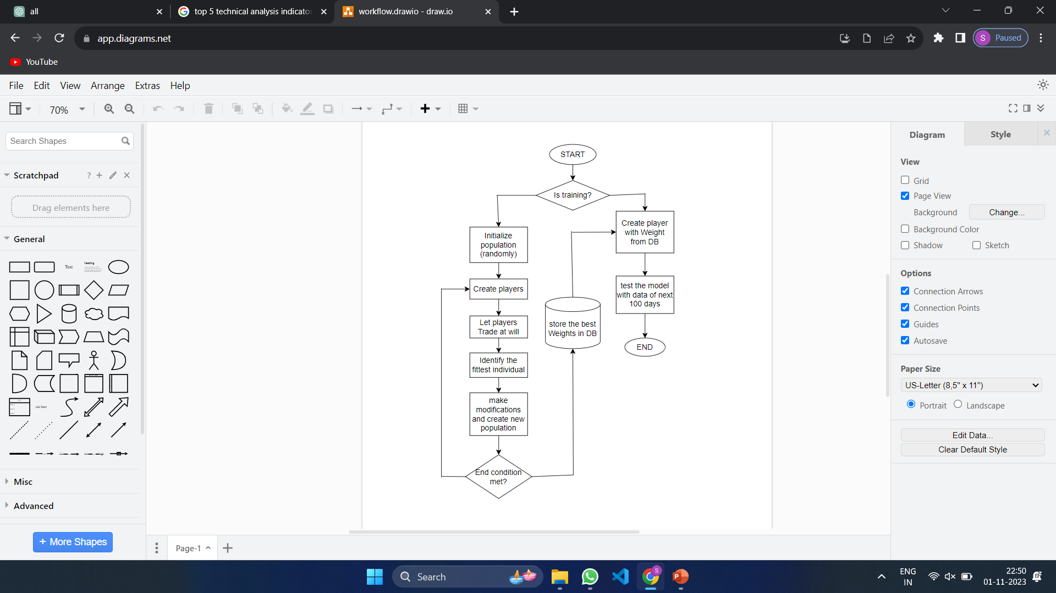
Workflow:

Slide 7
Proposed system Methodology
Step 1 : Initializing Weights: The process begins with the initialization of a population of potential solutions (individuals or "players"). These initial solutions are often generated randomly or start as null or empty solutions.
Step 2 : Number of Players: The population size is chosen representing the number of individuals in each generation. An initial population of around 20 individuals is often a good starting point.
Step 3 : Number of Generations: The genetic algorithm progresses through generations. In each generation, a new population evolves from the current one, and this continues for a set number of generations. Typically, easy problems may need 40 to 50 generations, moderate problems around 700 to 800 generations, while challenging problems may require 5000 or more generations for effective optimization.

Slide 8
Methodology (Contd…)
Step 4 : Parameters: Five essential technical indicators are input parameters for formulating a trading plan and making informed trading decisions.
Moving Averages
Relative Strength Index (RSI)
Moving Average Convergence Divergence (MACD)
Bollinger Bands
Stochastic Oscillator
Additional Parameters: capital limit to each trade, trade frequency, risk evaluation, modification rate.

Slide 9
Methodology (Contd…)
Step 5 : Finding the Best: Best individuals are selected based on specific criteria, often involving both survival and profitability. These individuals are more likely to pass their genetic material to the next generation. Survival ensures that well-performing solutions continue to influence the population.
Step 6 : Modification: The genetic algorithm performs modifications on the selected individuals. It can either create a new generation that retains a portion of the best solutions (elitism) or apply modifications to a fraction of the population.
Step 7 : End Condition: The algorithm runs for a defined number of generations or until a certain condition is met. This condition can be a specific level of performance, a predefined number of generations, or other criteria.

Slide 10
Conclusion
In our project, we propose to tackle forex prediction based on technical analysis using genetic algorithm. Through technical analysis, we evaluate indicators like Bollinger Bands, RSI, and MACD. What sets us apart is our genetic algorithm, which continuously evolves and adapts our model over numerous generations. This dynamic approach offers nuanced, numerical predictions, moving beyond binary outcomes. Our goal is to enhance decision-making in the forex market by improving forecasting accuracy using this innovative blend of technical analysis and genetic algorithms.

Slide 11
References
[1] A. Hernandez-Aguila, M. García-Valdez, J.-J.Merelo-Guervós, M.Castañón-Puga, and O. C. López, ‘‘Using fuzzy inference systems for the creation of Forex market predictive models,’’ IEEE Access, vol. 9,pp. 69391–69404, 2021.
[2] R. F. B. de Brito and A. L. I. Oliveira, "Comparative Study of FOREX Trading Systems Built with SVR+GHSOM and Genetic Algorithms Optimization of Technical Indicators," 2012 IEEE 24th International Conference on Tools with Artificial Intelligence, Athens, Greece, 2012, pp. 351-358, doi: 10.1109/ICTAI.2012.55.

Slide 12
Thank you

