Slide 1


Slide 2
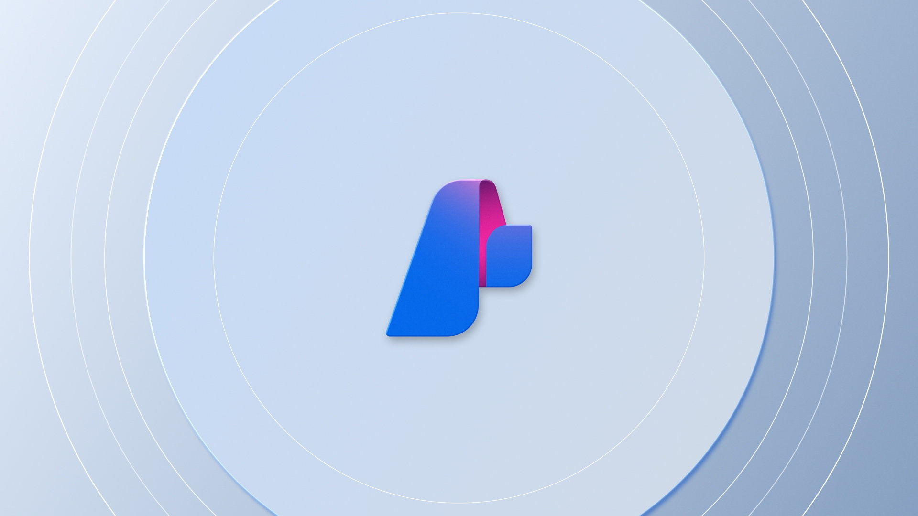

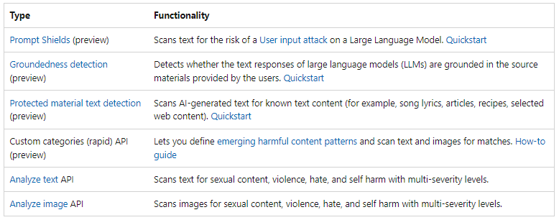
Azure AI Content Safety

Slide 3
Key scenarios
Online marketplaces that moderate product catalogs and user-generated content
Media companies that implement centralized moderation for their content.
Online education solution providers filtering out content that is inappropriate for students and educators.

Slide 4
Learn more
Microsoft Learn: https://learn.microsoft.com/en-us/training/modules/moderate-content-detect-harm-azure-ai-content-safety-studio/
GITHUB Workshop Repository: https://github.com/Azure-Samples/aacs-workshops/
Configure Content Filters for Azure OpenAI services: https://learn.microsoft.com/en-us/azure/ai-services/openai/how-to/content-filters
Documentation: https://learn.microsoft.com/en-us/azure/ai-services/content-safety/

Slide 5
Submit a session | https://sessionize.com/microsoft-governance-user-group/
Learn more about the meetup | https://www.meetup.com/microsoft-governance-user-group/
View previous meetup recordings | https://www.youtube.com/@yggdrasil13
Connect with us on LinkedIn Group | https://www.linkedin.com/company/microsoft-governance-user-group/

Slide 6
