Slide 1

Azure Policies: Setup Ground rules for your Cloud
Mohit Sharma
Chief consultant

Slide 2
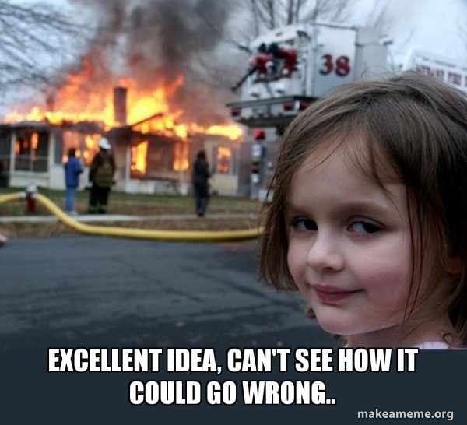
What could go wrong?
Identity and access
Unnecessary Contributor/Owner rights
Admin without MFA
Network
Resources with public access
Encryption
Security
Log Analytics agent should be installed on virtual machines
Web Application Firewall (WAF) should be enabled for Application Gateway
Guest acccount Owners
Unaccounted User Admins
Open for all traffic NSG
Storage account blobs with public access
Public IP on core infra servers
FTPS not enabled
TLS 1.0/1.1 enabled
Databases missing encryption
Disk encryption missing
Management ports need JIT
Encryption in transit missing
Transparent Data Encryption on SQL databases disabled
Endpoint protection should be installed on machines
Governance
Resource naming standard misssing
Resource tagging missing
Resources hosted in unapproved locations
Misconfigured Security Configuration
Misalligned governance rules or plain absense of them

Slide 3
What is Azure Policy?
Azure Policy is a service that you use to create, assign, and manage policy definitions
Enforce compliance by:
Turning on built-in policies or building custom policies for all resource types.
Performing real-time policy evaluation and enforcement.
Performing periodic and on-demand compliance evaluation.
Implementing virtual machine In-Guest Policy.
Apply policies at scale
Apply policies to a Management Group with control across your entire organization.
Apply multiple policies and aggregate policy states with policy initiative.
Handle exclusion scopes
Remediation
Real-time remediation.
Remediation on existing resources.

Slide 4
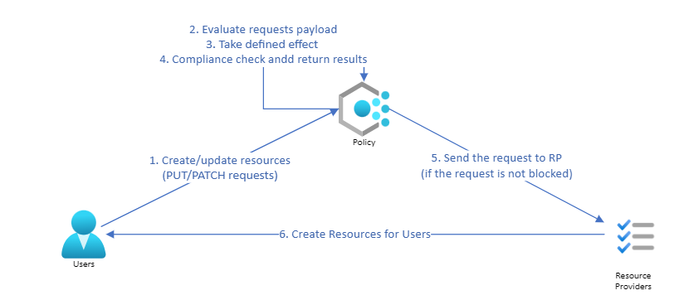
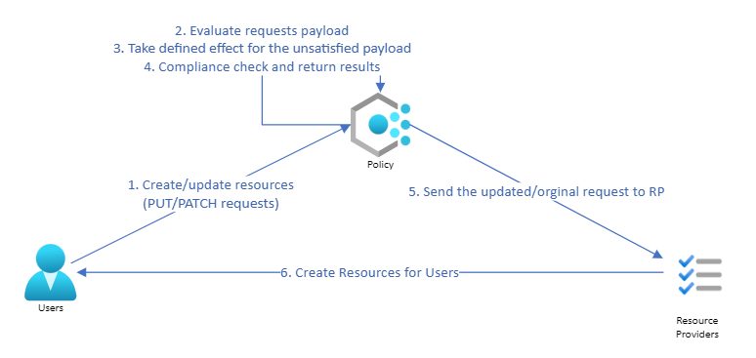
How does it work?
Deny and Audit effect
Append and Modify effect

Slide 5
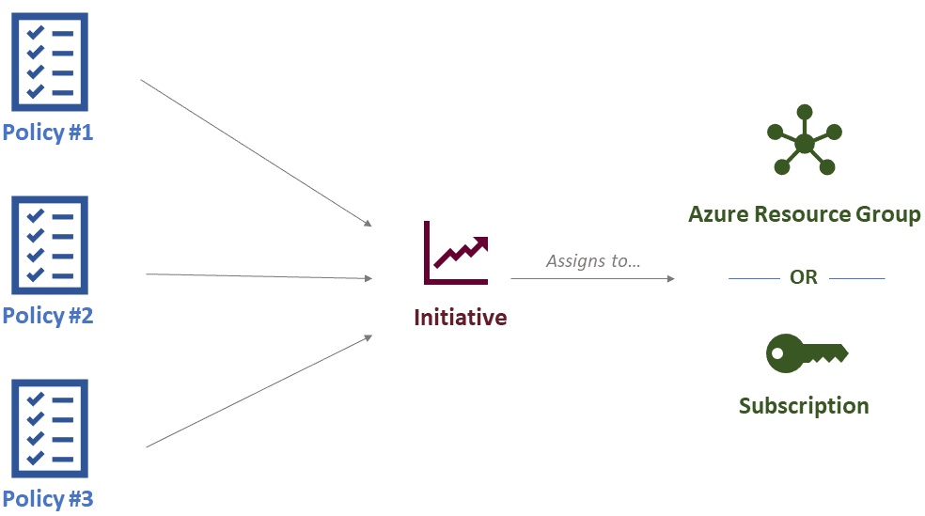
How does it work?
Source: https://k21academy.com/az-305/azure-rbac-vs-azure-policies-vs-azure-blueprints/

Slide 6
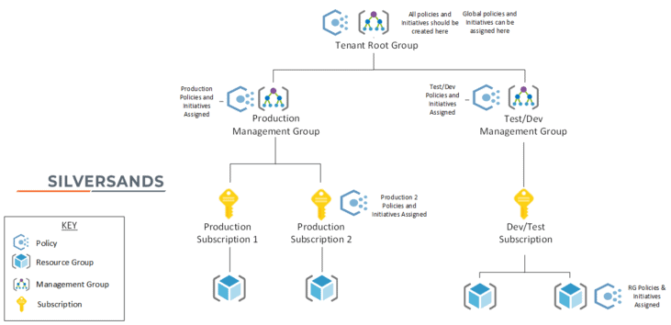
Azure Policy structure and Scope
Review: Azure Key Vault should disable public network access
Source: https://k21academy.com/az-305/azure-rbac-vs-azure-policies-vs-azure-blueprints/

Slide 7
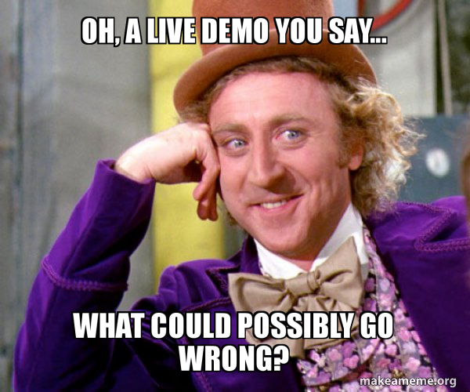
Portal Demo

Slide 8
Resource
Bicep element for Defining policy: https://learn.microsoft.com/en-us/azure/templates/microsoft.authorization/policyassignments?pivots=deployment-language-bicep
Azure Quick start templates: https://github.com/Azure/azure-quickstart-templates/tree/master/managementgroup-deployments/mg-policy
Azure Policy as code resource: https://jloudon.com/cloud/Flexing-your-Security-Governance-with-Azure-Policy-as-Code/
Azure Enterprise Policy as Code – A New Approach: https://techcommunity.microsoft.com/t5/core-infrastructure-and-security/azure-enterprise-policy-as-code-a-new-approach/ba-p/3607843

Slide 9
